Slide 1
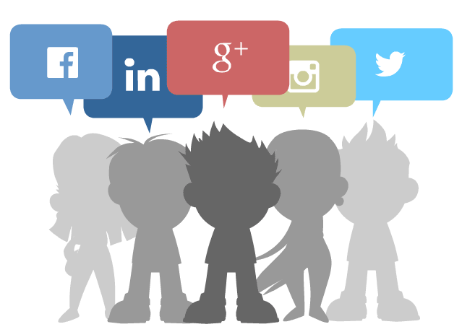

Slide 2

Welcome to all.

Slide 3



Slide 4

A: Look at the following logo. Are you familiar with them?

Slide 5


Slide 6
Let us watch the video.
Please click here to go to internet for watching Video.
Discuss with your partner what they are and how they are related to the field of e-communications.

Slide 7
Social Network Services
Unit : XIII
[Media and modes of e-communication]
Lesson : 2

Slide 8
Learning outcomes
After the students have studied the lesson, they will be able to --- ---
surf the Internet;
create Facebook ID;
narrate incidents in a logical sequence;
understand texts.

Slide 9




Slide 10

New Word
Argument
An exchange of opposite views
Syn.: disagreement

Slide 11

New Word
Advantage
A favourable circumstances
Syn.: benefit, gain
Ant.: disadvantage

Slide 12

New Word
Emerge
Come out
Syn.: appear

Slide 13
B: Open at page no. 168-169 from the text and read it to answer the questions that follow.
10 Minutes
The Internet technology has helped design a large number of web sites --- ----- --- --- --- --- --- --- --- --- --- --- --- --- --- --- --- --- --- --- --- --- --- --- --- --- --- --- --- --- measures too. A user himself or herself decides over the number of visitors/viewers, and what information should be shared with others.

Slide 14
Questions:
1. What do you understand by social networks?
2. What are some uses of social networks?
3. ‘These services …have made the users feel that they really live in a global village’. Do you agree with this view? Why/ Why not?
4. Make a list of the arguments as to why social networks are expanding so fast. Why do you think this is happening?
Answer to the question no-4:
1. They are cost free.
2. One can make profile public.
3. Pictures, multimedia contents can be uploaded. Profile can be modified.
4. Friends and others can comment on profile.
Answer to the question no-3:
I agree with this view as these services help people to share their interest and activities across the boarder of different countries.
Answer to the question no-2:
The users can interact through the internet. Their services make it possible to connect people sharing interests and activities across the borders.
Answer to the question no-1:
Social networks are websites which help people to make relations all around the world.
Now we see the answers of the four questions serially here.

Slide 15
C: Read the second paragraph of the text in section B again. Notice the words in italics and write how they work in maintaining logical sequence in the paragraph.
Secondly: How to make personal profile public.
Thirdly: How to upload picture and multimedia contents in profile.
Fourthly: How to post blog entries.
Finally: About privacy protection.
These linkers have been used to maintain logical sequences.

Slide 16
D: Choose the best answers.
1. The _____ technology has made social networking sites to emerge.
a) LinkedIn, b) Google+, c) Internet, d) Twitter,
2. Users have to pay for
a) social networks. b) their online connections.
c) multimedia contents. d) uploading pictures.
3. User accounts have _____ protection measures.
a) virus b) identity c) personal secrecy d)network
4. User profiles have a section for
a) others’ remarks. b) outsider’s editing.
c) outsider’s moderation. d) outsider’s uploading.
√ c) Internet,
√ b) their online connections.
√ c) personal secrecy
√ a) others’ remarks.

Slide 17
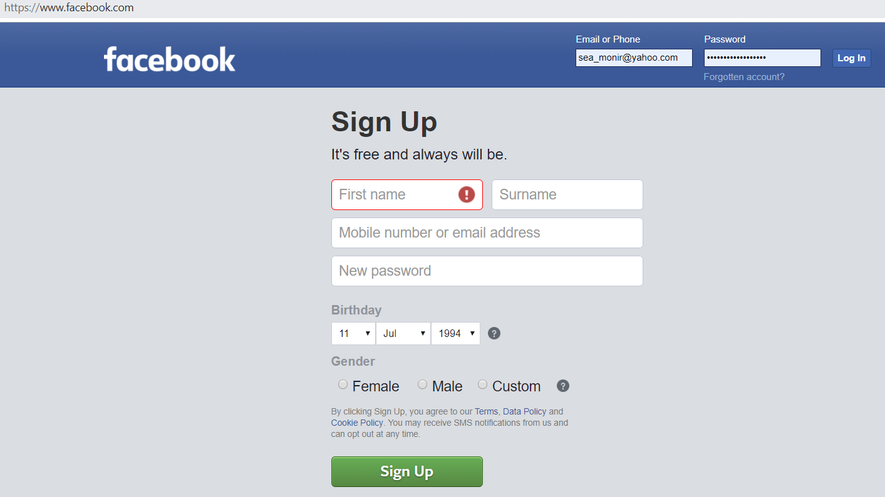
E: Fill in the following dialogue box to open a Facebook account.
Monirul
Islam
01711397309
monirmodel@gmail.com
*******************
12 July 1994
√ Male
Sign Up

Slide 18
F: Look at the following table adapted from Wikipedia. It shows some data on worldwide use of social networks.
Social Networks
 | Individual users |  | Regions covered
Facebook worldwide
Google+
Twitter
LinkedIn
MySpace
Others
Total
Percentage(%) of popularity
792,999,000
55.1 %
worldwide
250,000,000
17.7 %
worldwide
167,903,000
11.7 %
worldwide
94,823,000
6.6 %
Asia and Europe
61,037,000
4.2 %
USA and Canada
255,539,000
17.8 %
1,438,877,000
100%

Slide 19


Slide 20
Now complete the following dialogues about Facebook and MySpace, and provide your own dialogue on the rest of the social networks in the table. Act them out in pairs.
Which
1. Q: __________ social network is the most popular ?
A: Facebook is __________________ .
Q: _____________ individual users use Facebook?
A: About 793 million.
Q: __________ part of the world is Facebook mostly used in?
A: Worldwide. It’s popular worldwide among individual users.
the most popular.
How many
Which

Slide 21
Which
2=> Q: ________ the least popular ?
A: MySpace is __________________ .
Q: _____________ individual users use MySpace?
A: _______________ .
Q: _________________ mostly used?
A: ________________ among individual users.
3=> Q: _____________ individual users use Google+?
A: _____________ individual users use Google+.
4=> Q: _______ part of the world is MySpace mostly used in?
A: MySpace is mostly used in ___________________ .
5=>Q: _____ social network covers Asia and Europe?
A: ______ covers Asia and Europe.
the least popular.
How many
610 million.
Among whom is it
It is mostly used
How many
250,000,000
Which
USA & Canada
Which
LinkedIn
Now, act out yourselves.

Slide 22

Every student will create an account in Facebook or in Twitter.

Slide 23
Thank you all.

