Slide 1
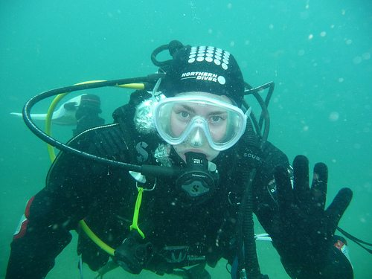
_{Welcome}

Slide 2
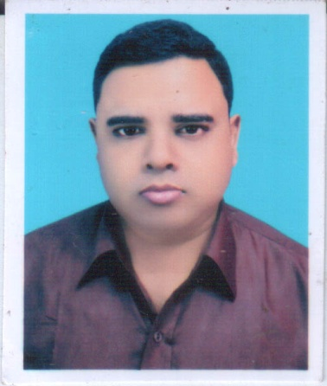
Abdul Aziz
English For Today
Class –Eight
Unit – Seven
Lesson – 02
B.A(Hon’s), M.A(English)
Assistant Teacher (English
Madhaia Bazar S. High School
Chandina,Cumilla
E-mail: azizabidpur@gmail.com
Mobile: 01921767310

Slide 3
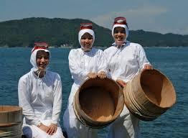
Look at the picture & talk about it
What can you see in the first picture?
In the first picture, I can see a diver. He is under water .
What can you see in the second picture?
In the second picture, I can see three divers but they are women.

Slide 4
Learning Outcomes
01
02
Ask & Question
03
Talk about divers
Write a short paragraph on “ Ama divers “

Slide 5
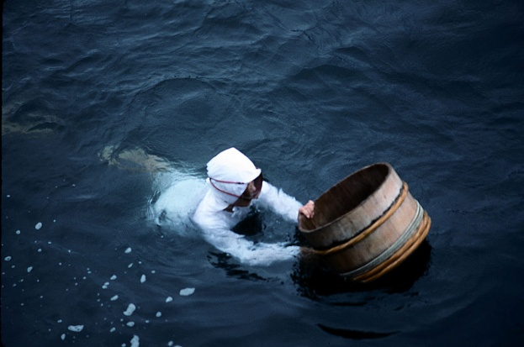
Our today’s lesson is
The Ama Divers

Slide 6
Key words
Rare
Meaning
Not common,

Slide 7
Key words
Descend
Meaning
To pass from a higher to a lower condition

Slide 8
Key words
hazardous
Meaning
Involving the possibility of injury

Slide 9
Key words
rely
Meaning
To place faith or confident

Slide 10
Before the begining of the 20th century, pearls were obtained from pearl oysters. These oysters were collected from the bottom of the ocean, lake or river

Slide 11
To get enough pearl oysters, free-divers often forced to descend to the depth of more than 100 feet in one breath. Because of the difficulty of diving pearls at that time were of different quality as well as very rare

Slide 12
In Asia, some pearl oysters could be found on shoals at a depth of 5-7 feet from the surface. At times, the divers had to go 40 feet or even up to 125 feet deep to find enough pearl oysters. These deep dives were extremely hazardous to the divers.

Slide 13
Evaluation
What is the text about?
The text is about the collection of pearls
Where did the people get the pearls from?
People got the pearls from oysters.

Slide 14
Home work
Write a short paragraph on “The Ama divers”

