Slide 1
To
My dear students

Slide 2
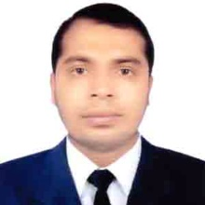
Teacher’s Identity
Misbahul haque
Assistant Teacher
Lontirmati government primary school
Kanaighat,Sylhet.
Mobile No:01715453647
Email:mhhaque520@gmail.com

Slide 3
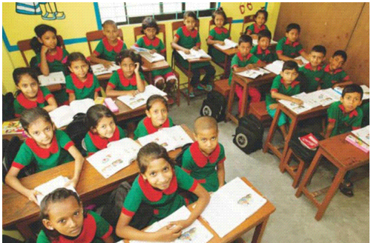
Introduce of the class
Class : Two
Section : A
Total students:50
Present students:45
Absent students:05
Date:16/06/2020

Slide 4
Lesson’s introduction
Subject : English
Unit :02
Lesson :4-6
Lesson’s name : Alphabet
Activity : B
Page : 05
Time : 45 minutes

Slide 5
Learning outcomes
By the end of the lesson students will be able to –
Speaking :
1.1.2 Say simple words and phrases with proper sounds and stress.
Reading :
1.3.1 recognize and read the names of objects having the same initial and final sounds.
Writing :
1.2.1 write non-cursive small letters.

Slide 6
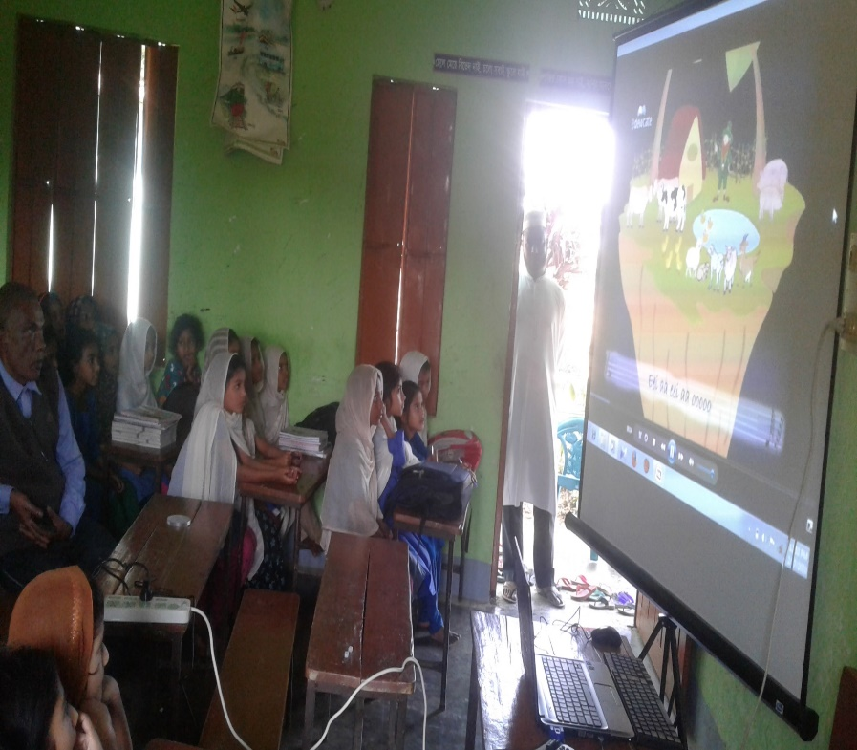
Let’s watch a video

Slide 7
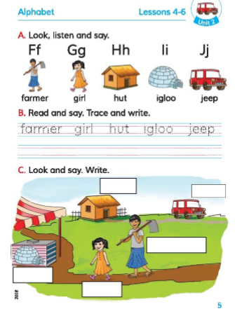
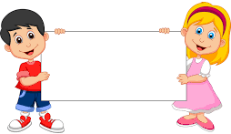
Lesson declaration
Alphabet

Slide 8
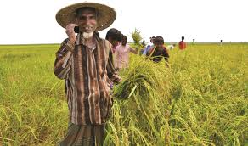
What’s his name?
He is a
Farmer

Slide 9
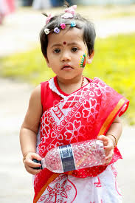
What’s her name?
She is a
Girl

Slide 10
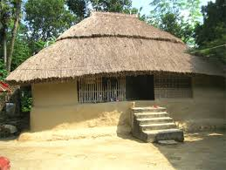
What is this?
It is a
Hut

Slide 11
What is this?
It is an
Igloo

Slide 12
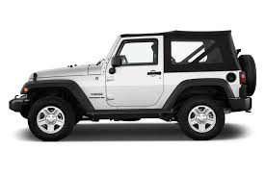
What is this?
It is a
Jeep

Slide 13
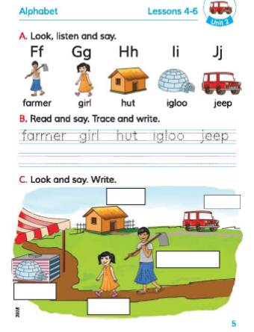
Open at page 5 of your book and look at the activity B
Listen carefully and say after it.

Slide 14
Word meaning
Farmer – কৃষক।
Girl – বালিকা।
Hut – কুঁড়েঘর।
Igloo – বরফের তৈরি ঘর।
Jeep – জীপগাড়ি।

Slide 15
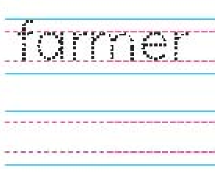
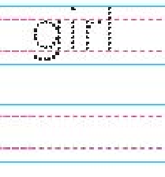
Look how to write the following words:
farmer
girl

Slide 16
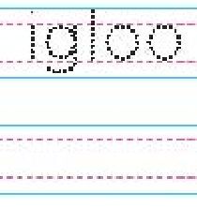
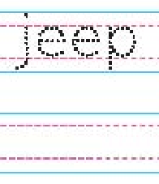
Look how to write the following words:
hut
igloo
jeep

Slide 17
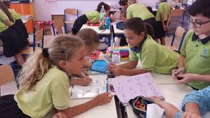
Group work
All the students will be divided in three Groups:
Group-1.Sun
Group-2.Moon
Group-3.Star
Every group will practice this letters(Ff,Gg,Hh,Ii,Jj) and with a word for every letter.

Slide 18
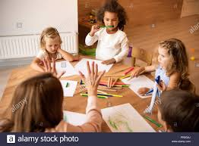
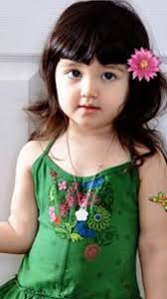
Pair work
Students will sit in pair.Every pair will re-arrange the following letters to make a meaningful word.
1.merfar
Farmer
Igloo
4.giloo
2. rigl
Girl
5. peej
Jeep
3. tuh
Hut

Slide 19
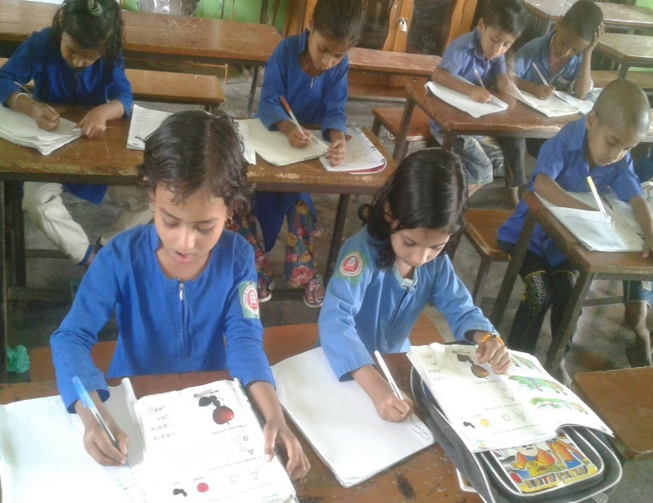
Silent writing
Write the name of the following pictures:
Girl
Farmer
Jeep
Hut
Igloo

Slide 20
Evaluation
Match the following letters with words:
Ff
Girl
Gg
Igloo
Hh
Farmer
Jeep
Ii
Jj
Hut

Slide 21
Home work
Practice the writing of the following words according to activity B.
Farmer,girl,hut,igloo,jeep

Slide 22
One day one word
Girl – বালিকা ।

Slide 23
That’s all for today.See you again tomorrow.

