Slide 1
Welcome

Slide 2
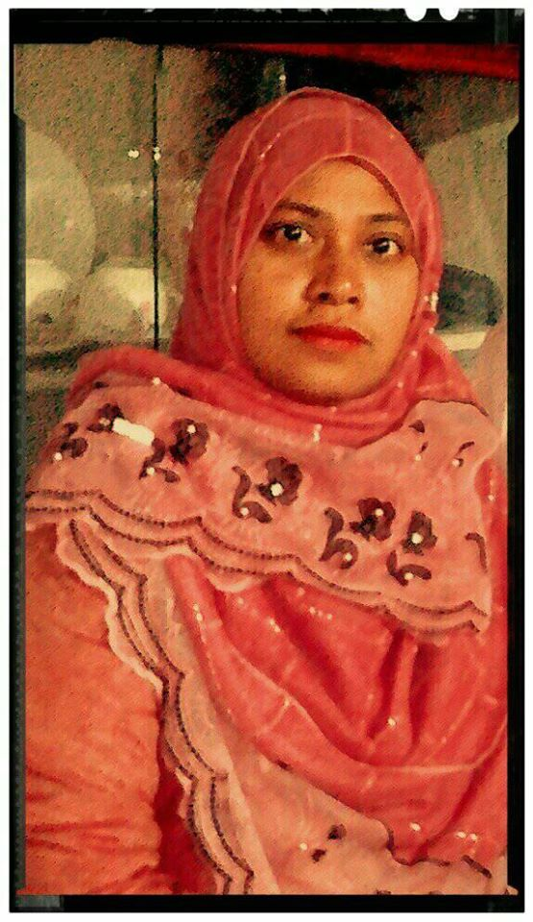
TEACHER’S IDENTITY
Anjuman Ara.
Nesbetgonj GOVERNMENT
PRIMARY SCHOOL.
Rangpur Sador.Rangpur

Slide 3
LESSON IDENTITY
CLASS: Five.
SUBJECT: ENGLISH.
LESSON: Occupations.
PART OF LESSON:(A)
Lesson Unit 9
TIME: 40 MINUTES.
DATE: 07/06/2020

Slide 4
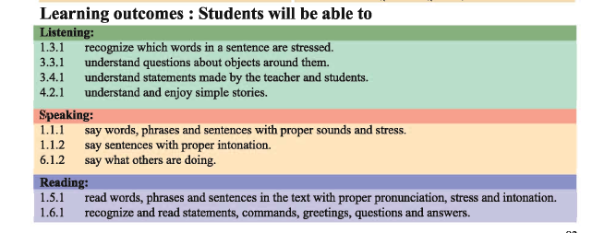

Slide 5
Our lesson
Occupations

Slide 6
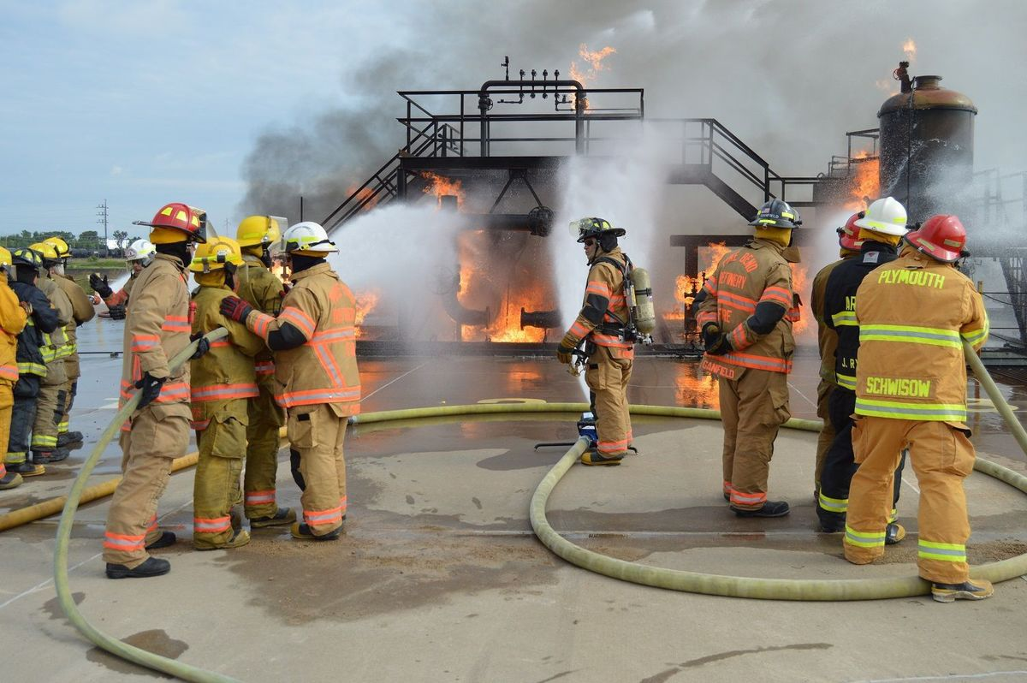
New words
Firefighter
দমকল কর্মী

Slide 7
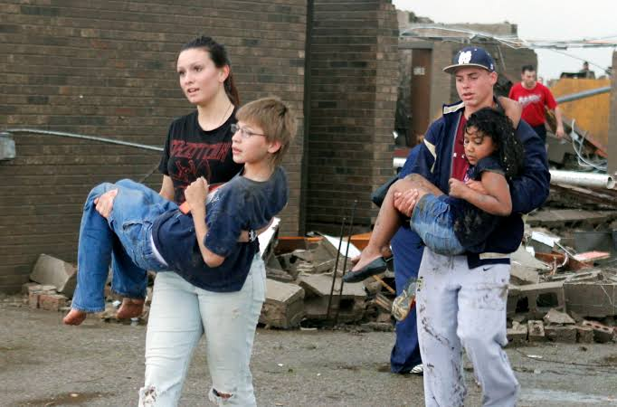
New words
Volunteer
সেচ্ছাসেবক

Slide 8
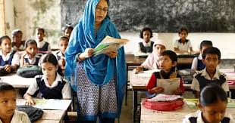
Teacher’s model reading

Slide 9
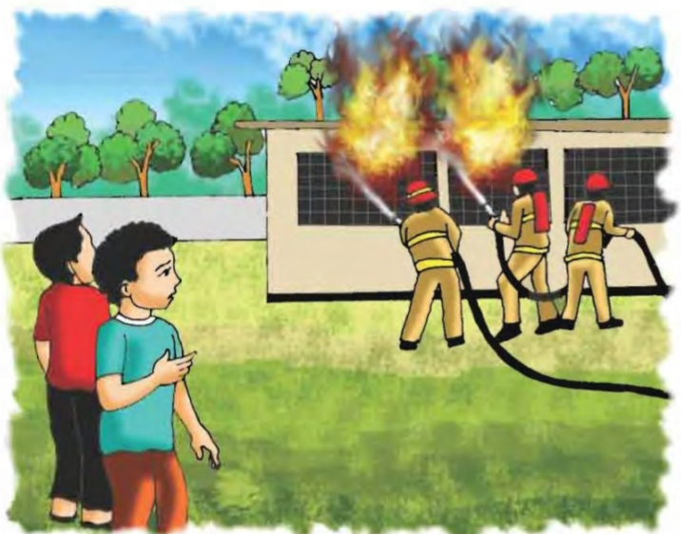
A long time ago, when Raju was in class 5, there was a fire in his school.

Slide 10
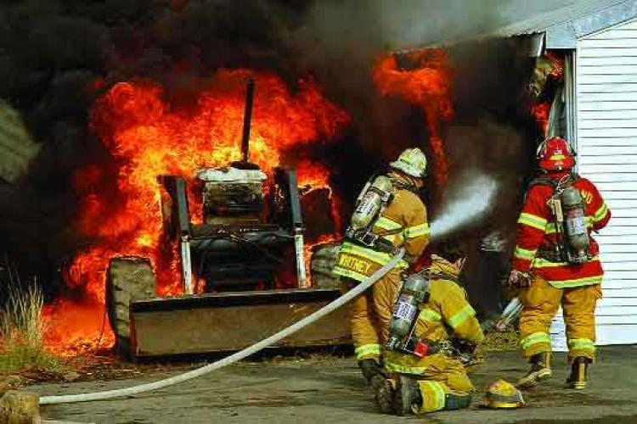
Everyone was very afraid , but no one panicked

Slide 11
The teacher helped the student to leave the building quietly and safely.

Slide 12
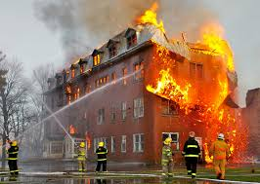
Soon the firefighters come and put out the fire . Raju watched the firefighters from the school yard. He thought about the fire and the fighters for a longtime.

Slide 13
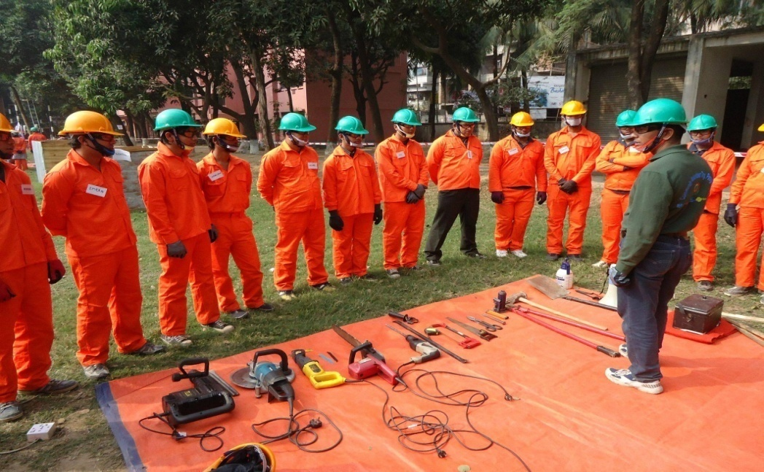
After college Raju joined a volunteer fire department. As a volunteer,he did not get any money for his work.But Raju did not mind

Slide 14
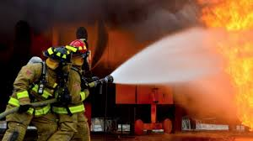
Now Raju is full-time firefighter. It is his job, so he earns money for it. Most of the time his work is putting out fires.

Slide 15
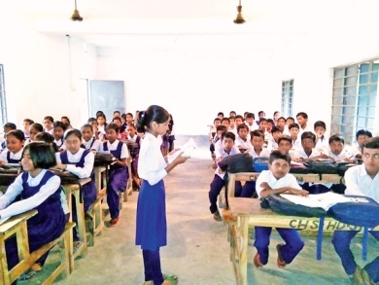
Student’s loud reading individually

Slide 16
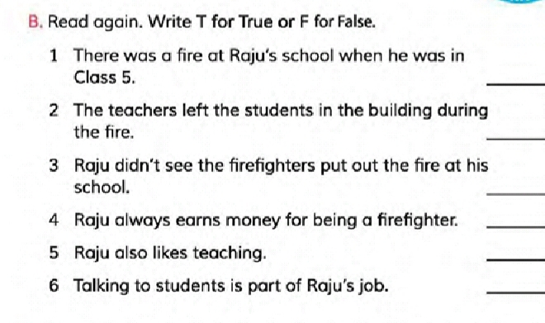
Group -A
T
F
F
F
T
F

Slide 17
Group-B
Fill in the blanks
.1 A firefighter puts out-------
2.Raju ---------a firefighter after college.
3. The teachers helped the students--------the fire.

Slide 18
Evaluation
1. Who joined the fire department?
2. When did Raju join as a volunteer firefighter?
3. What does he talk about with the studets?

Slide 19
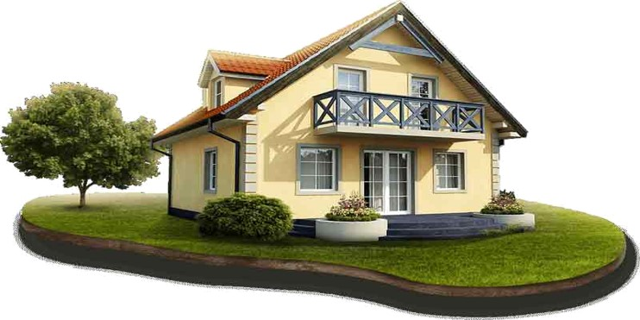
Home work
Write 5 sentence’s about a Firefighter.

Slide 20
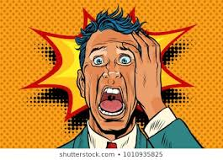
One day one word
Panicked
আতংকিত

Slide 21
Thank you

