Slide 1
From the Directorate of Technical Education Bangladesh
Wel Come to
Nanyang Polytechnic International
Singapore
Notes:
Ending slide.

Slide 2
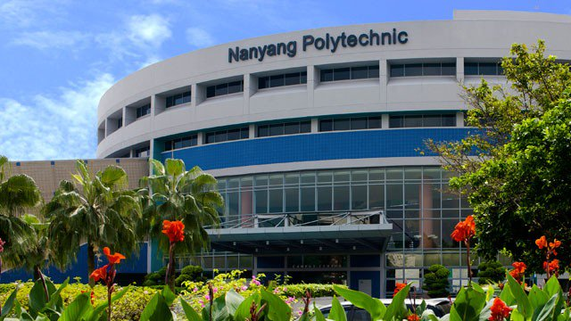
Nanyang Polytechnic International
Singapore

Slide 3
Batch-22
Group-A
Md.Habibur Rahman
Instructor(Physics)
Kishoreganj Technical school & college
Dates OF TRAINING AT NYP, SINGAPORE
6 NOV 2018 TO 26 NOV 2018
Mobile: +8801715342934
Email: mhabibur21@gmail.com

Slide 4
THREE KEY LEARNING POINTS
Design Thinking
Positive mind setup for STEM
Flipped Learning

Slide 5
JOB NAME & IT’S FUNCTION
JOB NAME: To Demonstrate Practical Teaching and Learning Physics (PTLP) of STEM in the Classroom Using Multimedia System.
Function 1: Identify the Integration Percentages of STEM into the PTLP.
Function 2: Develop the STEM of PTLP Curriculum
Function 3: Perform the PTLP of STEM Lessons

Slide 6
INDIVIDUAL PLAN OF ACTION (POA)
Description of Key Initiatives and Action Plans:
Key Initiatives (or Project) | Action Plan | Deliverables &/or KPIs | Timeline/ Schedule
To Demonstrate Practical Teaching & Learning Physics (PTLP) of STEM in the Classroom Using Multimedia System. | 1.Identify the Integration Percentages of STEM into the PTLP. 2.Develop the STEM of PTLP Curriculum 3.Perform the PTLP of STEM in the Lessons Plan Map. | 1.A List of Objectives Integrated in STEM. 2. A Complete set of Lesson Plan, T & L materials, MM materials, Assignment, Test. 3. A Video Clip, Group work, Smart Home work. | January2019 to March 2019 For Part-1

Slide 7
TASK OF JOB FUNCTION
Task 1: Match the Instructional Steps with the Integrated of PLTP Materials.
Task 2: Identify the Instructional Steps.
Task 3: Find the Respective PLTP Activities for each Instructional Brain-based.

Slide 8
May Allah bless you all.
Notes:
Ending slide.

Slide 9
THANKS TO ALL
Md.Habibur Rahman
Instructor(Physics)
Kishoreganj Technical school & college
Mobile: +8801715342934
Email: mhabibur21@gmail.com

