Slide 1
WELCOME

Slide 2
Identification
Md. Al Amin
Assistant Teacher
Kaitkuna GPS
Chhatak, Sunamganj
01716184734

Slide 3
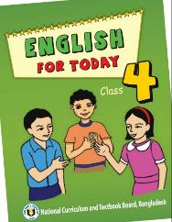
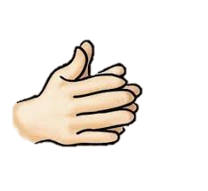
Identification
Unit -18
Clap Your
Hands

Slide 4
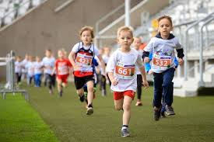
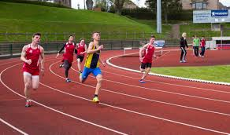
Lets see the pictures
What do you see in the Pictures?

Slide 5
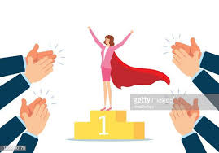
Lets see the pictures
What do you see in the Pictures?

Slide 6
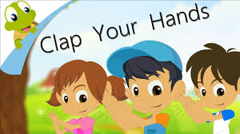
Today’s Lesson is :

Slide 7
Learning Outcome
Students will be able to…
1.5.1 read words, phrases and sentences in the text
with proper pronunciation, stress and intonation.
8.1.1 make sentences with words

Slide 8
At previous class

Slide 9
Listen to the rhyme

Slide 10
Individual Work
Recite the rhyme with proper pronunciation.

Slide 11
Listen, say and do
Clap, clap, clap
clap, your hands with me.

Slide 12
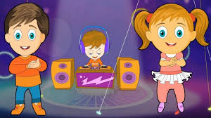
Listen, say and do
Listen to the music
and clap your hands with me.

Slide 13
Pair Work
Recite the rhyme 4 lines with Clapping the stressed word.

Slide 14
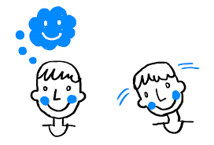
Listen, say and do
Move, move, move,
move your head with me.

Slide 15
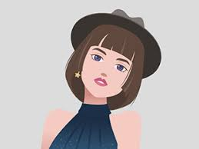
Listen, say and do
Move your head from side to side.
move your head with me.

Slide 16
Listen, say and do
Clap, clap, clap
clap, your hands with me.
Listen to the music
and clap your hands with me.

Slide 17
Listen, say and do
Move, move, move,
move your head with me.
Move your head from side to side.
move your head with me.

Slide 18
Evaluation
Say the rhyme again. Clap on all the stressed parts of the first four lines of the rhyme.
Clap, clap, clap
clap, your hands with me.
Listen to the music
and clap your hands with me.

Slide 19
How Work
Say the rhyme again. Clap on all the stressed parts of the rhyme.

Slide 20
Goodbye

