Slide 1
WELCOME TO MY CLASS

Slide 2
INTRODUCING MYSELF
A.H.M.MOSTAFIZUR RAHMAN
HEAD TEACHER
UTTAR KRRISHNAPUR GPS
PHULBARI. DINAJPUR
LESSON INTRODUCING
SUBJECT: ENGLISH FOR TODAY
CLASS: 5
UNIT: 8, WRITE TO ME SOON! (LESSON: 1-2)
NAME OF THE LESSON: THE DOCTORS ADVICE

Slide 3
LEARNING OUTCOME
student will be able to-
1.5.1 read words, phrases and sentences in the text with proper pronunciation, stress and intonation
6.1.1 read instructions and carry them out
3.3.1 understand questions asked by the teacher about objects about them

Slide 4
LOOK AT THE PICTURE

Slide 5
LOOK AT THE PICTURE

Slide 6
LOOK AT THE PICTURE

Slide 7
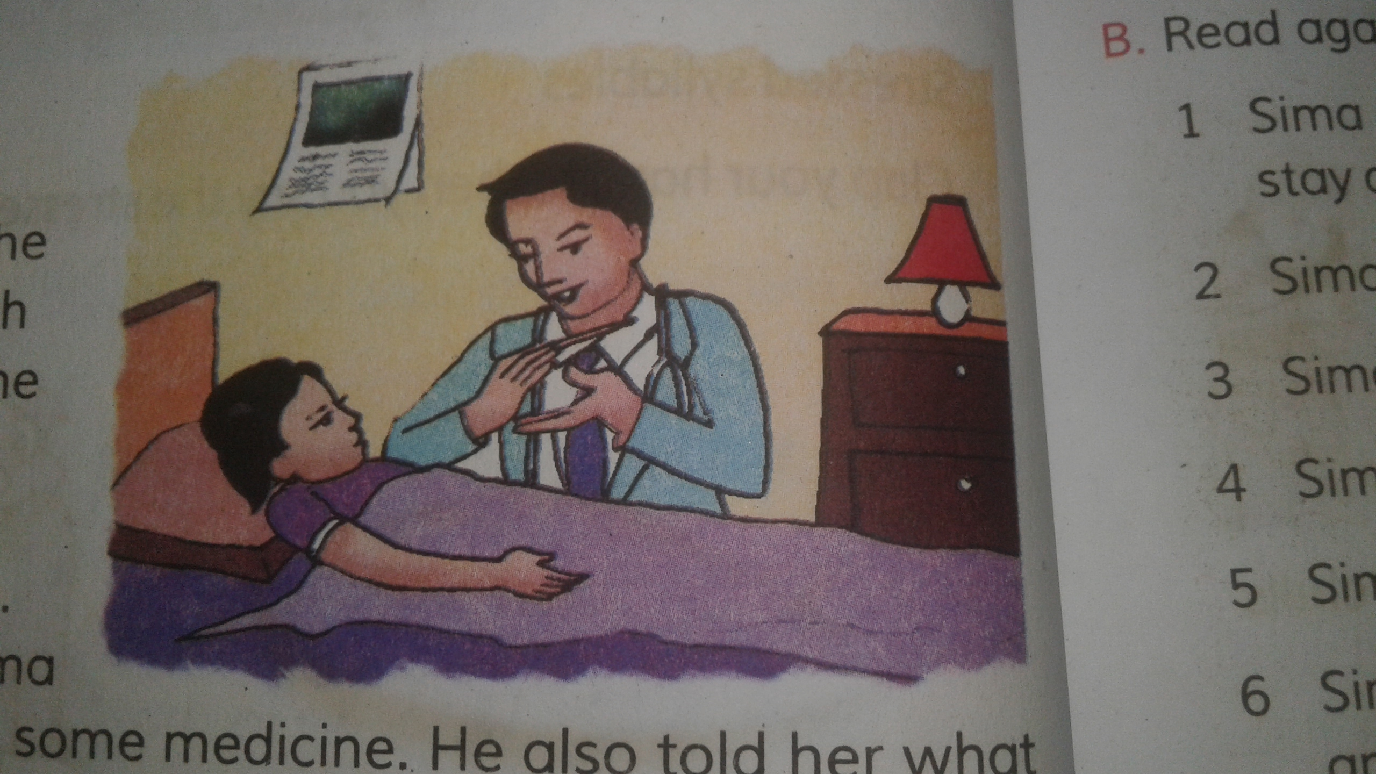
TO DAY’S LESSON
THE DOCTOR’S ADVICE

Slide 8
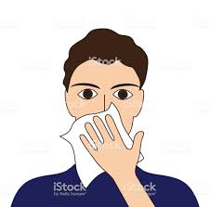
NEW WORDS
ENERGY
COVER
Eat food that gives your body energy
Cover your mouth and nose

Slide 9
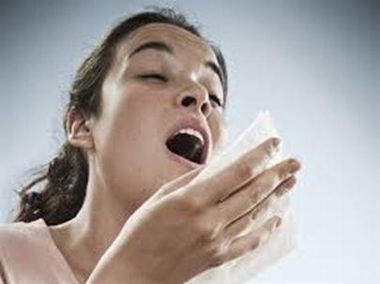
NEW WORDS
SNEEZING
ILLNESS
Are you coughing or sneezing ?
Other people can catch your illness from these things.

Slide 10
KIM’S GAME
ENERGY
COVER
SNEEZING
ILLNESS

Slide 11
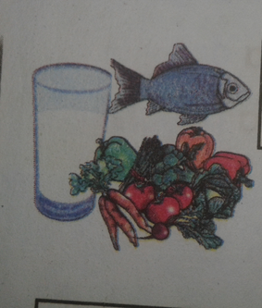
(Teacher’s reading) THE DOCTOR’S ADVICE
Eat food that gives your body energy. Try to eat, even if you aren’t hungry. You need to be strong.
Rest. Stay at home. Don’t go to school or work.
Drink a lot of water or juice. They are better than soft drinks.

Slide 12
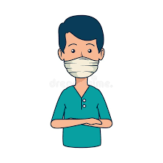

Slide 13
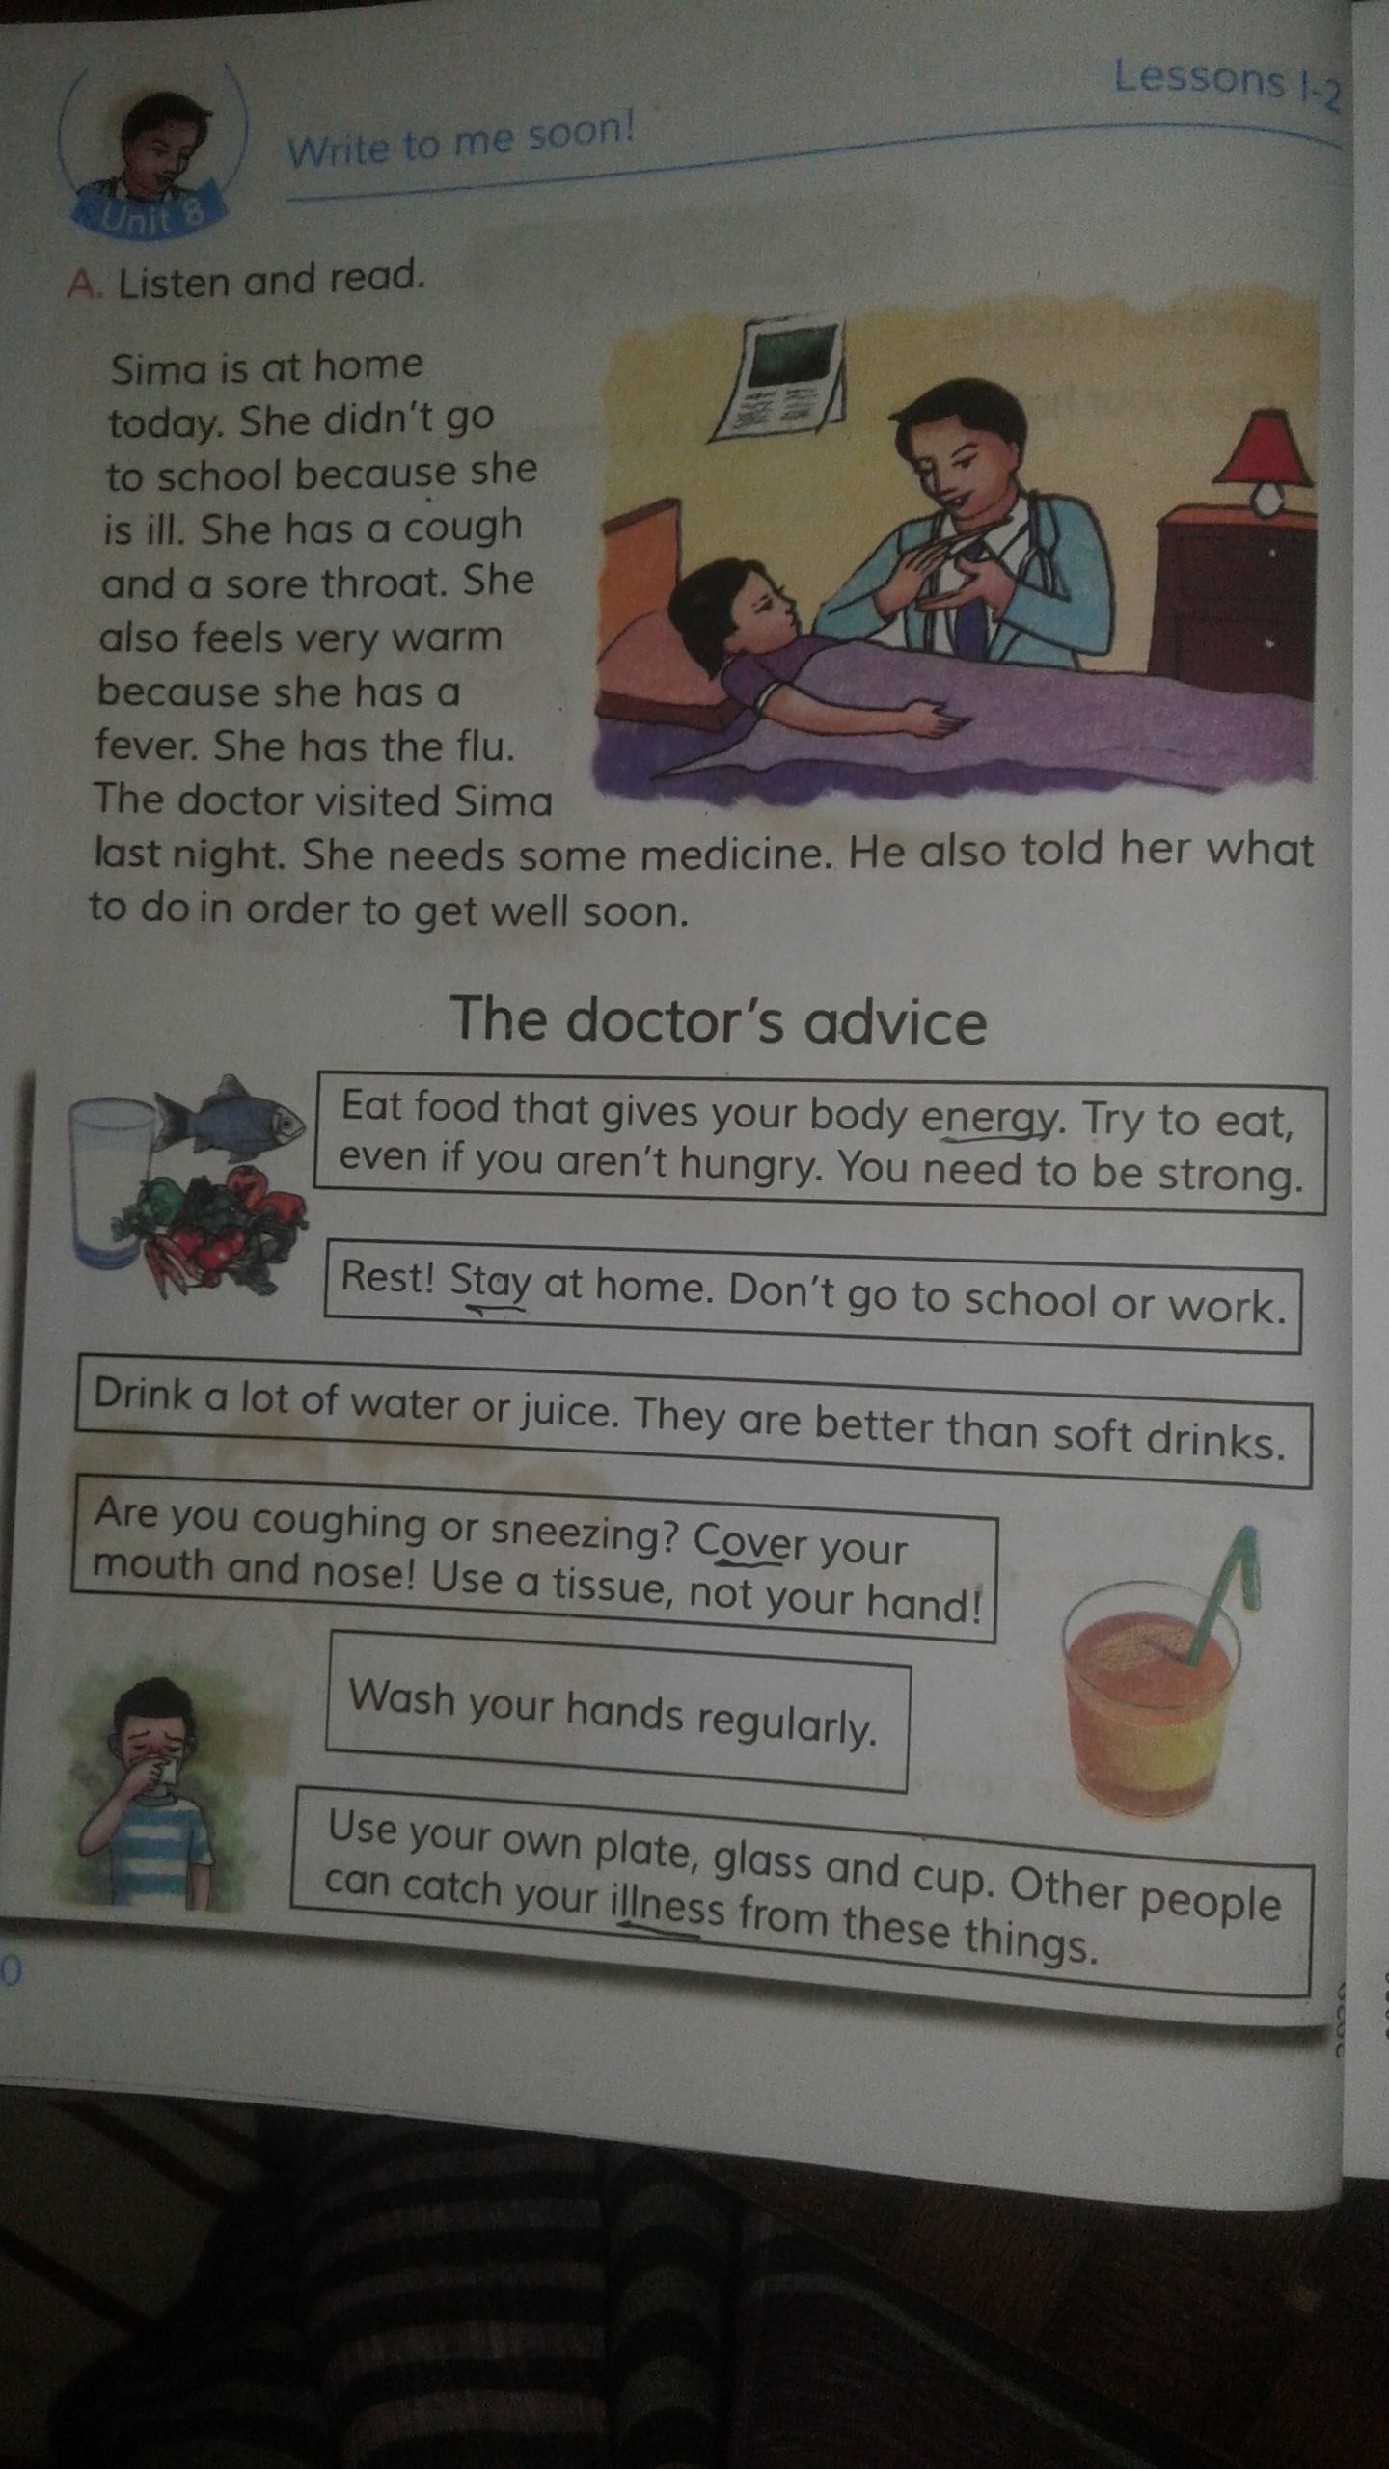
Silent reading for practice
(PAGE-30) Ques#10
Answer the following questing:
1. What should you do when you are hungry? ( knowledge) 1
Ans: I should eat food
2. Why do you eat food? ( Understanding) 2
Ans: I eat food that gives me body energy
3.What do you do when you feel into illness? ( Application) 3
Ans: I take rest. I stay at home. I eat food and drink a lot of water or juice. I wash my hands regularly and use my own plate, glass and cup.

Slide 14
(EVALUATION) ANSWERING SHORT QUESTIONS
Read the advice below about how to keep free from diseases. Then answer the questions.
HOW TO KEEP FREE FROM DISEASES
1. wash your hands properly
2. Put on sandals before entering into the toilet
3. Use soap to clean the hands after using toilet
4. Take a birth everyday
5. Drink safe water
6. Eat healthy food

Slide 15
EVALUATION
a) What should you put on before entering into the toilet?
( KNOWLEDGE) 1
b) Why do you use soap to clean your hands?
(UNDERSTANDING) 2
c) How do you keep yourself fit?
(APPLICATION) 3

Slide 16
Answer
a) What should you put on before entering into the toilet?
Ans: I should put on sandals before entering into the toilet
b) Why do you use soap to clean your hands?
Ans: I use soap to clean my hands to keep my hands germ-free and remain healthy
c) How do you keep yourself fit?
Ans: I eat healthy food and drink safe water. I take a birth everyday and use soap to clean my hands and body. I also use sandals in the toilet and wash my hands properly after using the toilet. Thus, I keep myself feet.

Slide 17
THANKS FOR WATCHING THE CLASS

