Slide 1
Welcome everybody
Notes:
As this section of grammar needs extensive practice , teachers are requested to add anything extra as

Slide 2
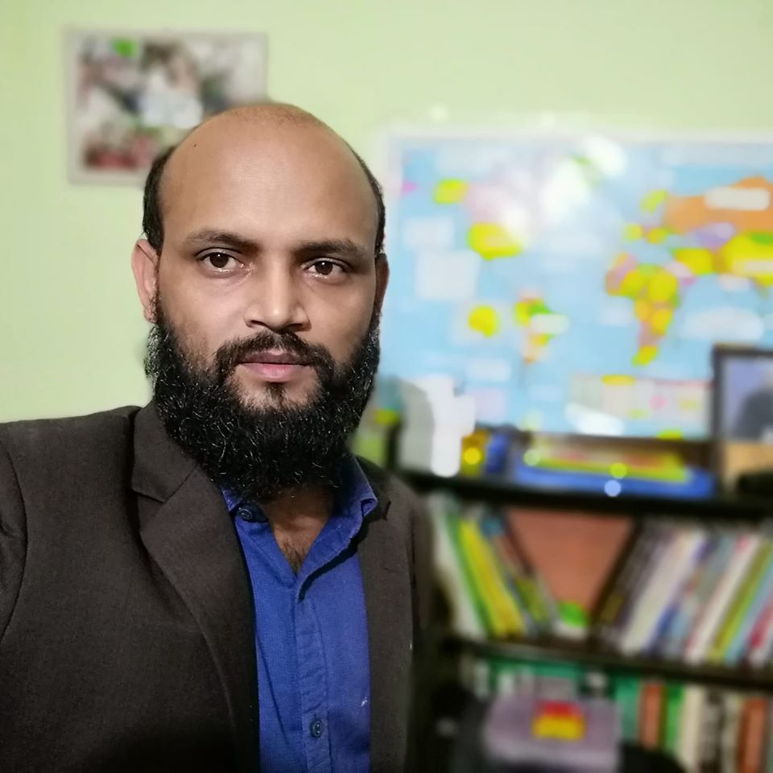
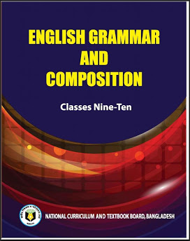
Nurul Aziz
Assistant Teacher
Krishnakumari City Corporation Girls’ High School,
Nandankanan, Chittagong
E mail : naziz13.na@gmail.com
Mobile : 01843773924
English Grammar and Composition
Class IX
Time : 45 Minutes
Date : 16/02/2020

Slide 3
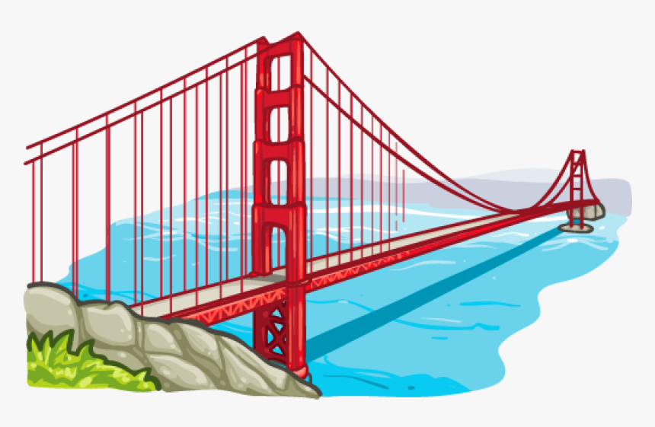
What does a bridge do?
A bridge connects people from both the sides of a river / for easy communication.

Slide 4
Similarly, when we want to connect words, sentences or clauses, we need such a bridge of words or phrase. For example…notice the function of the underlined words.
Let him do whatever he likes.
Since it rained all day long, they could not go out.
I went there but did not see him.
Karim and Rahim are students.
Though he is poor, he is honest.

Slide 5
Do you find any similarity of bridge with the words ‘And’ and ‘but’ ‘Since’ ‘Whatever’ above ?
If yes, what can you call them?
Connectors

Slide 6
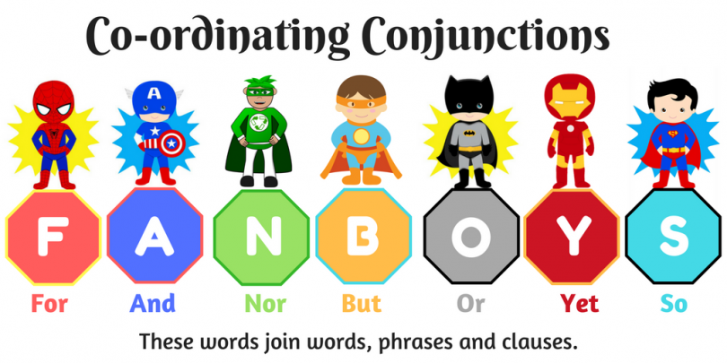
Our today’s lesson is Connectors or Linkers
Class : IX
Unit : 09/07
Page : 153

Slide 7
Learning outcomes
After the end of the lesson students will be able to know…
Say about linkers
Boast vocabulary stock
Identify linkers in a sentence
Apply linkers appropriately

Slide 8
What is linking word?
Linking words are words that join clauses into sentences..
There are three main types of Linking words
Conjunctions
Sentence connectors
Subordinators

Slide 9
Conjunction
Conjunctions are most common form of linking words.
For, And , Nor, But, Or , Yet, So (FANBOYS)
Example:
Successful students work hard and they organize their time effectively.
Independent Clause
Independent Clause
Independent Clause

Slide 10
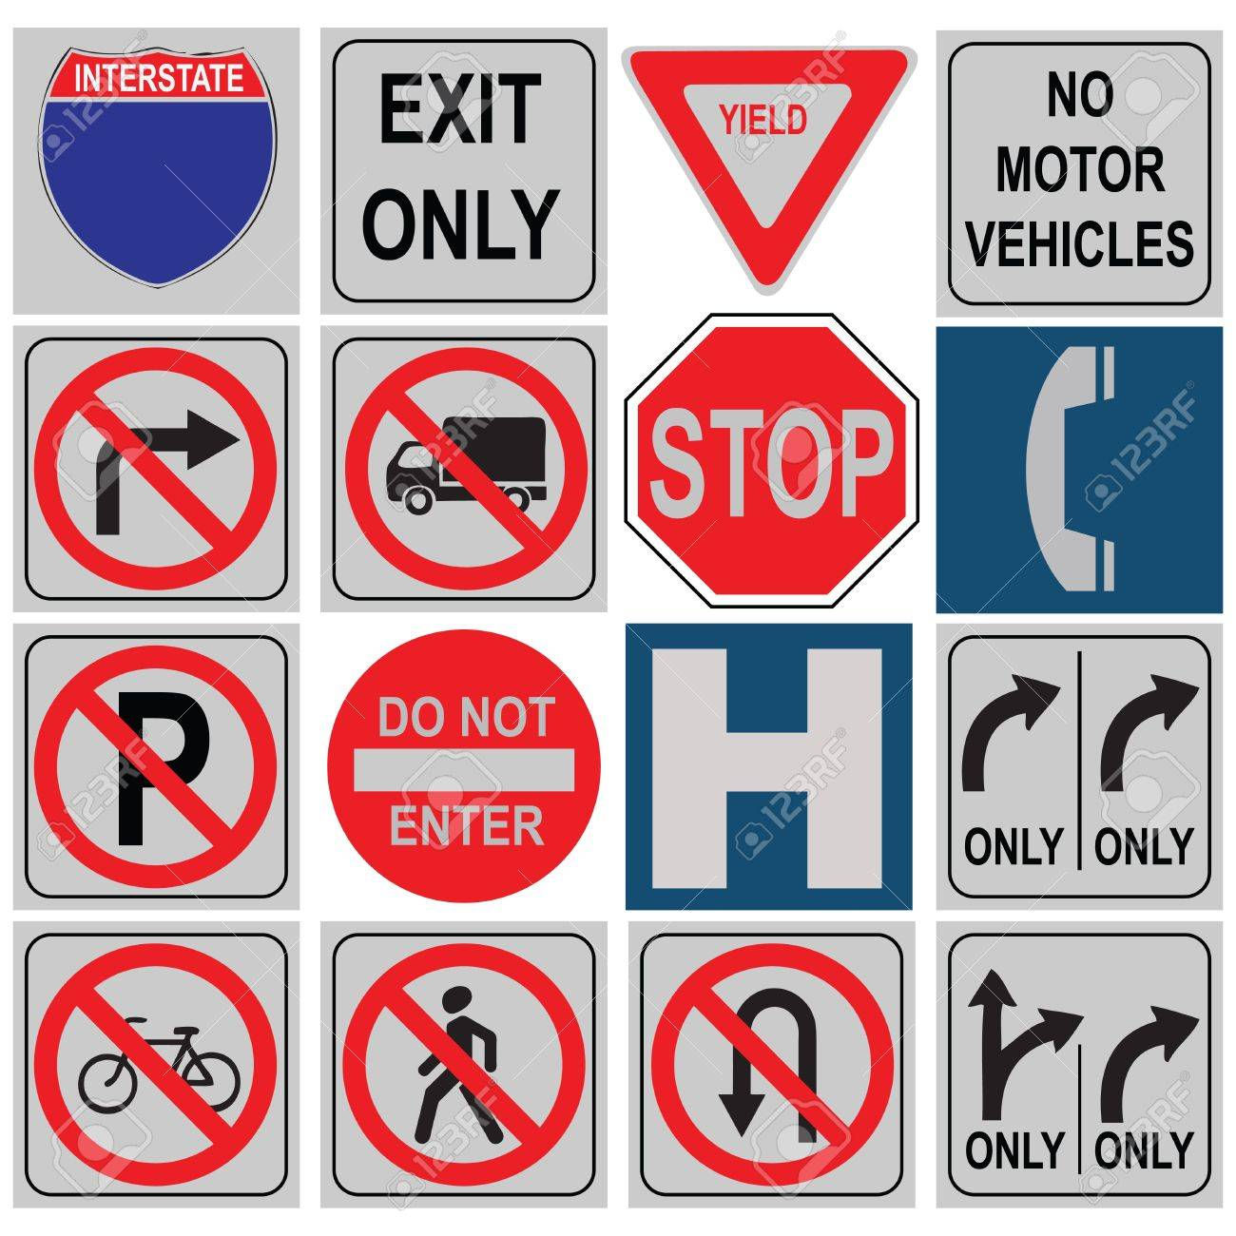
Conjunctions are like traffic signs that tell the readers when to go forward, turn, slow down and stop.

Slide 11
Group Work
Use appropriate linking words in the blanks.
We should hate the sin (a) not the sinner. The sinners are persons (b) us. We should motivate (c) correct them. It may (d) happen that one day they will be better persons (e) what we are now.
but
like
and
also
than

Slide 12
Sentence Connectors
Sentence connectors are used to….
link ideas from one sentence to another
give paragraphs coherence.
introduce order, contrast, sequence ideas, theory, data etc.

Slide 13
Sentence Connectors
Logical/Sequential order
Firstly, Secondly, Thirdly etc.
Next, Last, Finally
In addition
Furthermore
Also
At present/presently

Slide 14
Sentence Connectors
Summarizing
In short
In summary
In brief
In a nutshell
In conclusion
To summarize
We use these words usually at the beginning of a sentence to give a summary of what we have said or written.

Slide 15
Sentence Connectors
Order of importance
Most/more importantly
Most significantly
Above all
Primarily
It is essential/ essentially

Slide 16
Sentence Connectors
Contrast
However
On the other hand
On the contrary
By (In) comparison
In contrast
Result
As a result
As a consequence
Therefore
Thus

Slide 17
Sentence Connectors
Reason
The reason for
The cause of
Comparison
Similarly
Likewise
Also

Slide 18
Pair Work
Use appropriate linking words in the blanks.
Farmers of Bangladesh (a) live in a small (b) poor (c) populous country, cannot manage to eat even two square meal a day, (d) lead a luxurious life. (e) they remain uncared, there will be no hope for the nation.
who
but
and
let alone
If

Slide 19
Subordinators
Subordinators are linking words that are used to join clauses together. They are used at the beginning or in the middle of a sentence.
Although he is poor, he is honest.
Subordinator

Slide 20
Subordinators
Comparison and Contrast
Although
Though
Even though
While
Whereas
Cause and effect
Since
So that
Because
Possibility
If
As if
Whether
Unless

Slide 21
Subordinators
Adding information
And
In addition
As well as
Also
Too
Furthermore
Moreover
Apart from
Besides
Time
After
When
Until
Whenever
Before
Place and Manner
Wherever
How
Where

Slide 22
a) Read attentively you will fail.
b) his illness, he came to school.
c) He said he would come here in time.
d) They cut down trees recklessly. , forest lands are shrinking.
e) He gave me food shelter.
Individual Work
Use appropriate linking words in the blanks.
otherwise
In spite of
that
As a result
not only
but also

Slide 23
Evaluation
Use appropriate linking words in the blanks.
Yesterday I went to the house of one of my friends. I wanted to meet him. (a) I did not find him there (b) he had already gone out. (c) I was talking to his mother (d) left a note with her. (e) , I left the house .
but
as
So
and
Then

Slide 24
Home Work
Use appropriate linking words in the blanks.
Samia works……..she may earn her living.
Morning walk costs nothing……..gives more.
He is…….gentle……..polite.
………….his illness, he came to school.
Wait here………..you can.

Slide 25
Thank you.
Welcome everybody

