Slide 1

welcome

Slide 2
Teachers Picture

Slide 3
Teachers Identity
Abdul Jalil Hawladar
Asst.teacher(English)
R.D.H.N.U Fazil Madrasa
Sarankhola,Bagerhat.
Mobile-01948938092
E-mail:abduljalilbst@gmail.com

Slide 4
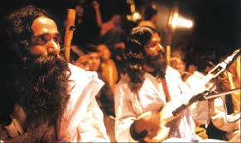

Slide 5
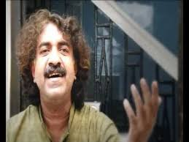

Slide 6


Slide 7


Slide 8
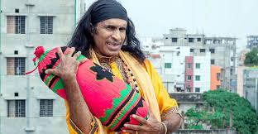

Slide 9
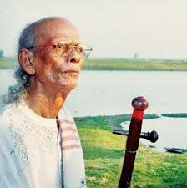
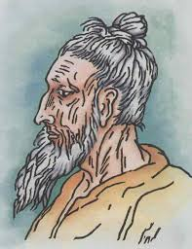

Slide 10
Lesson Identity
English For Today
Class-Six
Chapter-21

Slide 11
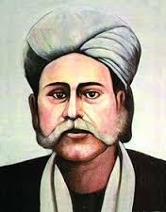
Todays Topics
Hason Raja the mystic bard of Bangladesh

Slide 12
Learning outcoms
#To learn various singer .
#To learn mystic singer .
#To learn about Lalon Fakir .
#To learn about Abdul Karim .
#To learn about Hason Raja .

Slide 13
Listening Test
Read the text

Slide 14

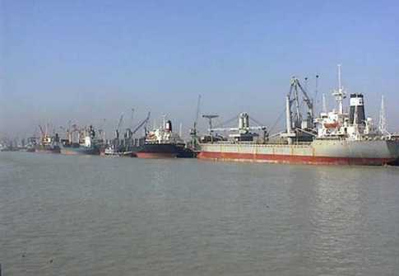
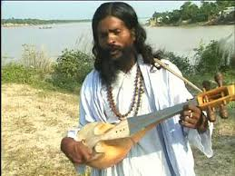
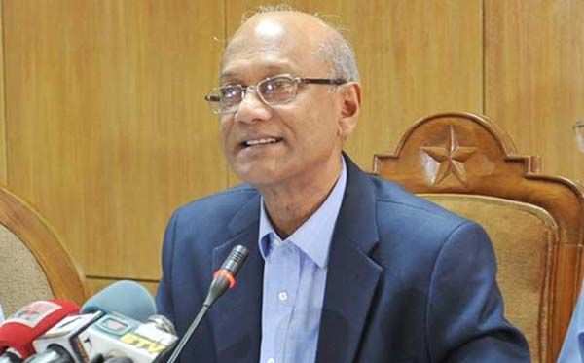
New Words
Mystic-Difficult to meaning .
Wealth- taka or property .
Creator- Allah .
Crazy-mad .
Comfort- pleasure .

Slide 15
Make sentence under this word
Mystic Bird
Land Lord
Crazy
Comfort
Meditation

Slide 16
Answer
#Hason Raja is the mystic bird of Bangladesh .
#Hason Raja was a landlord of Sylhet .
#Mystic singer usually may be crazy .
#Hason Raja does not like comfortable life .
#Meditation makes a man pious .

Slide 17
Group Work= A
#What is mystic song write down within 30 words .

Slide 18
Group work=B
# Descrive about Hason Raja .

Slide 19
Group work=C
#Why Hason Raja is famous for ?

Slide 20
Group work =D
# What is the thought of Hason raja ?

Slide 21
Group work = E
#Why Hason does not like property ?
Describe it ?

Slide 22

Evaluation
#When was Hason Raja born ?
#Where did he come from ?
#What was his childhood like ?

Slide 23
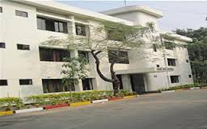
Home work
Write down some mystic singer of the world and describe

Slide 24

Thanks for all

