Slide 1
Welcome

Slide 2
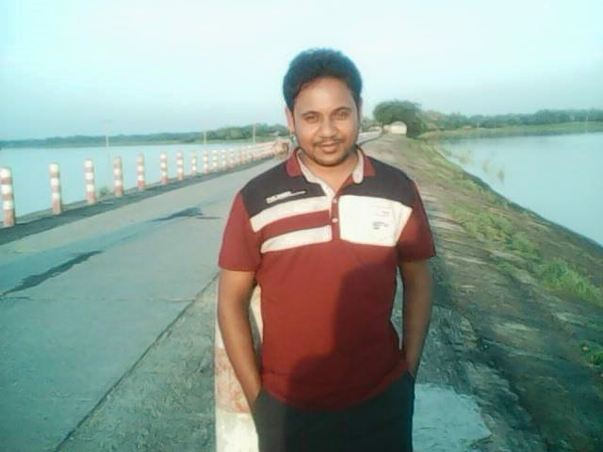
PRESENTED BY
MD TAJAMMUL HOSSAIN
LECTURER in ENGLISH
Karam-jai Degree Madrasah
Patnitola, Naogaon

Slide 3
Today topic is
RIGHT FORM OF THE VERBS

Slide 4
After the lesson the students will able to learn ………..
To make exercise on right form of verbs

Slide 5
Do the following exercise and check yourself
1. Bees (gather) honey.
2. Generally child (like) sweets.
3. It is time we (eat) our lunch.
4. I saw the farmer (plough) his land.
5. It is long since I (get) your letter.
6. I look forward to (receive) your letter.
7. They (arrive) here after you (leave).
8. If you wanted, I (help) you.
9. While (walk) in the garden, snake bit him
1.gather
2. likes
3.ate
4.ploughing
5.got
6.Receiving.
7.arrived, had leaved
8.would help
9. walking.

Slide 6
More practice:
10. The plane (take) off just now.
11. He (buy) the piece of gold last year
12. I will not let you (do) this work.
13. I wish I (know) the address of his house.
14. Occasionally he (visit) our house.
15. Everybody (love) flowers.
16. You can not shine in life without (work)hard
17. When I (be) young, I used to love song.
10. has taken.
11. bought.
12. do
13. knew
14. visits
15.loves.
16.working
17. was

Slide 7
HOME WORK:
Read all the rules again and again
Take preparation to do passage right form of verbs

Slide 8
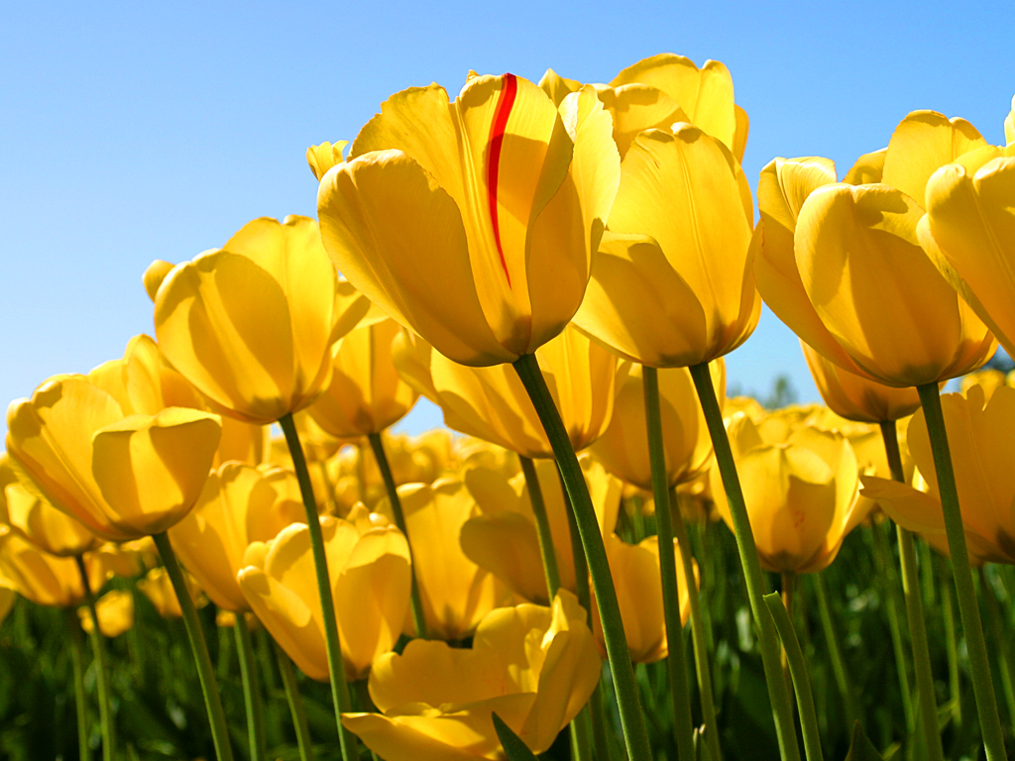
SEE YOU AGAIN INSALLAH

