Slide 1
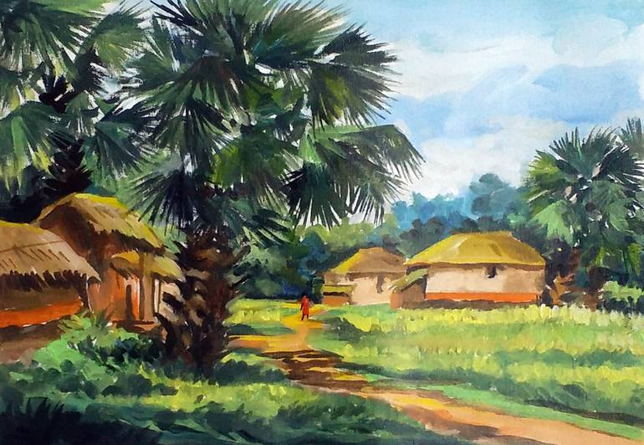
Welcome

Slide 2
Teacher’s Details
Sangita
Assistant Teacher
Boran Bindan Gps
Sadar, Gazipur

Slide 3
Lesson Title: City streets.....country again
Class: Five, Unit- 18, Lesson: 1-2, Page:70

Slide 4
Learning Outcomes:
Listening: 1.3.1 recognize which words in a sentence are stressed.
Speaking: 1.1.1 say words, phrases and sentences with proper sounds and stress.
Reading: 4.1.1 read aloud poems with proper sounds, stress and intonation
Writing: 3.1 to write sentences using non- cursive and cursive capital and small letters.

Slide 5
Bingo game
City, street,
country,
roads,
, sweet-smelling,
hay, grain, away
carts,

Slide 6
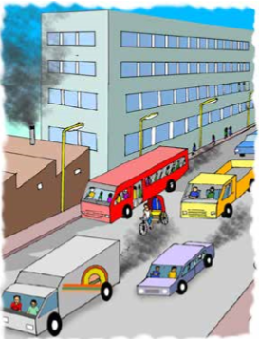
What can you see?

Slide 7
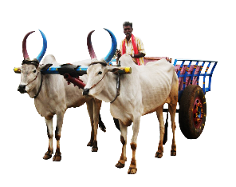
cart
cow
ricksaw
boat
chimney
building
cart
tree
van
va

Slide 8
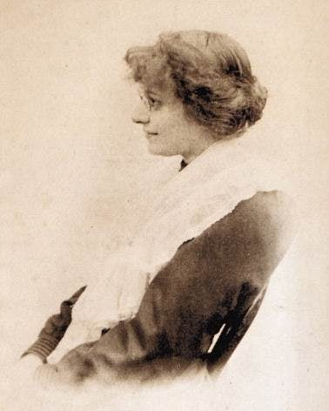
City streets and country roads
Written by
Eleanor Farjeon

Slide 9
street
carts
hay
grain
road

Slide 10
মহাসড়ক
গরুর গাড়ি
মেঠোপথ
খড়
শস্যদানা

Slide 11
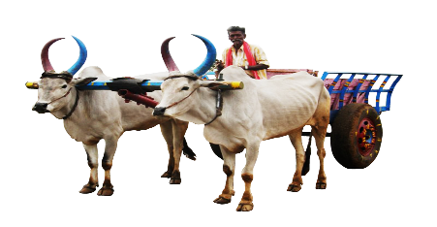
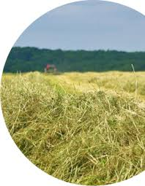
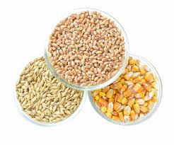
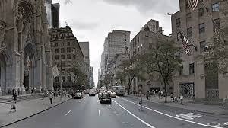
word
road
cart
meaning
মেঠোপথ
গরুর গাড়ি
খড়
hay
শস্যদানা
grain
street
মহাসড়ক

Slide 12
One day one word
Hay-খড়

Slide 13
I’ll recite the rhyme with proper stress and intonation. Student will enjoy.

Slide 14
I’ll recite the rhyme & student will repeat after me.

Slide 15
I will recite with clap. Students will listen and repeat
The city has streets-
But the country has roads.
In the country one meets
Blue carts with their loads

Slide 16
I will recite with clap. Students will listen and repeat
Of sweet-smelling hay,
And mangolds, and grain
Oh, take me away
To the country again!

Slide 17
Every one. Open your EFT book, Page 70.

Slide 18
Can anyone recite now?
Come over.

Slide 19
Everyone stand up. Count 1,2.3.4 and seat down. Now all 1 make a group,
All 1 seat together in group-1
All 2 seat together in group-2
All 3 seat together in group-3
All 4 seat together in group-4

Slide 20
Now make a pair and recite.
Raise your hand if you need help.

Slide 21
Any pair would like to recite?

Slide 22
Read silently and follow the spelling

Slide 23
Write the missing word
The city has -
But the country has .
In the country one meets
Blue with their loads
Of sweet-smelling hay,
And mangolds, and grain
Oh, take me away
To the country again!

Slide 24
Write 5 things you love about your village

