Slide 1
Welcome to

Slide 2
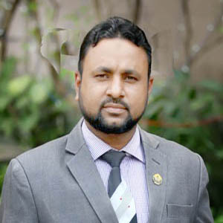
Teacher’s identity
Shahidul Islam
Assistant Professor (English)
Dhakadakshin ML H/S & College, Sylhet.
O1715600555
jusnasiam@gmail.com

Slide 3
Lesson Identity & watching a video
Class: XI
Sub: English 1st paper
Time: 45 m
Number of Students:90
http://youtube.com/watch?v=PQuis0dxYBA

Slide 4
Lesson Declaration
Unit: 11
Lesson: 03
Diaspora
Bangladeshis in Italy

Slide 5
Learning Outcomes
At the end of the lesson students will be able to …
1
Know about Diaspora,
2
Tell about the business of Bengali in Italy ,
3
Describe the life style of Bengali in Italy.

Slide 6
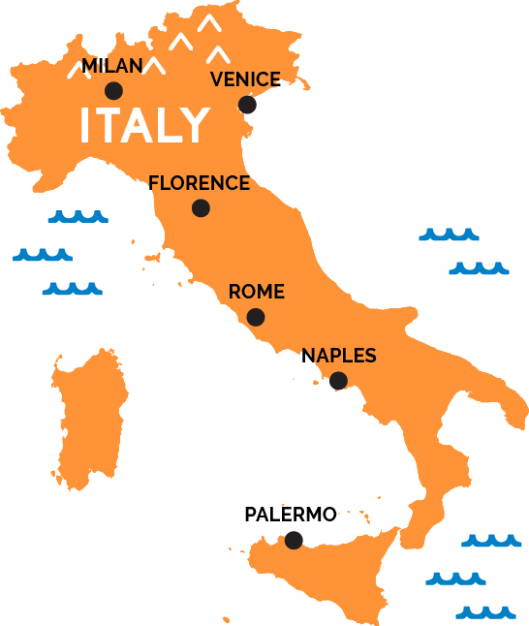
Individual work
Have heard the name of Italy and what is name of capital city of Italy?

Slide 7
Single work
What is Diaspora?
Ans: The term ‘diaspora’ is used to refer to people who have left their homelands and settled in other parts of the world, either because they were forced to do so or because they wanted to leave on their own.

Slide 8
Last month, a 20-year dream came true: we visited Italy. While it was an amazing lesson in history, I was also taken by surprise at the Bangladeshis in Italy. I heard estimates of between 200,000 and 600,000 Bangladeshis in Italy.

Slide 9
I saw them in Rome, Florence and Venice (but not in Siena.)

Slide 11
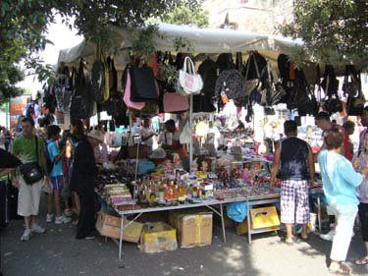
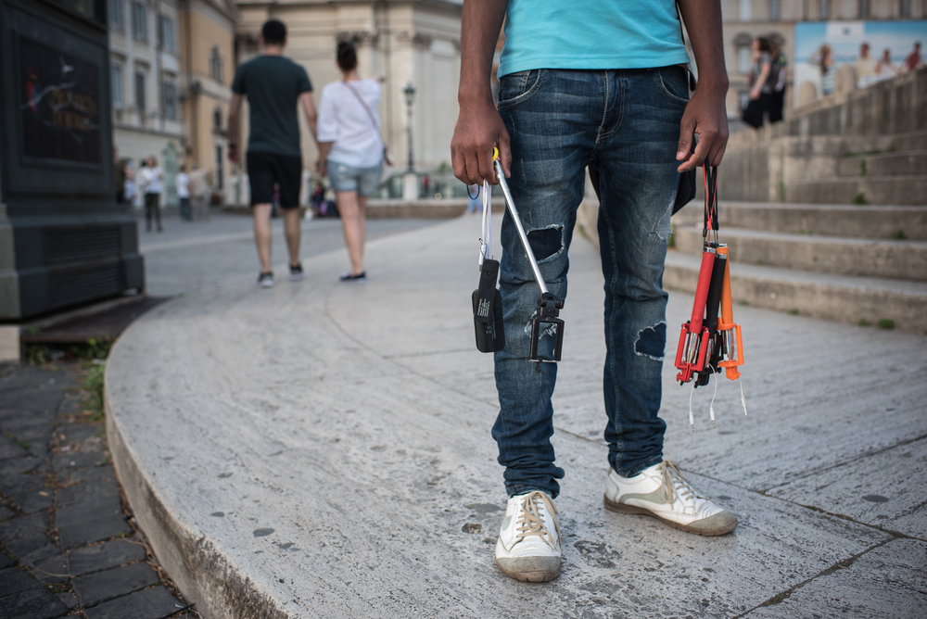
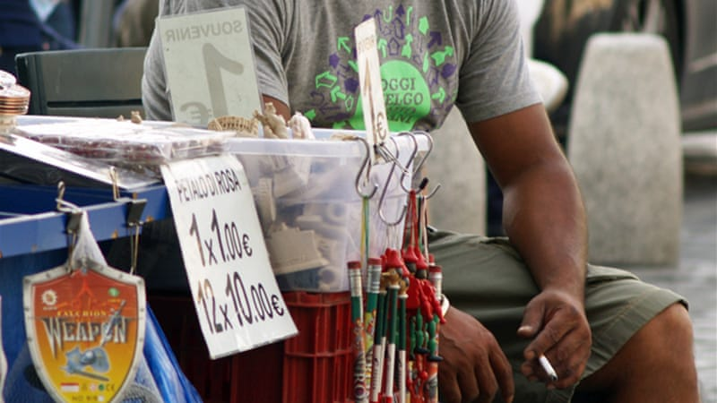
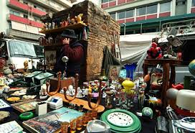
small to medium-size businesses

Slide 12
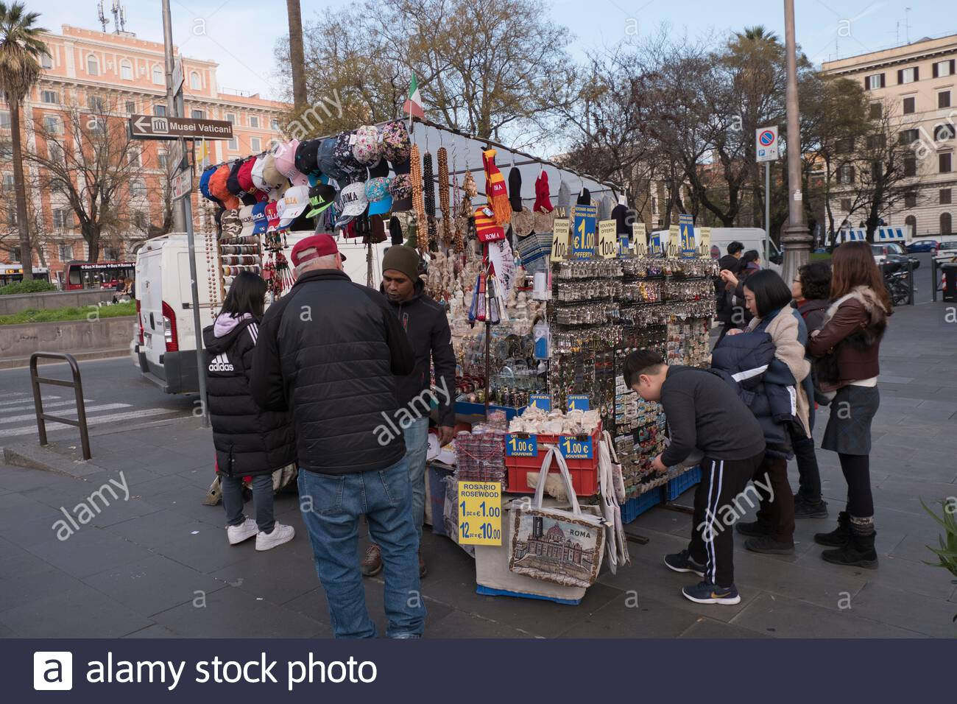
In Rome, they were selling handbags, sunglasses and tourist material on the streets.

Slide 13
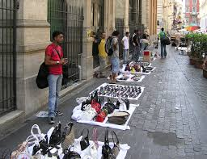
In Florence, we walked into a store selling ‘Indian-looking’ things - a ‘monohori dokan’-only to find the owner was a Bangladeshi who had a chain of these stores in the city.

Slide 14
In Venice, they were selling trinkets-like little puppets made from balloons - on the Accademia Bridge and in San Marco Square.

Slide 15
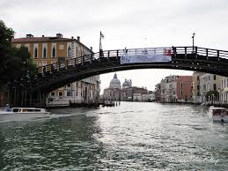
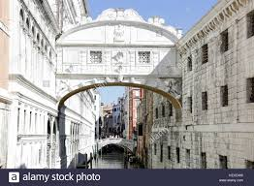
the Accademia Bridge and in San Marco Square.

Slide 16
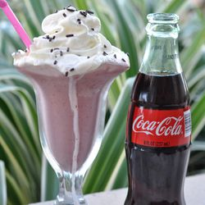
The person in Florence-much to our protestations-treated us with cokes and ice cream, and sold things to us at large discounts.

Slide 17
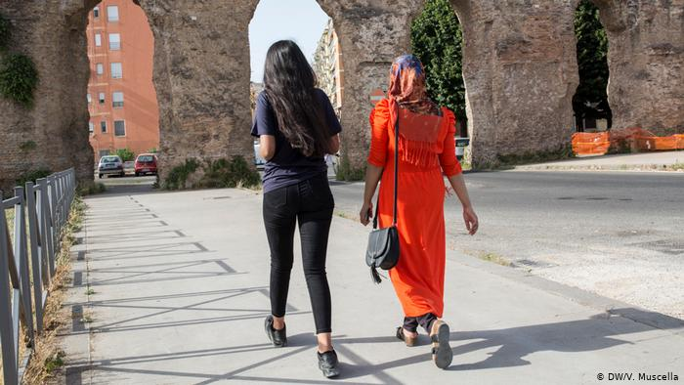
When it came to prices, they said “Pay us what you want-we are so happy to see a Bangladeshi tourist here.”

Slide 18
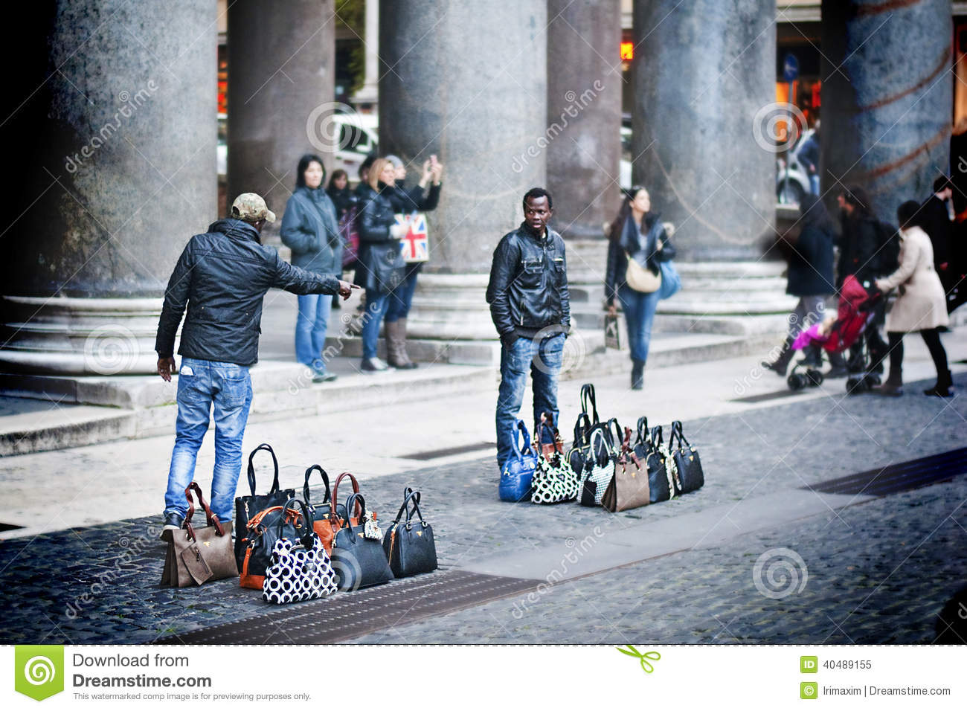
One street vendor in Rome,
after selling a sunglass at 18 Euro to a European person, turned around and sold me a similar sunglass at 4.5 Euro.

Slide 19
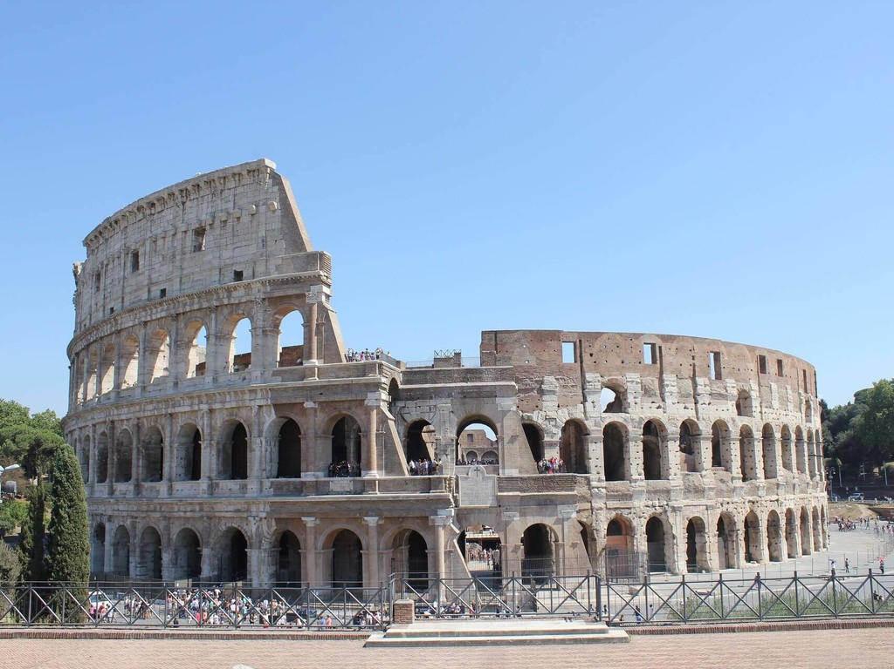
At a mini-flea-market of Bangladeshi stalls at the Tiburtina station in Rome, I fell into a discussion of the business.

Slide 20
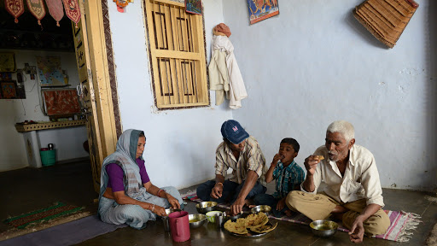
It costs them 1000-2000 Euros a month to rent each stall. The work is very hard, and they live frugally. So they are able to save some money which they send home.

Slide 21
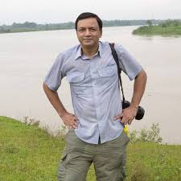
I was inspired by their entrepreneurship and touched by their generosity and hope their Diaspora comes true soon.
Ihtisham Kabir

Slide 22
Again Let’s watch a video
https://www.youtube.com/watch?v=yJKgxjkELQU

Slide 23
Group work –A(First Row)
a. What was the author’s dream and what did he expect to see in Italy?
b. What are some of the occupations of the Bangladeshis the author met in Italy?
c. How was the author treated by the expatriate Bangladeshis?

Slide 24
Group work –B(2nd Row)
d.What kind of bargaining took place between the author and some of these Bangladeshis?
e. What kind of savings do these Bangladeshis make and what do they do with them?
f. What is the authorÕs feeling about these expatriate Bangladeshis?

Slide 25
5. Read the following statements and write T if a statement is true and F if it is false.
a. The author was not impressed by Italy’s history.
b. The Bangladeshis the author met were big businessmen.
c. These Bangladeshis treated the author as they would do other customers.
d. The Bangladeshis he met were delighted to meet the author.
e. The Bangladeshi businessmen he met often sold him goods at low prices.
f. The author was deeply moved by his experience of meeting Bangladeshis in Italy.

Slide 26
6. What do the following idioms and phrases mean?
a. taken by surprise
b. haggling in reverse
c. estimates of
d. fell into a discussion of
e. if conditions were met
f. turned around

Slide 27
7. Convert the following into present tense:
a. was an amazing lesson
b. was taken by surprise
c. were selling
d. had a chain of stores
e. treated us with
f. would not take

Slide 28
Home work
Write a summary of the passage.

Slide 29
Departure

