Slide 1
WELCOME

Slide 2
Kazi Umme Kulchum
Assistant Teacher
Suapara G.K.High School
Shahrasti, Chandpur
Class-Eight
Subject-English First Paper
Unit-3
Lesson-6

Slide 3
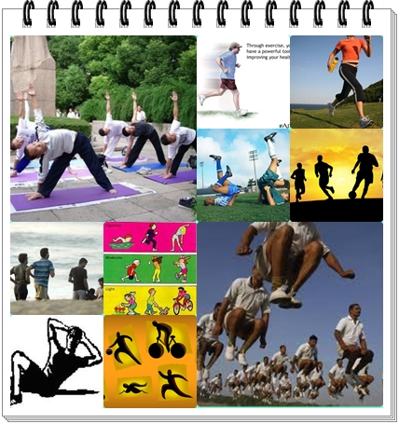
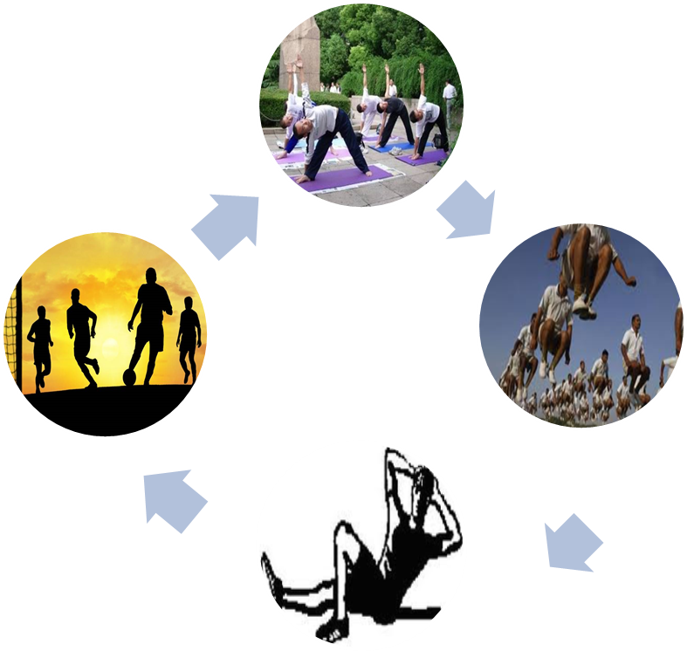
Look at the pictures and answer the questions.
what can you see in the pictures?
Do you go to play ground daily?
Do you take physical exercise regularly?
Notes:
After eliciting the answers from the learners he/ she can declare the topic.

Slide 4
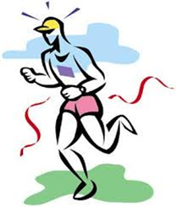
TODAY’S TOPIC
Physical exercise
Lesson-6
Unit-3

Slide 5
LEARNING OUTCOMES
By the end of the lesson the learners will be
able to…
1…………Read text trough silent reading;
2………answer question.

Slide 6
Work in pair-pre text reading activity
Look at the picture and talk about it with your partner. After that, answer the following questions.
1.Who can you see
in the picture?
2.What is he doing ?
3.Can you tell me
what it is called?
Notes:
After eliciting the answer the teacher can asked 1-2 students to say 5 sentences on the picture.

Slide 7
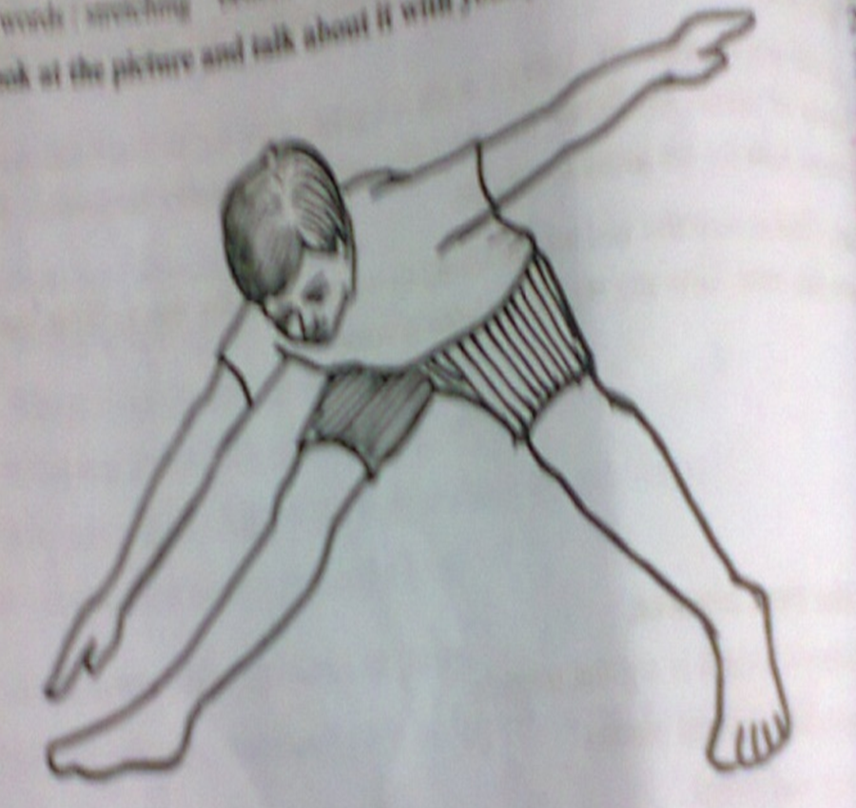
B.TEXT READING
Notes:
The learners will be asked for reading the text silently and I will monitor them. After they have Completed reading, They will answer some questions, match a table . I will elicit answers from them . Before that, the teacher can invite 2-3 students to pronounce some words so that they

Slide 8
Write word meaning
1.Necessary
2.Proper
3.Tidy
4.Regular
5.Benefit

Slide 9
1.Essential
2.Accurate
3.Clear
4.Ordinary
5.Something that promotes or enhances well being; an advantage

Slide 10
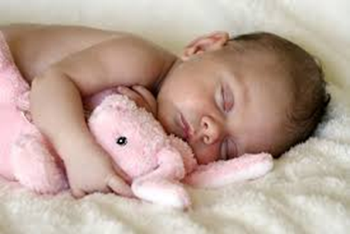
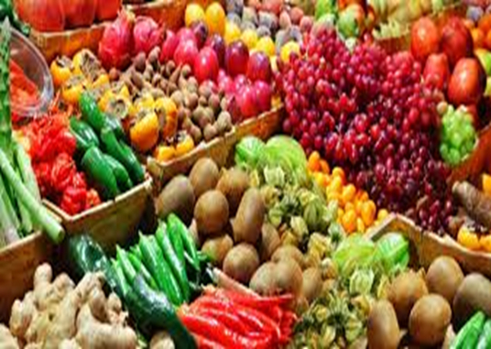
Individual work
PROPER REST AND SLEEP
Being/keeping
Regular physical exercise

Slide 11
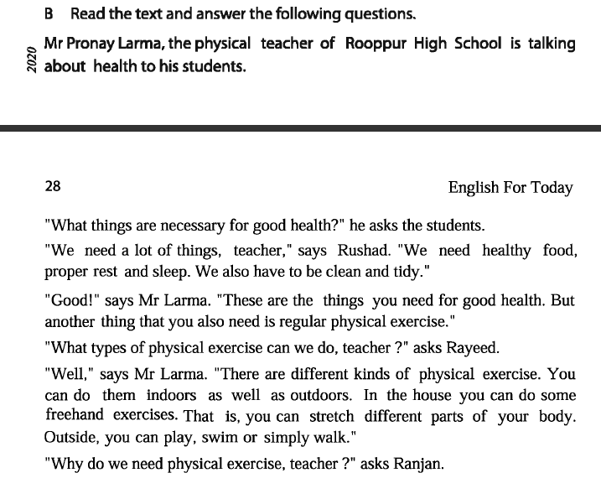
Read the text in silent

Slide 12
Group work
Here is a list of some physical exercise.write in your notebook which ones are indoor and which are outdoors,and which ones can be done both indoors and outdoors.
1.Playing sports.
2.Swimming.
3.Skipping
4.Jogging.
5.walking.
6.streteching.
:

Slide 13
Evaluation
Answer the following questions.
Which things are necessary for good health?
Name the different types of physical exercises?
Why do we need to take physical exercise ?
What type of physical exercise do we do?

Slide 14
Answer
TAKE EXERCISE, PROPER REST AND SLEEP,
EAT GOOD FOOD
&
REMAIN HEALTHY.

Slide 15
HOME WORK
What’s your favourite sport? Do you take
part in it? If so , where do you play it and
who with? Now write a paragraph on it.
.

Slide 16
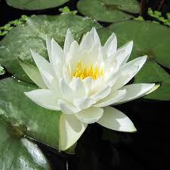
Thank you a lot

