Slide 1
wellcome

Slide 2
IDENTITY
JHUMA PAUL
Class: Six
Assistant Teacher,English
English For Today
Rangchati DAKHIL Madrasa
Lesson- 21
Kolmakanda, Netrakona

Slide 3
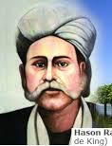

Slide 4
Lesson Declaration
HASON RAJA
The Mystic Bird Of Bangladesh

Slide 5
Learning outcomes
After completing the lesson the students will be able to :
Read and understand text
Know meaning from context
Ask and answer questions
Write paragraph about Hason Raja

Slide 6
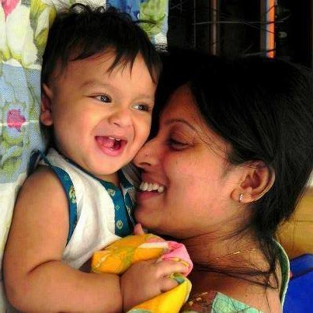
Key word
PLEASURE
Meaning
Delight

Slide 7
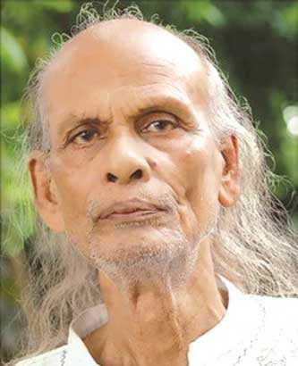
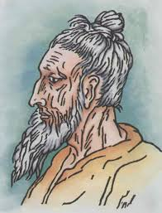
Look at the picture
Do you know who they are?
Shah Abdul Karim
Hason Raja
Lalon Shah

Slide 8
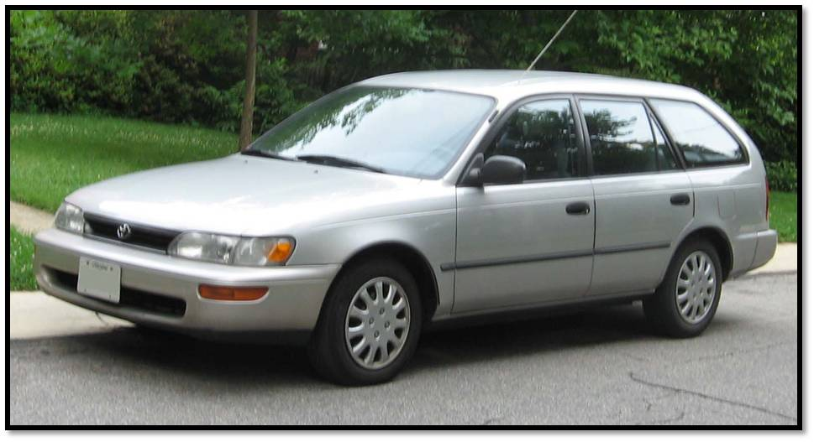
Keyword
Luxury
Meaning
Comfort

Slide 9
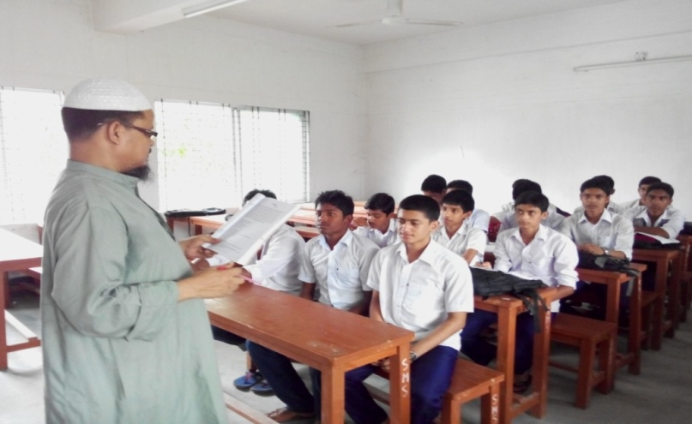
Reading
Close your book and listen to me

Slide 10
pairwork
How was Hason Raja’s childhood?

Slide 11
Evaluation
When was Hason Raja born?
What is the name of Hason Raja’s volume?
Where did he come from?

Slide 12
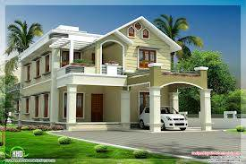
HOMEWORK
Write a paragraph about Hason Raja.

Slide 13
GOOD BYE

