Slide 1
WELCOME

Slide 2
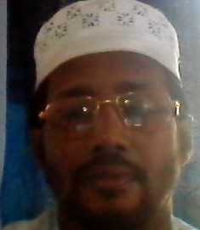
INTRODUCTION
Presented by
MD.Nasir Ahmed
BA in English B ED
Senior English Teacher
Baramasua Dakhil Madrasah
Class Eight
Subject English
For Today

Slide 4
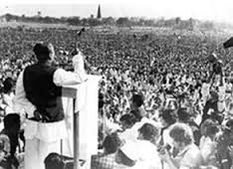
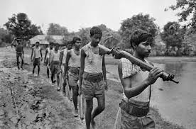
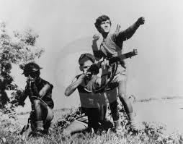
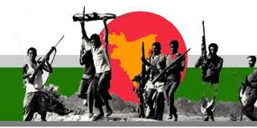
Look at the Picture
What is the Picture about?

Slide 5
Picture (1)The Speech of 7th March 1971.
Picture (2) Freedom Fighters are going to the war.
Picture(3)The young are fighting.
Picture(4) Peoples are enjoying Independence.

Slide 6
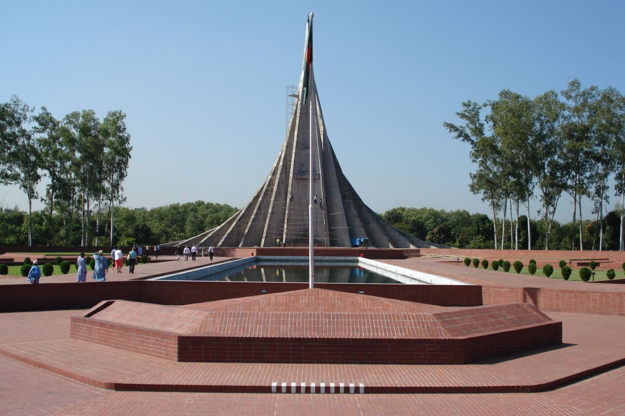
The National Mamorial.

Slide 7
Our Lesson Name is “Independence DAY”

Slide 8
Learning Outcomes
1.Tell The Meaning Of The New Words.
2.Write The Question Answer
3.Practicing Speaking English.

Slide 9
Meanings
Wreath = Garland
Spectator= Viewer
Display= Exhibition
Country = State

Slide 10
Read the text silently
26 March, our Independence Day, is the biggest state festival. The day is celebrated
every year in the country with great enthusiasm and fervour. It is a national holiday.
All offices, educational institutions, shops and factories remain closed on this day.
The day begins with 31 gunshots.
Early in the morning the President and the Prime Minister on behalf of the nation
place floral wreaths at the National Musolium at Savar. Then diplomats, political
parties, social and cultural organisations, and freedom fighters pay homage to the
martyrs. People from all walks of life also come there with rallies and processions.
There are several cultural programmes throughout the day highlighting the heroic
struggle and sacrifice in 1971.
The country also witness a smartly dressed parade of defence forces, border guards,
police, ansars and the VDP (Village Defense Party) at the National Parade Ground
near the National Parliament. In Bangabandhu Stadium, school children, scouts and
girl guides take part in various displays to entertain thousands of spectators. The
educational institutions also organise their individual programmes. Sports meets and
tournaments are also organised on the day including the exciting boat race in the river
Buriganga.
In the evening, all major public buildings are illuminated with colourful lights.
Bangla Academy, Bangladesh Shilpakala Academy and other socio-cultural
organisations hold cultural functions. Similar functions are also arranged in other
places in the country

Slide 11
GROUP WORK
ANSWER THE FOLLOWING QUESTION
1.WHAT IS YOUR DUTY IN THE INDEPENDENCE DAY.
2.WHY DO YOU PAY HOMAGE TO THE MARTYRS.
3.WHAT IS THE SIGNIFICANCE OF INDEPENDENCE DAY.

Slide 12
Evaluation
Choose the best answer.
Our biggest state festival is—
a) Victory day. b) Shaheed Dibosh. C) Pahela Boishakh. D)Independence Day.
2. The day begins with---
processions b) gunshots C) singing d) dancing
3. The national Mausoleum is ------
On Dhaka university campus b) at Ramna park. c) at Savar d) at medical college
4. How do the people come at savar?
By walking b) by Rickshaw C) by bus d) by launch
5. The major public building are decorated with--
a) flowers. b) papers C) papers and flowers d) colorful lights.

Slide 13
Answer Sheet
a) Independence Day
b) Gunshots
c) At Savar
d) By walking
e) Colorful lights

Slide 14
Home Work
* Write about how did you celebrate the Independence day in your Madrasah.

Slide 15
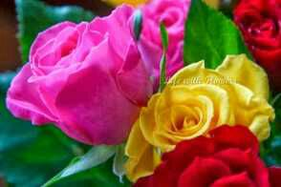
THANKS
ALL

Slide 16
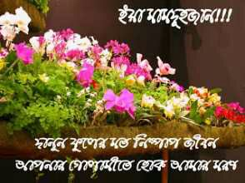
welcome

Slide 17
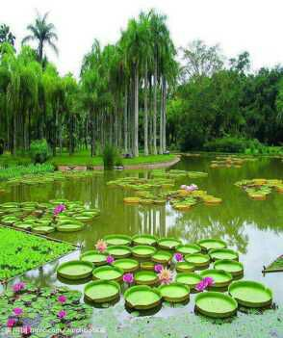
স্বাগতম

Slide 18
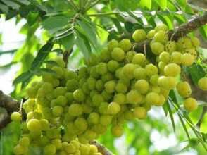
মোঃ নাছির উদ্দিন মনির
সহকারি শিক্ষক
বড়মাছুয়া দাখিল মাদ্রাসা
মঠবাড়িয়া,পিরোজপুর
০১৭২৪৩২৬১৫৪

Slide 19
