Slide 1
Welcome

Slide 2
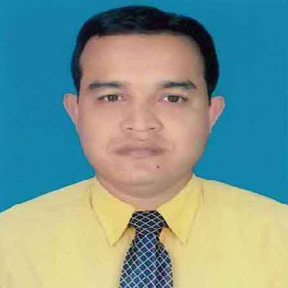
Name : MD BILLAL HOSAIN
Designation:Head Teacher
Digirpar govt primry school
UP : Kasba
Dist: Brahmanbaria

Slide 3
Class:Three
Subject:English
Lesson:Commands
Time:40 min

Slide 4
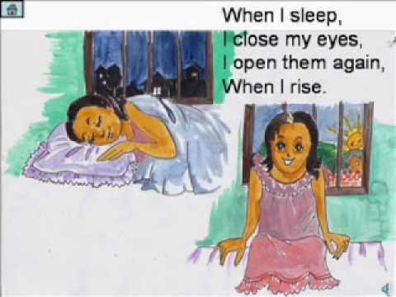

Slide 5
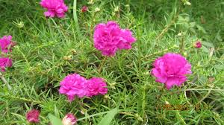
Learning outcomes:
1.Follow simple command and instructions.
2.Say and do the actions stand up,sit down,open the door.

Slide 6
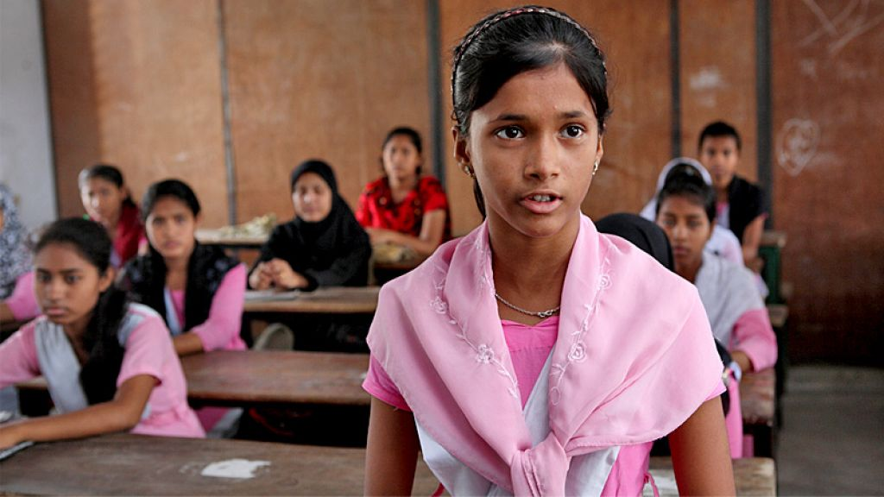

Slide 7
Stand up

Slide 8
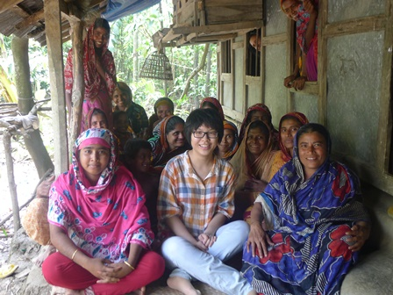
Sit down

Slide 9
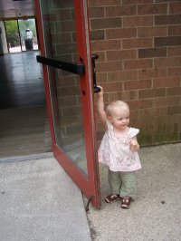
Open the door

Slide 10
Stand up

Slide 11
Sit down

Slide 12
Open the door

Slide 13
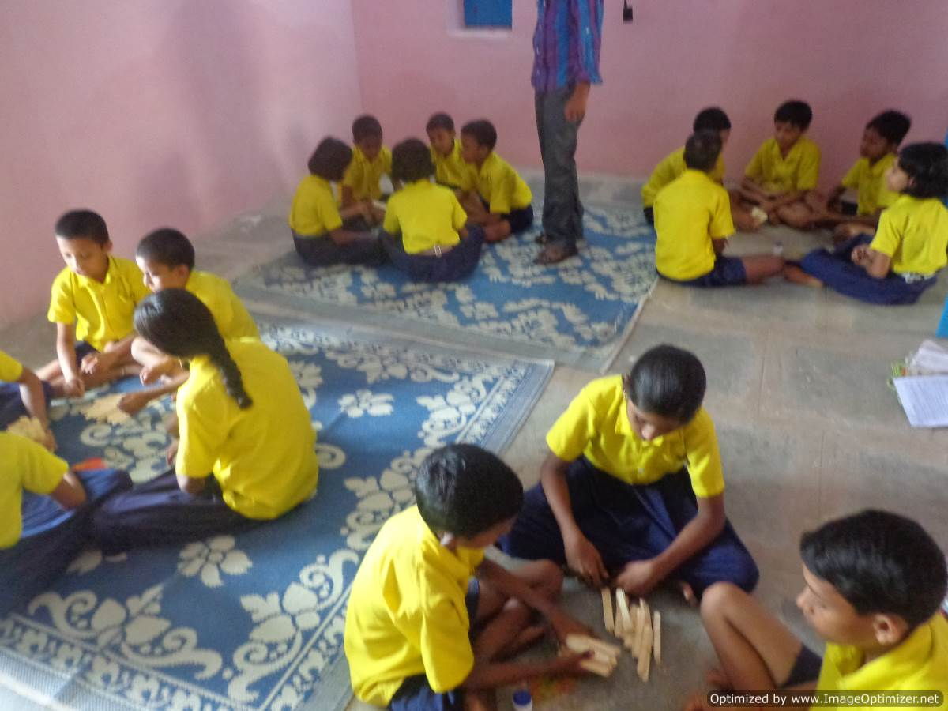

Slide 14
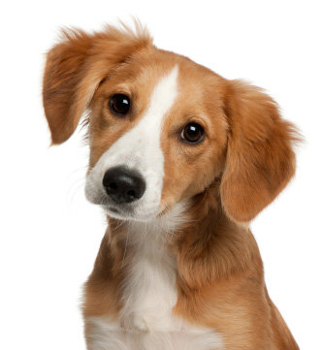
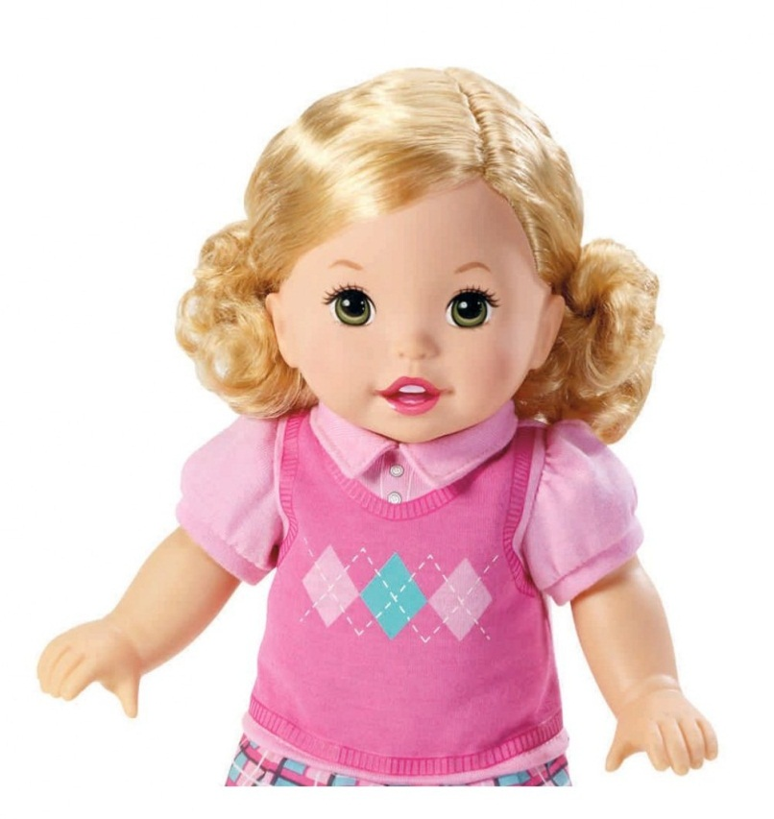
Circle the picture(b,d)

Slide 15
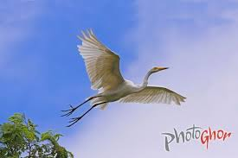
Thanks to all,Good bye students.

