Slide 1
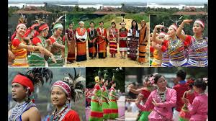
Welcome

Slide 2
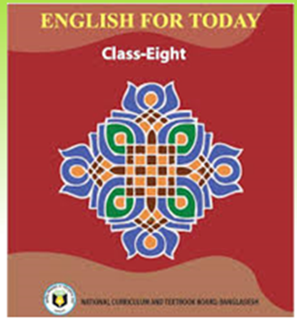
Acquantance
Akhi Akhtar
Assistant Teacher(English)
Sagoria Giris Dakhil Madrasa
Gararon,Sreepur
Topic
English For Today
Unit-01,Lesson-4
Class-Eight
Time-50 minutes

Slide 3
Our Ethnic Friends

Slide 4
After finishing this lesson we will be able to know------------------------
About some common caracteristics of Bangladeshi ethnic people;
About their life style;
About their food habits;
About their clothing;
About their pastimes.

Slide 5
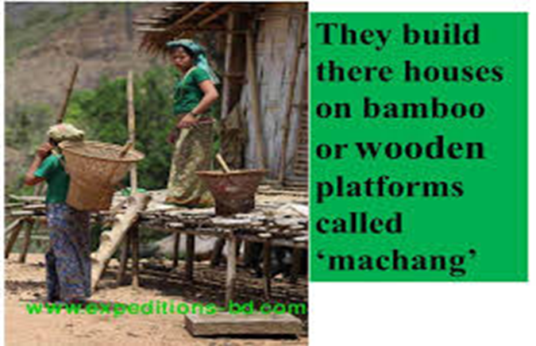
Women weave their own clothes

Slide 6
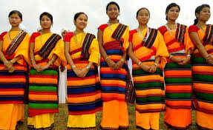
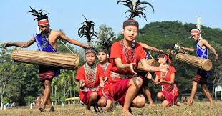
Women wear thamis or sarongs and angis
They are dancing with the music made by drums

Slide 8
Pair work
Answer the following questions.
What is machang?
Write about some musical instruments of ethnic people.
Write about the food habits of ethnic people in Bangladesh.

Slide 9
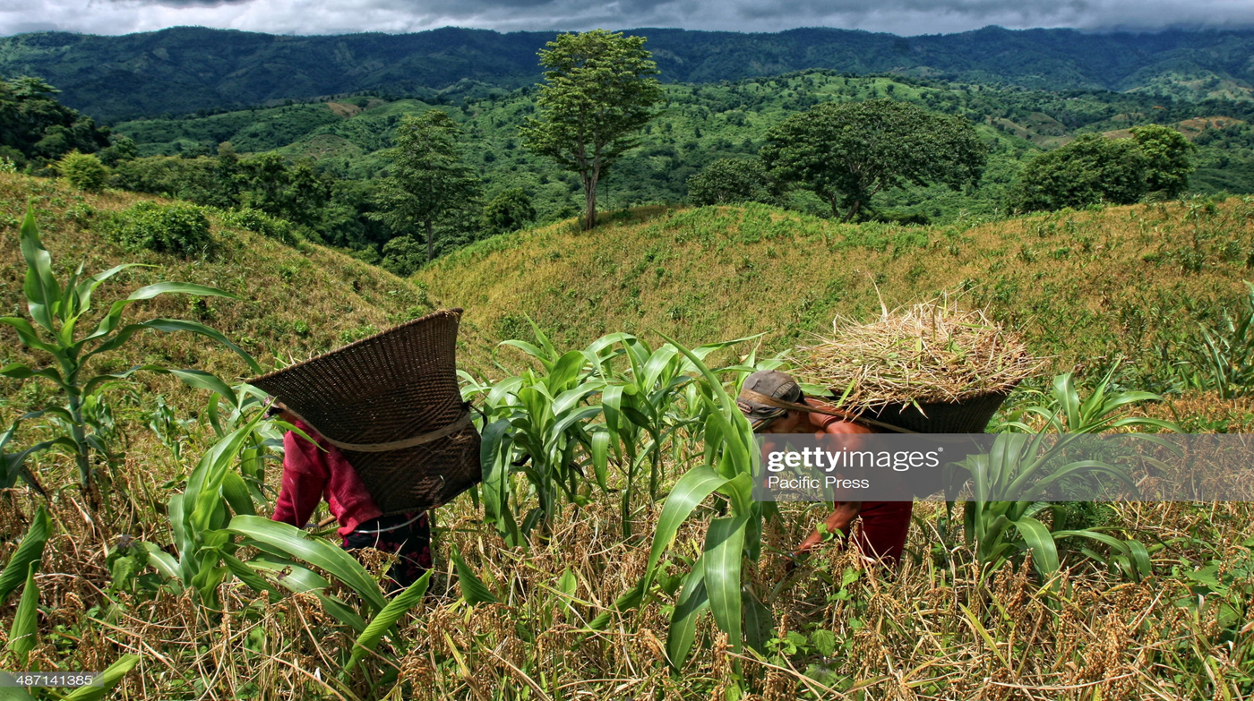
They are mostly farmers and they live in the forest areas ,in the hill tracts and forest areas

Slide 10
Groupwork
What is the main occupation of ethnic people?
Write about their farming system.
Write about their food habit.

Slide 11
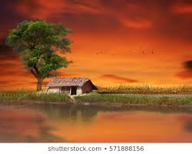
Homework
Write a dialouge between you and your friend asking and answering questions about dress,food,song,sports and pastimes of both of you.

Slide 12
Recap of todays lesson
Common charanterstics of ethnic people;
Their living place
Their life style
Their food habits
Their pastimes

