Slide 2
Introduction
Teacher Introduction
Teacher Introduction
Lesson Introduction
MD.Shaha alam
Jigatala dakhil Madrasha
Assistant teacher(English)
Bhuapur,Tangail
shahaalamm529@gmail.com
Class : Eight
Sub : English 2nd paper
Title : Preposition
Time : 45 minutes

Slide 3
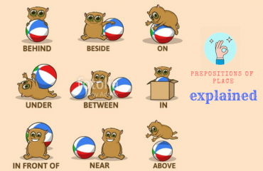
Look at the picture
.
.
.
Descrive the different position of the cat?

Slide 4
Today’s Lesson
preposition

Slide 5
LEARNING OUTCOMES
*By the end of the lesson the learner will be able to
1. Learn definition of preposition and use of preposition
2.Learn kinds of preposition.
3.Find out all kind of preposition.

Slide 6
Lets watch a vedio

Slide 7
Pair work
*Fill in the gaps with preposition from the box.
Man has an unquenchable thirst(a) knowledge. He is never satisfied (b) what he has known and
learnt. The curiosity (c) knowing.The
coupled (d) the indomitable spirit(e) adventure has inspired him to undertake and carry (f) dangerous tasks.
FOR
WITH
OF
TO
WITH
out

Slide 8
Kinds of preposition
Simple preposition: to,at
Double preposition: into,upto
Compound preposition:under,behind
Phrase preposition:look for,look at
Participle preposition:acording to
Disguised preposition:he went a hunting
Detached preposition:

Slide 9
Group work
Write the answer of the question given bellow
1.Where do we use it?
2.How do we use it ?
3.Write the use of to,at.in.of

Slide 10
Evaluation
*What is preposition?
*How many kinds of preposition ?
Write the use of at,to,of,in,under .

Slide 11
Home work
Make five sentences with following preposition.
On , to, behind, of with

Slide 12
THANKS TO ALL

