Slide 1
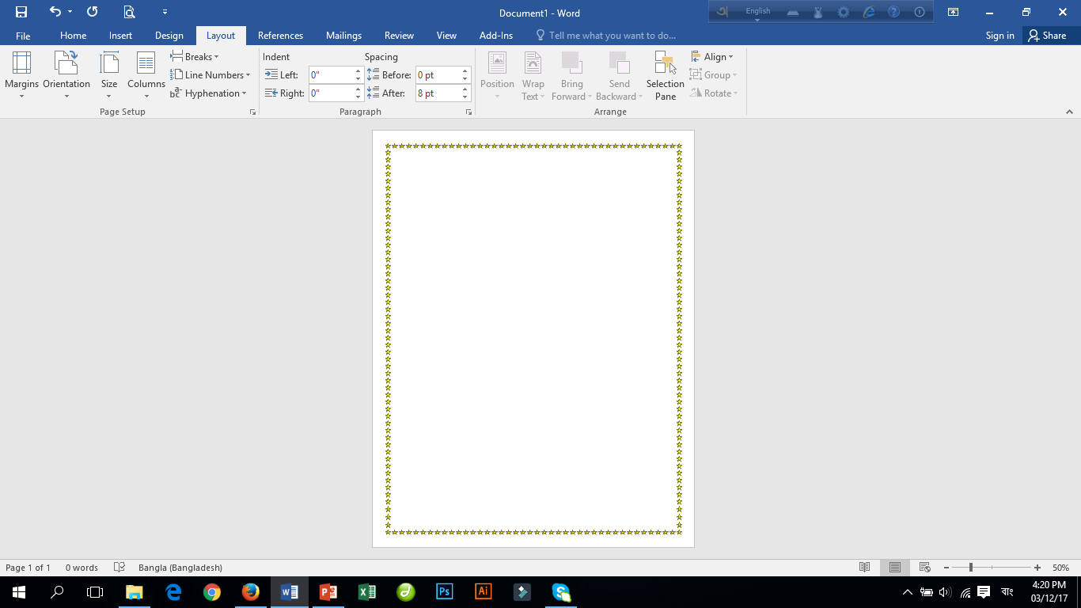

Welcome

Slide 2

Identity
Md. Babul Hossain
Assistant Teacher (Mathematics)
Dr. Mohiuddin High School
Madhabpur, Habiganj.
Phone: 01715844786
E-mail: babulbdx@gmail.com
Class: 9-10
Subject: Physics
Chapter: Second
Students: 25
Time: 50 Minute
Date: 15-03-2020

Slide 3
MOTION

Slide 4
Learning Outcomes
After completing the lesson students will be able to…
Plot and interpret displacement- time and velocity-time graphs
Determine distance, displacement and velocity from a
displacement –time graph
Determine distance, displacement velocity and acceleration
from a velocity–time graph.
.

Slide 5
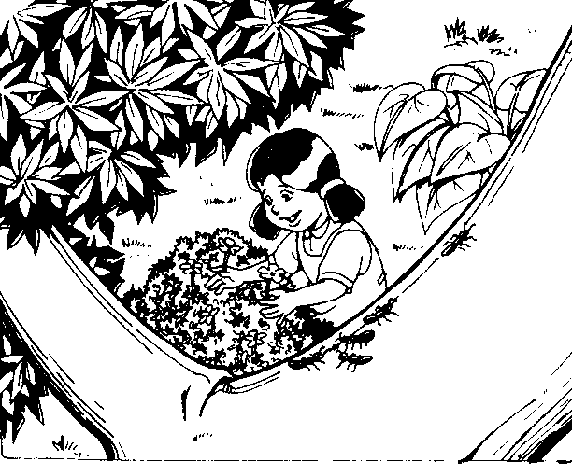
Look at the picture!
Use the ground as reference! What she is move?

Slide 6
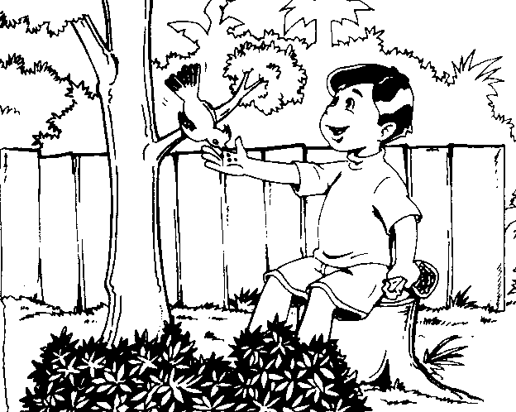
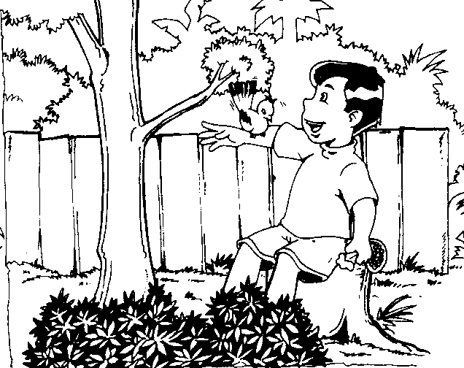
What bird is move..?
Use the ground as reference

Slide 7
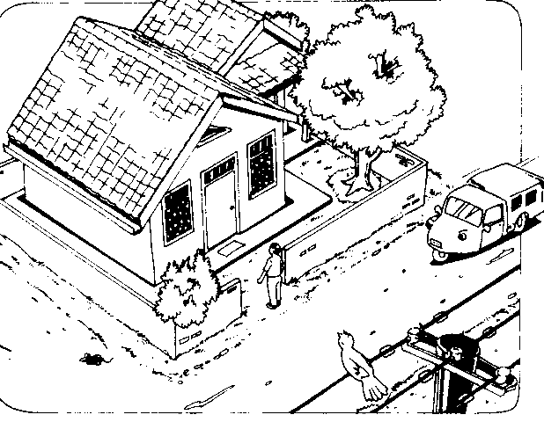
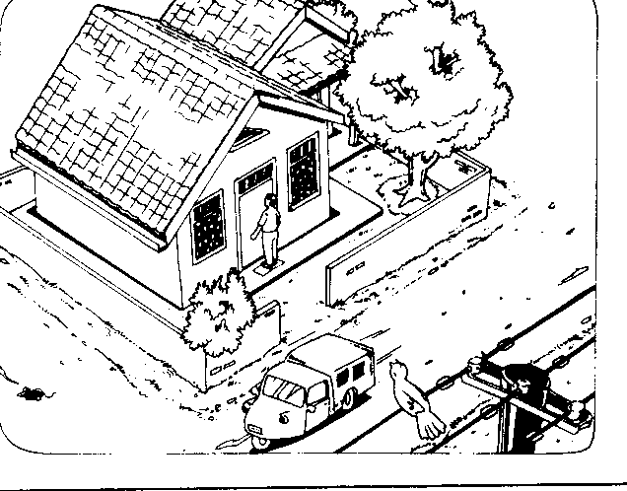
Mention the objects are move and motionless!!
Use the ground as reference

Slide 8
Conclude:
Motion is a change of position with respect to a point of reference.
Point of reference is something that is considered fixed and used as a comparison.
Motion very dependent on point of reference

Slide 9
.....
Motion dependent on point of reference is relative motion
Virtual motion is looks like motion but actually it is not motion, example:
  Sun rises in the east and sets in the west
  When you are inside a moving bus and look towards the window you will see trees moving away from you.

Slide 10


What is difference
between distance and
displacement?
200 m
Distance = 200 m
Displacement = 200 m to rigth

Slide 11
What is difference
between distance and
displacement?
m
A
C
0
1
2
3
4
5
6
7
8
9
B
4
3
2
1
Distance = 13 m
Displacement = 5 m to rigth

Slide 12
conclude
Distance is length of all lines passed through by an object
scalar quantity -> have: magnitude and unit
Diplacement is position change of an object from the initial point
Vector quantity -> have: magnitude, unit, and direction

Slide 13
What its distance?
What its displacement?
1.
10 m
25 m
Distance = 35 m
Displacement = 15 m to left

Slide 14
Speed and Velocity

Slide 15

the moving object is identified by its change of position of a point of reference
If we want to know how far the position has changed, we must know the concept about velocity
Why the change of position of car is longer than a bicycle?
0
4
Time (second)

Slide 16

Speed = the number of velocity.
(scalar quantity)
  Speed = distance
  time
Velocity = the change of position of each time.
(vector quantity)
  Velocity = displacement
  time

Slide 17
scalar quantity:
Speed = magnitude, and unit
vector quantity:
Velocity = magnitude, unit and direction
For example:
The speedometer of motorcycle shows 50 km/hour to west
Speed = 50 km/hour
Velocity = 50 km/hour to west

Slide 18
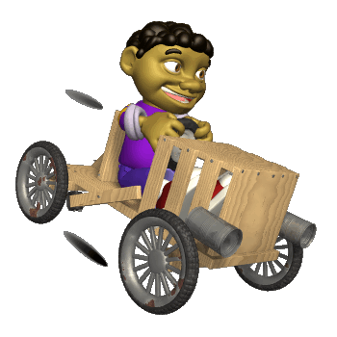
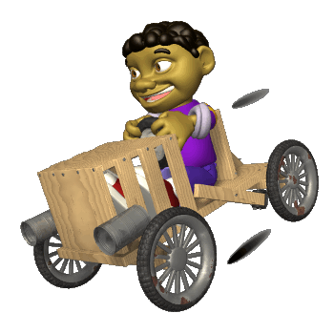
Speed and Velocity
What difference between a distance and
a displacement ?
A
B
200 m
150 m
If Budi go to C from A in 5 seconds that :
250 m
Speed =
90 m/s
Distance =
450 m
Velocity =
30 m/s
Displacement =
150 m
C

Slide 19
Average speed
Average speed is the total traveled distance divided by the total time needed to travel that distance
Average speed = total distance
total time
v = s₁ + s₂ + s_{3 ……}
t₁ + t₂ + t₃ ….

Slide 20
ACCELERATION
Symbol: a
Formula:
acceleration = change of velocity
time taken
SI Unit : m/sec²
The same formula can also be applied for deceleration, but the value of a is negative

Slide 21
Acceleration
Acceleration denotes the change of velocity per unit of time. (Vector Quantity)
acceleration decleration
The formula :
a = v_{t} – v_{0 or a = v/t}
velocity
acceleration
velocity
acceleration
t_{t} – t₀
With : a = acceleration (m/s²)
v_{t} = The final velocity (m/s)
v₀ = the initial velocity (m/s)

Slide 22
Equation of Motion
Mathematical relations relating motion variables are called equation of motion
For motion with constant acceleration, the variables are:
Displacement : s
Initial velocity : v
Final velocity : u
Constant acceleration : a
Time taken : t

Slide 23
Displacement-time graph
A displacement-time graph shows how the displacement of an object changes with time.
The gradient of a displacement-time graph represents the velocity of the object.

Slide 24
Displacement (m)
Time (s)
Zero gradient – stationary object

Slide 25
Displacement (m)
Fixed gradient-uniform velocity
Time (s)

Slide 26
Displacement (m)
Time (s)
Increasing gradient – increasing velocity

Slide 27
Displacement (m)
Time (s)
Decreasing gradient – decreasing velocity

Slide 28
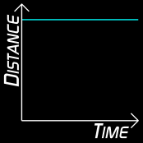
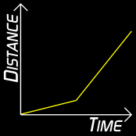
Distance - Time Graph
If something is not moving, a horizontal line is drawn.
If something starts out slow and then speeds up, its change in speed can look like this.

Slide 29
Velocity-time graph
A velocity-time graph shows how the velocity of an object changes with time.
The gradient of a velocity-time graph represents the acceleration of the object.
The area under a velocity-time graph represents the distance traveled by the object.

Slide 30
Examples
Velocity (m/s)
What is the acceleration of the car during
the part of the journey represented by:
- OA - AB - BC
What is the total distance traveled by the
Car?
Calculate the average velocity of the car
for its whole journey.
A B
15
C
Time (s)
O
20 50 60

Slide 31
Several examples of velocity-time graph
Regular / uniform linier motion
Velocity (m/s)
Uniform velocity – zero acceleration
0
Time (s)

Slide 32
Velocity (m/s)
Increasing acceleration
Time (s)

Slide 33
Decelerated dynamic linier motion
Velocity (m/s)
Uniform deceleration
Time (s)

Slide 34
Velocity (m/s)
Decreasing acceleration
Time (s)

Slide 35
Velocity (m/s)
Decreasing deceleration
Time (s)

Slide 36

Thank you

