Slide 2
INTRODUCTION OF THE TEACHER
SIMTA RANI SUTRADHAR
ASSISTANT TEACHER
KALAMBARPUR GPS
JAGANNTHPUR , SUNAMGONJ.

Slide 3
INTRODUCTION THE LESSON
ENGLISH FOR TODAY
CLASS: THREE
UNIT: 01 LESSON:1-3
LESSON TITLE: GREETINGS AND INTRODUCTION
TIME: 40 MINUTE

Slide 4
LISTENING
1.1.1 Recognize English sound differences in the context of word.
3.1.1 Understand simple question about student, family, and friend .
SPEAKING
2.1.1 Exchange greetings and farewells.
3.1.2 ask and answer yes/no question.
LEARNING OUTCOMES

Slide 5
Creating Safe Environment play game, song etc.
Review session

Slide 6
Look At The Picture
school
Student
teacher

Slide 7
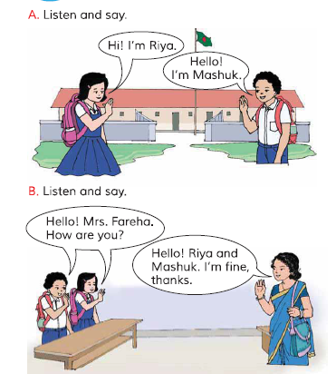
Open your book page no 02
W
C
W

Slide 8
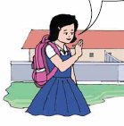
Listen And Say
A
Hello! I’m Mashuk
Hi! I’m Riya

Slide 9
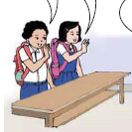
Listen And Say
B
Hello! Mrs. Fareha. How Are You?
Hello! Riya And Mashuk. I’m Fine, Thanks.

Slide 10
Pair Work
how are you?
I’m also fine.
Hello! I’m priyanka
Hi! I’m Suma
I’m fine. and you?

Slide 11
Homework
Practices This Lesson Again And Again At Your Home

