Slide 2
Teacher’s Identity
Subject Identity
English for Today
Class: one
Unit : 5
Lesson: 1-3 ( B )
Time: 45 minutes
Date: 03/ 02/ 2020
Mst. Lucky Akhter parveen
Assistant teacher
Bihari Govt.Primary School
Pirgachha, Rangpur

Slide 3
Learning outcomes
Students will be able to-
Listening: 1.1.1 become familiar with English sounds by listening to command English words.
2.1.1 follow simple command and instructions.
Speaking: 1.1.1 repeat after the teacher simple words and phrases.
1.1.2 simple words and phrases.
7.1.1 give simple commands and instructions.

Slide 4
Let’s enjoy the audio.

Slide 5
Let’s enjoy the video.

Slide 6
Today lesson
commands

Slide 7
Look, listen and say.
window
door

Slide 8
Look, listen and say.
floor
chair

Slide 9
Look, listen and say.
table
book

Slide 10
Look, listen and say.
pencil
book

Slide 11
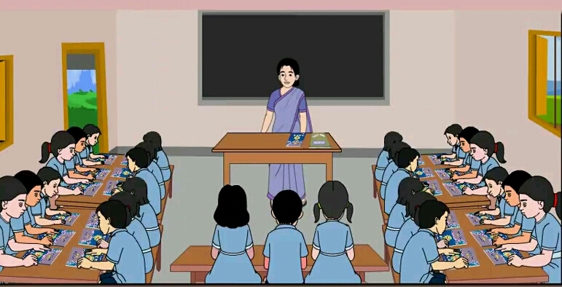
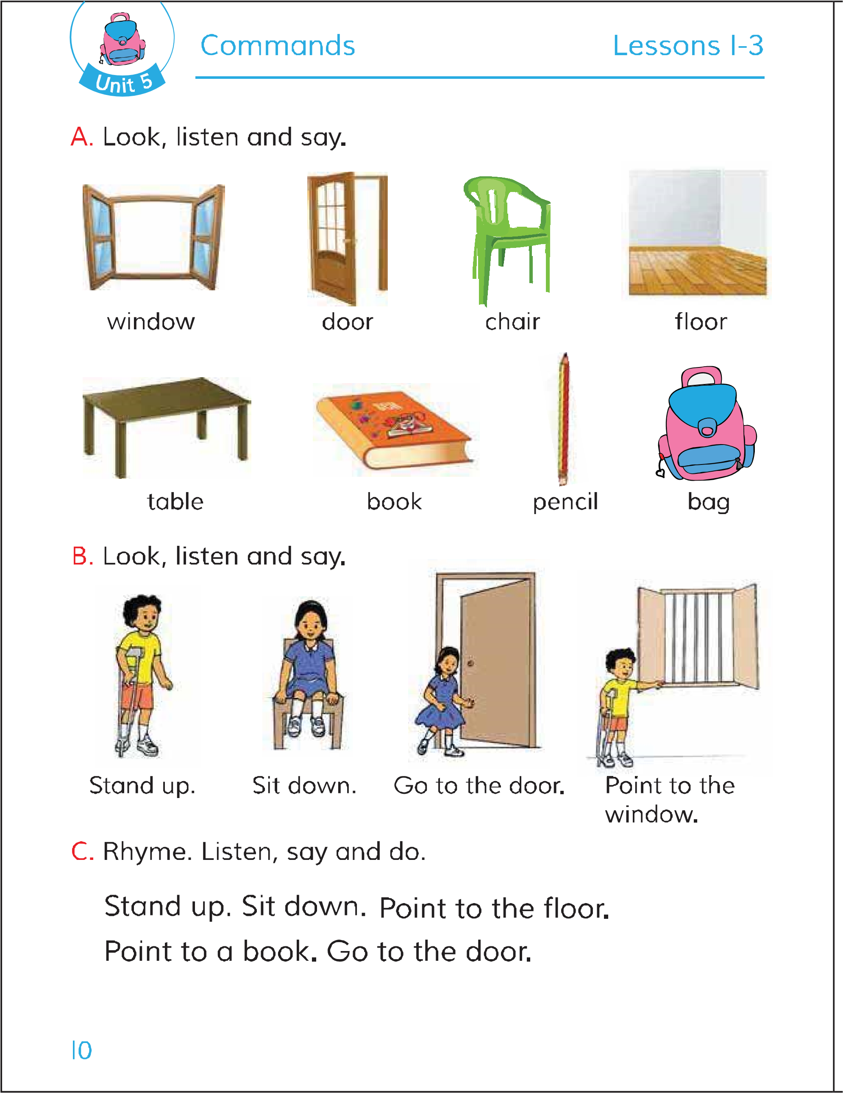
Open your English book page 10.

Slide 12
Look, listen and say.
Stand up.

Slide 13
Look, listen and say.
Sit down.

Slide 14
Look, listen and say.
Go to the door.

Slide 15
Look, listen and say.
Point to the window

Slide 16
Pair work.
student-1 command “Go to the door.”
Studend-2 act the command

Slide 17
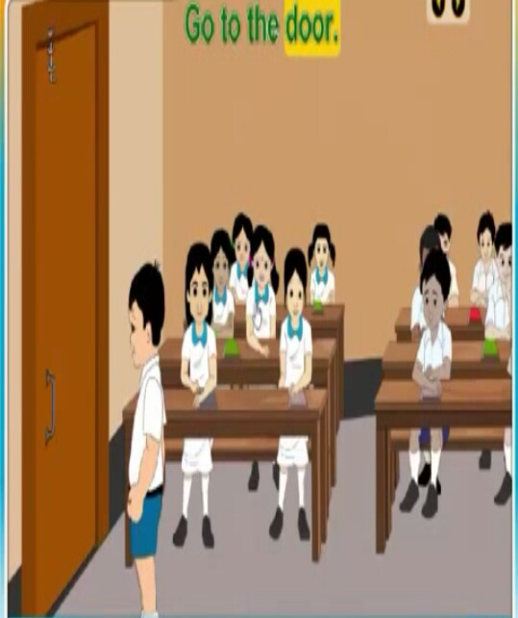
Pair work.
student-1 command “Go to the door.”
Studend-2 act the command

Slide 18
Pair work.
student-1 command “ Sit down.”
Studend-2 act the command

Slide 19
Evaluation.
student-1 command “ point to the window.”
Studend-2 act the command
student-1 command “ Stand up.”
Studend-2 act the command

