Slide 1
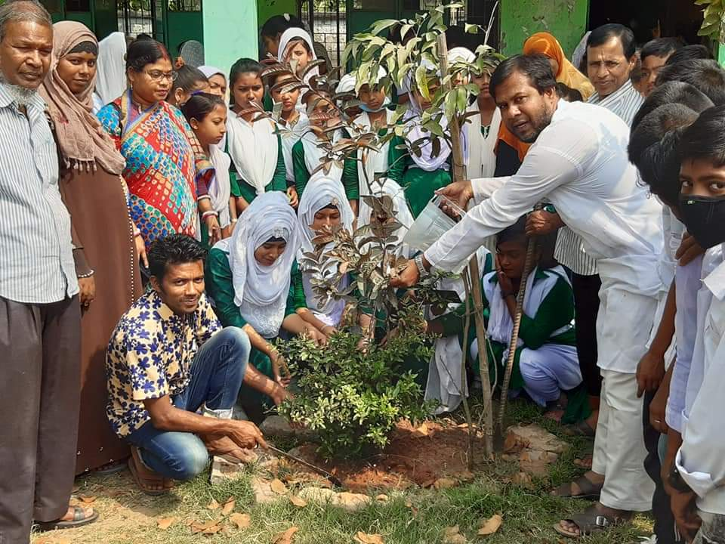
Chandrapur A.h.p High School

