Slide 1
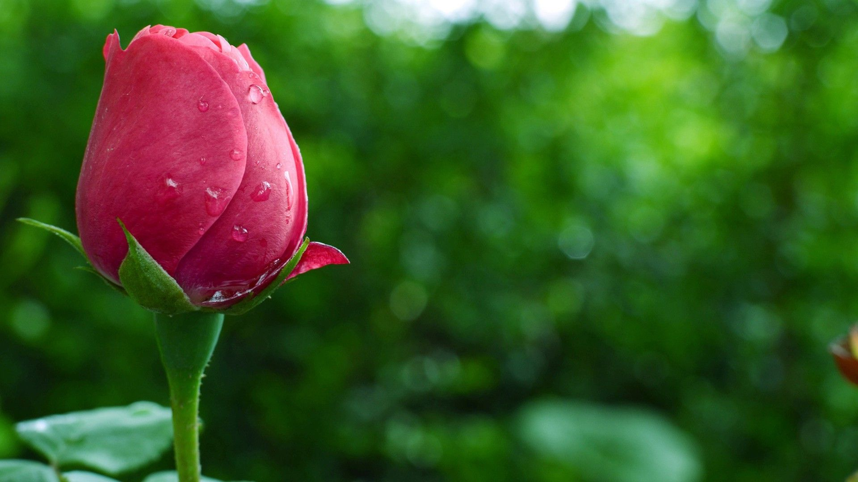
It’s my pleasure to welcome you.
Notes:
As this section of grammar needs extensive practice , teachers are requested to add anything extra as suits the class.

Slide 2
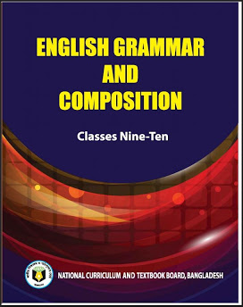
Nurul Aziz
Assistant Teacher
Krishnakumari City Corporation Girls’ High School,
Nandankanan, Chittagong
E mail : naziz13.na@gmail.com
Mobile : 01843773924
English Grammar and Composition
Class IX
Time : 45 Minutes
Date : 16/03/2020

Slide 3
Great! Mina and her friend are the only brilliant girls with highest score in class.
This is a sentence. What do we call every word of a sentence?
We call them Parts of speech.

Slide 4
Our today’s lesson is..
The use of Parts of speech.
(Fill in the blanks with clues)
Unit-(1-8)

Slide 5
How many parts of speech are there?
Eight
Noun, pronoun,
verb, adjective,
adverb,
preposition, conjunction interjection
What are they?

Slide 6
Learning Outcomes
After the end of the lesson students will be able to
Recognize parts of speech.
use appropriate words in sentences.
write English correctly.
Find out mistakes in sentences.

Slide 7
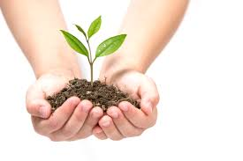
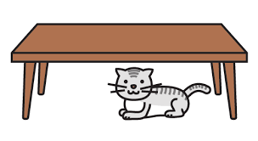
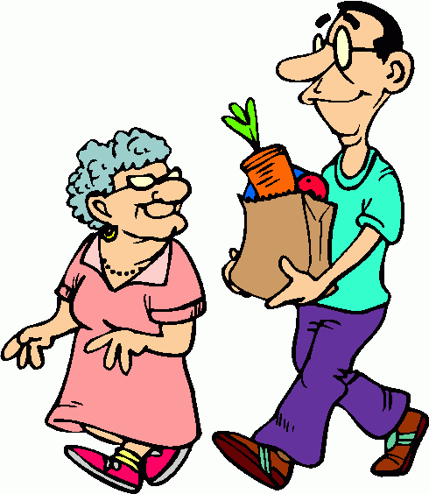
Use of Nouns
1) Nouns are used as subject and object in a sentence. i.e. are useful to us in many ways.
Trees
2) After an article , we use noun.
i.e. A is gift of nature.
flower
3) After preposition, we use a noun.
i.e. The cat is under .
The table
4) After an adjective, we use a noun.
i.e. He is a kind .
man

Slide 8
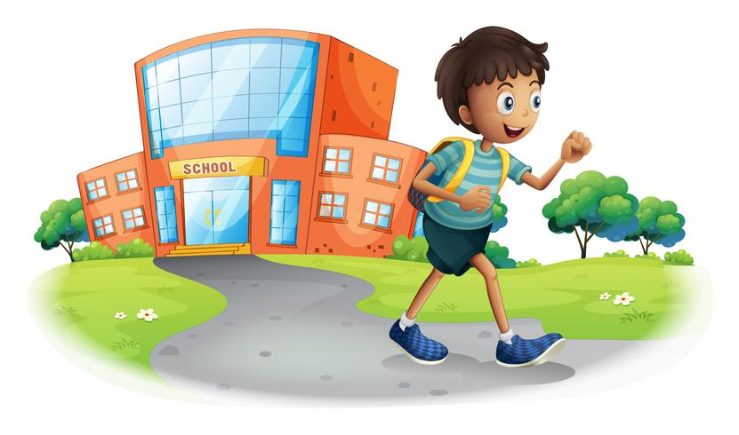
Use of Pronoun
The word that we can use in place of a noun, is called pronoun.
Some pronouns : I ,we , you, it, she, he, they, them, him, his, her, your, their, our etc.
Mamun is a good boy.
He goes to school regularly.
Here , He is a pronoun.

Slide 9
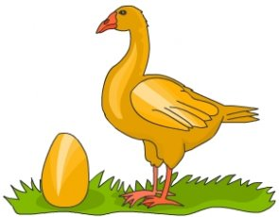
Use of Adjective
The word that modifies a noun or a pronoun is called Adjective.
For example- The goose laid a golden egg everyday.
Here, the word ‘Golden’ is an adjective.

Slide 10
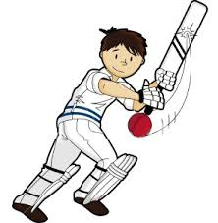
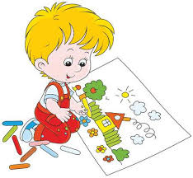
Use of Verb
Verbs are words that are used to express an action. Every sentence must have a verb that shows what the subject is doing or explains what is going on. Generally we use a verb after a subject.
He plays cricket in the field.
Here, the word ‘play’ is a verb.
I am drawing a picture.
Here, ‘drawing’ is a verb.

Slide 11
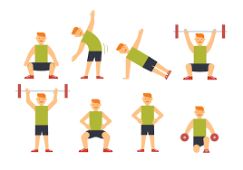
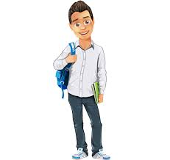
Use of Adverb
An Adverb is a word that modifies a verb, an adjective or an adverb. Therefore, an adverb modifies three kinds of words that adjectives do not modify.
Exercise keeps us physically fit.
Here, the word ‘physically’ is a adverb.
He is so smart.
Here, ‘so’ is an adverb.

Slide 12
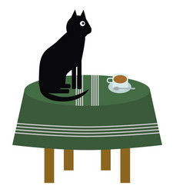
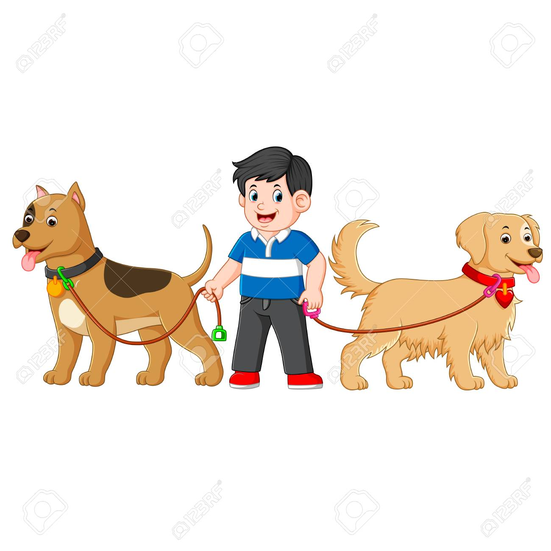
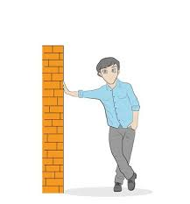
Use of Preposition
A preposition is a word which is placed before a noun or a pronoun to show its relation with something else in the sentence.
The cat is on the table.
Here ‘On’ is a preposition.
The boy is between the dogs.
Here ‘between’ is a preposition.
He is leaning against the wall.
Here ‘against’ is a preposition.

Slide 13
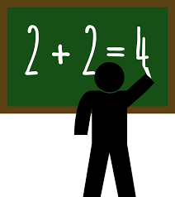
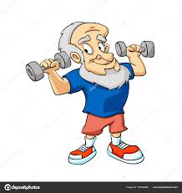
Use of Conjunction
A conjunction is a word that connects two words, phrases, clauses or sentences and show relation between them.
Two and two make four.
Here ‘and’ is a conjunction.
He is old but takes exercise daily.
Here ‘but’ is a conjunction.

Slide 14
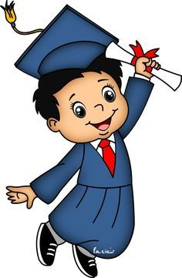
Use of Interjection
Interjections are words used to express sudden feeling.
Hurrah! I have passed the exam.
Wow! that’s really a good news.

Slide 15
Pair Work
1. Fill in the blanks with words from the box. You may need to change the forms of some of the words. You may need to use one word more than once.
Notes:
For this particular work slide no. 16 to 25 need to be followed . 1 slide for each gap. 1 pair may be given 1 slide.

Slide 16
of | The | for | at | which | adulterate | hardly | or | into
The issue of food has drawn the attention (b)____general people. We (c)____find any food in our country (d)____is not adulterated in one way (e)____other. (f)____present, sub-standard foods are sold in most of (g)___hotels. Very recently government has directed a mobile court to look (h)____the matter of food. They are catching dishonest hoteliers red handed (i)____using unhygienic ingredients (j)____are really harmful for human body.
(a)
adulteration
a) Rule : After article, adjective, preposition, possessive , we use nominal compound (one or more nouns / noun phrase). We need to change the verb adulterate into Noun adulteration. Here food adulteration is a nominal compound.
Notes:
Dear teachers, for this pair work , I have used Trigger with each gap. Please use trigger while explaining the blanks.

Slide 17
of | the | for | at | which | adulterate | hardly | or | into
The issue of food (a) ___ has drawn the attention general people. We (c)____find any food in our country (d)____is not adulterated in one way (e)____other. (f)____present, sub-standard foods are sold in most of (g)___hotels. Very recently government has directed a mobile court to look (h)____the matter of food. They are catching dishonest hoteliers red handed (i)____using unhygienic ingredients (j)____are really harmful for human body.
(b)
of
b) Rule : Generally we use a preposition to show relation of a noun or pronoun with the rest of the words in a sentence.
To ask , whose attention to be drawn , we say.. Of general people. So the answer is preposition ‘of’ .

Slide 18
of | the | for | at | which | adulterate | hardly | or | into
The issue of food (a)____has drawn the attention (b)____ general people. We find any food in our country (d)____is not adulterated in one way (e)____other. (f)____present, sub-standard foods are sold in most of (g)___hotels. Very recently government has directed a mobile court to look (h)____the matter of food. They are catching dishonest hoteliers red handed (i)____using unhygienic ingredients (j)____are really harmful for human body.
(c)
hardly
c) Rule : We can use an adverb between the subject and the verb in a sentence to modify the verb. Here ‘Hardly’ is an adverb to show we find good food in our country in no time.

Slide 19
of | the | for | at | which | adulterate | hardly | or | into
The issue of food (a)____has drawn the attention (b)____ general people. We (c) find any food in our country is not adulterated in one way (e)____other. (f)____present, sub-standard foods are sold in most of (g)___hotels. Very recently government has directed a mobile court to look (h)____the matter of food. They are catching dishonest hoteliers red handed (i)____using unhygienic ingredients (j)____are really harmful for human body.
(d)
which
d) Rule : The word that joins the principal clause and the subordinate clause is called subordinating conjunction. Here the ‘Which’ works a subordinating conjunction.

Slide 20
of | the | for | at | which | adulterate | hardly | or | into
The issue of food (a)____has drawn the attention (b)____ general people. We (c) find any food in our country (d)____is not adulterated in one way other. (f)____present, sub-standard foods are sold in most of (g)___hotels. Very recently government has directed a mobile court to look (h)____the matter of food. They are catching dishonest hoteliers red handed (i)____using unhygienic ingredients (j)____are really harmful for human body.
(e)
or
e) Rule : The word that joins similar type of words, clauses or sentences is called Coordinating Conjunctions. Here we need a coordinating conjunction that is ‘Or’.

Slide 21
of | the | for | at | which | adulterate | hardly | or | into
The issue of food (a)____has drawn the attention (b)____ general people. We (c) find any food in our country (d)____is not adulterated in one way (e)____ other. present, sub-standard foods are sold in most of (g)___hotels. Very recently government has directed a mobile court to look (h)____the matter of food. They are catching dishonest hoteliers red handed (i)____using unhygienic ingredients (j)____are really harmful for human body.
(f)
At
f) Rule : Sometimes we need to use linkers in the beginning of a sentence to keep the coherence of meaning. If we add ‘At’ here, it becomes at present and it’s a linking phrase.

Slide 22
of | the | for | at | which | adulterate | hardly | or | into
The issue of food (a)____has drawn the attention (b)____ general people. We (c) find any food in our country (d)____is not adulterated in one way (e)____ other. (f)_____present, sub-standard foods are sold in most of hotels. Very recently government has directed a mobile court to look (h)____the matter of food. They are catching dishonest hoteliers red handed (i)____using unhygienic ingredients (j)____are really harmful for human body.
(g)
the
g) Rule : If we want to indicate any place, person or things, we need to use article, ‘the’ . Here we are talking about the hotels that serve sub-standard foods.

Slide 23
of | the | for | at | which | adulterate | hardly | or | into
The issue of food (a)____has drawn the attention (b)____ general people. We (c) find any food in our country (d)____is not adulterated in one way (e)____ other. (f)_____present, sub-standard foods are sold in most of (g)______hotels. Very recently government has directed a mobile court to look the matter of food. They are catching dishonest hoteliers red handed (i)____using unhygienic ingredients (j)____are really harmful for human body.
(h)
into
h) Rule : Here the act of mobile court is to inspect the substandard food items. ‘Look into’ is a phrase verb. So we need to use into in this gap.

Slide 24
of | the | for | at | which | adulterate | hardly | or | into
The issue of food (a)____has drawn the attention (b)____ general people. We (c) find any food in our country (d)____is not adulterated in one way (e)____ other. (f)_____present, sub-standard foods are sold in most of (g)______hotels. Very recently government has directed a mobile court to look (h)____the matter of food. They are catching dishonest hoteliers red handed using unhygienic ingredients (j)____are really harmful for human body.
(i)
for
i) Rule : To show any reason we use preposition for before a noun/gerund/pronoun. Here we need ‘for’ to mean the reason of catching the dishonest hoteliers.

Slide 25
of | the | for | at | which | adulterate | hardly | or | into
The issue of food (a)____has drawn the attention (b)____ general people. We (c) find any food in our country (d)____is not adulterated in one way (e)____ other. (f)_____present, sub-standard foods are sold in most of (g)______hotels. Very recently government has directed a mobile court to look (h)____the matter of food. They are catching dishonest hoteliers red handed (i)____using unhygienic ingredients are really harmful for human body.
(i)
which
j) Rule : The word that joins the principal clause and the subordinate clause is called subordinating conjunction. Here the ‘Which’ works a subordinating conjunction.
Notes:
Dear teachers, for this pair work, we need to show slide no.16-25 for better understanding and explanation.

Slide 26
Group Work
Fill in the blanks with words from the box. You may need to change the forms of some of the words. You may need to use one word more than once.
numerous | early | a | the | suitable | moreover | maintain | make | fresh | ages
Morning walk is an exercise for the people of all . It gives us benefits. people who wake up and go out for walk, can enjoy morning air. these exercise helps them good health. Again, they can a good start of their work.
(a)
suitable
(b)
ages
(c)
numerous
(d)
the
(e)
early
(f)
a
(g)
fresh
(h)
Moreover
(i)
maintain
(j)
make
Notes:
Trigger has been used here.

Slide 27
Evaluation
Fill in the blanks with appropriate words.
1.We must not memorize anything without (understand).
understanding
2. Sometimes they drive night coach (reckless).
recklessly
3. He is an (intellect) person.
intellectual
4. Modern civilization is the (bless) of science.
blessing
Notes:
Trigger has been used here.

Slide 28
Home Work
Fill in the blanks with words from the box. You may need to change the forms of some of the words. You may need to use one word more than once.
Of | necessary | in | danger | had | protect | repent | wise | so | the
Our environment is polluted (a)___many ways. We often do (b)___things and (c) our lives. We (d)___to think about (e)___harmful effect (f)___our activities. To (g)___the environment, we must take some (h)___steps. If not (i)___, we will have to (j)___.
Notes:
Trigger has been used here.

Slide 29
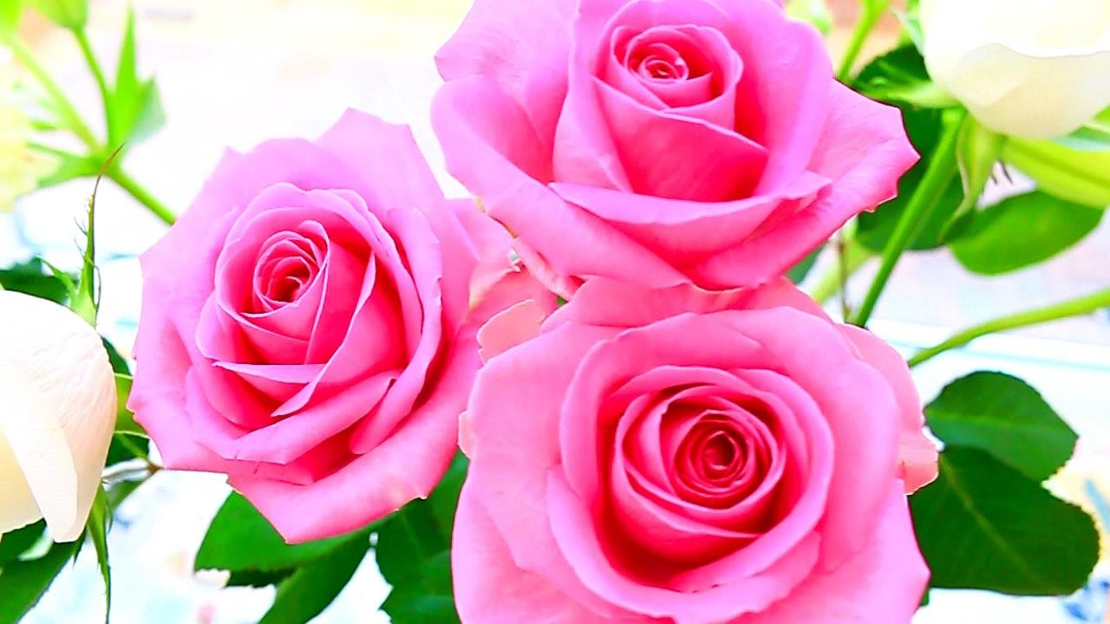
Thank you for your attention.

