Slide 1
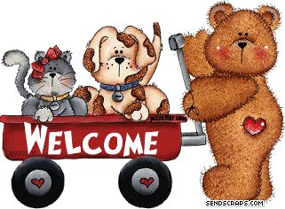

Slide 2
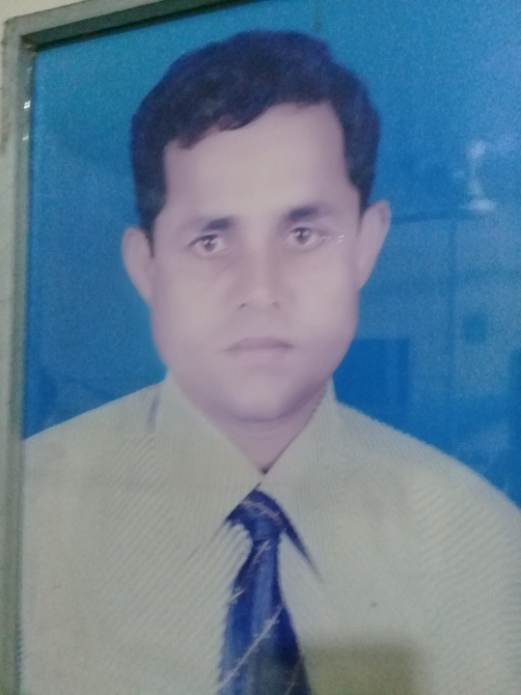
TEACHER’S INTRODUCTION
NAME: MD SHARIF UDDIN
ASSISTANT TEACHER
SCHOOL: RICHI GOVT. PRIMARY SCHOOL
HABIGANJ SADAR.
HABIGANJ

Slide 3
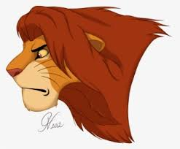
LESSON’S INTRODUCTION
Title of the lesson: THE LION AND THE MOUSE
Part of the lesson: One day…..angry
Lesson unit:42
Subject: English
Class:4
Date: 1/3/2020

Slide 4
LISTENING
1.1.1.recognize sounds differences in the context of words.
1.2.1. recognizewhich syllable in a word is stressed.
1.3.1. recognize which words in a sentence are stressed.
4.3.1. enjoy and understand simple stories.

Slide 5
SPEAKING
1.1.1. Repeat after the teacher simple words and phrases and sentences with proper sounds, stress and intonation.
6.2.1. talk about people, objects, events, etc.

Slide 6
READING
1.4.1. Read words, phrases and sentences in the text
1.5.1. read words, phrases and sentences in the text with proper pronunciation, stress and intonation.

Slide 7
WRITING
3.1.1. write words, phrases and sentences using non cursive capital and small letters.

Slide 8
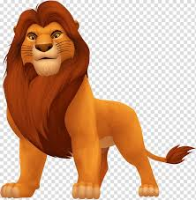
LETS SEE SOME PICTURE
What is this?

Slide 9
Lion

Slide 10
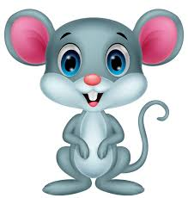
What is this?

Slide 11
Mouse

Slide 12
At first lets see a video

Slide 13
TODAY’S LESSON

Slide 14
LISTEN TO ME.

Slide 15
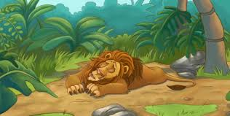
The lion and the mouse
One day a lion was sleeping in the forest.

Slide 16
It was big and strong.

Slide 17
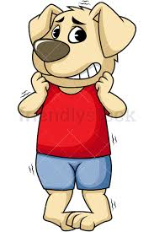
All the animal feared the lion,
Apart from one mouse.

Slide 18
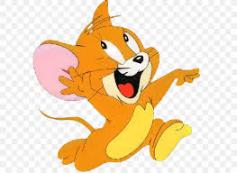
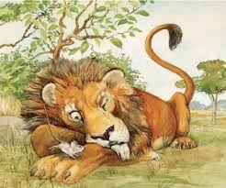
A mouse was playing near the lion.
She ran onto the lion’s nose and he woke up.

Slide 19
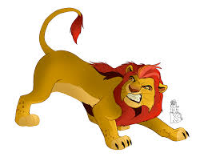
He was angry.

Slide 20
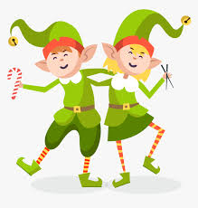
LETS FIND SOME NEW WORDS IN PAIR

Slide 21
Forest

Slide 22
Forest
Jungle

Slide 23
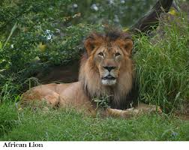
The lion lives in a forest

Slide 24
Strong

Slide 25
Strong
Fit and healthy

Slide 26
The lion is strong

Slide 27
Feared

Slide 28
Feared
Scared

Slide 29
All the animals feared the lion

Slide 30
NOW LISTEN TO ME AND REPEAT AFTER ME.

Slide 31
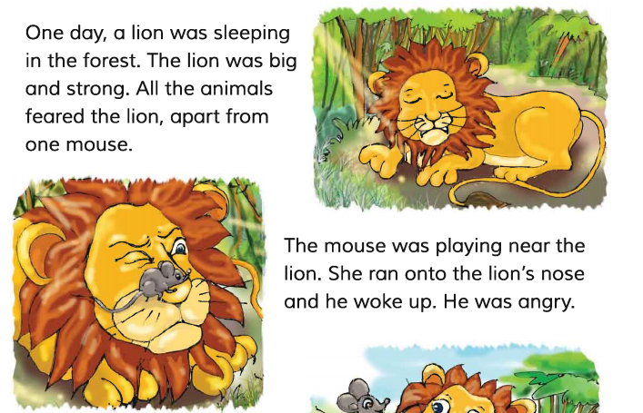
OPEN YOUR BOOK

Slide 32
STUDENT WILL READ THE LESSON AND EVERYONE WILL REPEAT AFTER HIM.

Slide 33
READ THE LESSON SILENTLY

Slide 34
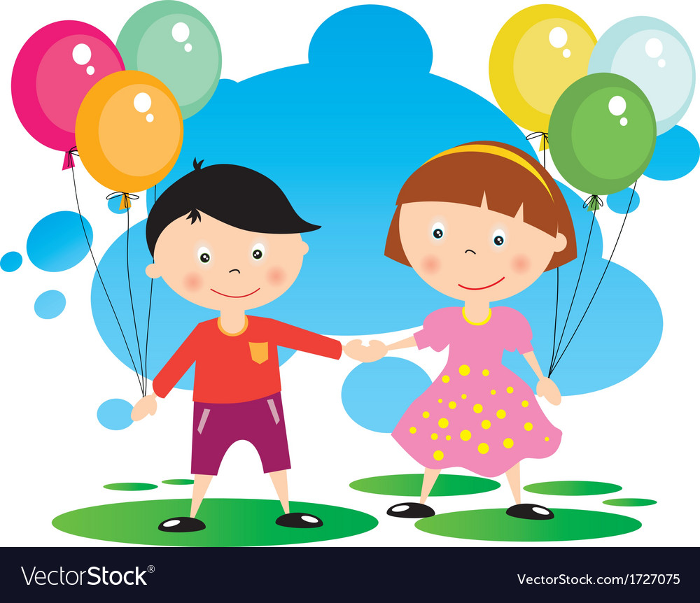
PAIR WORK

Slide 35
FILL IN THE GAPES
Strong
lion
mouse
1. The was _.
2.All the animal feared the_.

Slide 36
INDIVIDUL WORK

Slide 37
Write answers of the questions.
Who was angry?
Who was playing?

Slide 38
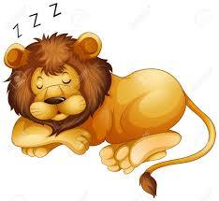
HOMEWORK
Write two sentences about the lion.

Slide 39
GOODBYE STUDENTS

