Slide 1
Sub : English 2nd Paper
Class : seven
Unit- 3, ADJECTIVE
Time : 45 minutes

Slide 2
TEACHER CONTACTS
MD.MOSTAFIZUR RAHMAN
ASSISTANT TEACHER (COMPUTER)
MOHAMMADPUR ADORSHA HIGH SCHOOL
GANGNI,MEHERPUR
CELL PHONE NO-01922314170

Slide 3
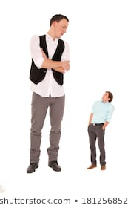
TODAY OUR TOPIC IS ?
ADJECTIVE
TALL
MAN
LARGE
SMALL
OVAL
SHORT
OVAL
MAN

Slide 4
LEARNING OUTCOMES
STUDENTS WILL BE ABLE TO…..
FIND OUTS ADJECTIVE WORDS FROM SENTENCE …..
WHERE ARE ADJECTIVES WORD SITTING……
HOW TO USE ADJECTIVES INSIDE A PASSAGE….

Slide 5
ADJECTIVES
REZA IS A SMART BOY.
OUR HOME IS BIG.
DO YOU HAVE ANY RED PEN ?
THE WORDS ‘SMART’, ’BIG’ AND ‘RED’
DESCRIBE A BOY, A HOUSE AND
A PEN RESPECTIVELY .
THESE WORDS ARE CALLED ADJECTIVE .

Slide 6
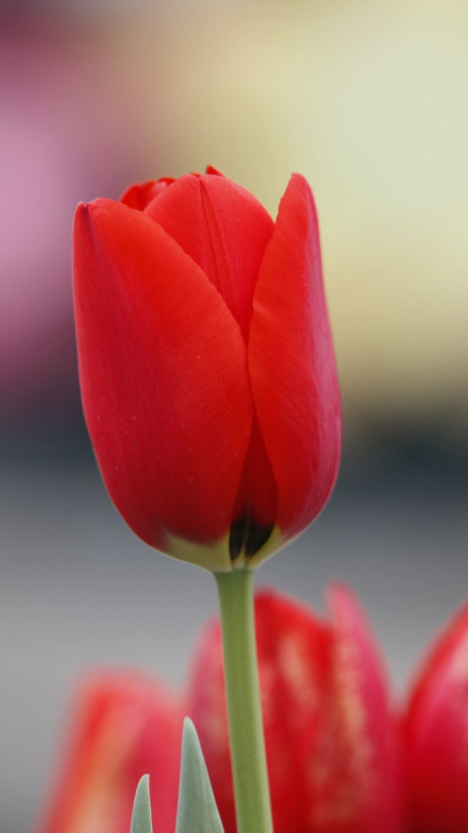
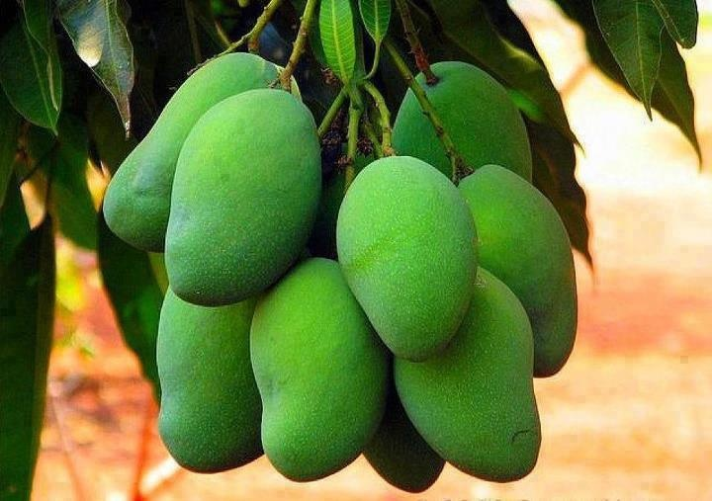
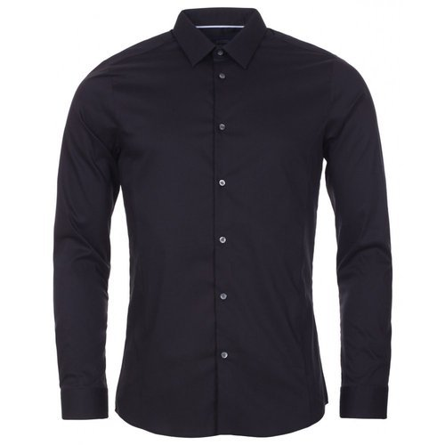
RED
1.
FLOWER
2.
GREEN
MANGO
2.
NICE
SHIRT

Slide 7
LOOK AT THE UNDERLINED WORDS IN FOLLOWING TEXT
MR.RAHMAN IS A SKILLED TEACHER .
HE IS QUALIFIED TOO.
HE HAS A LONG TEACHING EXPERIENCE.
HE IS A FAVORITE TEACHER .TO HIS STUDENTS.
THE WORDS ‘SKILLED’ , ‘QUALIFIED’ , ‘LONG’ ,AND
‘FAVORITE’ DESCRIBED AND MODIFY
SOME OF NOUN AND PRONOUN
SO THESE WORDS CALLED BY ADJECTIVE .

Slide 8
EVALUATION BY
INDIVIDUAL
AND
GROUP WORK

Slide 9
INDIVIDUAL WORK
FILL THESE BLANK WITH ADJECTIVES
RED
ASHIK HAS A …........BALL.
RANI IS A …………… GIRL.
HE IS A …………….. DOCTOR .
PRETTY
QUALIFIED

Slide 10
GROUP WORK
WRITE 5 SENTENCE WITH THESE ADJECTIVE
RED,FIVE,GOOD,TALL,SHORT.

Slide 11
ANSWERS
1.I HAVE A RED PEN .
2.SHE HAS FIVE DOLLS
3.HE IS A GOOD MAN .
4.REZA IS A TALL BOY.
5.RIA IS A SHORT GIRL.

Slide 12
HOMEWORK
FILL IN THESE GAPS WITH APPROPRIATE ADJECTIVE.
HELLO ! I AM MOSTAFIZUR.
I AM A ……………. TEACHER.
I HAVE A …………… MOBILE.
I GO HOME WITH MY ………. BIKE.
I RIDE BIKE OVER ………. ROAD.
SOMETIMES I TAKE TEA FROM A ….. STALL.

Slide 13
NO MORE TODAY
THANKS FOR ALL
SEE YOU AGAIN ON NEXT CLASS

