Slide 1
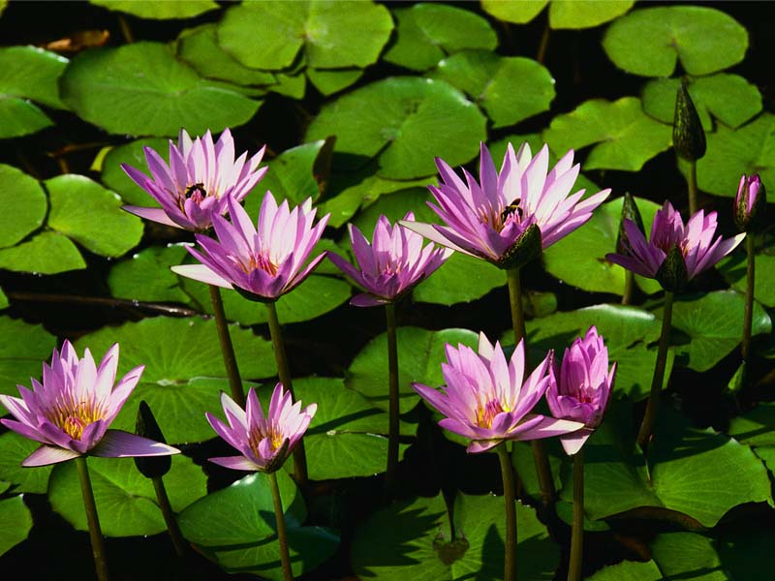
WELCOME

Slide 2
Rowshonara Begum
Assistant teachers, (ICT)
Sreepur Islamia Fazil Madrashah.
Bijoynagor,Brahmanbaria.
rowshonara1980@gmail. com

Slide 3
Class:six
English 2nd Paper
Topic: Grammar
Date:18-03-2020

Slide 4
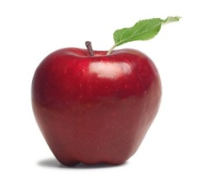
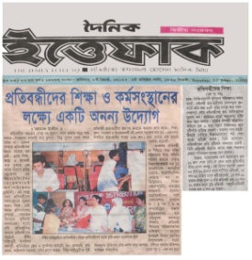
1.This is a book.
2.This is an apple.
3.I read the Daily Ittefaq .
a an the are called articles.

Slide 5
Our today`s lesson is on
The uses of articles:
Indefinite Articles

Slide 6
articles
Indefinite: a,an
Definite: the

Slide 7
Examples:
a pen an egg
a river an ice-cream
a cat an orange
a horse an umbrella
a boy an ant

Slide 8
Purpose:
The form a is used before a word beginning with a consonant sound…………
The form an is used before words beginning with a vowel(a,e,I,o,u)…………..

Slide 9
Special use:
a one-taka note
an honest man
an M.P.
a European

Slide 10
So ,the form a is used before a word beginning with a consonant, or a vowel with a consonant sound.
The form an is used before words beginning with a vowel(a ,e, I, o, u) or words beginning with a mute h.

Slide 11
Fill up the gaps with appropriatearticles(a/an).
1.He eats…… mango.
2.The rose is …… flower.
3.I saw …… owl.
4.Sixty minutes make…….. Hour.
5.Mr. Hasan is …… M.A.
6.Mr. Karim is……. B.A.
7.I saw ….. One-eyed man.
8.I have ……. flower garden.
9.My father is…….. engineer.
10.This is……. unique oppurtunity

Slide 12
Fill up the gaps with appropriate articles(a/an).
1.He eats…… mango.
2.The rose is …… flower.
3.I saw …… owl.
4.Sixty minutes make…….. Hour.
5.Mr. Hasan is …… M.A.

Slide 13
6.Mr. Karim is……. B.A.
7.I saw ….. One-eyed man.
8.I have ……. flower garden.
9.My father is…….. engineer.
10.This is……. unique oppurtunity.

Slide 14
Fill up the gaps with appropriatearticles(a/an).
1.He eats.. … mango.
2.The rose is …a… flower.
3.I saw …an… owl.
4.Sixty minutes make…an… hour
5.Mr. Hasan is ……an… M.A.
6.Mr. Karim is…a… B.A.
7.I saw ….a… One-eyed man.
8.I have ……a.. flower garden.
9.My father is..an… engineer.
10.This is…a… unique oppurtunity
a
a
a
a
a
a
a,an

Slide 15
Home Work
Fill up the first 10 sentences of your exercise with appropriate articles.

Slide 16
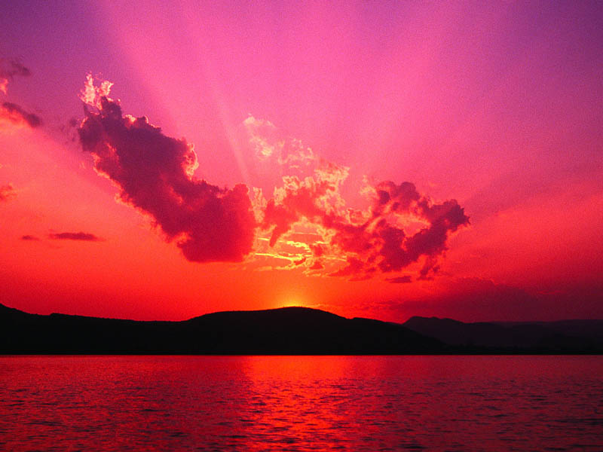
THANK YOU

