Slide 1
Welcome to the…
KKT Digital World,L.P High School,Chhatak,Sunamgonj

Slide 2
.Welcome to the KKT Digital world Presentation

Slide 3
Introduction
Komal Kanta Ray Talukder
Assistant Teacher
L.P High School
Chhatak,Sunamgonj.
Presentation-made by
Class:Nine/Ten
Subject:English 2nd Paper
Transformation of Sentences
Part-2

Slide 4
The sight looks so nice.
Doesn’t the sight look so nice?
It is a very beautiful sight.
Isn’t it a very beautiful sight?

Slide 5
Our today’s lesson is--
Transformation of sentence
Part-2 (Assertive to Interrogative)

Slide 6
Learning outcomes
After completing this lesson, we will be able to—
apply the use of be verb with negative.
apply the use of auxiliary verbs with negative.
apply question word (‘wh’ word) in interrogative.
change from assertive to interrogative.

Slide 7
Let us see a video about Transformation Sentence

Slide 8
Notice carefully
Computer is most essential for us. (Interrogative)
Isn’t computer most essential for us?
It plays a very important role in our life. (Interrogative)
Doesn’t it play a very important role in our life?
Everybody needs it. (Interrogative)
Who does not need it?

Slide 9
How to change Assertive(with be verb) to Interrogative
Human mind is very short.(Interrogative)
Isn’t human mind very short?
I am the best gift of Allah to my mother. (Interrogative)
Amn’t I the best gift of Allah to my mother?
Akbar was the greatest king of India. (Interrogative)
Wasn’t Akbar the greatest king of India?
If the assertive sentence is, subject + be ( am, is, are, was, were) + extension,
it will be--
Be(amn’t /isn’t/aren’t/wasn’t/weren’t +subject +extension +?

Slide 10
Activities
Change the sentences into Interrogative
1. I am an ardent follower of Hazrat Muhammed (SM).
2. He is the guide of the human being.
3. We are obedient to him.
4. Hazrat Abu Bakar (R) was the first man to receive his invitation.
5. Hazrat Omar & Ali (R) were the next caliphs of Hazrat Abu Bakar.

Slide 11
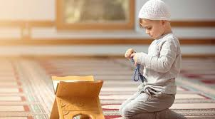
How to change Assertive (with action verb) to Interrogative
I say my prayer five times regularly. (Interrogative)
Don’t I say my prayer five times regularly?
My mother wants me to be a model of truth. (Inter)
Doesn’t my mother want me to be a model of truth?
Our prophet ordered us to follow him (Interrogative)
Didn’t our prophet order us to follow him?
If there is action verb in the sentence, Interrogative will be started with Don’t/Doesn’t/Didn’t according to tense, subject & number.

Slide 12
Activities
Change the sentences into Interrogative
1. Religion plays an important role in human life.
2. Noble people follow their religions properly.
3. All the prophets sacrificed their lives for the sake of religion.
4. Religions teach us morality.
5. It shows the way of truth.

Slide 13
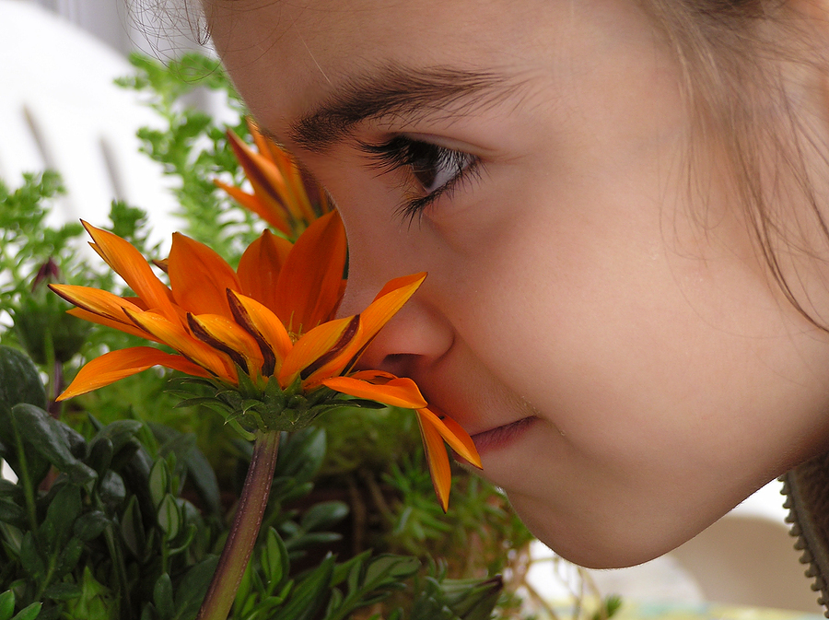
Assertive (with Every) to Interrogative
Everybody wishes to be happy.(Interrogative)
Who does not wish to be happy?
Change the sentences into negative
1. Everybody loves flowers.
2. Nobody hates it.
3. Everyone smells flowers.
4. Everybody enjoys it.
5. All desire its beauty.

Slide 14
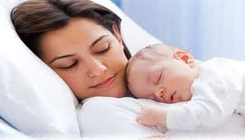
Assertive (with Every+ noun) to Interrogative
Every mother loves her child.(Interrogative)
Is there any mother who does not love her child?
Change the sentences into negative
1. Every man loves flowers.
2. Every person hates a liar.
3. Every woman likes ornament.
4. Every baby wants toys.
5. Every man desires more and more.

Slide 15
Assertive (with never/nothing) to Interrogative
I never drink tea.
Do I ever drink tea?
I had nothing to say.
Had I anything to say?

Slide 16
Activities at home
Change the sentences into Interrogative.
1. He is a noble man.
2. Everybody likes him.
3. He was a bright student.
4. He studied regularly in his student life.
5. He did not do any work subversive to state and society.
6. He is now a model of the society.
7. We are proud of him.
8. We pray for him to be a famous person.

Slide 17
Inviting you to enjoy part-3
Thank you all

