Slide 1
INTRODUCTION
Anwar Hossain
Assistant Teacher (English)
Alhaj Abdul Gofur Madrasah
Muksudpur, Gopalgonj.

Slide 2
Class: Nine
Subject :English 1st Paper.

Slide 3
Learning outcome
By the end of the lesson Students will be able to.
Read a newspaper report about Pahela Baishakh
Described pictures of the preparation for a mela
Planned how to organise abaishakhi mela at your school .

Slide 4
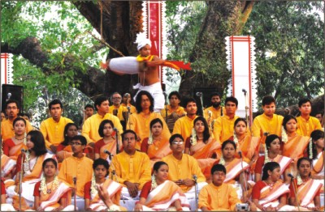
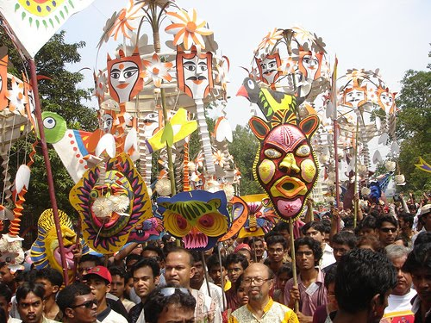
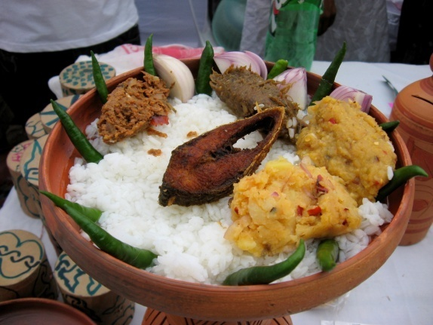
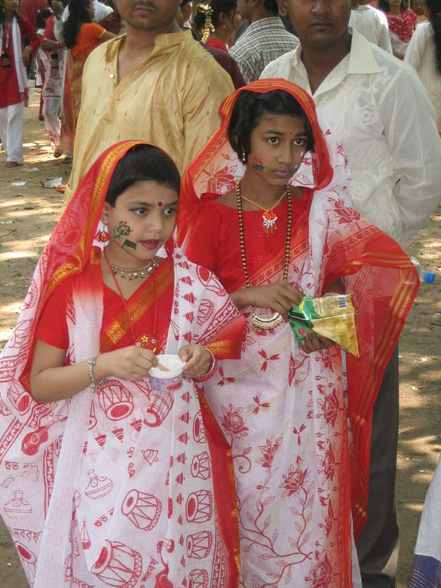
What do you see in the picture?
Romna Batmool
Rally
Traditional dress
Panta Ilish
Today we will learn about Pohela Baishakh.

Slide 5
Guess and answer the following questions-
Which New Year is Masum talking about?
Which Bangla year is this?
When are you going to celebrate pahela baishakh this year?
Show the video clips:

Slide 6
Meaning of the following words:
Celebrate, Procession, Premise , Traditional.

Slide 7
Ask Ss to read the article of the book about pahela boishakh.

Slide 8
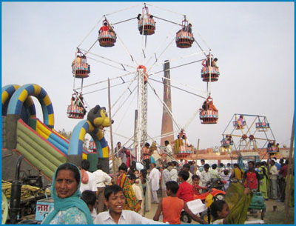
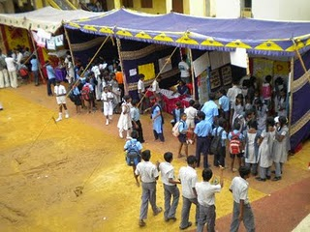
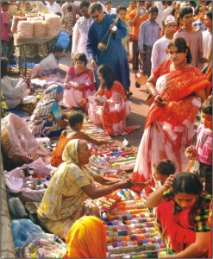
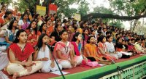
The pictures bellow are taken from different venues where the baishakhi mela will be held.
Bangla Academy
School Premise
Doel Chotter
Romna Battmool

Slide 9
Group Work
Discuss in groups What preparations you would need to hold a Baishakhi mela at your school and make a list of the activities you want to have during the mela.

Slide 10
Evaluation
By asking questions:
Where the first program of Pahela Baishakh begin?
How do you organise a Baishakhi mela in your school?
What things do you have to need to arrange a baishskhi mela in your school?

Slide 11
Home Work
Write a paragraph about Pahela Baishakh

Slide 12
THANKS TO ALL.

