Slide 1
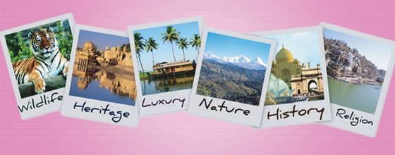
WELCOME

Slide 2
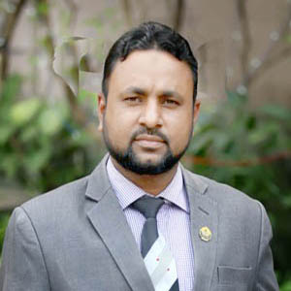
Teacher’s identity
Shahidul Islam
Assistant Professor (English)
Dhakadakshin ML H/S & College, Sylhet.
O1715600555
jusnasiam@gmail.com

Slide 3
English For Today
Class: XI
Unit : 15 Lesson: 01
First Period
50 minutes

Slide 4
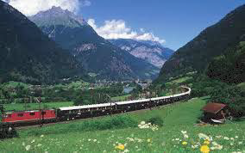
Look at the pictures and try to guess today's topic about. Note down the name in your exercise book.

Slide 5
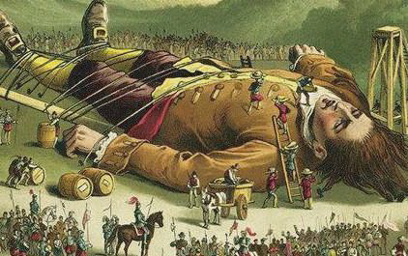
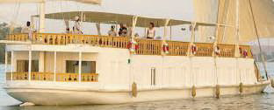

Slide 6
Today’s topic is …
Tours and Travels
Travelling to a Village in Bangladesh

Slide 7
Warm up activity:
How many villages are in Bangladesh now? Sixty four thousands or more?
Have the villages changed much over the years?

Slide 8
Learning outcomes
At the end of the lesson students will be able to …
Identify the natural beauties of Bangladesh.
Mark out the benefits of travelling in Bangladesh.

Slide 9
In the following extract, we will see a Bangladeshi village and the villagers

Slide 10
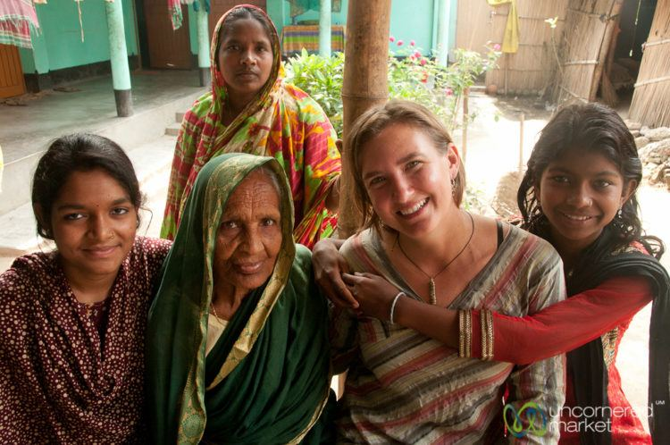
Through the eyes of an English professor from England who taught in Dhaka university 1947 -1951 and again in 1972.

Slide 11
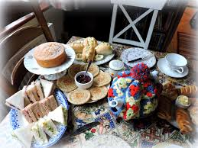
Let’s start our story
We set out on the evening of July 21st. Food was scarce in the village so Abdul packed a suitcase with two loaves and some tea and tins of milk, cheese and jam.

Slide 12
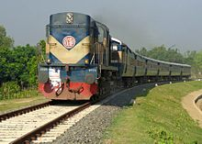
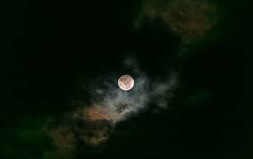
We travelled Intermediate class in a cross-country train
It was a moonlit night of broken soft clouds;

Slide 13
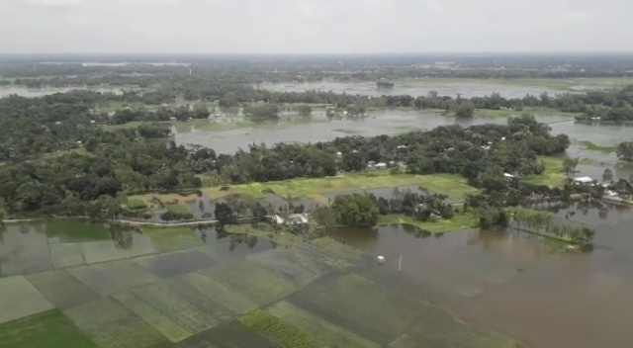
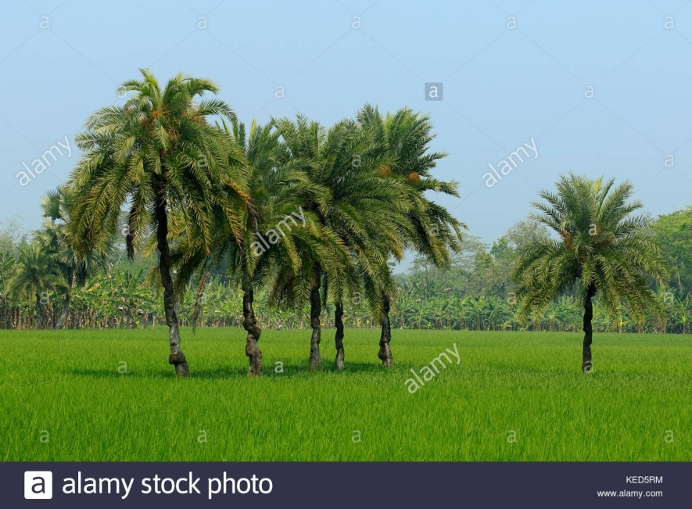
The land was mostly under water
with paddy and coco-palms growing from it

Slide 14
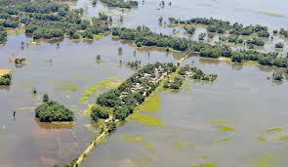
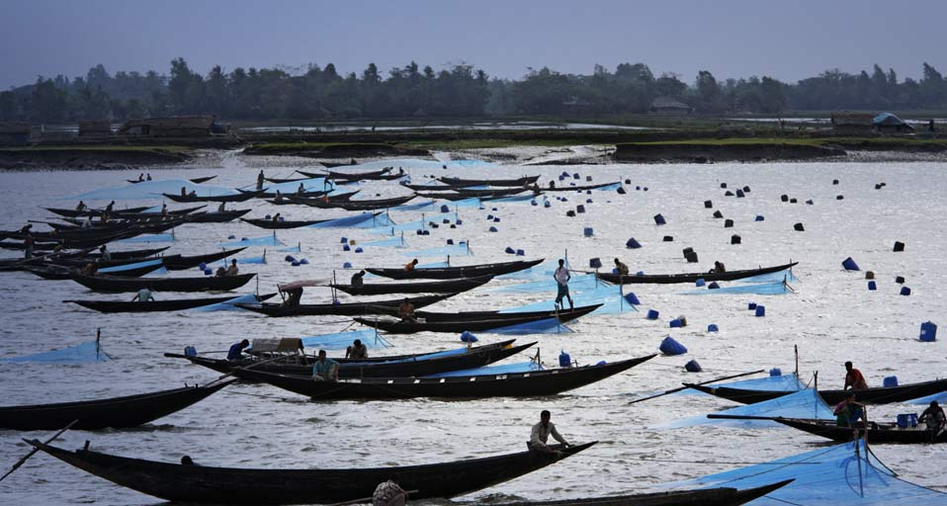
groups of cottages islanded among clumps of bushes,
fisherman's boat in open water.

Slide 15
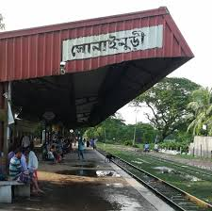
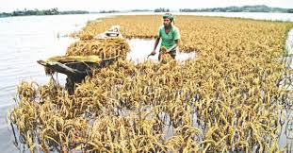
At dawn we reached Sonaimuri, a small canal-side station among wide fields, from there we had eight more miles by country boat, some of it along the canal, some of it across the flooded paddy fields.

Slide 16
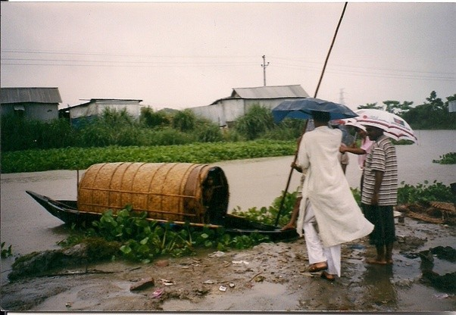
We reached the landing-ghat at Khorshed's house, in a blaze of sunlight.

Slide 17
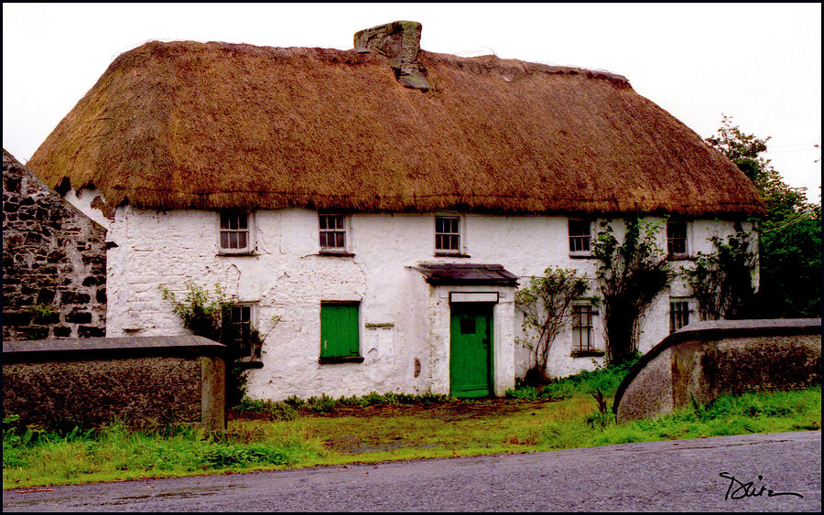
Khorshed set me up a camp, a wooden bed, chair and table in a thatched bamboo outhouse.

Slide 18
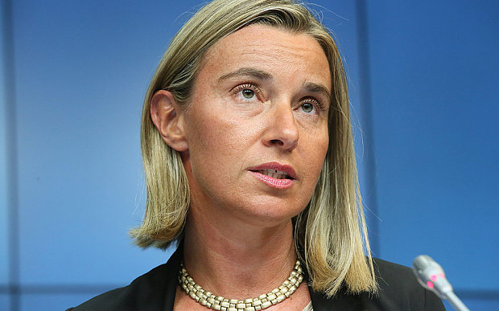
I was the first European to go there
People kept coming and coming:

Slide 19
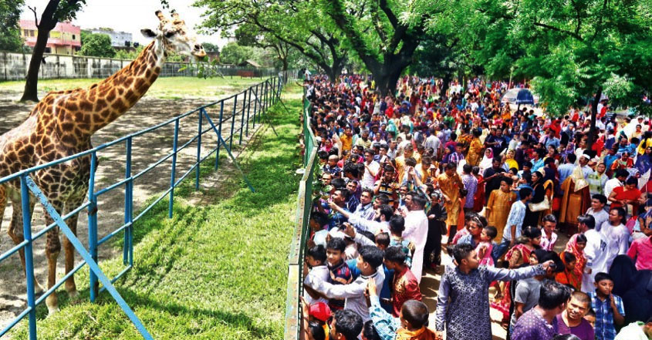
I was tired of being looked at, like a zoo animal into its sleeping hut. Even then the little hut would fill up with women and children.

Slide 20
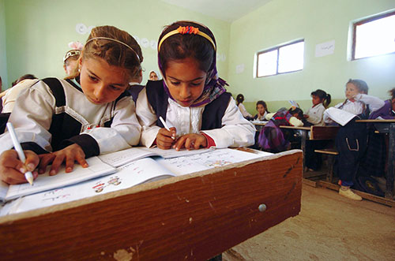
Group Work
Have you ever seen any European in your village? If yes, write down your experience talking with your friends.

Slide 21
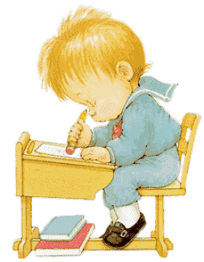
Home work
Write a short paragraph describing your first visit to place away from home.

Slide 22
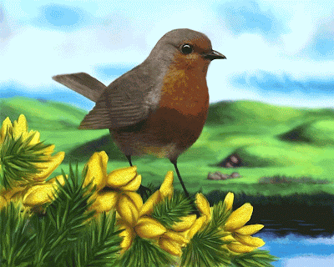
Good bye

