Slide 1
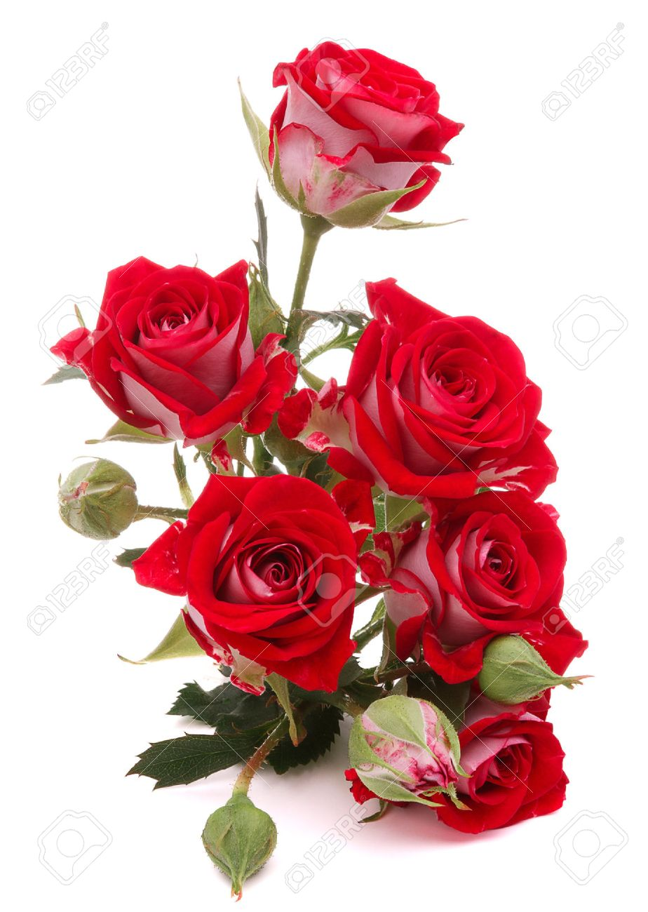
WELCOME

Slide 2
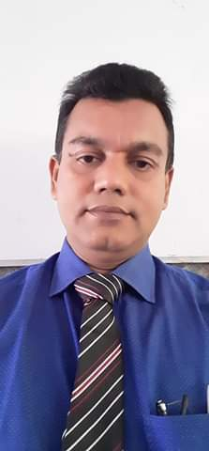
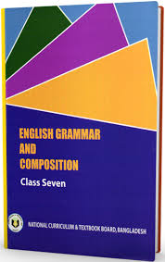
INTRODUCTION
Nurul Amin Azad ASSISTANT TEACHER ( ENGLISH)
Jahangirpur T. Amin Govt. Pilot sHigh School
Madan, Netrakona
Mobile no. 01718431636
E-mail: nuruasif@gmail.com
Lesson
ENGLISH GRAMMAR.
Class : Vii ,Unit:1 Lesson:2
Time: 50 minutes.
Date: 2/ 03/ 2020

Slide 3
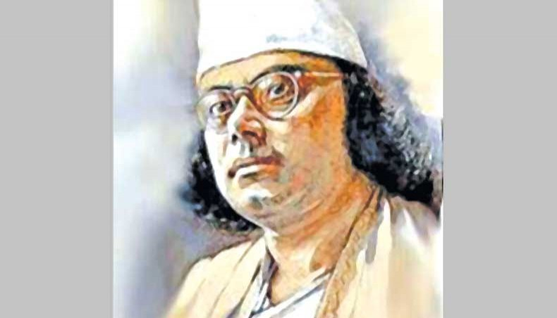
Kazi nazrul islam was born in 1899 at the village of chorolia in the district of bordoman. He was a poet playwright and actor. He is widely regarded as the national poet of Bangladesh. He enjoys enoromous popularity even in the modern age for poems and plays.

Slide 4
Guess what are these underlined words
These are nouns
So our topic is noun
Noun

Slide 5
Learning outcomes
After completing the lesson the students will be able to
Define noun
Classify noun
identify of noun in a pronoun

Slide 6
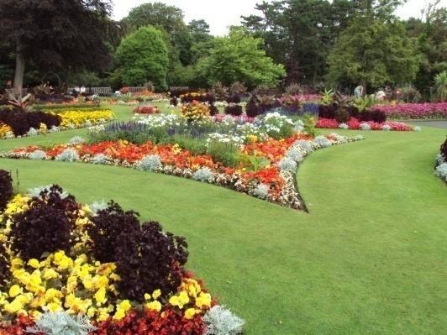
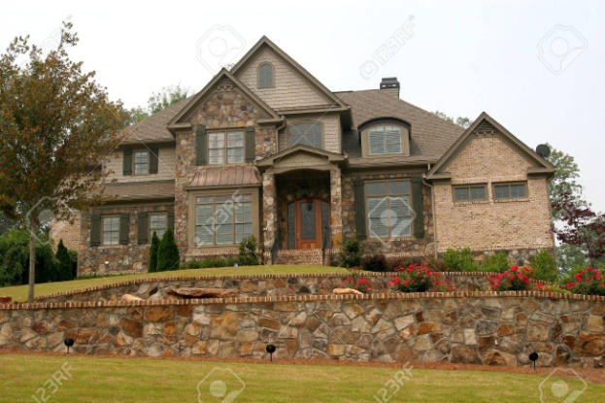
Definition
Noun: noun is a naming word . It may name a person, place, thing or quality.
I have a flower garden.
It is a nice house.

Slide 7
So firstly there are two kinds of noun
Noun
Abstract
Concrete

Slide 8
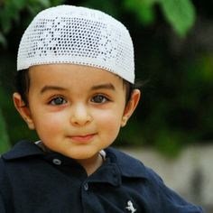
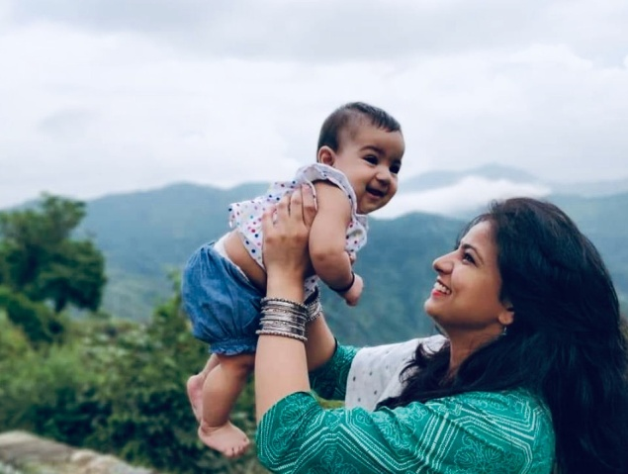
Honesty is the best policy.
Love is devine

Slide 9
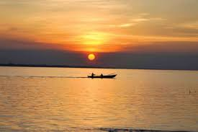
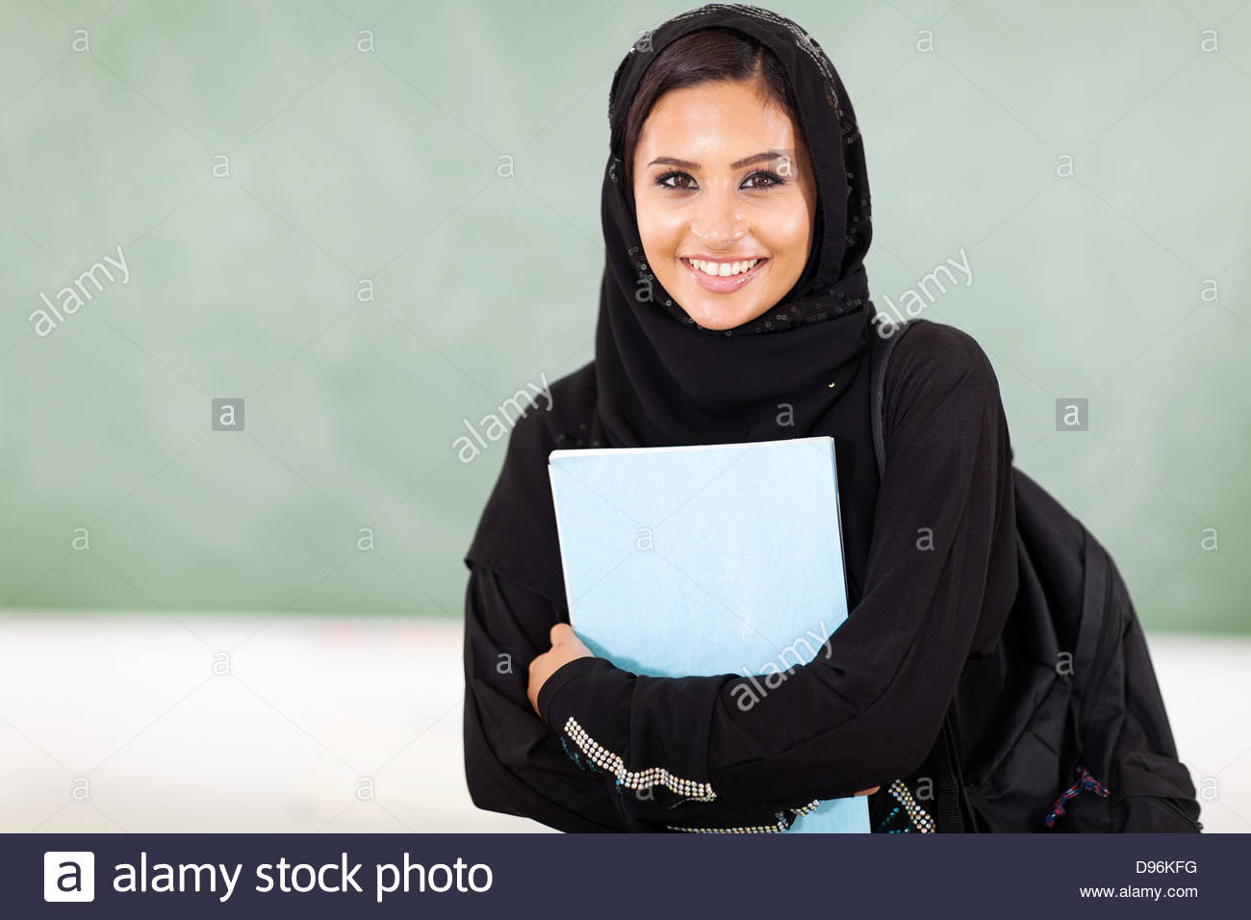
Proper noun
A proper noun is the name of some particular person or thing only
The Padma is a big river
Neela is a college girl

Slide 10
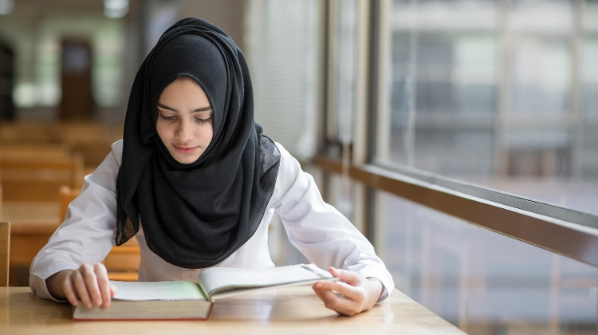
Common noun
Ahona is a beautiful girl.
She is bright student too.
She reads in a local college.
She has many friends.
Every teacher is fond of her.
So, girl, student, college, friend, teacher are example of common noun.
These are common nouns. A common refers to every person, place or thing of the same class or kind.

Slide 11
Collective noun
Salam comes of a big family. His elder brother has recently joined the army. His younger brother is a cricketer who plays for the national team. Salam himself is a member of a national cricket committee.
These underline words are collective noun.
So a collective noun is the name of a collection or group of people or things taken together.
For example : an army is a group of soldiers and team is group of player.

Slide 12
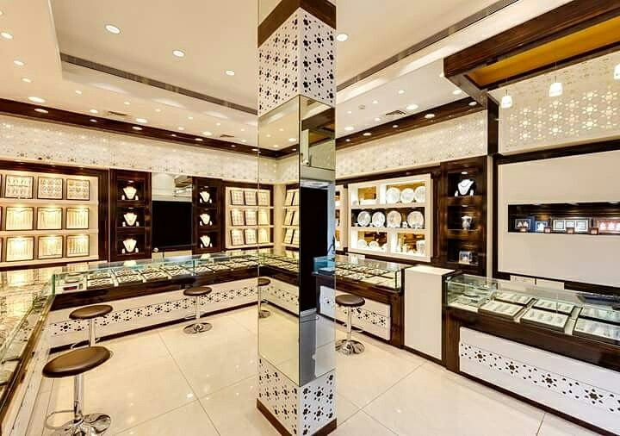
Material noun
Mrs Mohona is now visiting a jeweler. She will buy some gold and silver to make some jewellery. Next she also go to a grocery shop. She needs to buy some sugar, tea, milk, salt and oil.
Yes dear students gold, silver, sugar, tea, milk, oil all are material noun that has weight but cannot be counted

Slide 13
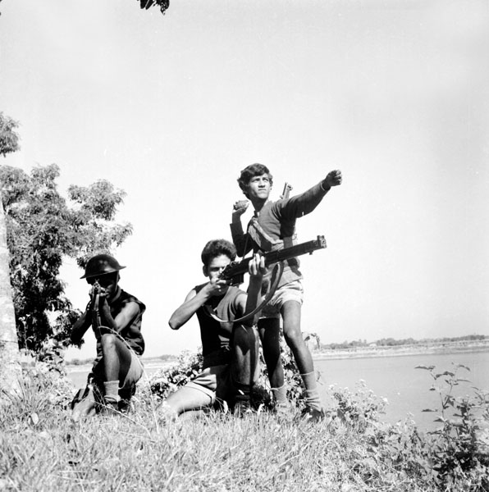
Abstract noun
Mr. Motiur Rahman is a freedom fighter. He is known for his bravery. Every body loves him for his honesty. And sincerity . He is an admirer of freedom and justice
These are abstract noun. An abstract noun is the name of a quality, state or concept. It has no material form, shape or size.

Slide 14
Besides this by the side of counting, noun are two kinds such as –
Countable:
Proper- Dhaka, Rahim, Padma.
Common- Man, girl, teacher.
Collective-cattle, army, team.
Material-gold, salt, sugar etc.
Abstract- honesty, beauty, boyhood etc.
Uncountable:

Slide 15
GROUP WORK
Group:1– Identify some countable and uncountable noun and make a few sentences.
Group :2- Think of some other abstract nouns and make sentences with each of them.

Slide 16
HOME TASK
Identify the nouns in the following passage and write whether they are proper, common, collective, material, or abstract.
Nouns– Salam is a rich farmer who lives in a village in the district of Netrakona. He has a lot of cultivable land. He grows rice, wheat and other crops. He has a herd of cattle and other domestric animals. They provide them with milk and meat. Salam is a kind man. He has love and sympathy for poor class of people.

Slide 17
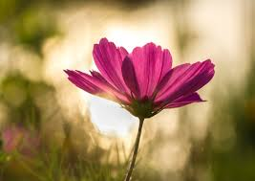
Thanks to all

