Slide 1
Good Morning

Slide 2
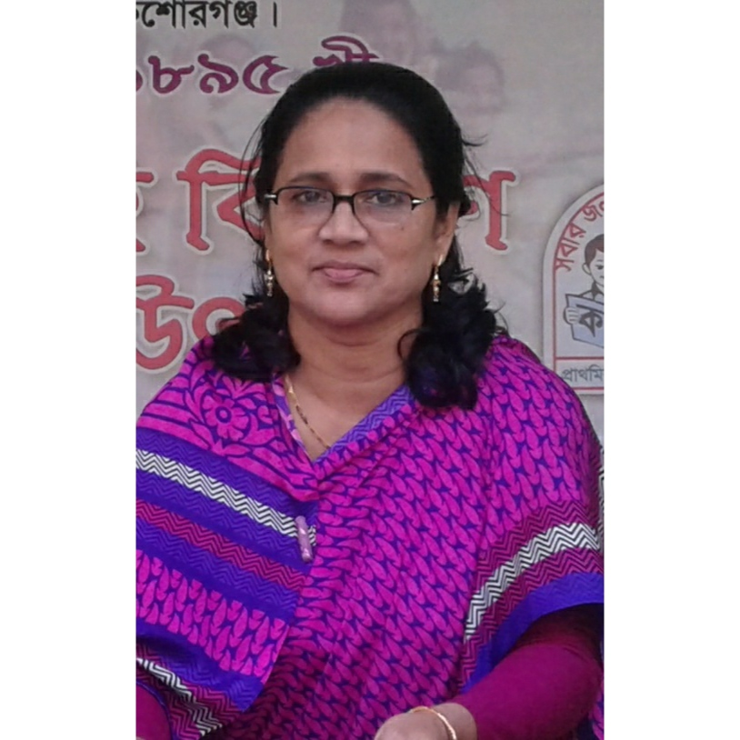
Teacher’s Introduce
Ferdousi Begum
Head Teacher
Jagannathpur Puraton GPS
Bhairab, Kishoregonj.
Class Two
Sub- English
Date- 2/3/2020
Time- 40 minutes

Slide 3
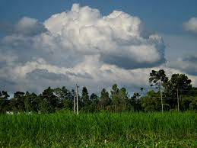
Look at the picture
Clouds
How many clouds are there?
Five (5)

Slide 4
How many umbrellas are there?
Six (6)

Slide 5
How many men are there?
Seven (7)

Slide 6
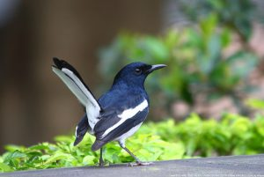
How many birds are there?
Eight (8)

Slide 7
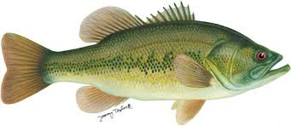
How many fishes are there?
Nine (9)

Slide 8
Nine fishes and one fish
Ten (10)

Slide 9
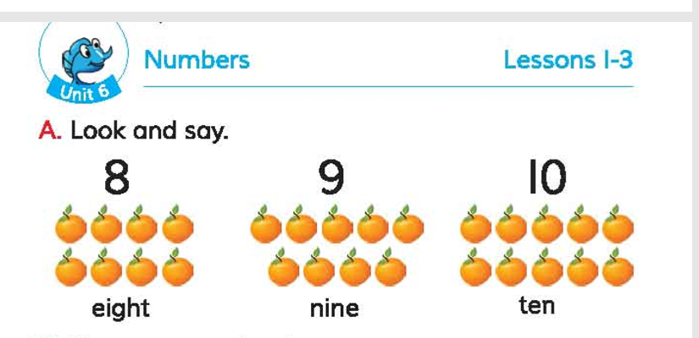
Now open your book at page 12

Slide 10
Learning outcomes: Students will be able to
Listening:
1.1.1 become familiar with English sounds
by listening to common English words.
Speaking:
1.1.1 repeat after the teacher simple words
and phrases with proper sounds and stress.
1.1.2 say simple words and phrases
with proper sounds and stress.
Reading:
2.1.1 recognize and read cardinal
numbers up to 30.

Slide 11
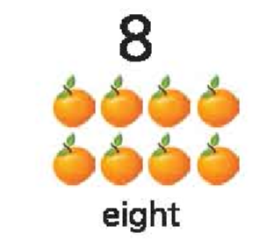

Slide 12
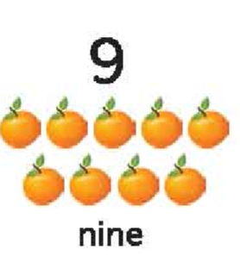

Slide 13
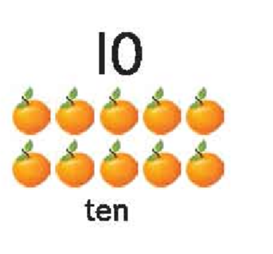

Slide 14
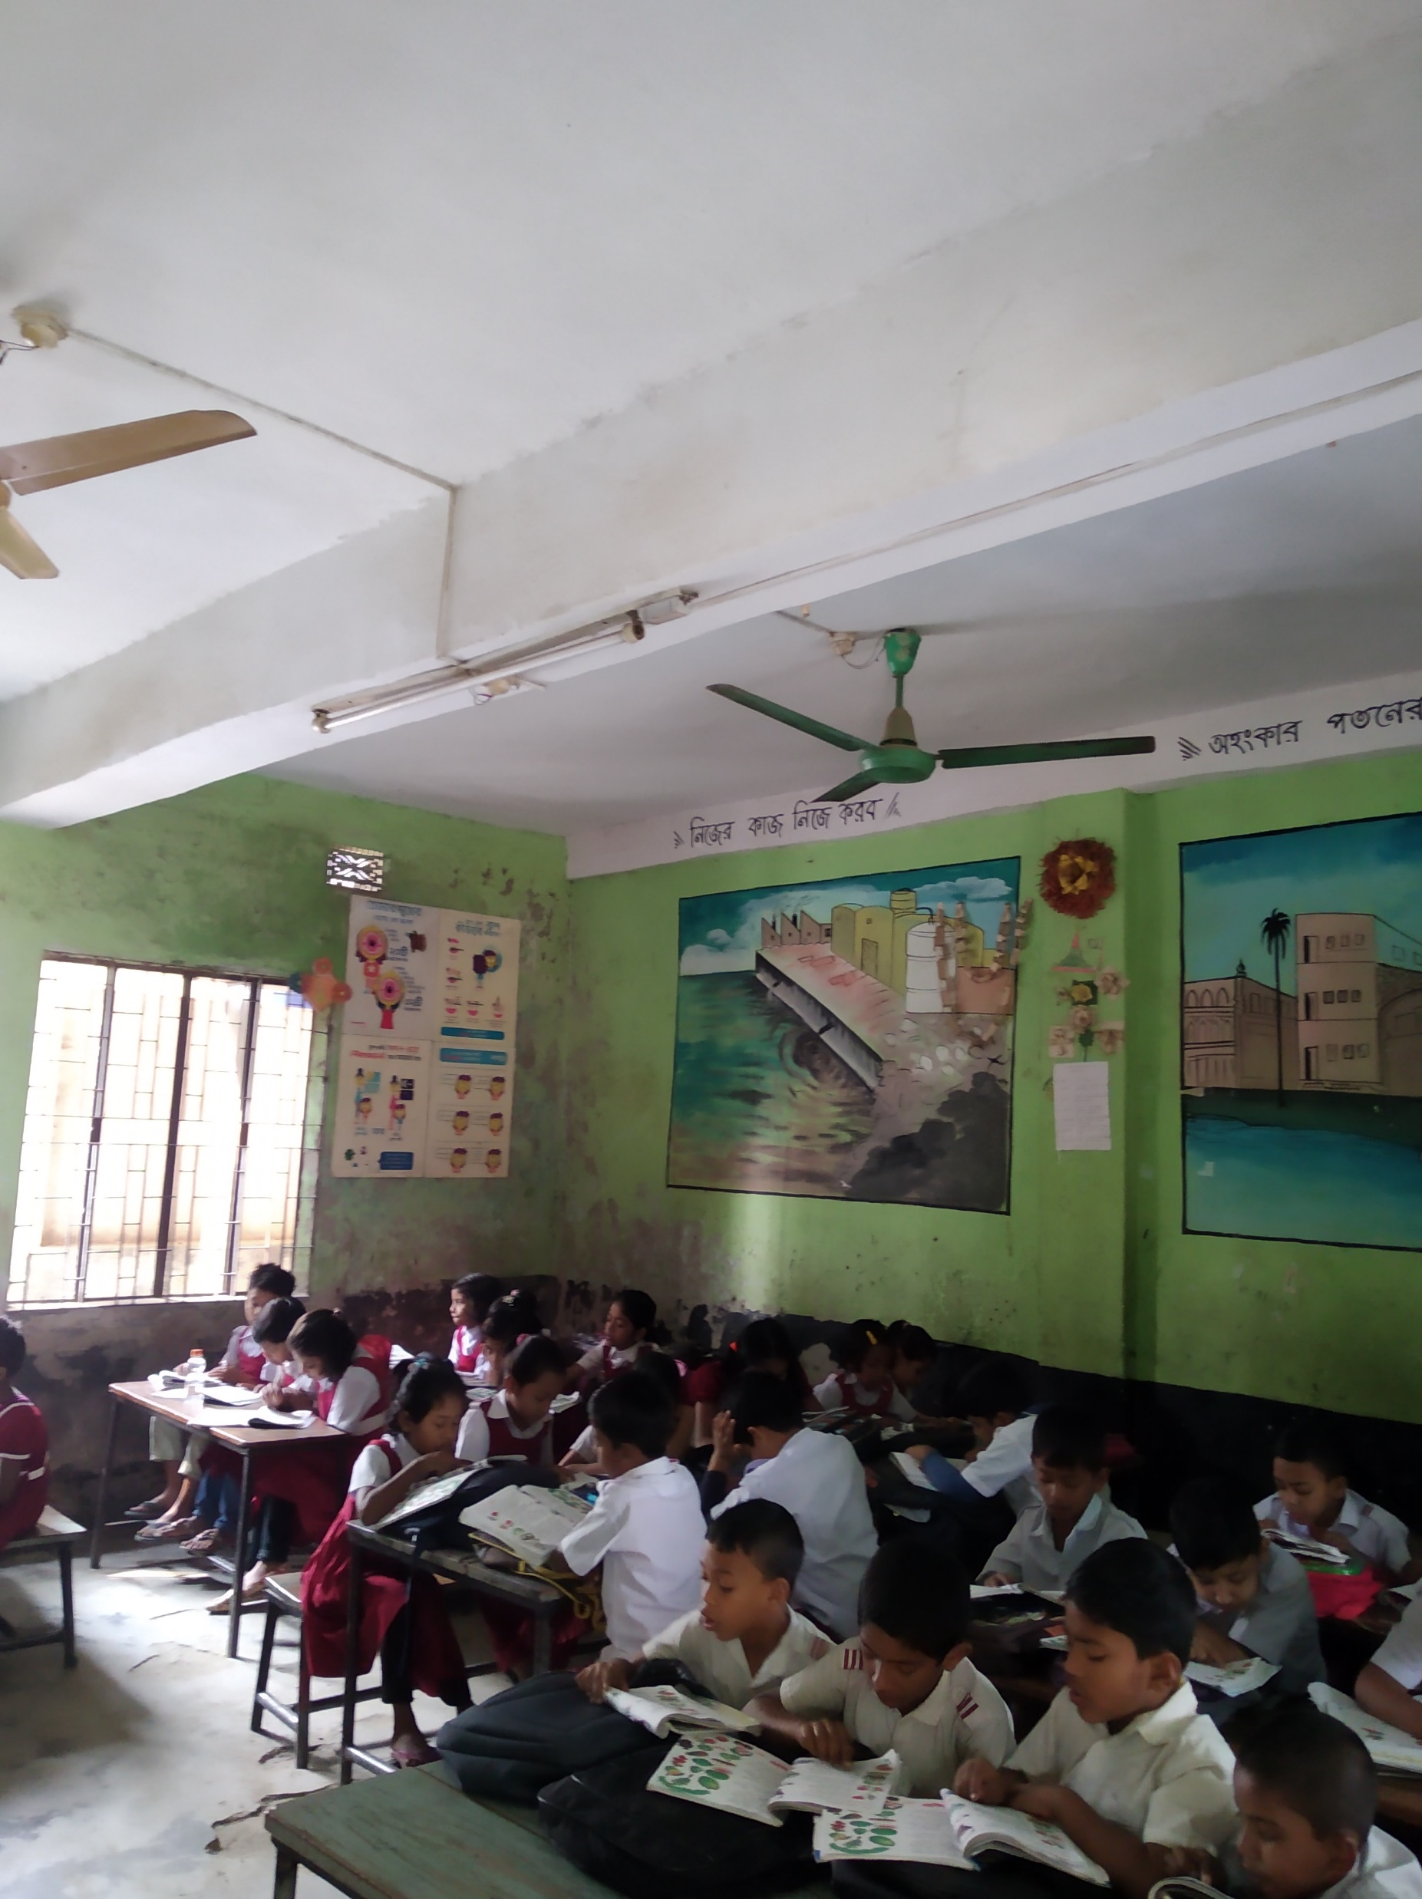
WCW
Students will say eight, nine and ten
two or three times.

Slide 15
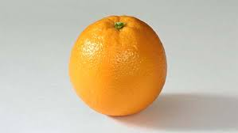
Pair Work
How many oranges are there?
Eight

Slide 16
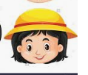
How many oranges are there?
Nine

Slide 17
How many oranges are there?
Ten

Slide 18
Good Bye

