Slide 1
WELCOME

Slide 2
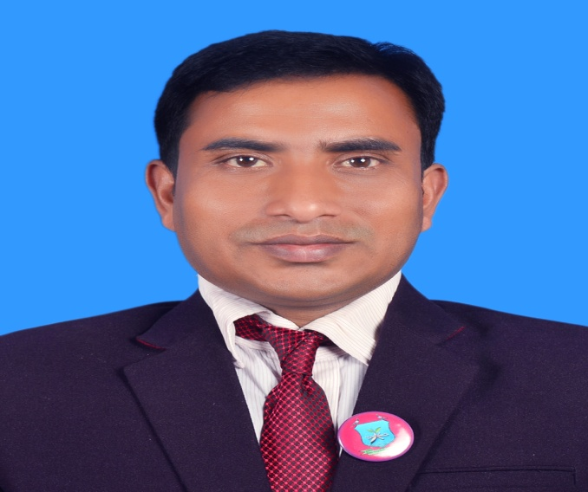
INTRODUCTION
Suranjit Talukder
( BA, B-Ed; MSS, M-Ed; C-in-Ed )
Assistant teacher
Voishber Govt. Primary School.
Sunamgonj Sadar , Sunamgonj.
Class: Five
Subject: English
Unit:8,Lesson: 1-2.
Date:
Time:40 Minutes

Slide 3
CREATING EMOTION
Good morning , students.
Good morning , teacher.
How are you?
Fine . And you?
I’m also fine. But you are looking pale .(By showing a student)
Have you any problem?
No/Yes , Sir.
Let’s sing a song …”

Slide 4
Only a few years ago, men communicated with one another by letters.
How many parts of a letter?
There are six parts of a letter.
Suppose you have written a letter to your intimate friend and you want to know about him on his return letter. To write about himself soon what will you write to him?
You are requested to write me soon.
Today’s topic is “ Write to me soon!”

Slide 5
LEARNING OUTCOMES
Students will be able to………
3.4.1: Understand statements made by the teacher and students.
1.1.1: Say words, phrases and sentences with proper sound stress and intonation .
5.1 .To read silently with understanding paragraph, stories,
Dialogues, personal letters and others texts materials.
11.1. simple letters to friends and relatives.

Slide 6
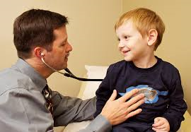
Please think about the pictures and discuss in pairs.
What do you see in these pictures?
Thank you.
These are the common picture of a doctor and a patient

Slide 7
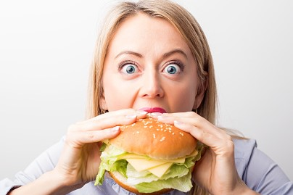
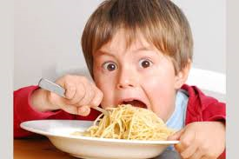
Please think about the pictures and discuss in pairs.
What does the picture mean?
They are so hungry.

Slide 8
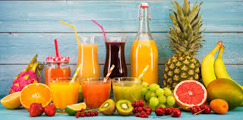
Please think about the pictures and discuss in pairs.
What does the picture mean?
It’s the picture of different kinds of fruits juice.

Slide 9
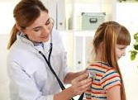
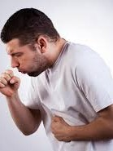
NEW WORDS MEANINGS
Doctor: A person who treats a patient.
Cough : expel air from the lungs with a sudden sharp sound.

Slide 10
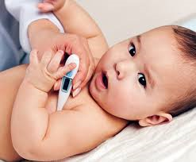
NEW WORDS MEANINGS
Fever : High temperature, Heat.
Medicine : Drug.

Slide 11
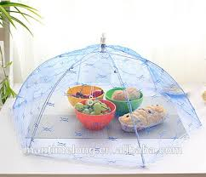
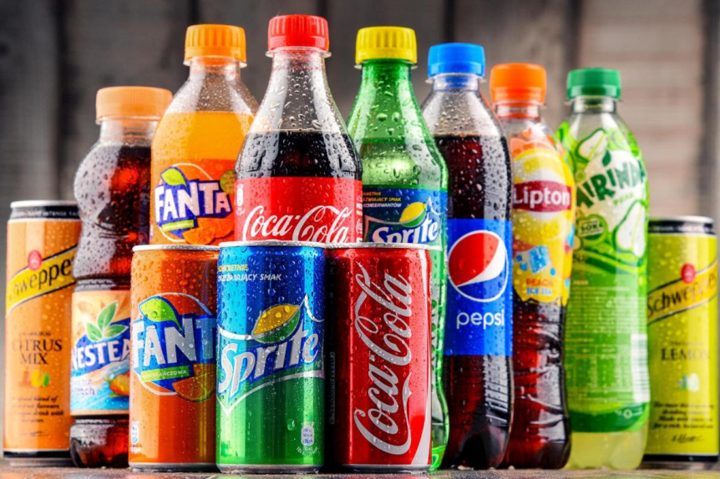
NEW WORDS MEANINGS
Covered : Encircled, Overcast.
Soft drinks : A nonalcoholic drink, specially one that is carbonated.

Slide 12
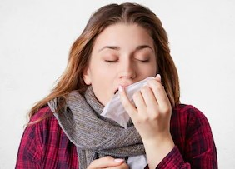
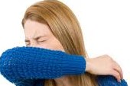
NEW WORDS MEANINGS
Flue: Flu (one kind of infectious disease).
Sneezing: Make a sudden involuntary expulsion of air from the nose and mouth.

Slide 13
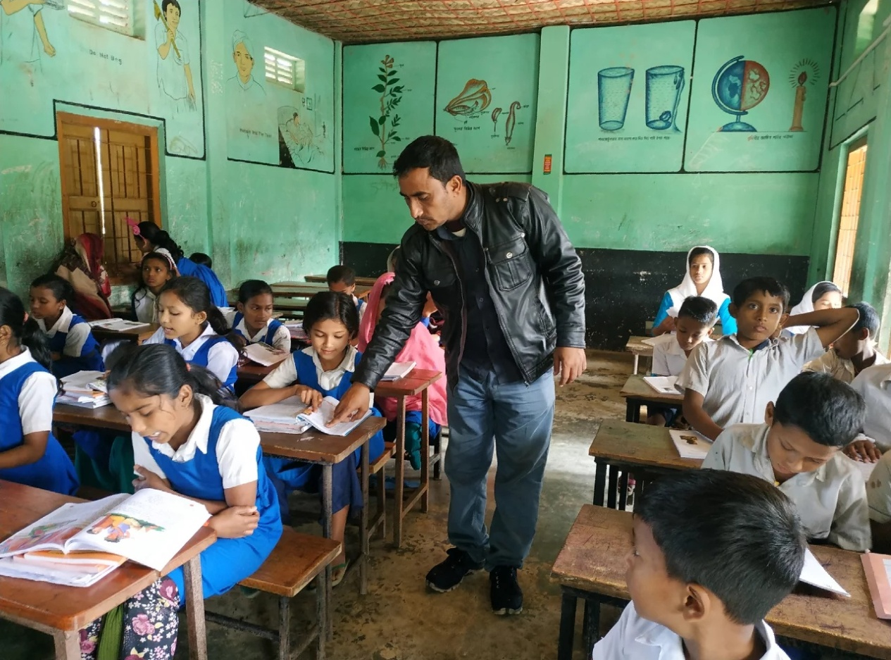
Listen to the text with me and put your finger under the line.
Now read loudly after me.

Slide 14
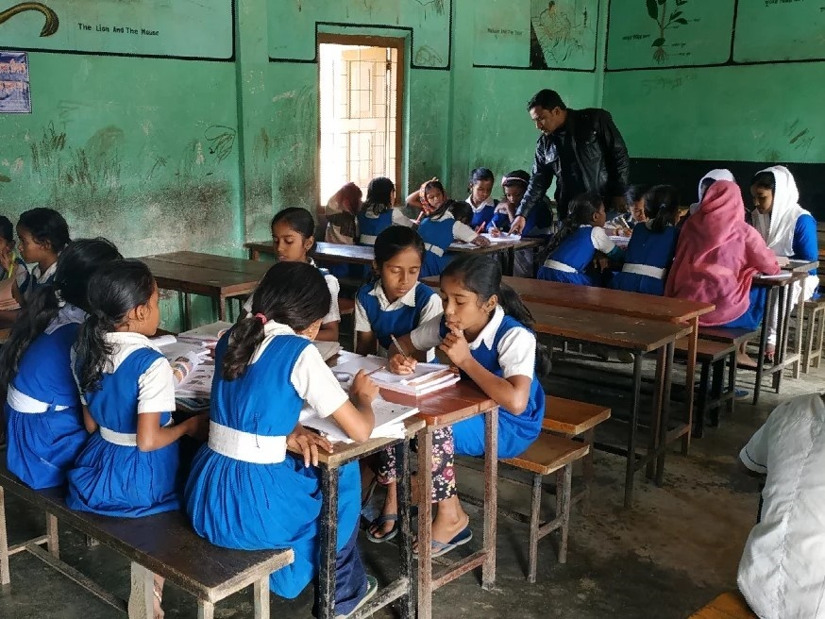
Now read the text in groups.

Slide 15
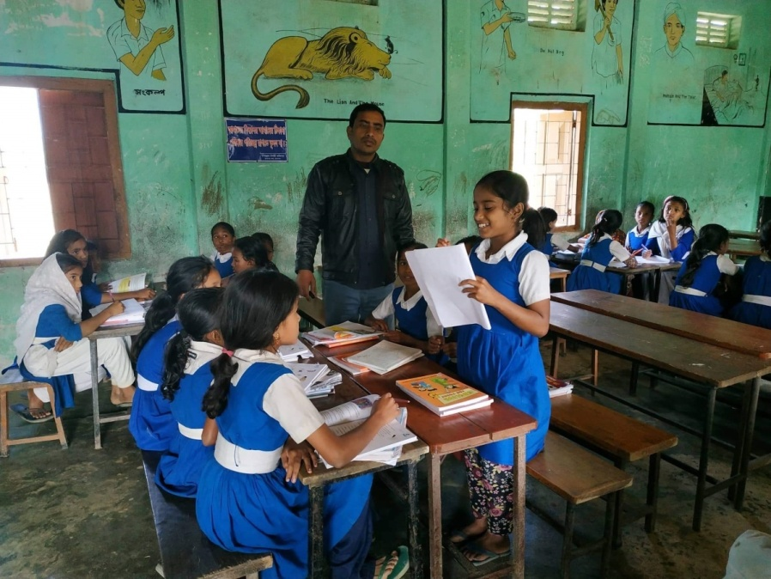
A student will be selected from every group to present their group work.

Slide 16
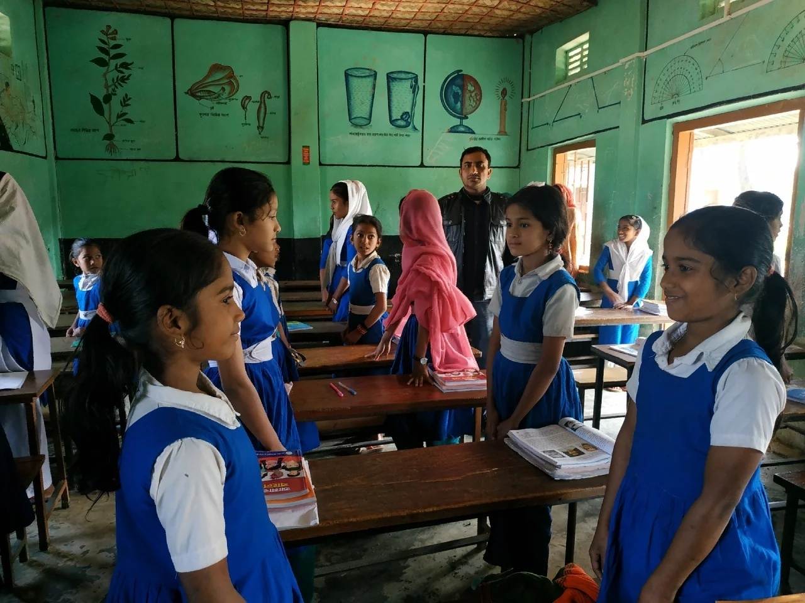
Ask and answer in pairs.

Slide 17
Ask and answer in pair
Answer the questions:
1.Who has written the letter?
2.Who is the receiver of the letter?
3.How many parts of a letter?
4.Why didn’t Raka go to school?
5.Why should Raka stay at home?

Slide 18
INDIVISUAL WORK
(Write the answer )
1. Why does Raka need some medicine?
2. Why should Raka use her own plate , glass and cup?
3. Which are better than soft drinks?
4. Why should Raka try to eat even if she isn’t hungry ?
5. Who visited Raka last night?

Slide 19
Homework
Write a letter to your friend about your illness at least six sentences.

Slide 20
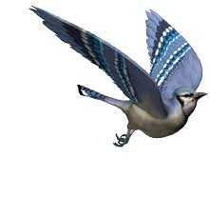
GOODBYE

