Slide 2
INTRODUCTION OF THE LESSON
Mafuza Akter
Lecturer of English
Kushtia City College,Kushtia
LOVE AND FRIENDSHIP
Unit-7, Lesson 2
English First Paper
Class (XI-XII)

Slide 3
Now Let us Watch a video

Slide 4
At the end of the lesson Ss ,will be able to -
Read the lyrics and answer the questions.
Can explain the personification of the poem.
Make summery of the song .

Slide 5
Our Today’s Lesson
Love and Friendship
Unit-7,Lesson-2

Slide 6
Love and friendship are the two important demands of human life. Human life becomes unlivable in their absence. Though human beings need them badly, true love and friendship are difficult to find. The short song from William Shakespeares(1564 - 1616) play “As You Like It” laments the absence of true love and friendship in human life

Slide 7
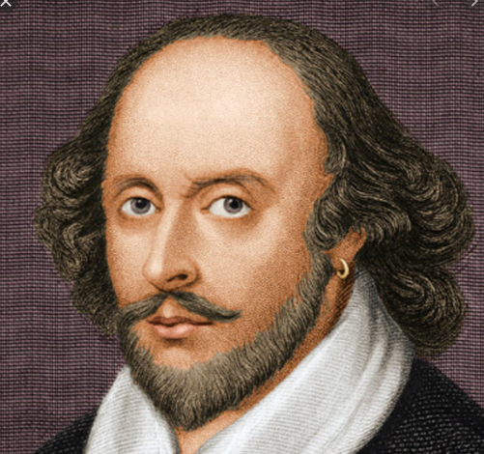
William Shakespeare was an actor, playwright, poet, and theatre entrepreneur in London during the late Elizabethan and early Jacobean eras. He was baptised on 26 April 1564 in Stratford-upon-Avon in Warwickshire, England, in the Holy Trinity Church. He died in his home town of Stratford on 23 April 1616, aged 52.
William Shakespeare

Slide 8
Blow, Blow Thou Winter Wind by William Shakespeare Blow, blow, thou winter wind Thou art not so unkind As man’s ingratitude; Thy tooth is not so keen, Because thou art not seen, Although thy breath be rude. Heigh-ho! sing, heigh-ho! unto the green holly: Most friendship if feigning, most loving mere folly: Then heigh-ho, the holly! This life is most jolly. Freeze, freeze thou bitter sky, That does not bite so nigh As benefits forgot: Though thou the waters warp,
Thy sting is not so sharp As a friend remembered not. Heigh-ho! sing, heigh-ho! unto the green holly: Most friendship is feigning, most loving mere folly: Then heigh-ho, the holly! This life is most jolly.

Slide 9
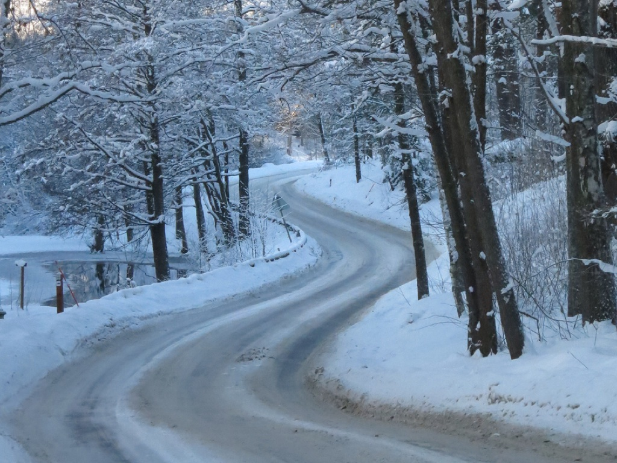
The poem "Blow, Blow, Thou Winter Wind" is from Shakespeare's play As You Like It. It exemplifies personification in giving human characteristics to a nonhuman subject. It is also an example of apostrophe, in which a speaker addresses a person or thing that can't respond.
Shakespeare employs apostrophe in this poem. Apostrophe is when the speaker addresses someone or something that cannot respond. In this case, the speaker directly addresses the winter wind in the first few lines, creating apostrophe.

Slide 10
Wind does not actually possess a "tooth" or "breath," but this personification draws attention to how much the wind's figurative bite can sting our skin and wound us. Comparing the wind's blowing to breath and calling it "rude" also draws our attention to its harshness and the negative impact it can have on us. In personifying the wind, the speaker makes its features seem much more personal; however, even still, a false friend is much worse.
The speaker employs apostrophe again when he or she directly addresses the "bitter sky" in the second stanza. He also says that the "bite" of the frozen sky isn't as painful as the "sting" of not being remembered as a friend. He compares a physical pain to an emotional one via a simile: "Thy sting is not so sharp / As friend remembered not." A simile is a comparison of two unalike things using like or as.

Slide 11
1.Why does the poet call the winter wind unkind?
2.Why does the poet imagine that the wind has tooth?
3.What has got sharper tooth than the winter wind?
4. Can 4the wind breathe?
5.Why does the poet say that the winds breath is rude?
6.What is the poets observation about friendship and love?
7.Why does the poet find the sky bitter?
8.What kind of people forget received benefits?
9.What makes the sting of the sky sharp

Slide 12
Pair work
When writers give human characteristics and attributes to objects, it is called personification. Find out instances of personification in the poem. What ideas does the poet convey by using the device?

Slide 13
Noun | Adjectives
a.Wind: The southern wind is blowing gently. | Winter : It is a winter morning .
Sky: The sky is blue. | Keen: I have keen interest in physics.
Man: I see a man standing here. | Ingratitude: It is an ingratitude that we often do not say , “ Thank you” for one’ favour to us.
Tooth: The little girl has broken her tooth. | Rude: He is a rude and arrogant boy.
Breath: I use mouthwash for fresh brearth. | Sharp: A knife has a sharp edge.
Evaluation
Find 5 noun words and 5 adjectival words from the poem and make sentences with them.

Slide 14
HOMe Work
Make a summery of the song.

