Slide 1
WELCOME

Slide 2
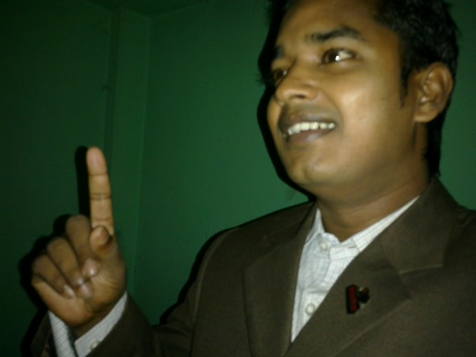
Teacher’s Identity:
Md. Robel Haque
Assistant Teacher
Nirmoil Darazia Dakhil Madrasha
Shampur,Patnitala,Naogaon.
Mob: 01774795179
Subject: English For Today
Class: IX

Slide 3
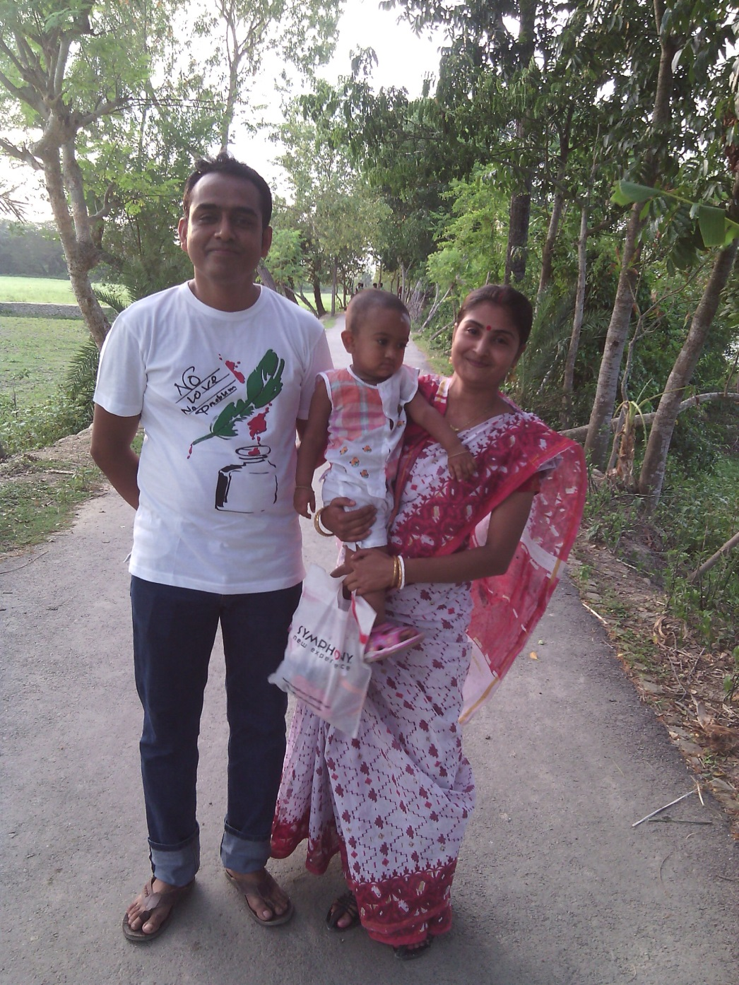
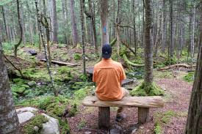
Living alone
Living with family
Notes:
Difference between living together and living alone.

Slide 4
Which one do you
unlike between the two?

Slide 5
Today’s Topic
Living Alone

Slide 6
Learning outcomes
After we have studied this lesson, we will be able to-
ask and answer questions
read and understand the text through silent reading
write incidents
participate in discussions
Notes:
All the four skills will be focused in this lesson.

Slide 7
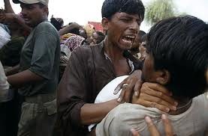
Let us know some key/new words to understand the topic clearly.
Ill-feelings
Bad mentality/
bad thinking/
misconduct
Ill feelings should not be the quality of human beings.
Notes:
The text words are triggered. If you click on the word, you will find the meaning of the word. If you click blank or on the picture, you will find the sentence made with the word. Now you can do any one you like to conduct this option.

Slide 8
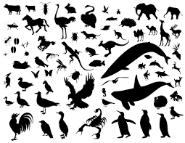
Creatures
Living beings,
Creation of life
Man, animals,
birds and insects
All creatures are essential for environment.
Notes:
The text words are triggered. If you click on the word, you will find the meaning of the word. If you click blank or on the picture, you will find the sentence made with the word. Now you can do any one you like to conduct this option.

Slide 9
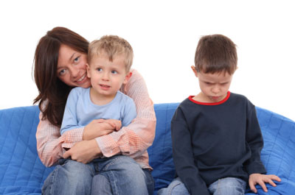
Jealousy
Protectiveness,
distrust
The boy feels jealousy to the other boy.
Notes:
The text words are triggered. If you click on the word, you will find the meaning of the word. If you click blank or on the picture, you will find the sentence made with the word. Now you can do any one you like to conduct this option.

Slide 10
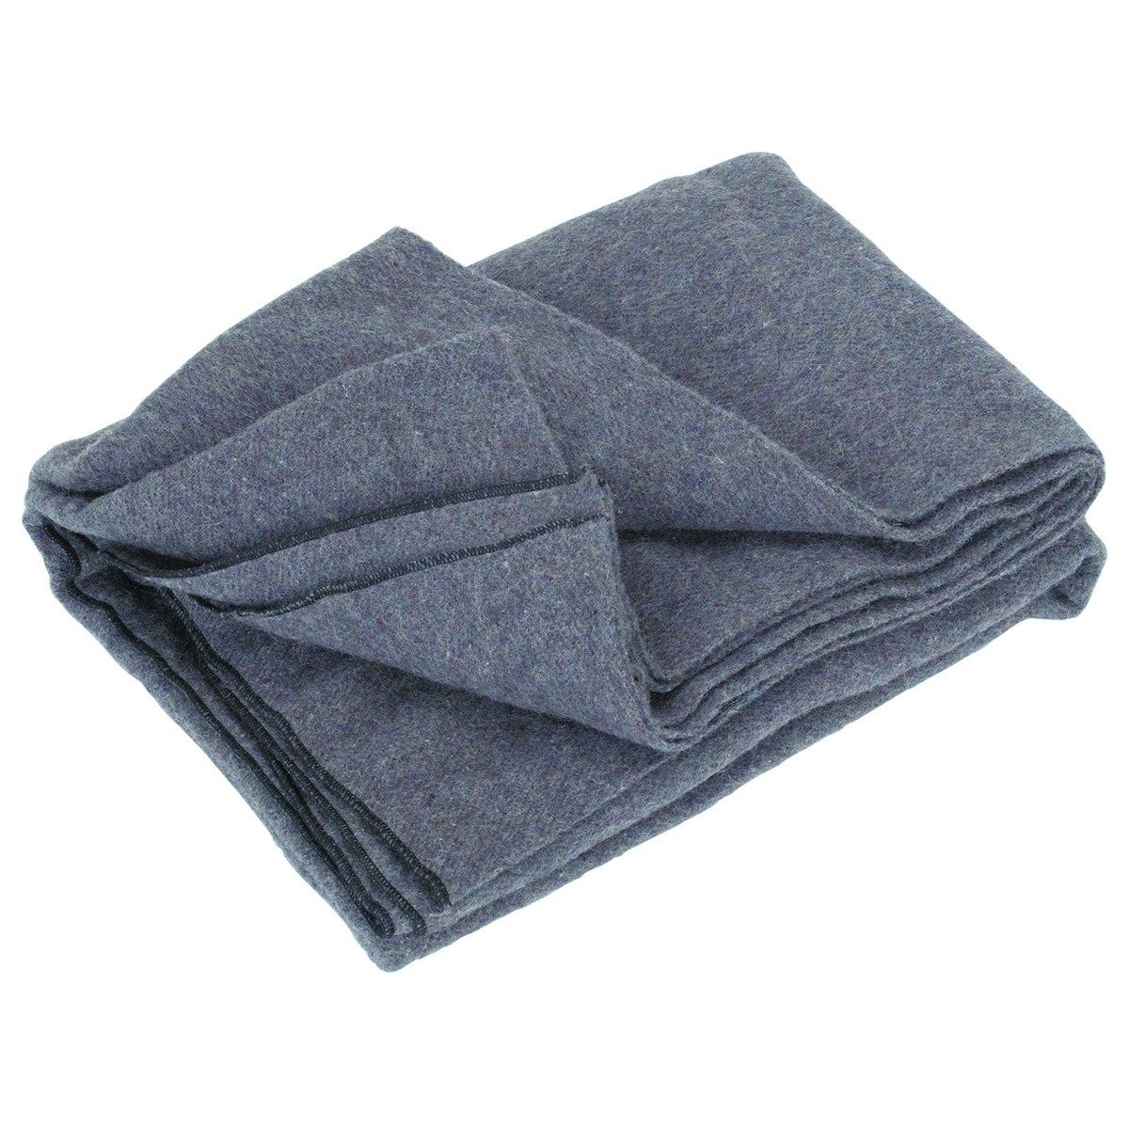
Blanket
Thick cloth
to protect cold,
in Bengali ‘kombol’
We use blanket during winter to protect cold.
Notes:
The text words are triggered. If you click on the word, you will find the meaning of the word. If you click blank or on the picture, you will find the sentence made with the word. Now you can do any one you like to conduct this option.

Slide 11
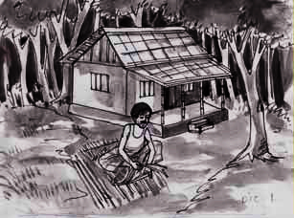
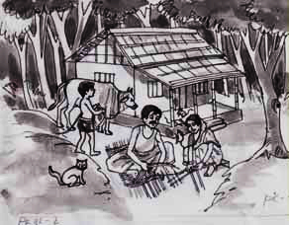
Pair work
A Look at the pictures and discuss in pairs the following questions.
1 Can you live alone in a house?
2 Make a list of the problems you think you will have if you live alone in a
house, e.g. having accidents, cooking, etc.

Slide 12
Answer these questions after reading the text ‘B’ carefully.
1 Why did the young man leave his house?
2 Where did he make a hut? What did he make the hut with?
3 Was the man happy in his hut?
4 How did he find himself again in a family?
5 Where and how can a person be happy?
6 What is the moral of the story?

Slide 13
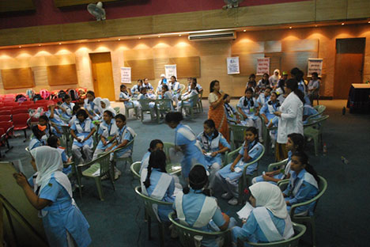
Group work
What five things did the young man do in the jungle?
Notes:
Teacher may go according to the text.

Slide 14
Homework
Write a paragraph on
“ The problems and comforts
of living in a society,”

Slide 15
Thank You All

