Slide 1
WELCOME

Slide 2
Teacher’s Identity:
Md. Robel Haque
Assistant Teacher
Nirmoil Darazia Dakhil Madrasha
Shampur,Patnitala,Naogaon.
Mob: 01774795179
Subject: English For Today
Class: IX

Slide 3
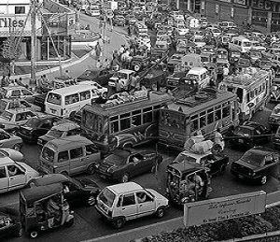
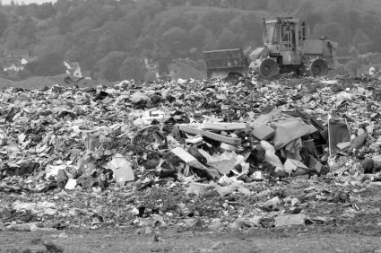
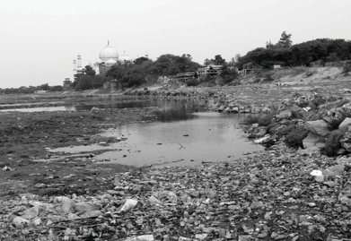
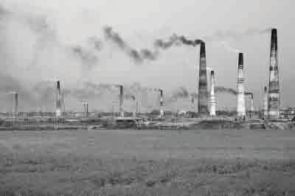
The Symptoms/Pictures of Pollution
Picture 1
Picture 2
Picture 3
Picture 4

Slide 4
Today’s The Lesson
Environmental Pollution

Slide 5
Learning outcomes
By the end of the lesson the students will be able to -
Talk about various types of pollutions.
Describe the reasons of environmental pollution.
Tell about water pollution.
Explain air pollution

Slide 6
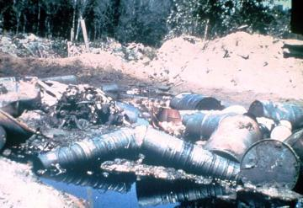
Water Pollution

Slide 7
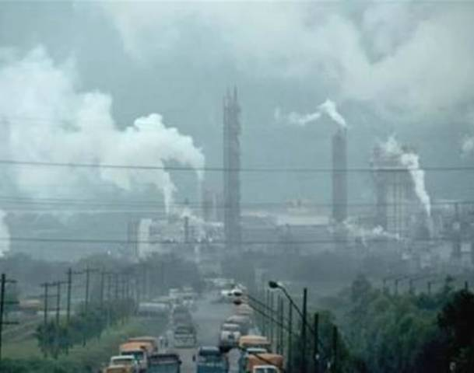

Slide 8
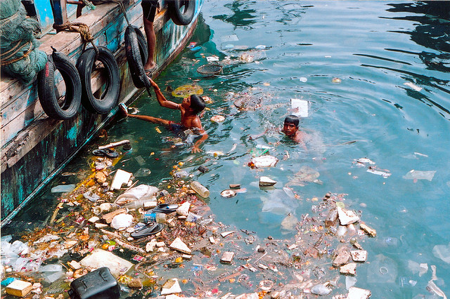
As different sources flow together, the pollution can spread easily and quickly

Slide 9
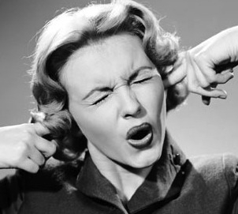
When unwanted sound created by human beings hits our ears and disturbs the environment, noise pollution is created.
There are several sources of noise pollution that contribute to both indoor and outdoor noise pollution. Noise emanating from factories, vehicles, and playing of loudspeakers during various festivals can contribute to outdoor noise pollution, while loudly played radio or music systems, and other electronic gadgets can contribute to indoor noise pollution.

Slide 10
The reasons of water pollution

Slide 11
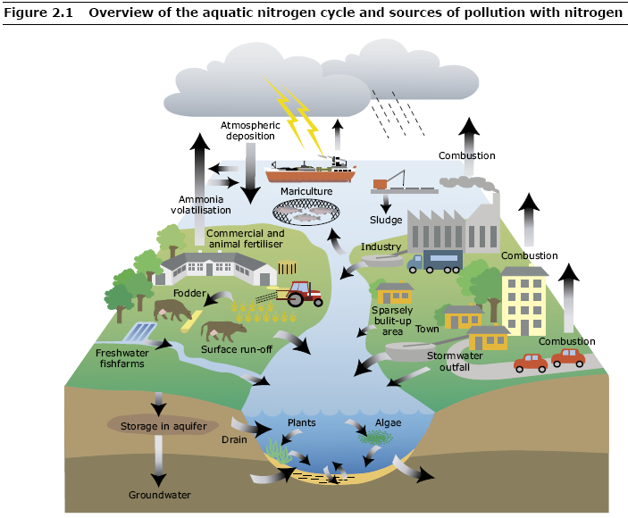

Slide 12
The way of keeping water free from pollution
Right way
Wrong way

Slide 13
Evaluation
What is pollution?
What is environment pollution?
How is environment polluted?
How many pollutions are there in this lesson?
How is air polluted?

Slide 14
Homework
Write a Paragraph about our ‘’environment pollution’’.

Slide 15
Thank You All

