Slide 2
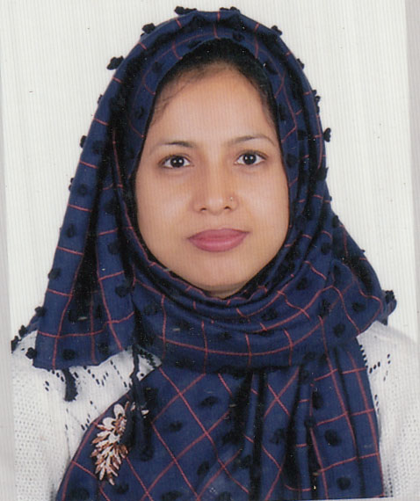
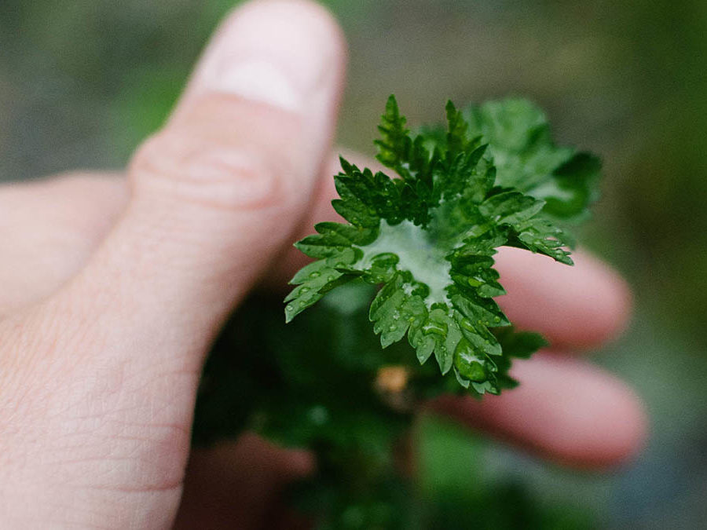
Introduction
Jayeda Akter
Assistant teacher
Atghoria Govt. primary School
Habigonj Sador, Habigonj

Slide 3
Lesson Introduction
Class; Four
Lesson 1-2
Time: 40 minute
Months of the year
2

Slide 4
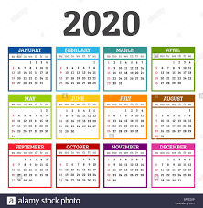
Lets see a picture?
What can you see in this pictures?

Slide 5
Todays lesson is …..
Months of the year 2

Slide 6
Learning outcomes
At the end of the lesson student will be able to………….
1.1.2 say sentences with proper intonation
4.1 to read aloud poems with
proper sounds, stress and
intonation.
4.3 to enjoy and understand
simple poems.
3.1 to recognize and study the
calendar.

Slide 7
Teacher read the poem two times….

Slide 8
. There are thirty days
In September,
April, June and November
All the rest have thirty- one
Expect February,
Which has twenty-eight days clear,
And twenty-nine in each
Leap Year

Slide 9
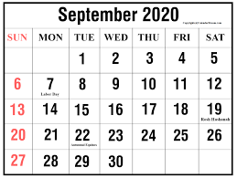
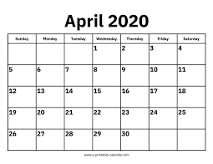
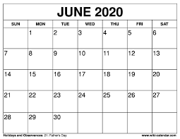
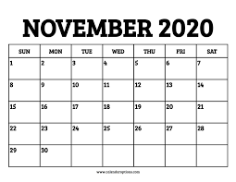
Read and say
There are thirty days
In September,
April , June and November.

Slide 10
All the rest have thirty-one,

Slide 11
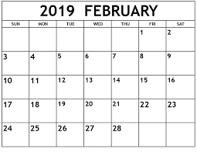
Expect February,
Which has twenty-eight days clear,
There are 28 days make in February.

Slide 12
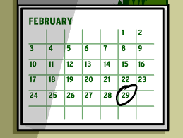
And twenty-nine in each
Leap Year.
Every 4 years later comes Leap Year.

Slide 13
Individual work
Say the months of the year.

Slide 14
Group Work
Group : A
How many month are there in the thirty days?
September 30
April 30
June 30
November 30

Slide 15
Group : B
Write the answers.
Months with 30 days:
Months with 31 days:
Number of days in a leap Year:

Slide 16
Home work
Write the twelve months name.

