Slide 1
WELCOME

Slide 2
Teacher’s Identity:
Md. Rubel Haque
Assistant Teacher
Nirmoil Darazia Dakhil Madrasha
Shampur,Patnitala,Naogaon.
Mob: 01774795179
Class-8
English First paper
Writing Part

Slide 3
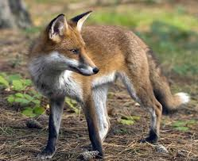
Let us watch and enjoy

Slide 4
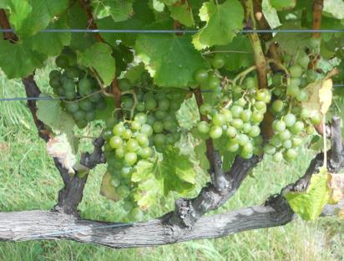
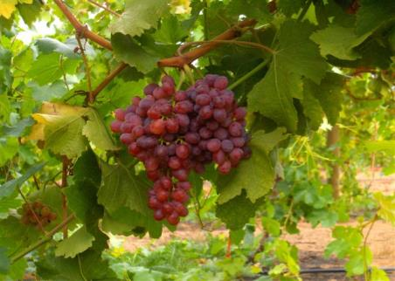

Slide 5
Our Today’s lesson is-
“are sour”
A story from writing part.

Slide 6
Learning outcomes
After we have studied this lesson we will be able to-
Listen information
Ask and answer questions
Write a story.

Slide 7
Let us enjoy
a video

Slide 8
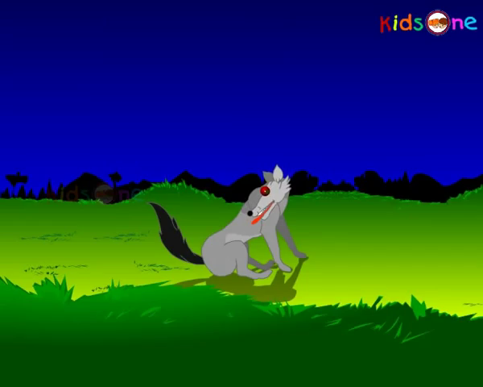
Once there was a fox in a jungle. It was very hungry.

Slide 9
It was searching food here and there. But he did not manage any food.

Slide 10
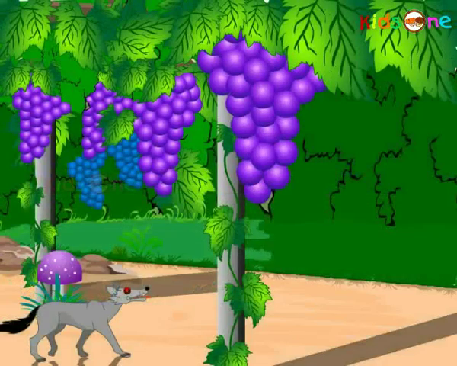
When he was about to leave its hope, he saw a vineyard full of sweet grapes at a distance

Slide 11
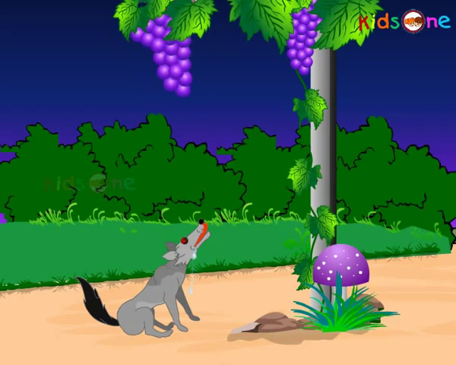
He became very hopeful. His mouth became watered at the sight of the grapes.

Slide 12
He wished to meet his hunger with the sweet grapes. So he went there

Slide 13
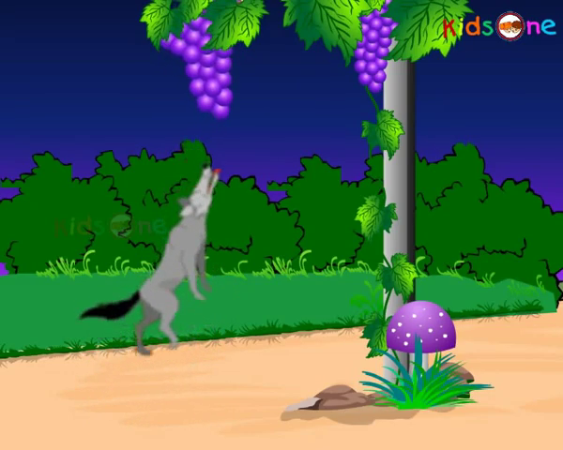
Then the fox tried to eat the grapes by jumping higher and higher.

Slide 14
The grapes were hanging over his reach

Slide 15
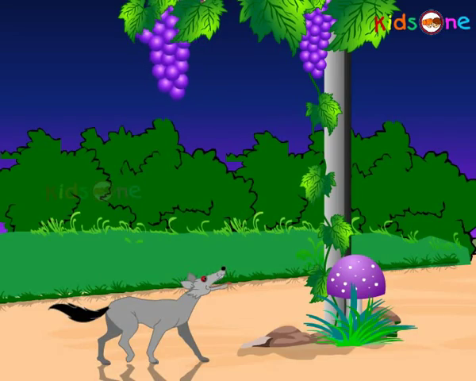
But the fox still could not reach the grapes

Slide 16
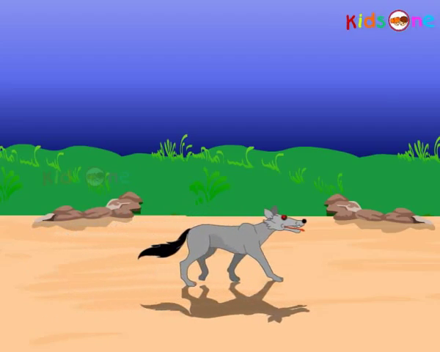
When he became tired, he finally gave up and walked away from the vineyard.

Slide 17
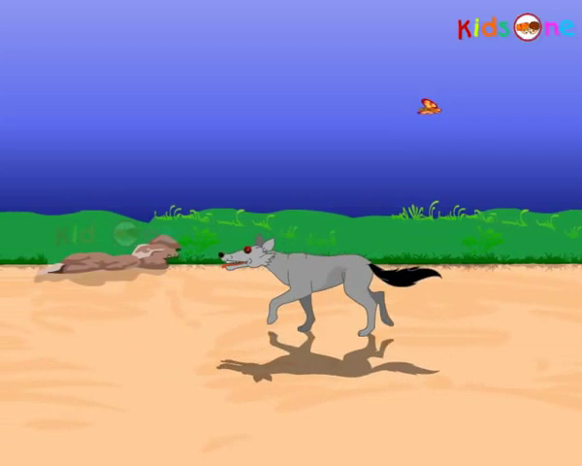
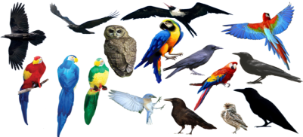
Some birds perched on a tree nearby asked, “How are the grapes?” The fox complained, “The grapes are sour.”

Slide 18
Group Work

Slide 19
Evaluation
Answer the following questions
What was the fox searching?
What did he find at a distance?
What did he do to have the grapes?
Why could he not eat the grapes?
What did the fox say when he failed to eat the grapes?

Slide 20
Homework
Write a story on “Grapes are sour”

Slide 21
Thank You All

