Slide 1
WELCOME

Slide 2
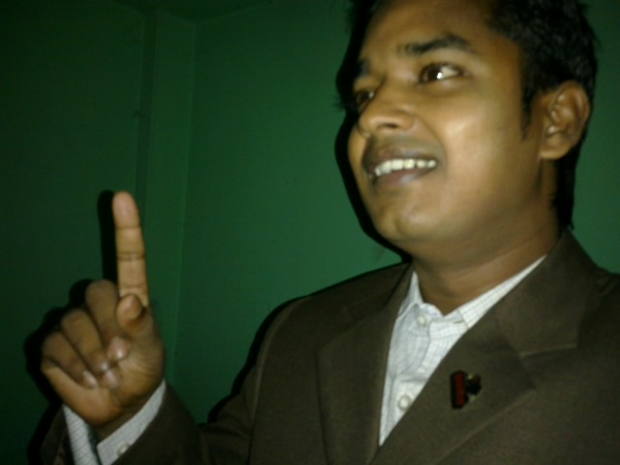
Teacher’s Identity:
Md. Rubel Haque
Assistant Teacher
Nirmoil Darazia Dakhil Madrasha
Shampur,Patnitala,Naogaon.
Mob: 01774795179

Slide 3
Lesson Introduction Class-Ten Subject-English

Slide 7
Today’s Lesson THE GREED OF THE MIGHTY RIVERS

Slide 8
Learning out comes By the end of this lesson ss will be able to:-
Make fire and cooking meals
Talk about river erosion
Talk about Meherjan family

Slide 9
SILENT READING TEXT

Slide 10
Ques:- (a)What does Meherjan use to make fire for cooking her meals? (b)What property did Meherjan lose due to river eroion? ©What do you know about Meherjan”s family?
INDIVIDUAL WORK

Slide 11
GROUP WORK Dialogues about roaring and erosions of the rivers

Slide 12
EVALUATION To ask questions about bad effect of roaring rivers

Slide 13
Homework
Paragraph writing 70-80 words about “Environment pollution”

Slide 14
Thank You All

