Slide 1
Welcome

Slide 2
Khalidur Rahman Manik
Assistant teacher
Khasgaon G.P.S
Chhatak,Sunamganj
01712-114197
I
D
E
N
T
I
T
Y
Subject: English
Class: Three
Unit:23
Lesson: 1-3
Date:22/03/2020
Time: 40 Minutes.

Slide 3
Good morning students.
How are you today?
Let’s sing the good morning song.

Slide 4
Look at the picture
A tall tree and a short tree.
What do you see in the picture?

Slide 5
So, our today’s lesson is…
What do they do?
Lesson:A

Slide 6
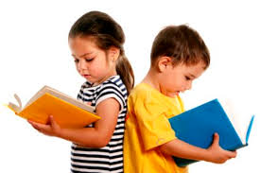
Students will be able to…
1.1.2 say words, phrases and sentences with
proper sounds and stress.

Slide 7
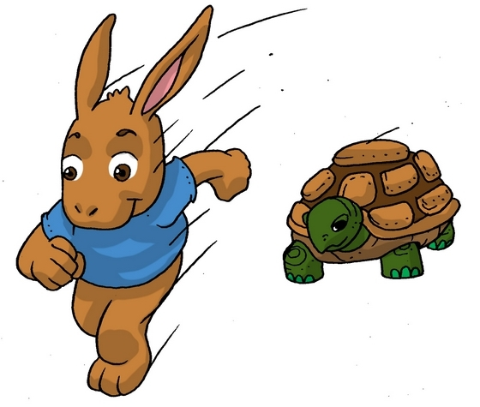
Look at the picture
Quick
Slow

Slide 8
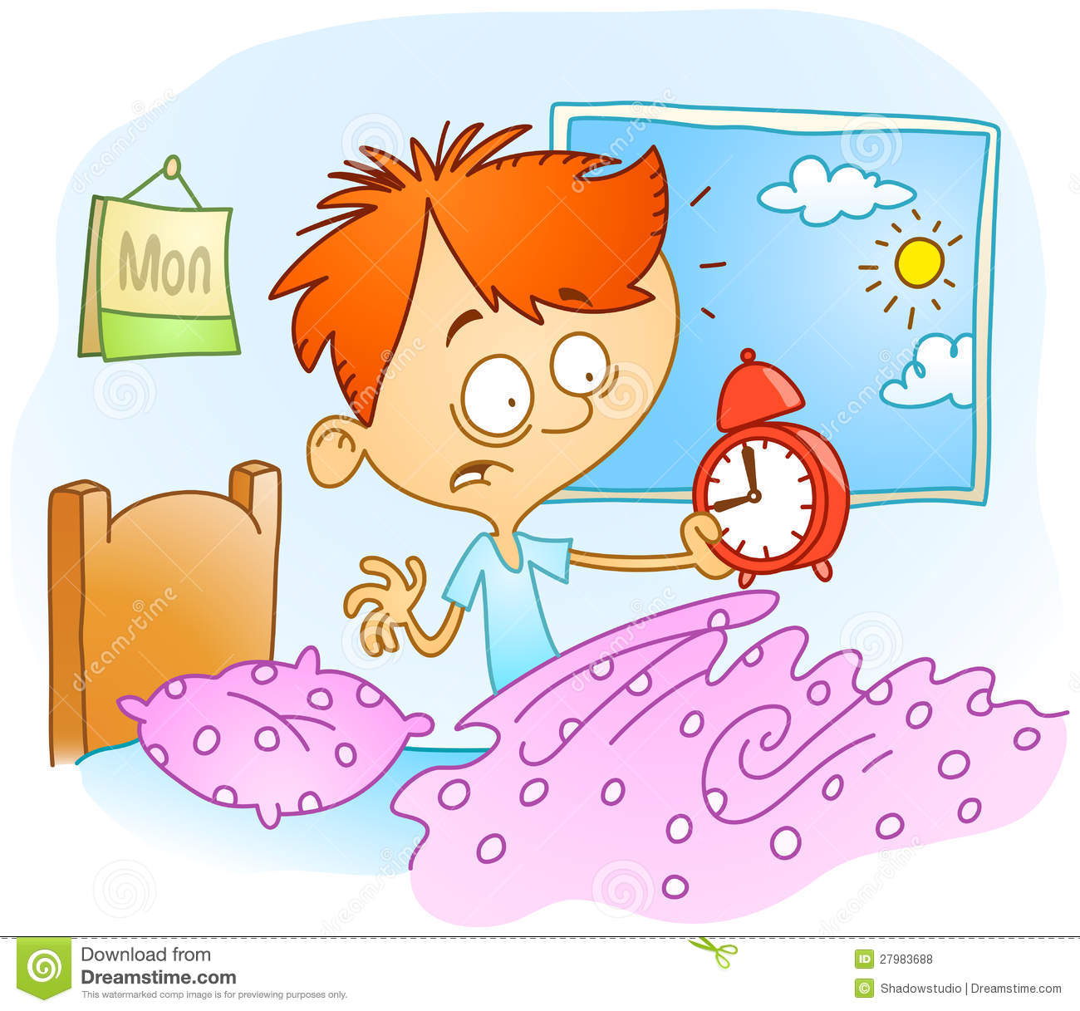
Look at the picture
Early
Late

Slide 9
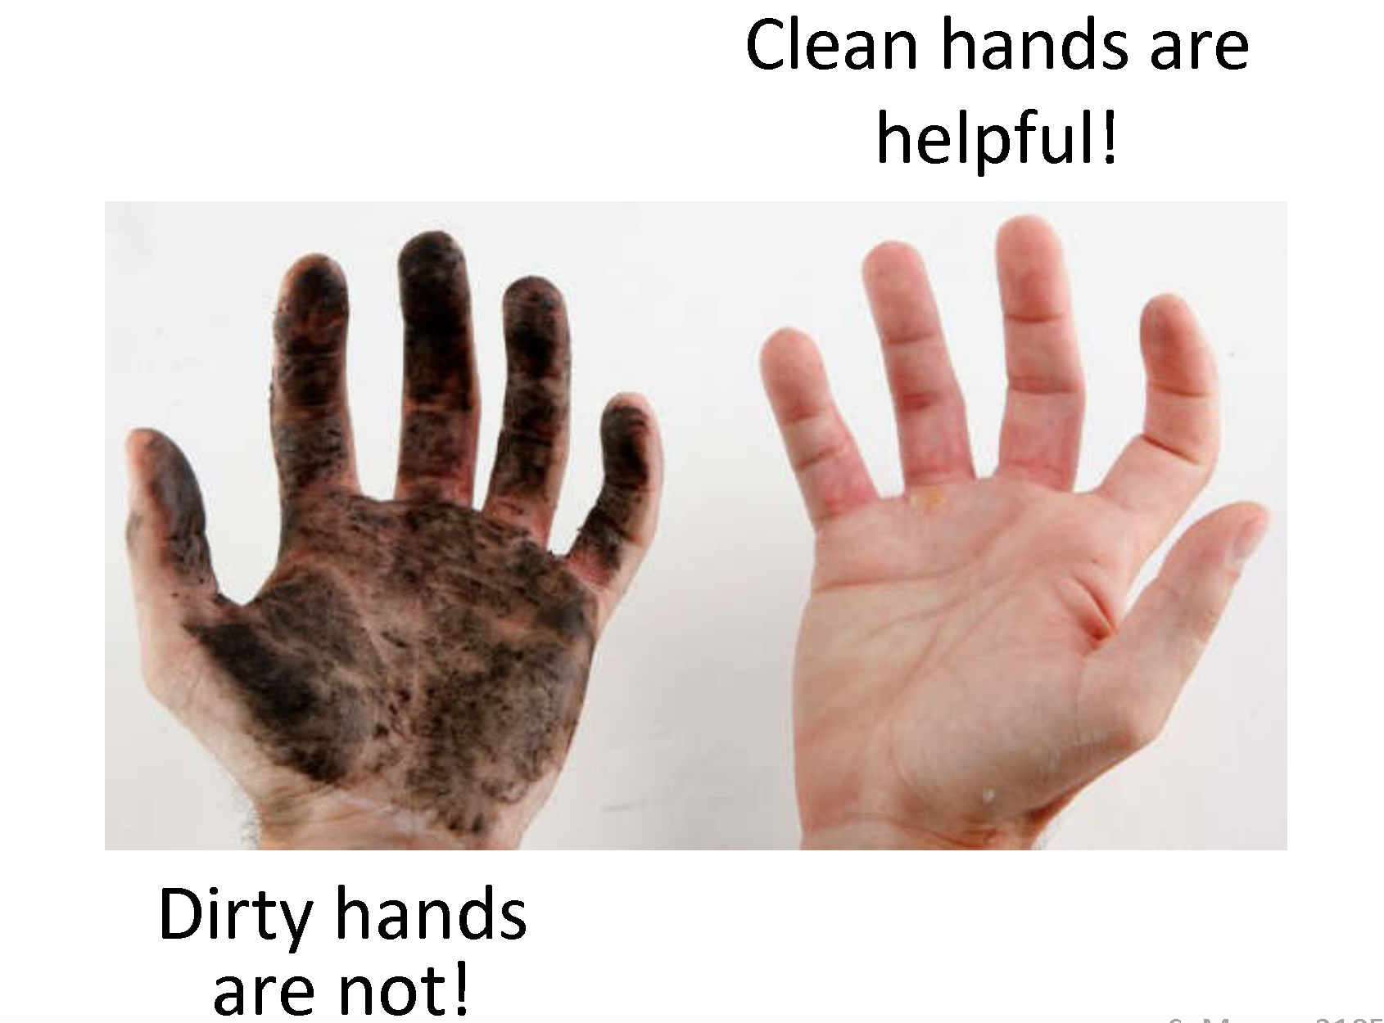
Look at the picture
Clean
Dirty

Slide 10
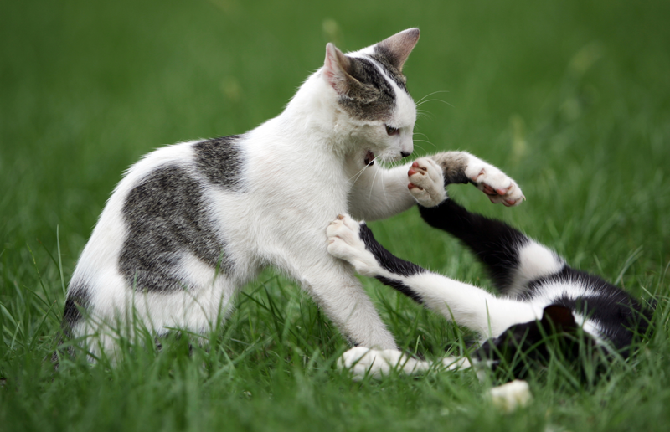
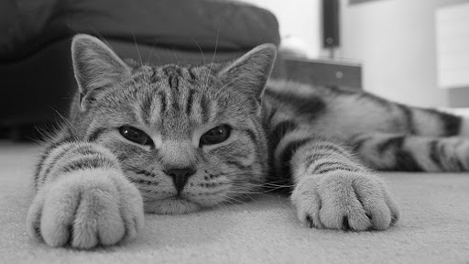
Look at the picture
Active
Lazy

Slide 11
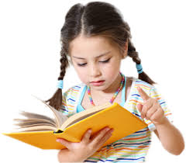
Individual Work
Two students will come front, One will ask a word and another will reply with it’s opposite. It will be continued by turns.

Slide 12
Now, open at page 46 of your textbook.

Slide 13
Now, listen to the Audio of the text.
Listen to the Audio again and repeat after it.

Slide 14
Let’s learn Bangla meaning of the words.
Words with meaning | Opposite with meaning
Quick (দ্রুত) | Slow (ধীর)
Early (সকাল-সকাল) | Late (বিলম্বে)
Clean (পরিষ্কার) | Dirty (নুংরা)
Active (কর্মঠ) | Lazy (অলস)

Slide 15
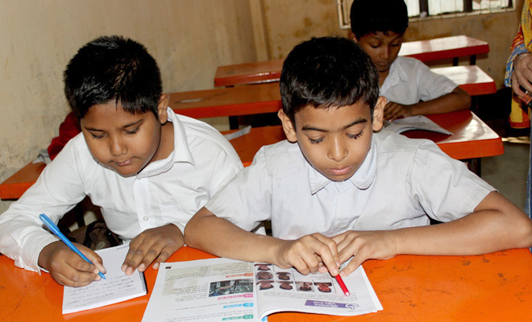
Pair Work
Students will practise the opposite words
in pairs and will try to make sentences.

Slide 16
Evaluation
I’ll ask a word and students will reply with it’s opposite by turns.

Slide 17
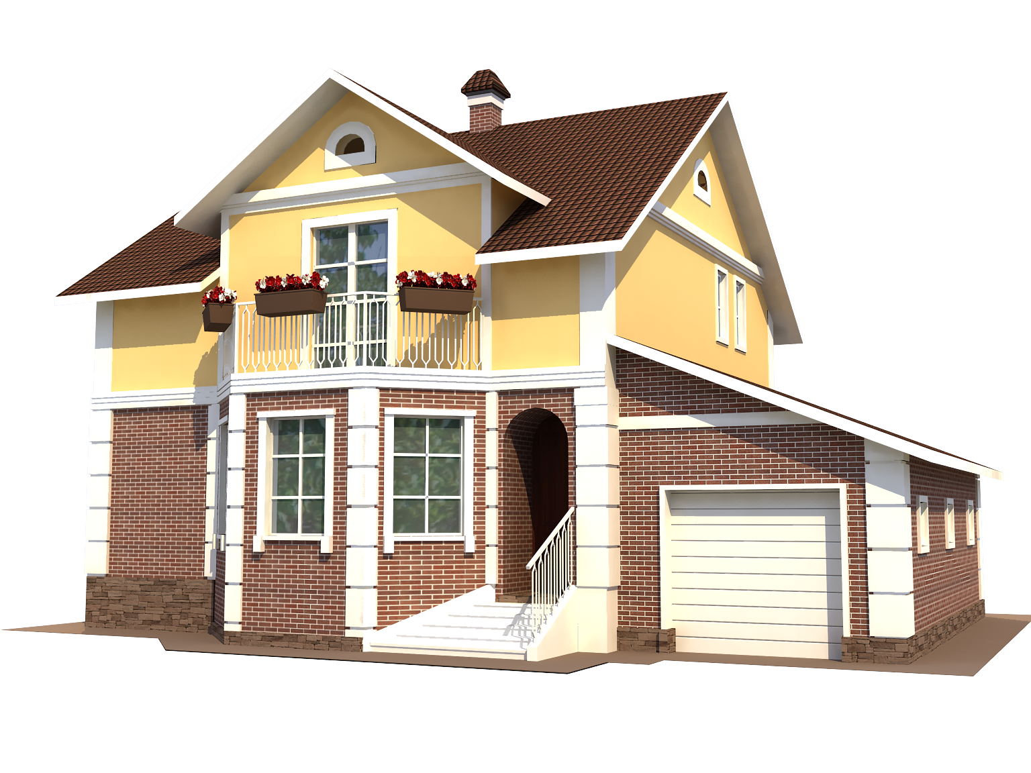
Home Work
Students will bring the opposite words writing with Bangla meaning.

