Slide 1
Welcome

Slide 2
Note for the honourable teachers:
The subject teachers are requested to read the notes given below the slides.
Notes are given bellow the slide no. 4, 7, 12, 13, 17, 21 and 22 .

Slide 3
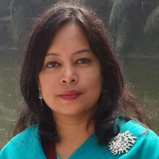
INTRODUCTION
ROUFUN NAHAR
ASSISTANT TEACHER ( ENGLISH)
MAZIDA GOVT. HIGH SCHOOL
TONGI, GAZIPUR
CLASS: SEVEN
SUBJECT: ENGLISH FIRST PAPER

Slide 4
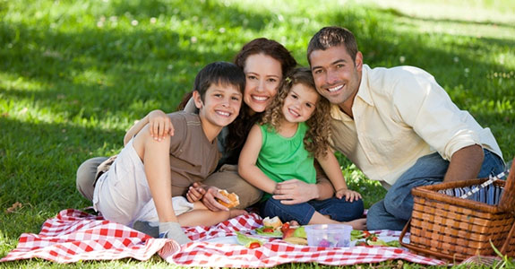
What do you see in the picture?
A Happy family
Notes:
Showing the picture teacher can ask the question to the whole class. SS can raise their hands. Teacher can ask 2/3 students randomly.

Slide 5
Today our topic
Paul and his family
UNIT: Eight
LESSON: 7

Slide 6
LEARNING OUTCOMES OF THE LESSON
By the end of the lesson the students will be able to
Read and understand text.
make questions and answers about likes/dislikes.
Complete guided and semi-guided writing task.
Infer the meaning of some key words from the inference.

Slide 7
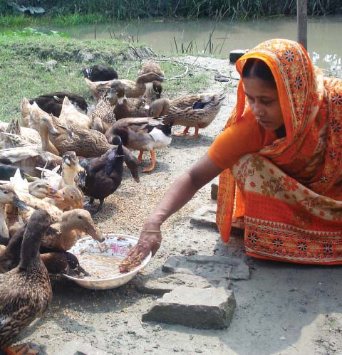
Feed
Vocabulary
Meaning
To give food to a person or an animal.
She feeds the ducks everyday .
Notes:
First, the word will be shown. The SS will be asked to pronounce the word. If it is needed teacher can help. Then the picture and the sentence will be shown and asked to guess the meaning. After that the meaning will be shown. Then the teacher can ask the students to make a sentence of their own. In the same way, slide no. 8-11 can be conducted.

Slide 8
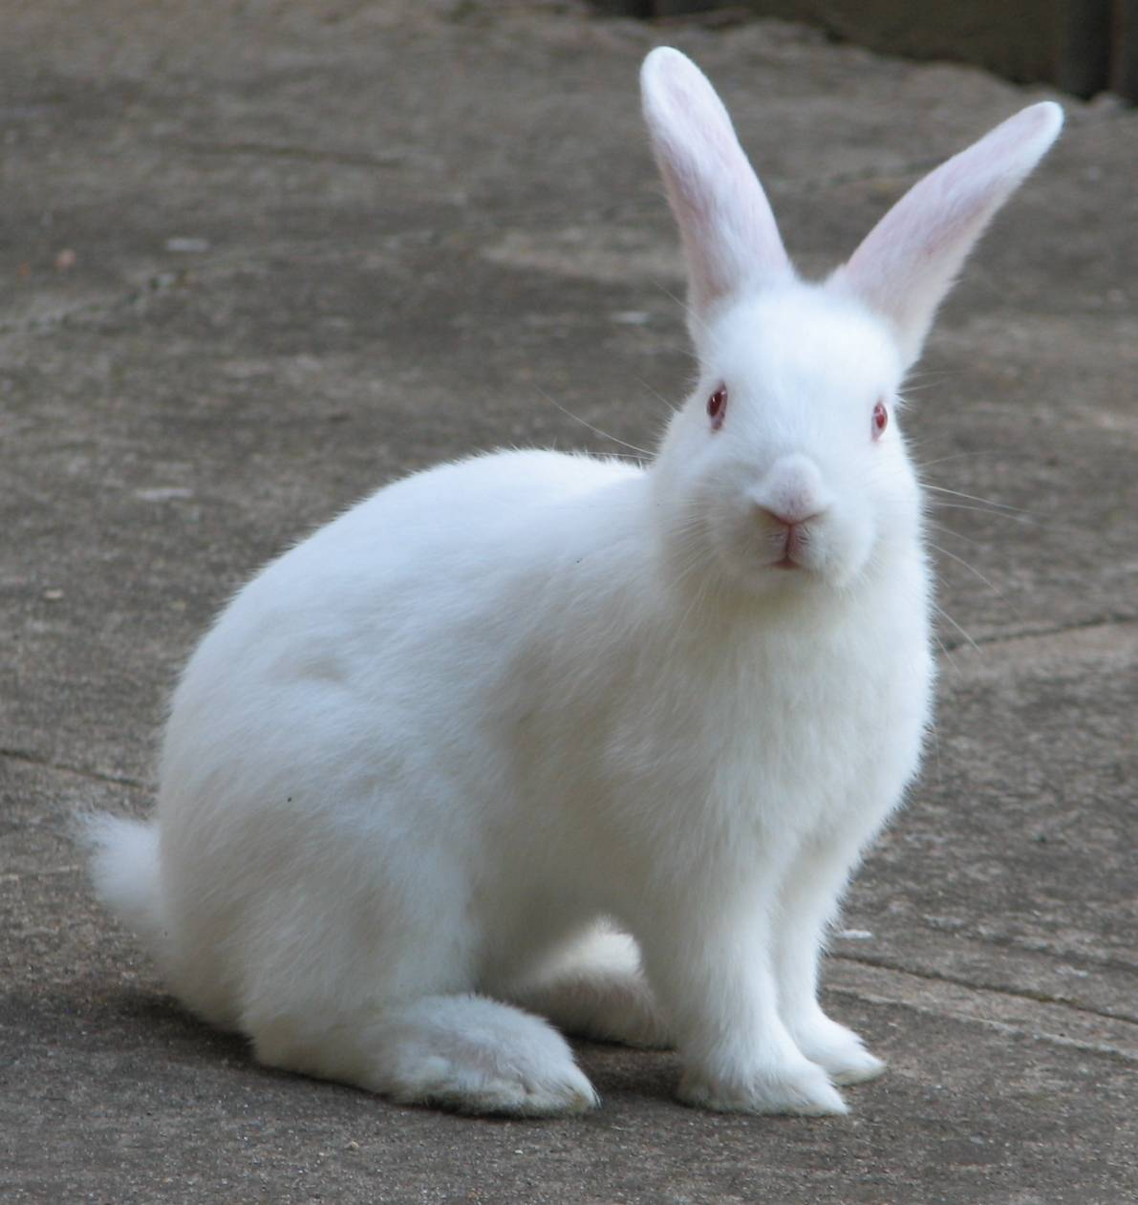
Rabbit
Vocabulary
a plant-eating mammal with long ears, long hind legs, and a short tail.
Meaning
The rabbit is sitting.

Slide 9
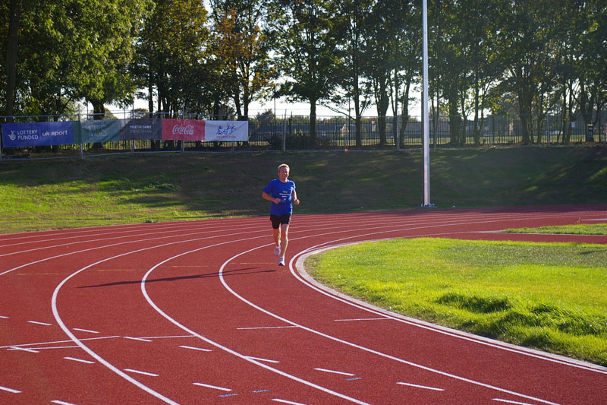
Run around
Vocabulary
Meaning
Run all sides.
The man is running around the track .

Slide 10
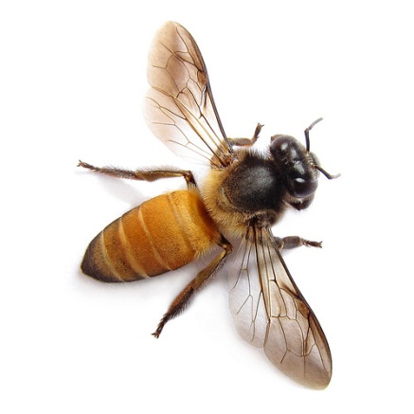
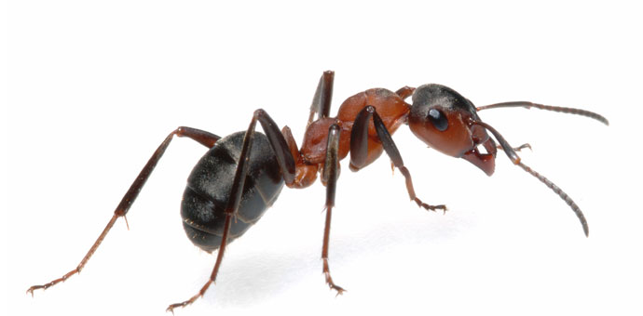
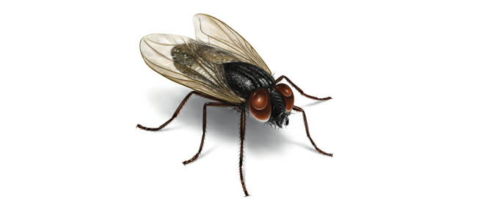
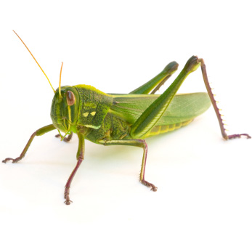
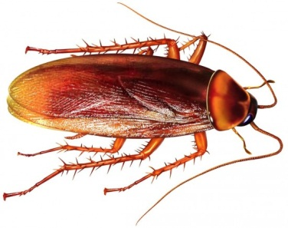
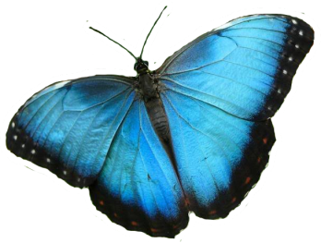
Insects
Vocabulary
A type of small creatures having six legs and a body divided into three parts. Insects usually also have wings.
Meaning
All these are called insects.

Slide 11
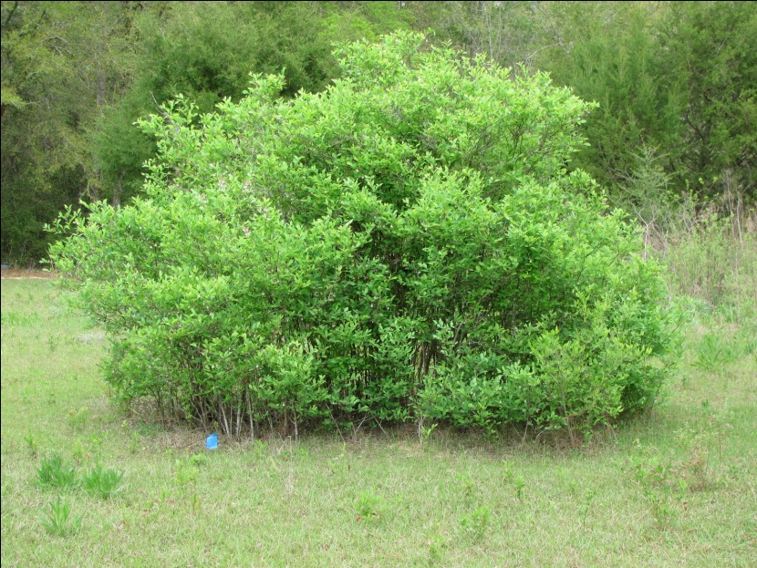
Bush
Vocabulary
Meaning
A plant that grows thickly with several stems coming up from the roots; a shrub
The children should not go to the bush.

Slide 12
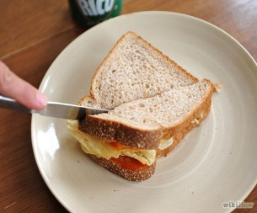
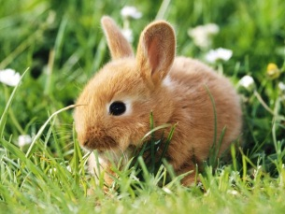
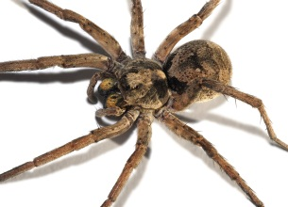
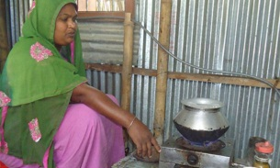
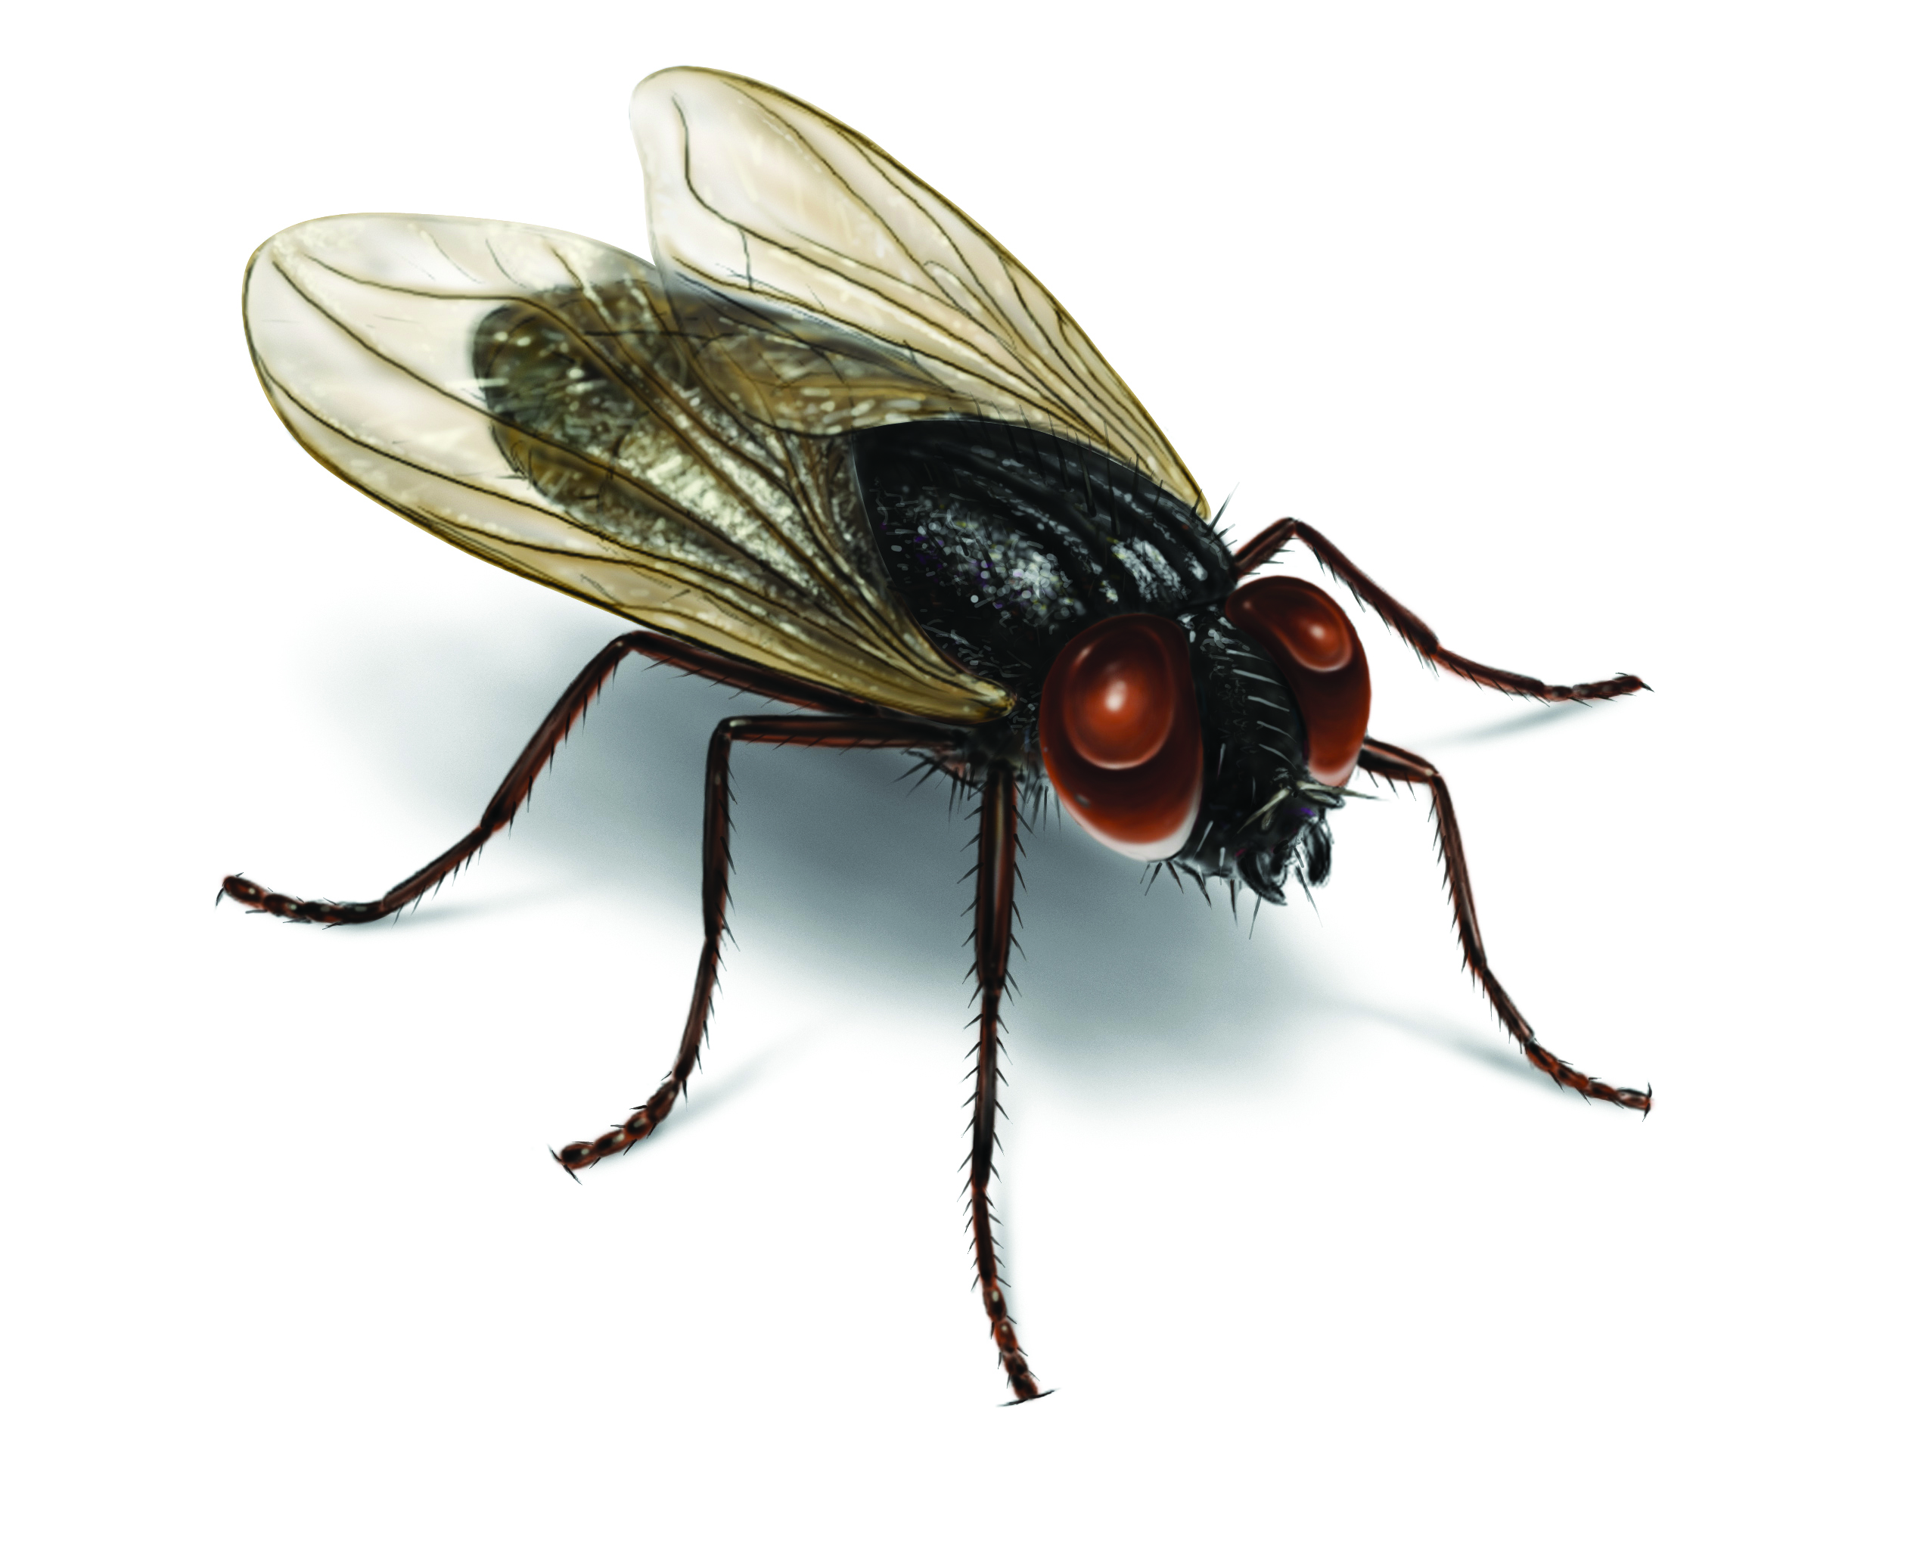
Go to the textbook , section A and read the text and fill the table below. Use the words likes/doesn’t like/loves/hates appropriately under each member of Paul’s family. One is done for you.
Thing/activity | Paul | Sister | Mother | Father
Making sandwiches |  |  | likes
Watching animals
Spiders
Cooking
Flies
loves
loves
hates
hates
doesn’t like
Notes:
Here, showing the table, the teacher can explain what the students have to do. The teacher can ask SS to go to the textbook , section A and read the passage. After reading the passage student will find out the answer from the passage. 7-8 minutes can be given for the task. Then teacher can elicit answer of each row. Here, when teacher will elicit answer he/she can ask the SS to raise their hands. Eliciting answer from one, teacher can ask other whether they agree or not. For giving the feedback of each answer please click on the picture.

Slide 13
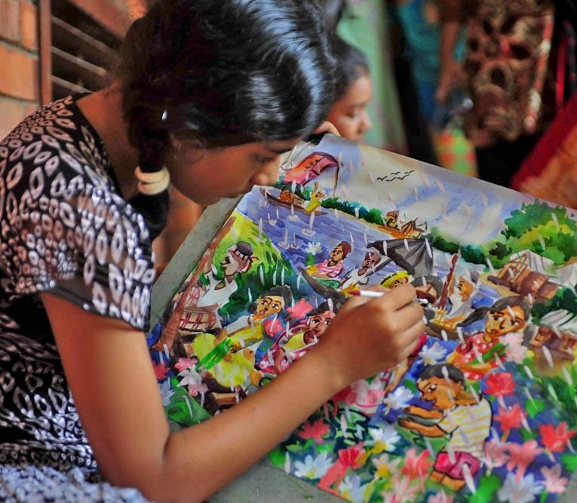
See the jumble words. Rearrange the words and make question from the box 1 and answer from the box 2.
1. she/ like /drawing/ does /picture/ a/?
2. likes / she /drawing/ yes, /a/ picture/.
Q: Does she like drawing a picture?
A: Yes, she likes drawing a picture.
Notes:
From the jumble words the SS will make question and answer. Then teacher can elicit answer from them. Here when teacher will elicit answer he/she can ask the SS to raise their hands. Eliciting answer from one student teacher can ask other students whether they agree or not. If answer is not correct teacher can give the chance to others. Then teacher can give them the feedback showing the answer. In the same way, slide no. 14-16 can be conducted.

Slide 14
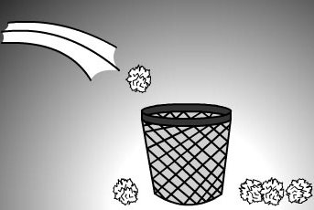
See the jumble words. Rearrange the words and make question from the box 3 and answer from the box 4.
3. you/ waste/ like /throwing/ do / here and there /?
4. don’t / I /like /throwing/ no, /waste/ here and there.
Q: Do you like throwing waste here and there?
A: No, I don’t like throwing waste here and there.

Slide 15
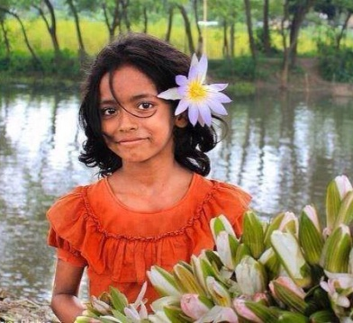
See the jumble words. Rearrange the words and make question from the box 5 and answer from the box 6.
5. she/ like /herself/decorating/ does /flower/ a/with/?
6. loves / she /decorating/ yes, /a/ flower/with/herself.
Q: Does she like decorating herself with a flower?
A: Yes, she loves decorating herself with a flower.

Slide 16
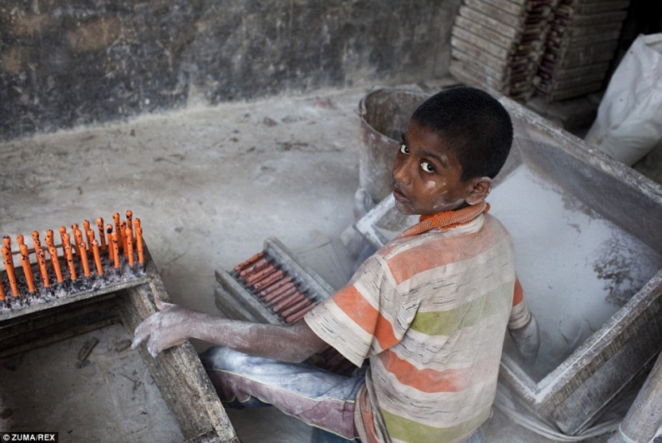
See the jumble words. Rearrange the words and make question from the box 7 and answer from the box 8.
7. he/ like /in/working/ does /factory/ a/?
8. hates / he /working/ no, /a/ factory/in/.
Q: Does he like working in a factory?
A: No, he hates working in a factory.

Slide 17
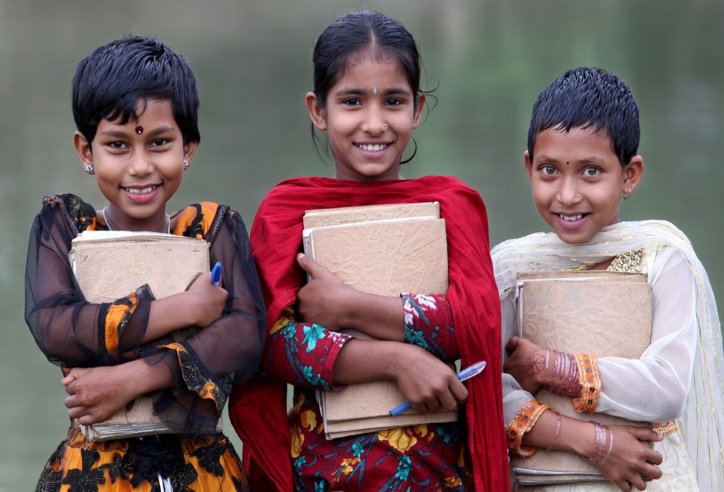
Use the clues to make questions and answers about likes/dislikes.
2. They go to school.
2. She draws picture.
Q: ( like ) …………………………?
A: ( Yes, like ) ……………………
Q: (like) Does she like drawing a picture?
A: (Yes, like) Yes, she likes drawing a picture.
Q: Do they like going to school?
A: Yes, they like going to school.
Remove example:
See the example:
Notes:
Here the SS will make question and answer using the clues. How the students will make Q/A, the teacher can explain that clicking on “see example”. They will make question and answers using the structures of example. Teacher can click on “Remove example” to again to the exercise. Students can make Q/A orally or it can be written. Then teacher can elicit answer from them. Then teacher can give them the feedback showing the answer.

Slide 18
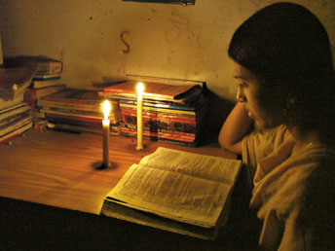
Use the clues to make questions and answers about likes/dislikes.
2. She studies in load-shedding.
Q: ( like ) ………………………………?
A: ( No, not like ) ……………………
Q: Does she like studying in load-shedding?
A: No, she does not like studying in load-shedding.

Slide 19
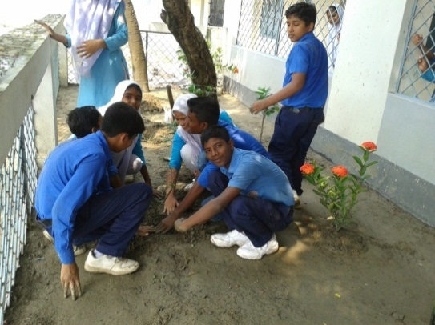
Use the clues to write questions and answers about likes/dislikes.
1. They make garden.
Q: ( like ) ………………………………?
A: ( Yes, love ) …………………………
Q: Do they like making garden?
A: Yes, they love making garden.

Slide 20
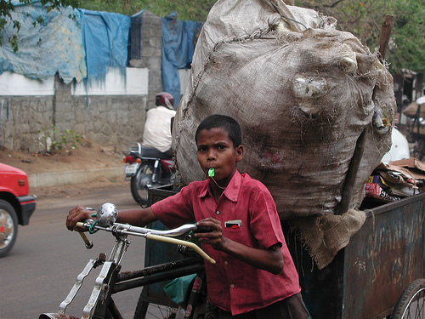
Use the clues to write questions and answers about likes/dislikes.
1. The boy pulls garbage.
Q: ( like ) ………………………………?
A: ( No, hate ) …………………………
Q: Does the boy like pulling garbage?
A: No, the boy hates pulling garbage.

Slide 21
Look at the structure of making question and answer.
Q: Does she like drawing a picture?
Q: Do you like throwing waste here and there?
1. Structure of Question:
Do/Does + Subject + like + verb + ing + others + ?
A: Yes, she likes drawing a picture.
A: No, I don’t like throwing waste here and there.
2. Structure of Answer:
Yes,/No, + Subject + like/likes/don’t like/doesn’t like/love/loves/hate/hates +verb + ing + others.
Notes:
Teacher can show the structures and explain the structures here.

Slide 22
Look at the grid below. It shows the likes and dislikes of two people. Now write sentences about what Sumaiya likes and doesn’t like. One is done for you.
 | Yamim | Sumaiya
Listen to music
Read story books
Draw pictures
Take exercise
1. Yamin likes listening to music and reading story books but he doesn’t like taking exercise or drawing pictures.
Notes:
The SS will see the grid and example on Yamin. Then they will write about what Sumaiya likes and doesn’t like. Then teacher will elicit answer from the students (as many as possible). Teacher will give feedback orally.

Slide 23
Home Work
Write about what you like and don’t like. (Not more than 10 lines)

Slide 24
Acknowledgement
MoE, DSHE, NCTB & A2I respective of officials
And the editors panel: Ranjit Poddar, Associate Professor (English) TTC, Dhaka, Md. Jahangir Hasan (English), Assistant Professor TTC, Rangpur and Urmila Khaled Assistant Professor (English) TTC, Dhaka.
Their direction, valuable suggestions and intensive supervision have enriched the model contents.

Slide 25
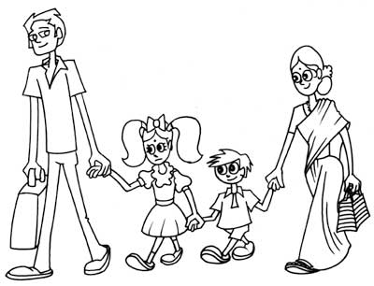
Love and respect your family. Take care of each member’s likes and dislikes.

