Slide 1
LINGUA FRANCA
Presents YOU
The Core of Narration\ Speech

Slide 2
DIRECT AND INDIRECT SPEECH

Slide 3
Direct and indirect speech can be a source of confusion for English learners. Let's first define the terms, then look at how to talk about what someone said, and how to convert speech from direct to indirect or vice-versa.
You can answer the question What did he say? in two ways:
by repeating the words spoken (direct speech)
by reporting the words spoken (indirect or reported speech).

Slide 4
DIRECT SPEECH
Direct speech repeats, or quotes, the exact words spoken. When we use direct speech in writing, we place the words spoken between quotation marks (" ") and there is no change in these words. We may be reporting something that's being said NOW (for example a telephone conversation), or telling someone later about a previous conversation.

Slide 5
EXAMPLES
She says, "What time will you be home?"
She said, "What time will you be home?" and I said, "I don't know! "
"There's a fly in my soup!" screamed Simone.
John said, "There's an elephant outside the window."

Slide 6
INDIRECT SPEECH
Reported or indirect speech is usually used to talk about the past, so we normally change the tense of the words spoken. We use reporting verbs like 'say', 'tell', 'ask', and we may use the word 'that' to introduce the reported words. Inverted commas are not used.
She said, "I saw him." (direct speech) = She said that she had seen him. (indirect speech)
'That' may be omitted: She told him that she was happy. = She told him she was happy.

Slide 7
'SAY' AND 'TELL'
Use 'say' when there is no indirect object: He said that he was tired.
Always use 'tell' when you say who was being spoken to (i.e. with an indirect object): He told me that he was tired.

Slide 8
'TALK' AND 'SPEAK'
Use these verbs to describe the action of communicating: He talked to us. She was speaking on the telephone.
Use these verbs with 'about' to refer to what was said: He talked (to us) about his parents.

Slide 9
TENSE CHANGES WHEN USING REPORTED SPEECH

Slide 10
Normally, the tense in reported speech is one tense back in time from the tense in direct speech: She said, "I am tired." = She said that she was tired.

Slide 11
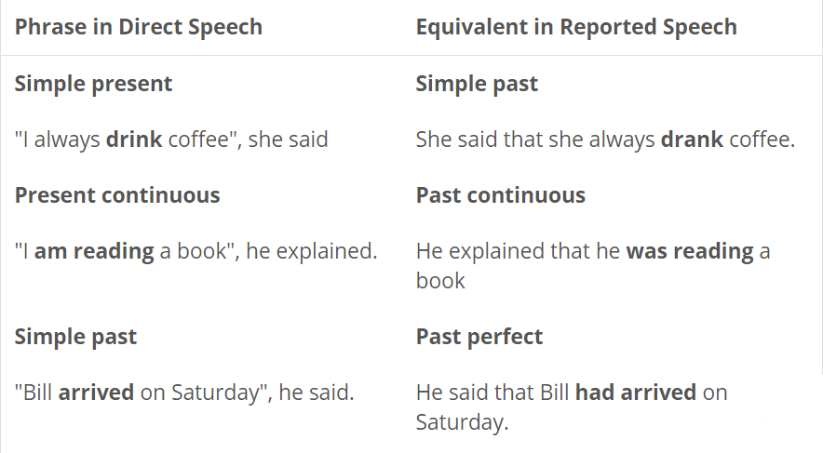

Slide 12
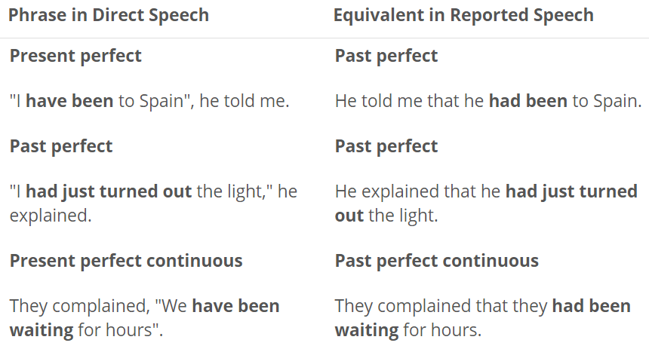
VOCABULARY

Slide 13
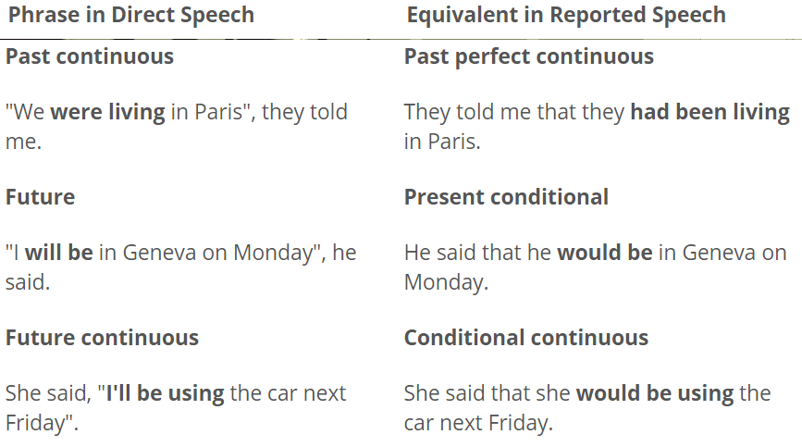
VOCABULARY

Slide 14
You do not need to change the tense if the reporting verb is in the present, or if the original statement was about something that is still true, e.g.
He says he has missed the train but he'll catch the next one.
We explained that it is very difficult to find our house.

Slide 15
These modal verbs do not change in reported speech: might, could, would, should, ought to:
We explained, "It could be difficult to find our house." = We explained that it could be difficult to find our house.
She said, "I might bring a friend to the party." = She said that she mightbring a friend to the party.

Slide 16
CHANGING TIME AND PLACE REFERENCES

Slide 17
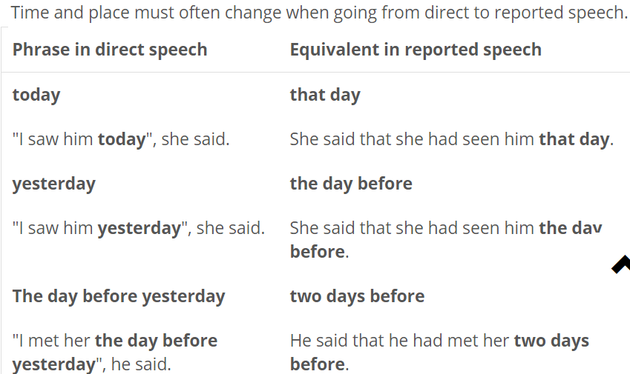
VOCABULARY

Slide 18
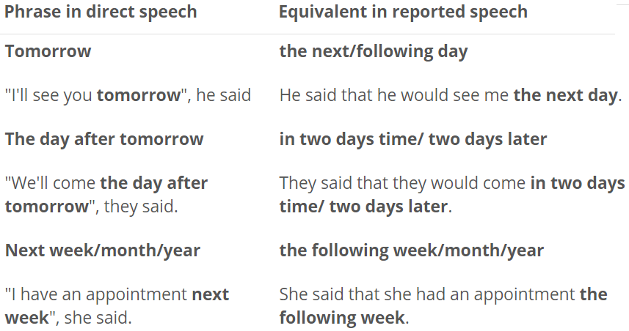
VOCABULARY

Slide 19
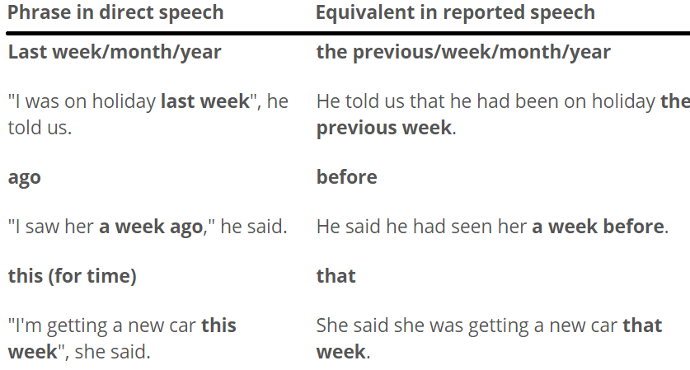
VOCABULARY

Slide 20
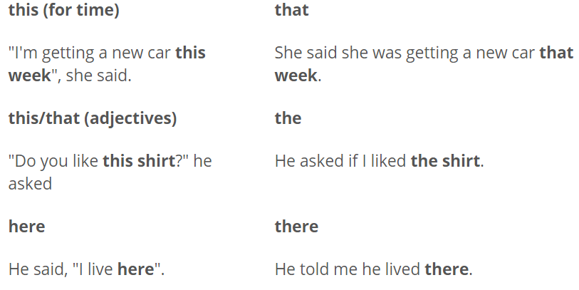
VOCABULARY

Slide 21
In general, personal pronouns change to the third person singular or plural, except when the speaker reports his own words: I/me/my/mine, you/your/yours = him/his/her/hers we/us/our/ours, you/your/yours = they/their/theirs
He said: "I like your new car." = He told her that he liked her new car. I said: "I'm going to my friend's house." = I said that I was going to my friend's house.

Slide 22
QUESTION FORMS AND REPORTED SPEECH

Slide 23
WORD ORDER
Normal word order is used in reported questions, that is, the subject comes before the verb, and it is not necessary to use 'do' or 'did':

Slide 24
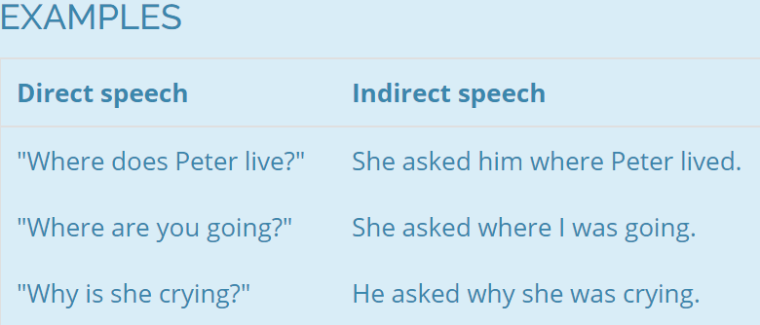
VOCABULARY

Slide 25
YES / NO QUESTIONS
This type of question is reported by using 'ask' + 'if / whether' + clause:

Slide 26
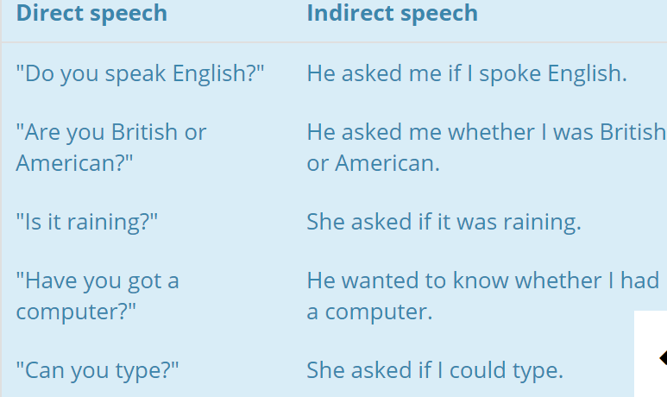
VOCABULARY

Slide 27
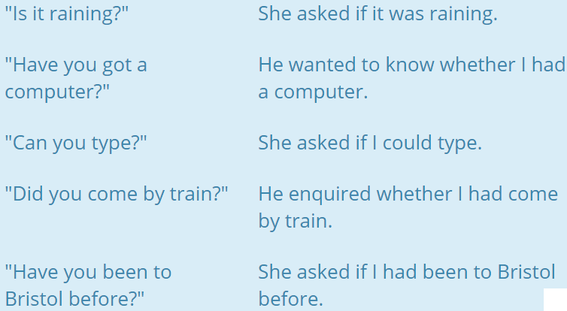
VOCABULARY

Slide 28
QUESTION WORDS
This type of question is reported by using 'ask' (or another verb like 'ask') + question word + clause. The clause contains the question, in normal word order and with the necessary tense change.

Slide 29
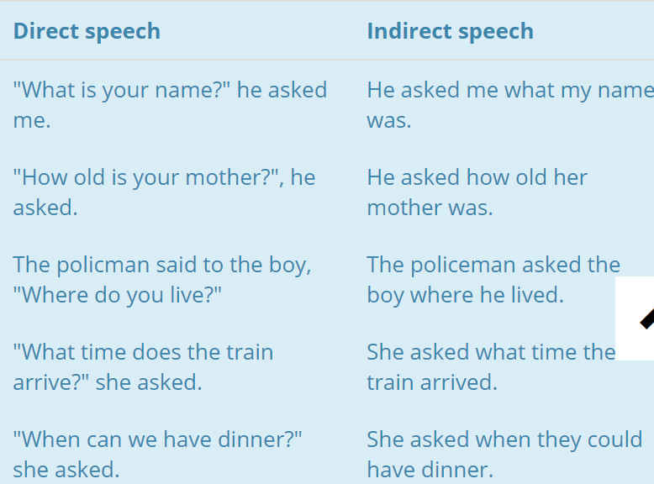
VOCABULARY

Slide 30
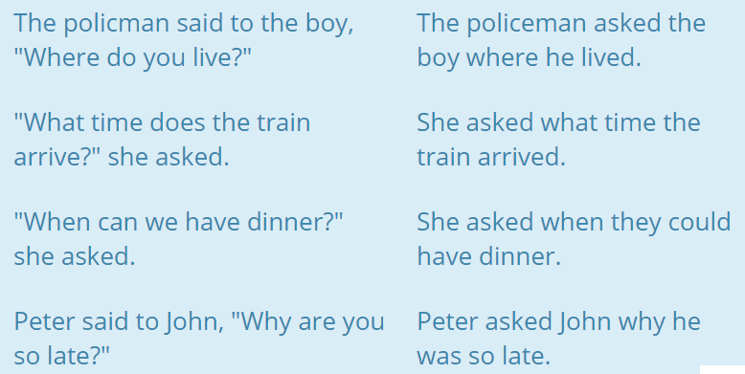
VOCABULARY

Slide 31
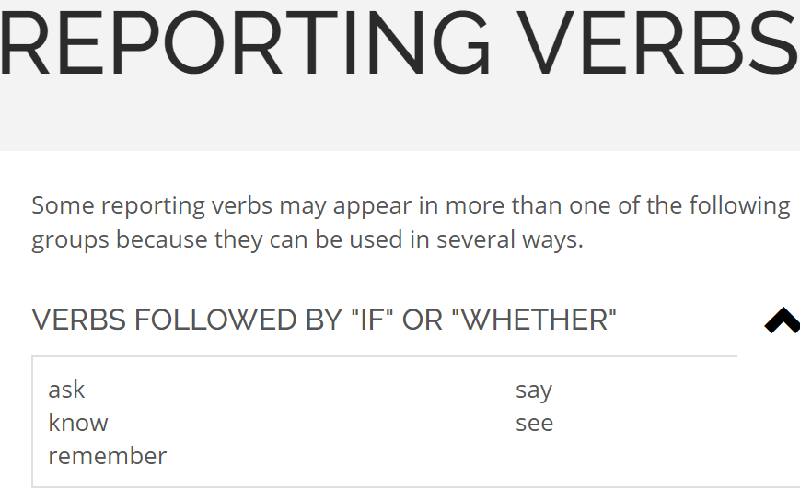
VOCABULARY

Slide 32
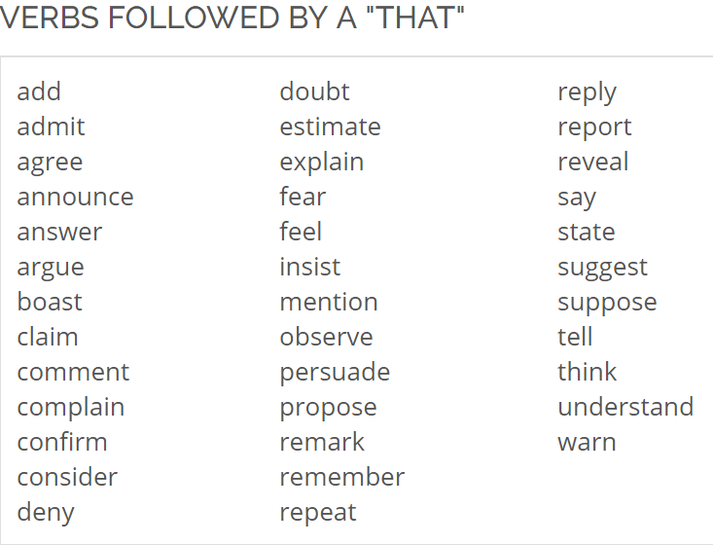
VOCABULARY

Slide 33
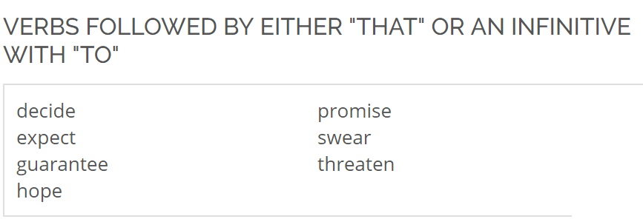
VOCABULARY

Slide 34
VOCABULARY

Slide 35
VOCABULARY

Slide 36
VOCABULARY

Slide 37
REPORTING ORDERS AND REQUESTS
When we want to report an order or request, we can use a verb like 'tell' with a to-clause: He told me to go away. The pattern is verb + indirect object + to-clause. The indirect object is the person spoken to. Other verbs used to report orders and requests in this way are: command, order, warn, ask, advise, invite, beg, teach, & forbid.

Slide 38
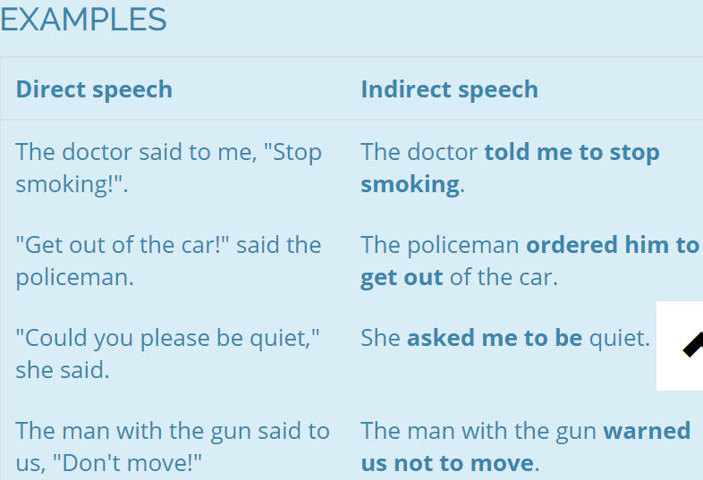
VOCABULARY

Slide 39
REQUESTS FOR OBJECTS
Requests for objects are reported using the pattern "asked for" + object.

Slide 40
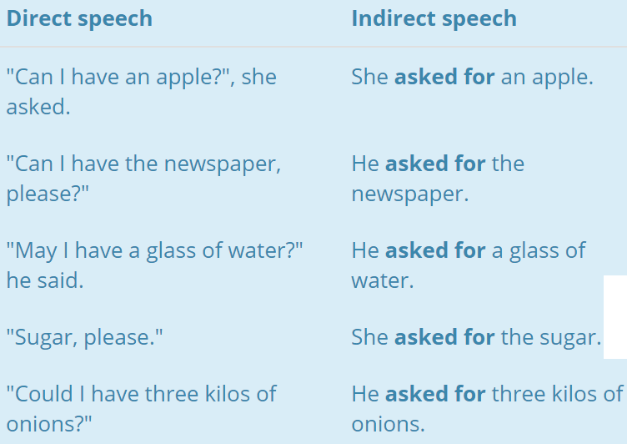
VOCABULARY

Slide 41
SUGGESTIONS
Suggestions are most often reported using the verbs suggest, insist, recommend, demand, request, and propose followed by a that clause. 'That' and 'should' are optional in these clauses, as shown in the first two examples below. Note that suggest, recommend, and propose may also be followed by a gerund in order to eliminate the indirect object (the receiver of the suggestion) and thus make the suggestion more polite. This usage of the gerund is illustrated in the fourth and fifth examples below.

Slide 42
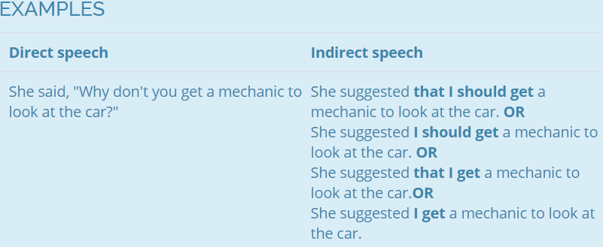
VOCABULARY

Slide 43
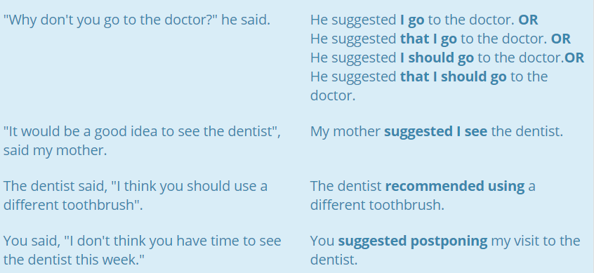
VOCABULARY

Slide 44
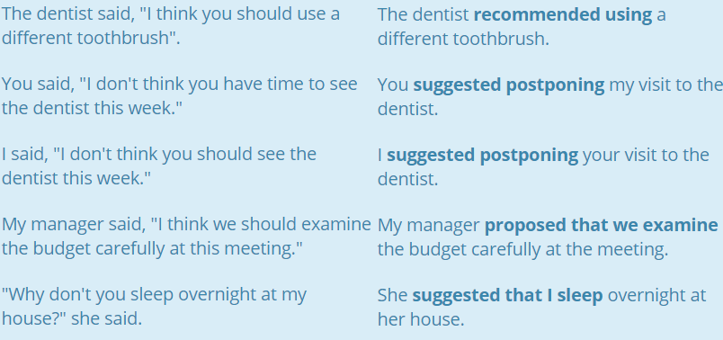
VOCABULARY

Slide 45
REPORTING HOPES, INTENTIONS, AND PROMISES
When we report an intention, hope or promise, we use an appropriate reporting verb followed by a 'that' clause with 'would' in it, or a to-infinitive clause. Verbs used in this pattern include: hope, promise, threaten, guarantee, & swear. Note that the word 'that' is optional when using a that clause, as in the first example below.

Slide 46
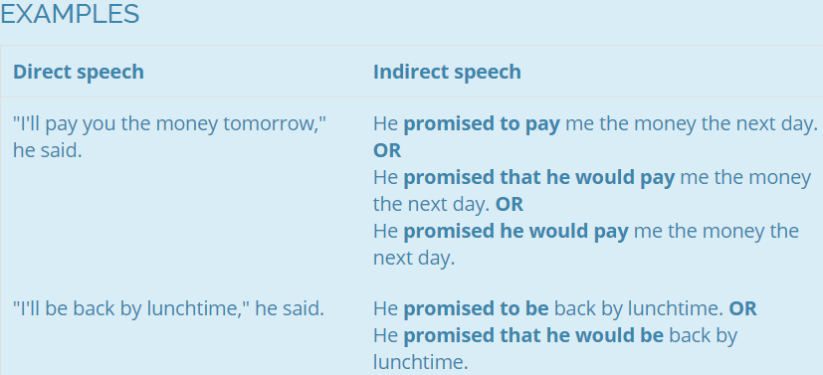
VOCABULARY

Slide 47
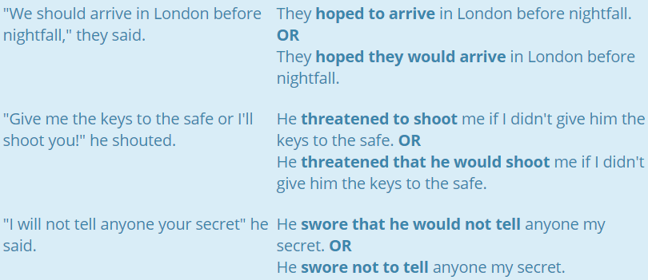
VOCABULARY

Slide 48
THANKS!!

