Slide 1
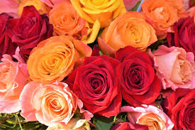
Welcome

Slide 2
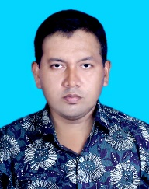
Personal details
Md.Moniruzzaman Khan
Assistant Teacher(ICT)
Sharonkhola Mohila Dakhil Madrasah
Class:Six
Subject:English
Unit:One,Lesson:5
Time:45 miniutes

Slide 3
Todays Topic
Thanks for your work

Slide 4
Learning outcomes(শিখনফল)
After Completing the lesson Students will be able to---------
Talk about people & place,
Ask & answer questions,
Practise vocabulary,
Write short paragraph.

Slide 5
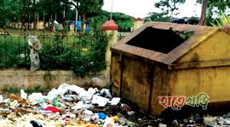
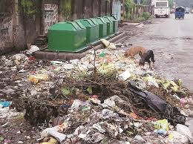
Look and Say:

Slide 6
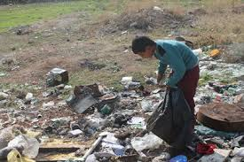
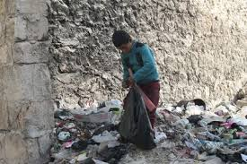
Look and Say:
Bulbul is a garbage collectors

Slide 7
Word dissection
Rubbish=garbage ,Pile=heap,Dirty=unc[ean,wake up=get up,Believe=trust,
Unhygienic=unsanitary,Turn into=transform

Slide 8
Choose the best answer from the alternatives.
Bulbul collects --------
Money
Tickets
Rubbish
Ice cream
(b)Bulbul collects rubbish at --------
Mirpur
Uttara
Sankar
gulsan
Rubbish
Sankar

Slide 9
Choose the best answer from the alternatives.
(c) Bulbul wakes up at ---------
4 o’clock
6 o’clock
7 o’clock
5 o’clock
(d) Bulbul wakes along the --------
Park
Side of the river
Home
Streets
5 o’clock
Streets

Slide 10
Choose the best answer from the alternatives.
(e)Bulbul was sick for ---------
5 days
4 days
3 days
2 days
(f) The word collect means --------
Add
Sum
Gather
together
2 days
Gather

Slide 11
(g)People put their rubbish in ------- bins.
Soil
Plastic
Metal
normal
Plastic
Answering the following questions.
What does Bulbul do?
What time does Bulbul wakes up?
How does Bulbul collect rubbish?
Why does Bulbul works hard?
Why did not Bulbul come to collects rubbish?

Slide 12
Answering questions`
Ans.(a)Bulbul collects rubbish from Sankar area in Dhaka.
Ans.(b)Bulbul wakes up at 5 o’clock everyday.
Ans.(c)Bulbul walks door to door to collect rubbish.
Ans.(d)Bulbul works hard to keep the area clean.
Ans.(e)Bulbul did not come to collect rubbish because he was sick.

Slide 13
Homework
Write 5 sentences about Bulbul

Slide 14
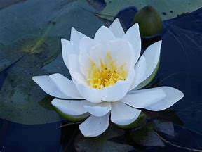
Thank you everyone

