Slide 1

Welcome
To
My English Class

Slide 2
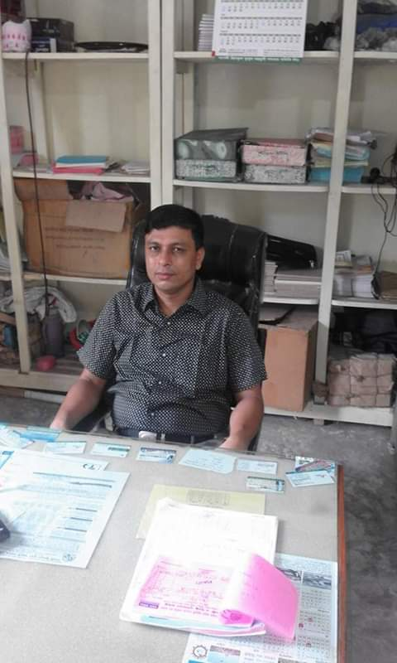
Introduction
Teacher-
Sultan Ahmed Miazi
Assistant Teacher (English)
Balia K.B.D.N.Dakhil Madrasah,Chandpur.
Mob. No.-01817106106
E-mail-sultanshapdi@gmail.com
Subject-
English For Today
Class : VI
Lesson- 5
Time- 45 Min.

Slide 3
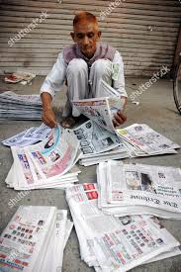
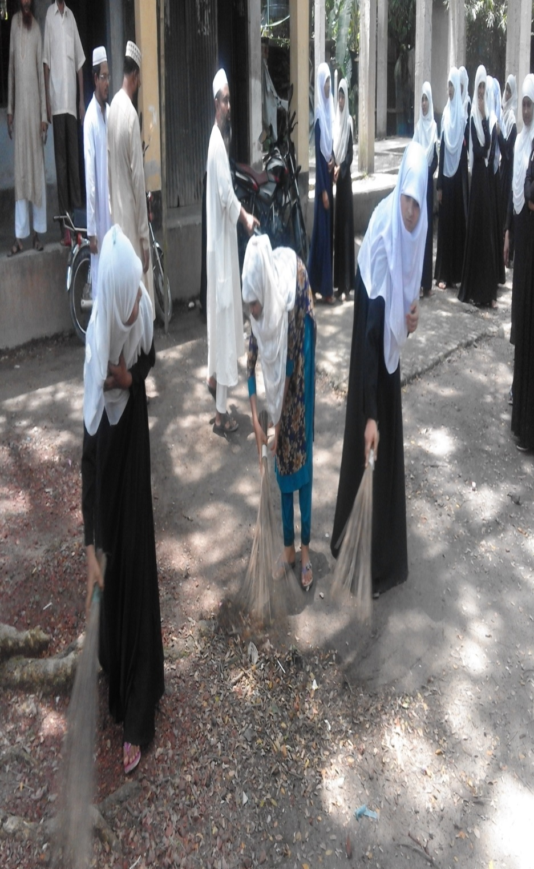


Slide 4
Thanks for your work

Slide 5
Learning Outcome-
-talk about people, places and familiar objects in short and simple sentences;
-Ask and answer questions;
-Participate in short dialogues and conversations on familiar topics;
-Read and understand texts;
-write short paragraphs;

Slide 8
Read the passage
Sec-B

Slide 11
Home Work
Write a paragraph about
‘’life of a day labor’’

Slide 12

Thanks to all

