Slide 1
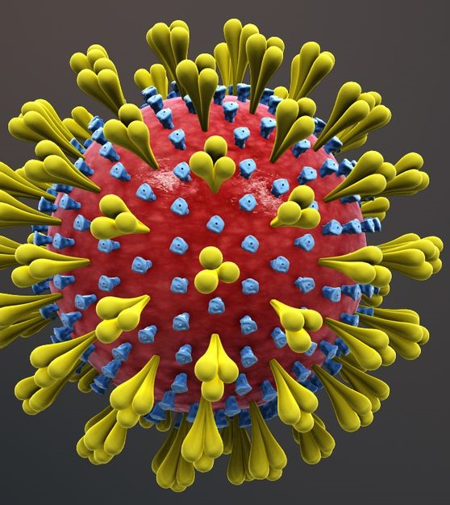
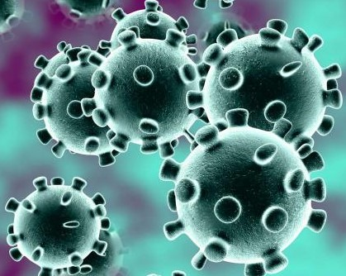
WELCOME

Slide 2
TEACHER’S IDENTITY
Mohammad Jahangir Alam
Senior Teacher.
Kaptai Al amin Nuria Dakhil Madrasah
Kaptai, Rangamati.
Mob. 01815411762
Email:mjahangirkaptai@gmail.com

Slide 3
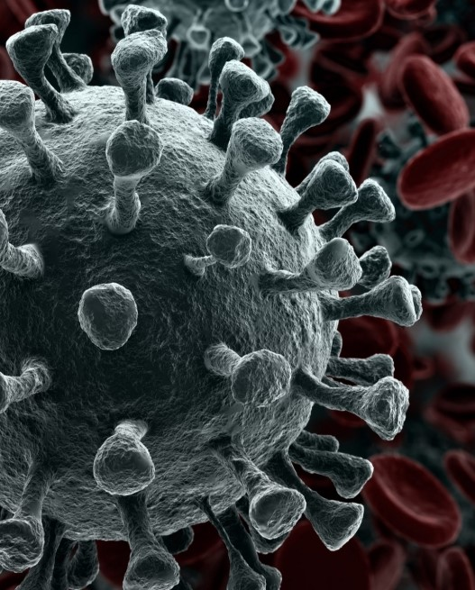
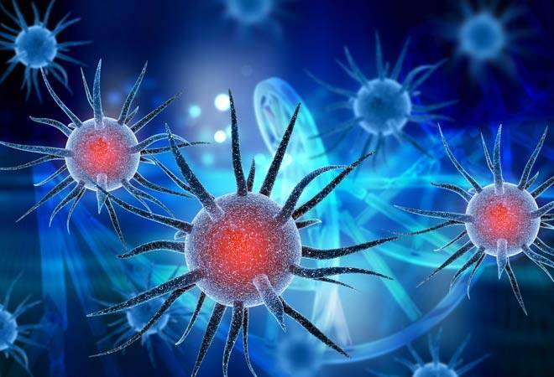
Today’s lesson is
A Paragraph on
Corona Virus Dieases

Slide 4
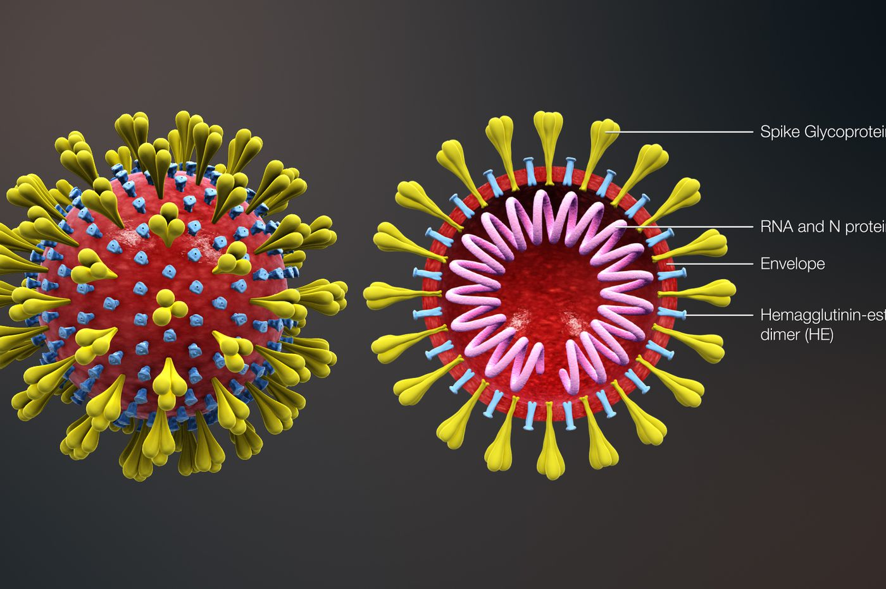
What is Corona Virus Diseases?
Corona Virus Diseases (COVID- 19) is an infectious dieases caused by a new virus . Coronaviruses belong to the subfamily Coronavirinae in the family Coronaviridae . Corona Viruses are type of virus. There are many different kinds and some cause disease. A newly identified type has caused a recent out break of respiratory illness now called COVOD-19. At present it is one of the main problems in the whole world countries. The people of Bangladesh also face this problem.

Slide 5
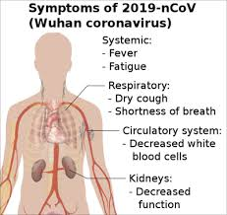
The Symptoms of Corona Virus dieases
The dieases causes respiratory illness (like the flu) with symptoms such as a cough, fever and in more severe case , difficulty breathing. It appears that symptoms are showing up in people within 14 days of exposure to the virus. It rare cases COVID-19 can lead to severe respiratory problems, kidney failure or death.

Slide 6
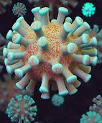
How to Spread of Corona Virus Dieases
Corona Virus dieases spreads primarily through contact with an infected person when they cough or sneeze . It also spreads when a person touches a surface or object that has the virus on it , then touches their eyes, nose or mouth . COVID-19 appeared in Wuhan, a city in China , in December 2019.

Slide 7
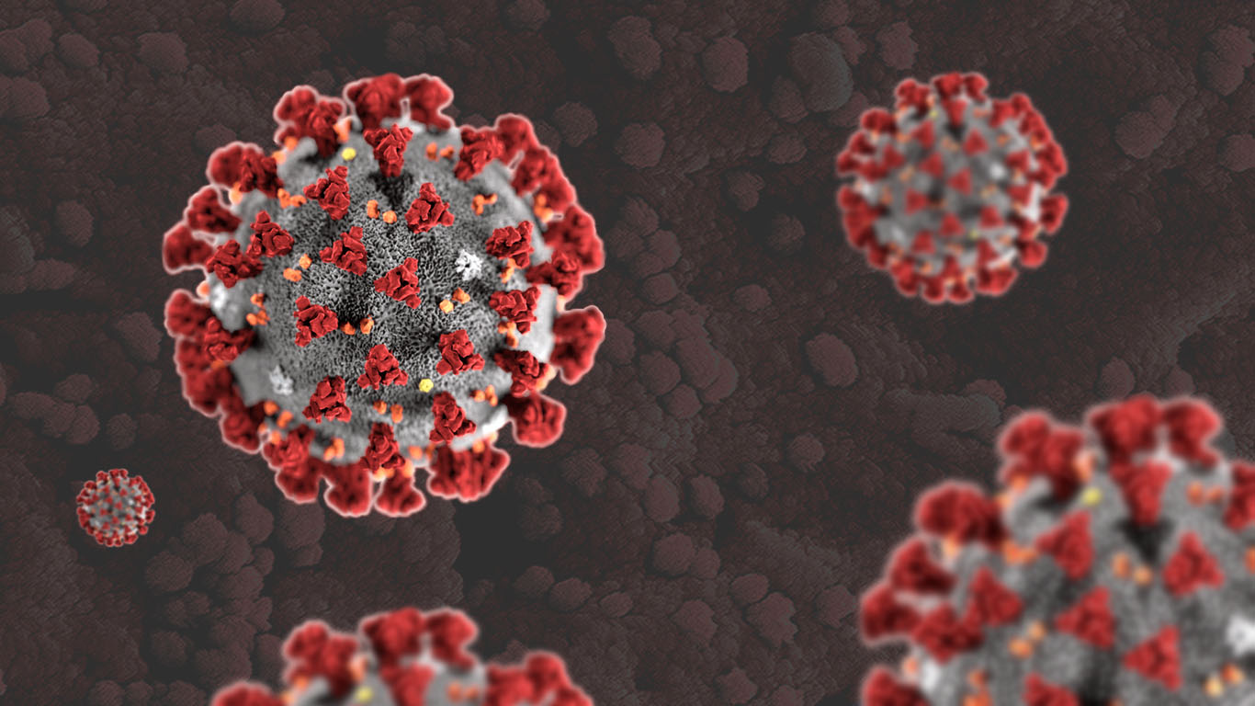
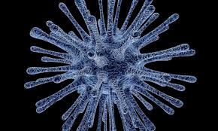
History of Corona virus
Researchers first isolated a coronavirus in 1937. They found a coronavirus responsible for an infectious bronchitis virus in birds that had the ability to devastate poultry stocks . Scientists first found evidence of human coronaviruses (HCoV) in the 1960s in the noses of people with the common cold. Two human corona viruses are responsible for a large proportion of common colds : OC43 and 229E. The name “coronavirus” comes from the crown-like projections on their surfaces. “Corona” in Latin means “halo” or “crown.”

Slide 8
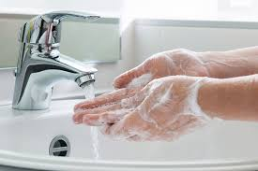
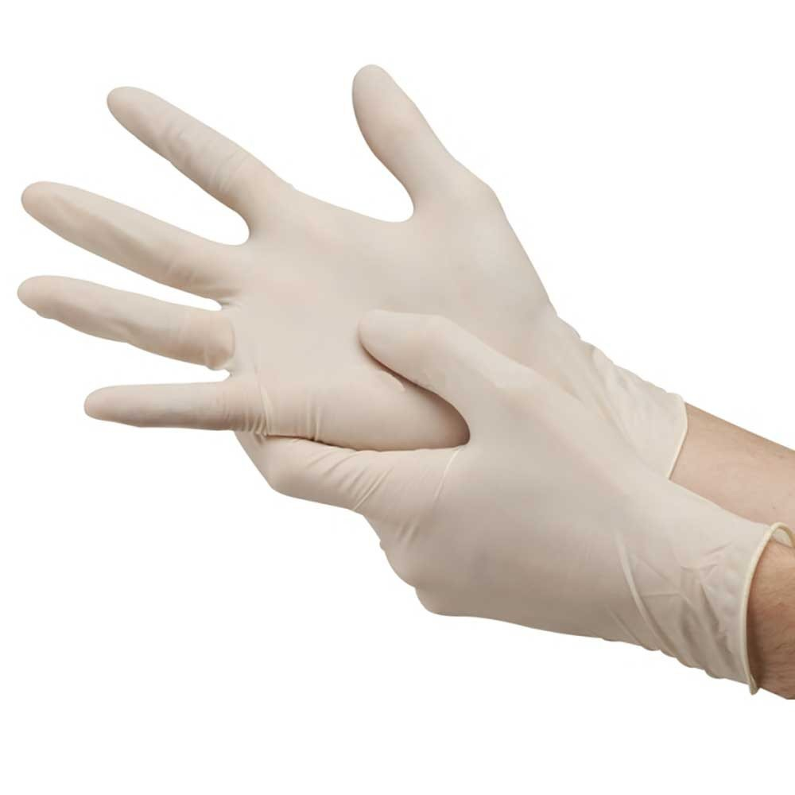
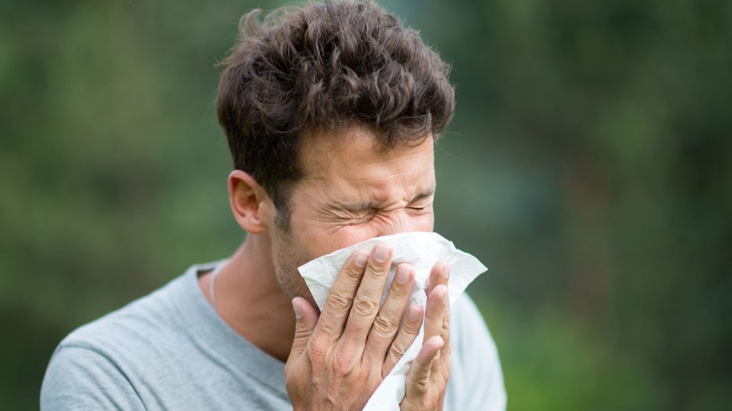
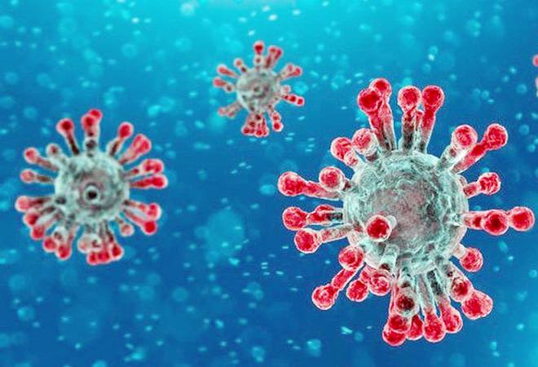
The way to get rid of it.
Now the problem is out of control. Already 200 countries effected ,about 28000 people had died and about 500000 are injured with Corona Virus . The people should awareness . The government should take proper step to control Corona Virus diease .

Slide 9
HOMEWORK
Write a paragraph on-------
Corona Virus Dieases

Slide 10
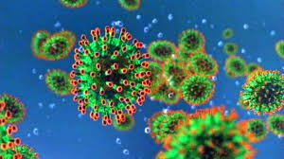
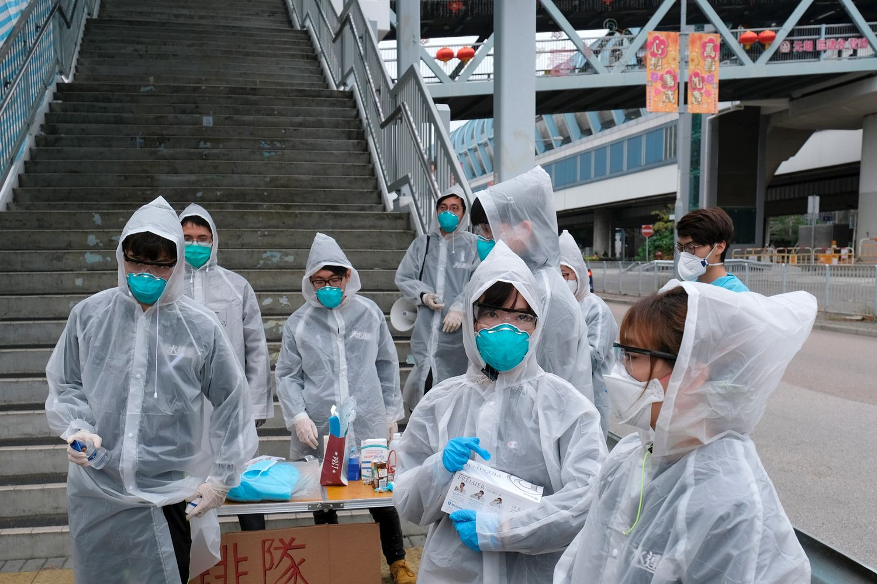
Allah bless all
Thank You

