Slide 1


Welcome

Slide 2
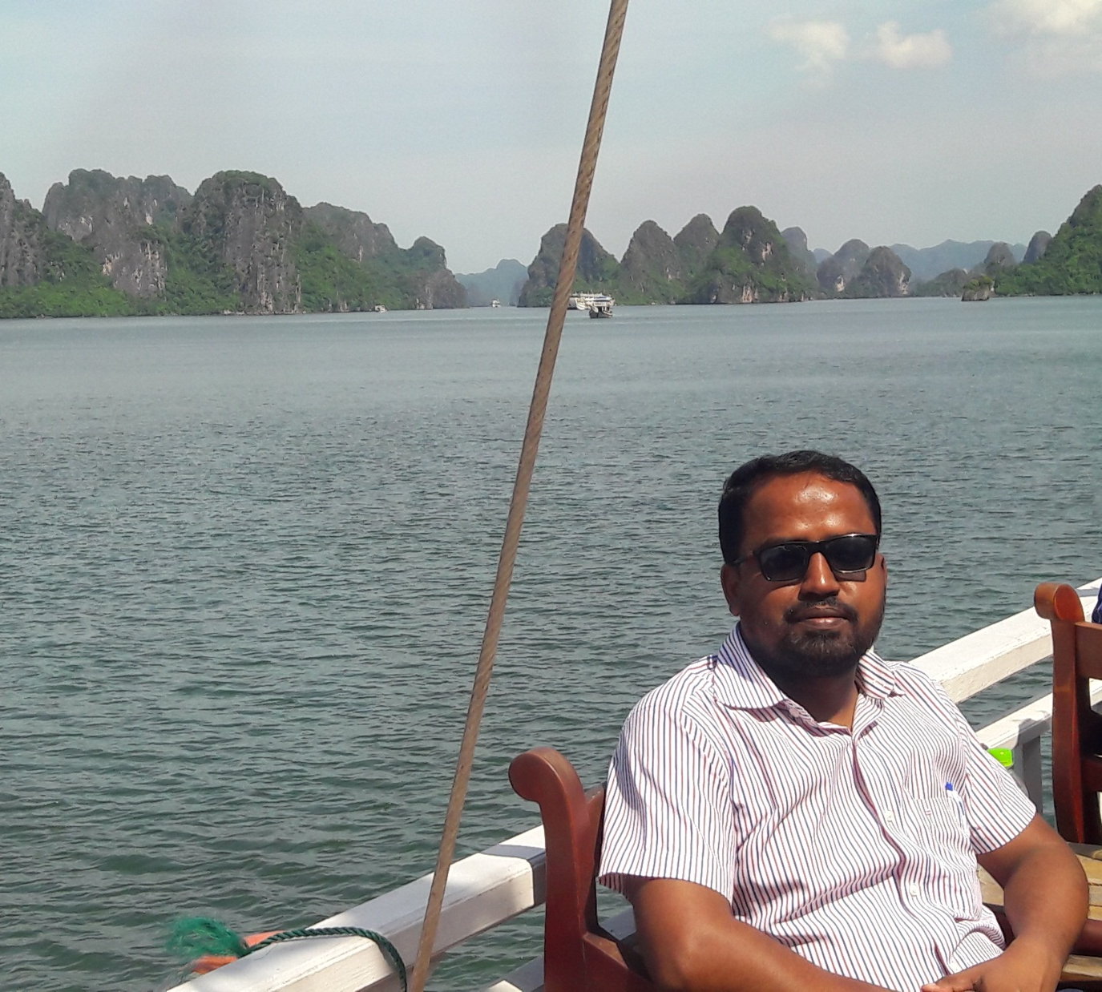
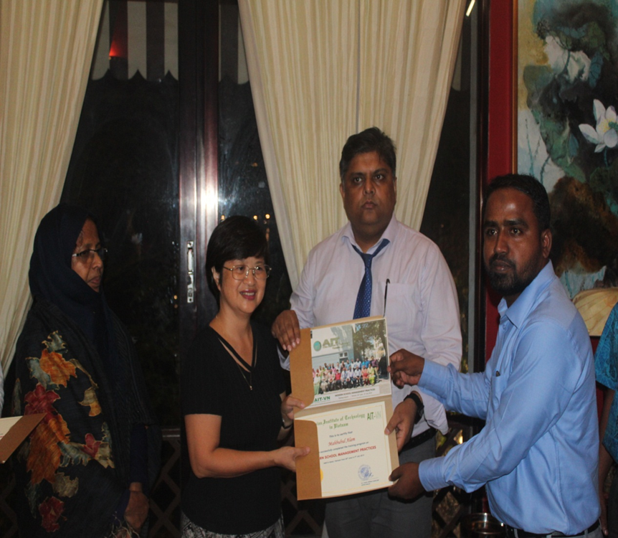
Educator’s Information
Mahbubul Alam
Assistant Teacher
Hatirdia Government Primary School
Monohardi, Narsingdi.

Slide 3
Lesson’s Information
Class: Five
Subject: English
Time: 50 minutes
Unite: 9
Lesson: 1-2
Page: 34

Slide 4
Attainable Competencies
Listening:
4.2 to enjoy and understand simple stories.
Speaking:
1.1 to say words , phrases and sentences with proper sounds, stress and intonation.
3.1 to ask and answer Wh- and Yes/No questions.
Reading:
1.5 to read words, phrases and sentences in the text with proper sounds, stress and intonation.
1.6 to recognize and read sentences, commands, greetings, questions and answers.
1.7 to read stories.
Writing:
5.1 to use full-stop, comma, question mark and exclamation mark.
10.1 to write a short piece of composion by answering a set of questions.

Slide 5
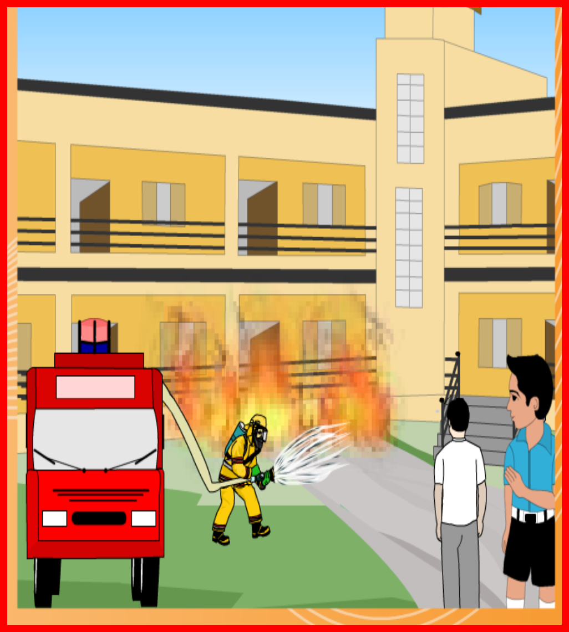

Slide 6
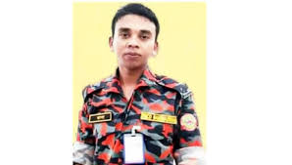
Firefighter | A person who works in a fire department
Panick | Awful fear or anxiety
Volunteer | A person who works without pay.

Slide 7
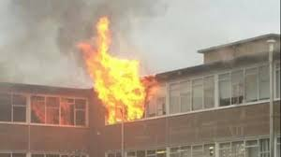
A long time ago, when Raju was in class 5, there was a fire in his school.

Slide 8
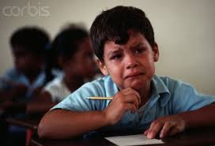
Everyone was afraid, but no one panicked.

Slide 9
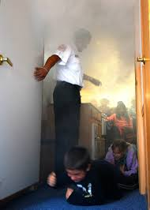
The teachers helped the students to leave the building quietly and safely.

Slide 10
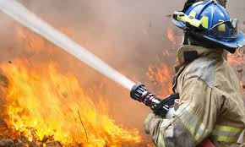
Soon the firefighters came and put out the fire.

Slide 11
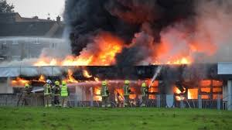
Raju watched the firefighters from the school yard. He thought about the fire and the firefighters for a long time.

Slide 12
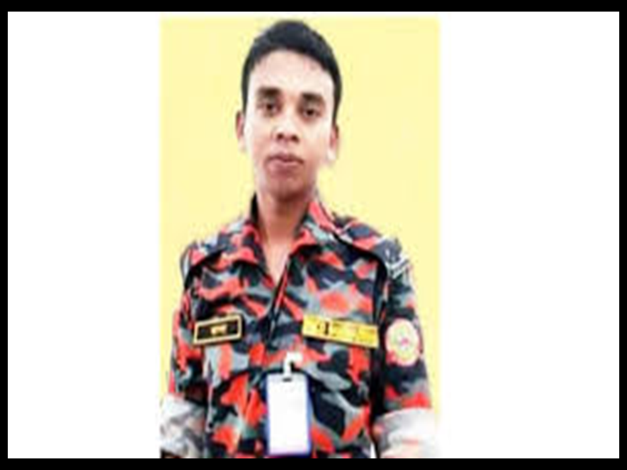
After college, Raju joined a volunteer fire department. As a volunteer, he didn’t get any money for his work. But he didn’t mind.

Slide 14
Write T for True or F for False:
Raju was a learner of class five.
Everyone was panicked.
The students left the building quietly and safely.
The teachers put out the fire.
Raju joined a volunteer fire department.
1.T 2. F 3. T 4. F 5. T

Slide 15
Fill in the blanks.
1.There was a ------------ in Raju’s school.
2.The teachers -------- the students to leave the building.
3.Everyone was -----------------.
4.The firefighters ----------------- the fire.
5.Raju joined a -------------- fire department.
a. fire
b. helped
c. afraid
d. put out
e. volunteer

Slide 16
Group: A
1. When was there a fire in Raju’s school?
Answer: A long time ago.
Group: B
2. Who was afraid?
Answer: The students was afraid.
Group: C
3. How did the students leave the building?
Answer: Quietly and safely.

Slide 17
Write five sentences about a fire accident that you was seen, answering the following questions:
When was the accident occurred?
Where was the accident occurred?
Who put out the fire?
What was the lesson of the accident?
How do we avoid fire accident?

Slide 18
See you again
1.Stay at home, stay safe
2.Breaks the chain save your community
3.Wash your hands regularly
4.Use a tissue when you are coughing
5.Use your own plate, glass and cup.
Goodbye

