Slide 1
Peace Be Upon You.
WELCOME!
HOW ARE YOU ?
Md. Sirajul Islam Jamil
Assistant. Teacher
Cantonment Public School & College
Momenshahi
ENGLISH FIRST PAPER
Class : Nine & Ten
Unit – Four Lesson – 1 (The Ferry Boat)

Slide 2
Peace Be Upon You
WELCOME
HOW ARE YOU ?

Slide 4
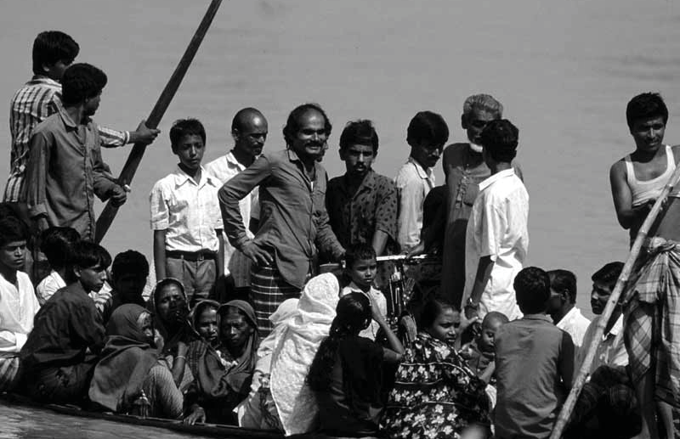

Slide 5
Answer the following questions
1 Where can you findthis kind of boat?
2 Why does the boatman carry passengers across a river?
3 Why do people use country boats?

Slide 6
In land area Bangladesh is (1)larger than Sri Lanka, but (2) smaller than India. China is, of course, (3) biggest of all four countries. Sri Lanka has the (4) least population among the four countries. However, China has the (5) largest population shown in the chart. In fact, China has the (6) most population in the world and India has the (7)secind highest population in the world. On the other hand, China has the (8) _least__ growth rate among the 4 countries. Bangladesh has (9) lower/lesser growth rate than India, but higher birth rate than (10)China and (11) Srilanka

Slide 7
“I don’t exactly know how I should go about my plan. But one thing I know for sure, I (1) will need a lot of money for the work. If I had 5 million taka, I (2)would start an adult education centre. Then if I found an expert on adult education, I (3)would prepare learning materials for the people. If you ask him what the materials (4)might look like, he (5)would be able to explain in details. I know if the people attended the classes at the centre, they (6)will learn how to read, write and count. I (7)will definitely give time to this project. But to carry out the project successfully I (8)may have to live in the village almost permanently. Here is a problem. Who (9) will take care of my flat in Dhaka? If I had a good, reliable man, I (10) would make him caretaker of my flat. But where (11) can I find such a man?

Slide 8
Skilled workforce
1.Describe briefly the things that have made the present world smaller.
2. Give reasons why a common language is needed in today’s world.
3. Why is English needed all the more in Bangladesh?
4.How can our youths become skilled workforce?

Slide 9
Stay conscious
Simple / Clairvoyant / Articulate / Effective / Influential

Slide 10
So much for today
Thank you all

