Slide 1
Dear Students
Notes:
Welcome the learners.

Slide 2
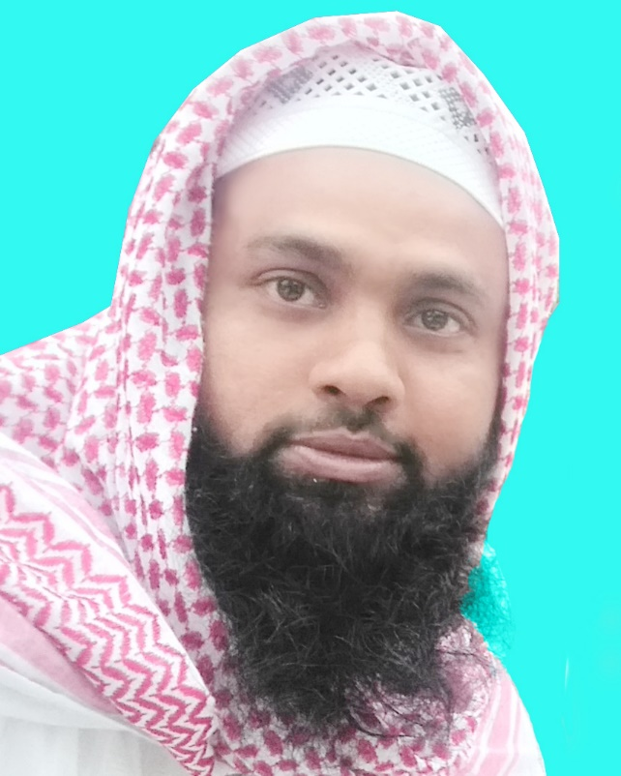
Introduction
Md. Jakirul Islam
BA (Hons’), MA in English, B.Ed, LL.B
Assistant Teacher, English
Shaitshala Adarsha High School
& College
Brahmanpara, Cumiilla
Class-IX-X
Subject: English 2nd Paper
Notes:
Giving Identity of teacher & class.

Slide 3
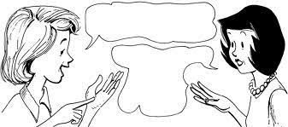
What fruits do you like, Sumi?
I like mango, and date. What do
You like,
Rani?
Rani asked Sumi what fruits she (Sumi) liked.
Sumi replied that she liked mango and date and asked her/Rani what she (Rani) liked.
What can be Today’s lesson?
Notes:
Preparing the students for the lesson.

Slide 4
Today’s lesson is:
Direct Speech &
Indirect Speech
in Passage
Notes:
Lesson declaration.

Slide 5
Learning outcomes
After the end of this lesson, learners will be able to---
Convert direct speech into indirect in passage.
Notes:
Target of today’s class.

Slide 6
Flash Back

Slide 7
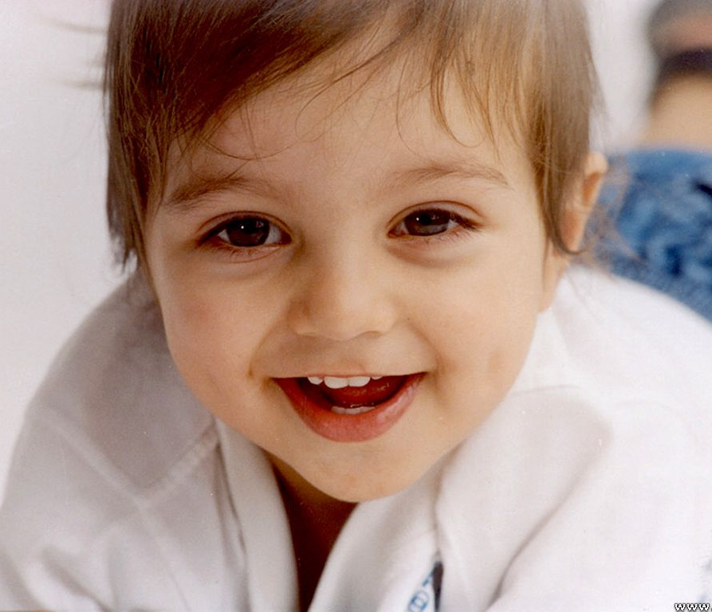
Remember
If the reporting verb is in present & future tense, there will be no change of the verb of the reported speech.
He says, “ My mother loves me more than her life.”
Direct speech
Indirect speech
He says that his mother loves him more than her life.
Notes:
Practice & implementation of verb shown through example.

Slide 8
” I want to feel free as the flowers.”
Direct speech
Change of Tense (Verb)
Indirect speech
He told that he wanted to feel free as the flowers.
Notes:
Practice & implementation of verb shown through example.

Slide 9
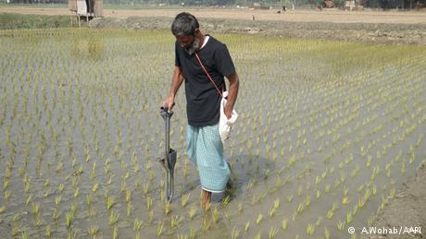
He said to me, “ I was working in the field.”
Direct speech
Change of Tense (Verb)
Indirect speech
He told that he had been working in the field.
Notes:
Practice of Verb through example.

Slide 10
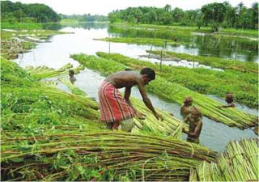
He said, ‘’We have finished our work.”
Direct speech
Change of Tense (Verb)
Indirect speech
He said that they had finished their work.
Notes:
Practice & implementation of verb shown through example.

Slide 11
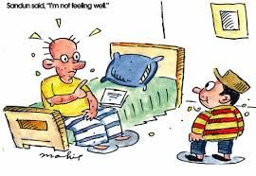
The student said, ‘May I leave, sir?”
Direct speech
Change of Tense (Verb)
Specific Word
Indirect speech
The student respectfully asked if he might leave.
Notes:
Practice & implementation of Verb & Specific Word through example.

Slide 12
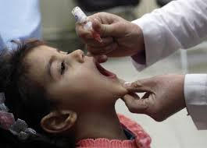
Shima said, “I took medicine yesterday.”
Direct speech
Change of Tense (Verb)
& Specific Word
Indirect speech
Shima said that she had taken medicine the previous day.
Notes:
Practice & implementation of Verb & Specific Word through example.

Slide 13
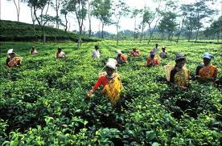
The worker says, “we work in the tea garden.”
Direct speech
Change of Tense (Verb)
Indirect speech
The worker says that they work in the tea garden.
Notes:
Practice & implementation of verb shown through example.

Slide 14
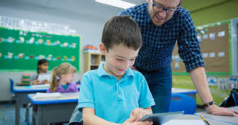
The speeches of ‘The teacher’
The speeches of ‘I’
The teacher said to me, “Do you understand the point?” “Yes,” said I. “But I have some other problems.” “Then come to my room in the afternoon. I am busy now,” said he. “Thank you, sir,” said I. “I will come on time today. Should I need to bring any book?” “No,” said the teacher.
The teacher said to me, “Do you understand the point?” “Yes,” said I. “But I have some other problems.” “Then come to my room in the afternoon. I am busy now,” said he. “Thank you, sir,” said I. “I will come on time today. Should I need to bring any book?” “No,” said the teacher.
Notes:
A demonstration of a passage direct speech.

Slide 15
The teacher said to me, “Do you understand the point?”
Indirect: The teacher asked me if I understood the point.
“Yes,” said I. “But I have some other problems.”
Indirect: I replied in the affirmative and added that I had some other problem.
Let’s divide the speeches.
“Then come to my room in the afternoon. I am busy now,” said he.
Indirect: He told me then to go to his room in the afternoon and added that he was busy then.
“Thank you, sir,” said I. “I will come on time today. Should I need to bring any book?”
Indirect: I respectfully thanked the teacher/him and added that I would go on time that day and also asked if I should need to bring any book.
“No,” said the teacher.
Indirect: The teacher replied in the negative.
Notes:
Dividing the speeches of persons included in the passage.

Slide 16
The teacher said to me, “Do you understand the point?” “Yes,” said I. “But I have some other problems.” “Then come to my room in the afternoon. I am busy now,” said he. “Thank you, sir,” said I. “I will come on time today. Should I need to bring any book?” “No,” said the teacher.
Indirect
The teacher asked me if I understood the point.
I replied in the affirmative and added that I had some other problem.
He told me then to go to his room in the afternoon and added that he was busy then.
I respectfully thanked the teacher/him and added that I would go on time that day and also asked if I should need to bring any book.
The teacher replied in the negative.
Notes:
Showing question & answer.

Slide 17
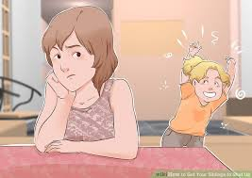
The speeches of ‘Sanjida’
The speeches of ‘her brother’
Sanjida said to her brother, “Where are you going?” “I am going to play cricket.” “ It is time to read. Don’t go now,” said she. “I will not read now because I have an important match today,” said he.
Sanjida said to her brother, “Where are you going?” “I am going to play cricket.” “ It is time to read. Don’t go now,” said she. “I will not read now because I have an important match today,” said he.
Notes:
A demonstration of a passage direct speech.

Slide 18
Sanjida said to her brother, “Where are you going?”
Indirect: Sanjida asked her brother where he was going.
“I am going to play cricket.”
Let’s divide the speeches.
Indirect: He replied that he was going to play cricket.
“ It is time to read. Don’t go now,” said she.
Indirect: She told that it was time to read and forbade to go then.
“I will not read now because I have an important match today,” said he.
Indirect: He told that he would not read then because he had an important match that day.
Notes:
Dividing the speeches of persons included in the passage.

Slide 19
Sanjida said to her brother, “Where are you going?” “I am going to play cricket.” “ It is time to read. Don’t go now,” said she. “I will not read now because I have an important match today,” said he.
Indirect
Sanjida asked her brother where he was going.
He replied that he was going to play cricket.
She told that it was time to read and forbade to go then.
He told that he would not read then because he had an important match that day.
Notes:
Showing question & answer.

Slide 20
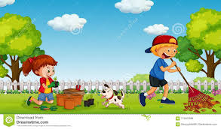
The speeches of
‘Rina’
The speeches of
‘Hasan’
“What a beautiful garden it is! Have you made this garden, Hasan?” said Rina. “Yes, I have made it myself. Gardening is my hobby,” said Hasan. “What is your hobby?” “My hobby is reading books,” said Rina.
“What a beautiful garden it is! Have you made this garden, Hasan?” said Rina. “Yes, I have made it myself. Gardening is my hobby,” said Hasan. “What is your hobby?” “My hobby is reading books,” said Rina.
Notes:
A demonstration of a passage direct speech.

Slide 21
“What a beautiful garden it is! Have you made this garden, Hasan?” said Rina.
Indirect: Rina exclaimed with joy that it was a beautiful garden and asked Hasan if he had made that garden.
Let’s divide the speeches.
“Yes, I have made it myself. Gardening is my hobby,” said Hasan. “What is your hobby?”
Indirect: Hasan replied in the affirmative that he had made it himself and added that gardening was his hobby and asked what her hobby was.
“My hobby is reading books,” said Rina.
Indirect: Rina replied that her hobby was reading books.
Notes:
Dividing the speeches of persons included in the passage.

Slide 22
“What a beautiful garden it is! Have you made this garden, Hasan?” said Rina. “Yes, I have made it myself. Gardening is my hobby,” said Hasan. “What is your hobby?” “My hobby is reading books,” said Rina.
Indirect
Rina exclaimed with joy that it was a beautiful garden and asked Hasan if he had made that garden.
Hasan replied in the affirmative that he had made it himself and added that gardening was his hobby and asked what her hobby was.
Rina replied that her hobby was reading books.
Notes:
Showing question & answer.

Slide 23
Group Work
10 min
For Group- A & C
The new teacher entered the classroom and said, “Can you tell me what I should do now?” “No, sir,” said one of the students. The teacher smiled and said, “Try to guess.” “You should introduce yourself to us,” another student said. “Thank you,” said the teacher. “You are really brilliant.”
For Group- B & D
Mina said to Rina, “When does your Test Examination commence?” “It commences on 9 November,’’ said she. “Your Test Examination is knocking at the door and you don’t have a lot of time,” said Mina. “You’re right,” said Rina.
Notes:
Arrangement of Group Work.

Slide 24
The new teacher entered the classroom and said, “Can you tell me what I should do now?” “No, sir,” said one of the students. The teacher smiled and said, “Try to guess.” “You should introduce yourself to us,” another student said. “Thank you,” said the teacher. “You are really brilliant.”
Answer for Group- A & C
The new teacher entered the classroom and asked students if they could tell him what he should do then.
One of the students respectfully replied in the negative.
The teacher smiled and told (them/students) to try to guess.
The teacher smiled and told (them/students) to try to guess.
Another student told that he should introduce himself to them.
The teacher thanked him and told that he was really brilliant.
Notes:
Feedback of the Group Work-A & C.

Slide 25
The new teacher entered the classroom and said, “Can you tell me what I should do now?” “No, sir,” said one of the students. The teacher smiled and said, “Try to guess.” “You should introduce yourself to us,” another student said. “Thank you,” said the teacher. “You are really brilliant.”
Answer for Group- B & D
Mina asked Rina when her Test Examination commenced.
She replied that it commenced on 9 November.
Mina told that her Test Examination was knocking at the door and she didn’t have a lot of time.
Rina told (Mina) that she was right.
Notes:
Feedback of the Group Work-B & D.

Slide 26
Home work
Three direct passages into indirect passages
from the Practice Book.
Notes:
Assignment at home.

Slide 27
“Have you done your home-works?” The mother said to the daughter. “No, I’ve forgotten”, said the daughter. “That’s bad. You must be more careful about your home-works. By doing so, you can’t expect to do well in your studies”, said the mother.
“How lovely the toy is! I’ll buy it”, said Tonim. “No, it is not durable. Tomorrow we will visit another village fair. Then you can buy another toy. Let’s go now”, said mother. “You must buy me a good toy”, said Tonim. “Yes”, replied she.
The teacher said to the boy, “Do you think that honesty is the best policy?” The boy said, “Yes, sir. I think so.” “Then learn to be honest from your boyhood”, said the teacher. “Thank you, sir”, said the boy. May Allah grant you a long life”, said the teacher to the boy.
Notes:
Tell the students to mark the direct passages.

Slide 28
Notes:
End of class with greetings.

