Slide 1
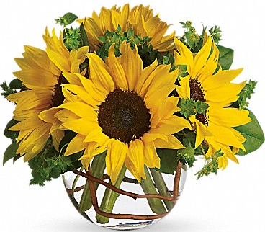
Welcome

Slide 2
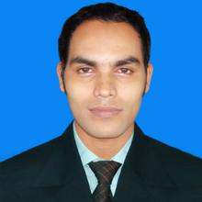
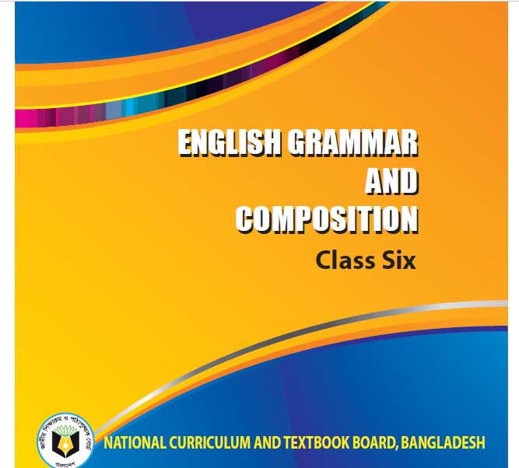
Sabuj Bhattacharjee
Computer Demonstrator
Raozan Arjamoatreya Institution
Raozan, Chittagong
Class : six
Sub : English Grammar and composition
Unit: One
Time : 50 Minutes

Slide 3
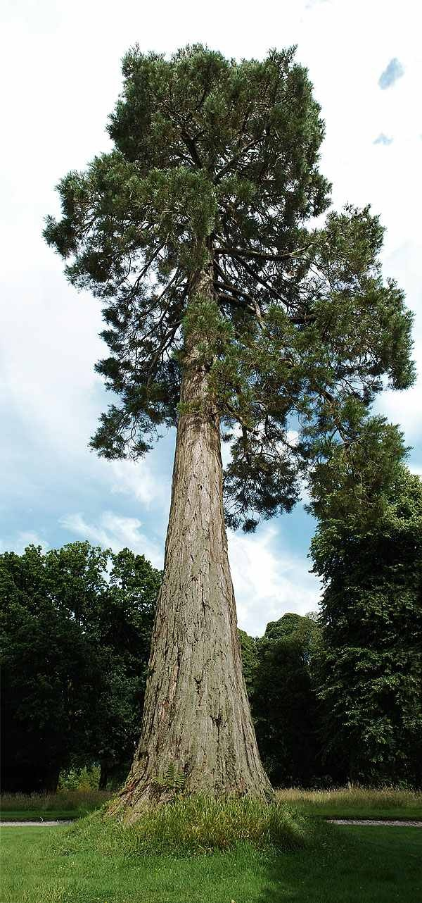
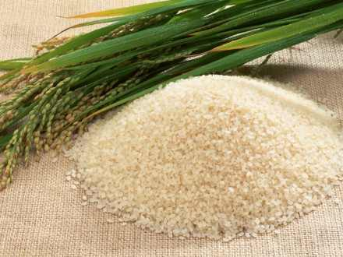
Seven candles
Tall tree
Ten kilo rice
Beautiful flower

Slide 4
ADJECTIVE
Today’s TOPIC
Page: 9-11

Slide 5
By the end of this class students will able to---
Describe the definition of Adjective
Say the classification of Adjective
Identify the different types of Adjective

Slide 6
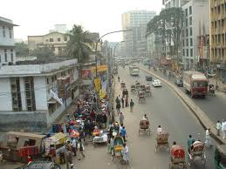
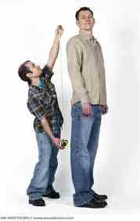
Dhaka is a big city
Kamal is a tall boy
He is an honest man
Adjective of quality

Slide 7
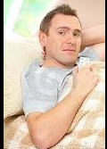
I ate some rice
We have enough talk over the mater.
I did not feel any better even after talking rest.
Adjective of quantity

Slide 8
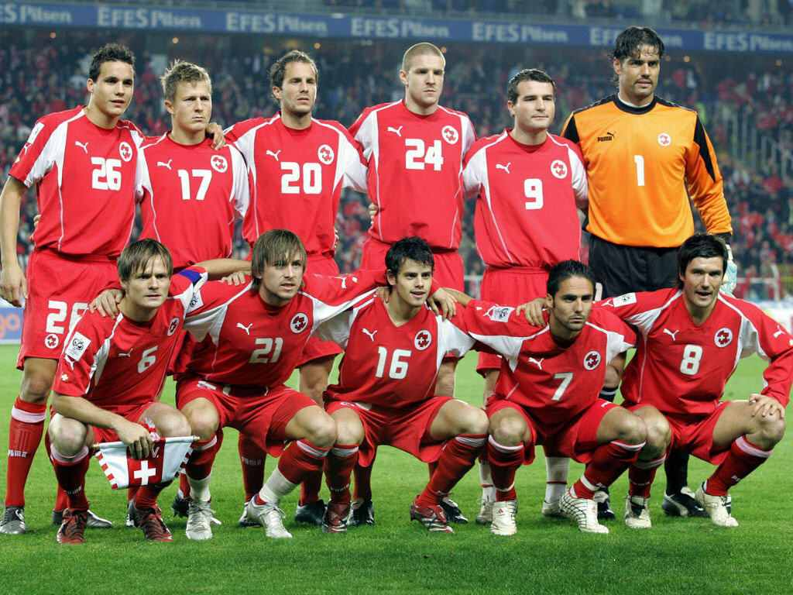
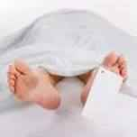
1. A football team has eleven players.
Every man must die.
2. Several people were killed in the gunfight.
Adjective of number

Slide 9
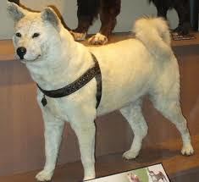
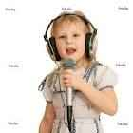
I found this dog on the street last night.
That girl singing on the stage is cute.
Demonstrative Adjective

Slide 10
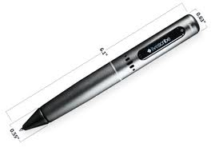
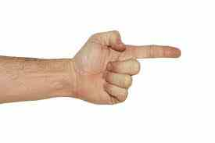
Whose pen is this?
Which book did you look for?
What manner of man is he?
Interrogative Adjective

Slide 11
KINDS OF ADJECTIVE
ADJECTIVE
Adjective of quality
Adjective of quantity
Adjective of number
Demons-
trative adjective
Interroga-tive adjective

Slide 12
S
Group Work
What are the types and what are the adjective? Write two example on each adjective.

Slide 13
Home Tasks
Write the name of the adjective of the following words :
Honest, some, Enough, Which, What, Any, eleven, this, That, Every, Several, Big, Tall.

Slide 14

Thank You All

