Slide 1
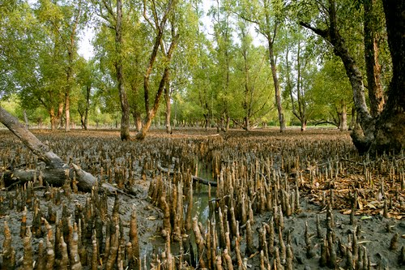
WEL
COME

Slide 2
Introduction
Amzad Hussain Rasel
At Teacher
Amria Islamia Alim Madrasah
Dakshin Sunamgonj.
E-mail : amzadhrasel1981@gmail.com

Slide 3
Introduction of lesson
English First Paper
Class - ix-x.
Unit - 08
Lesson - 01

Slide 4
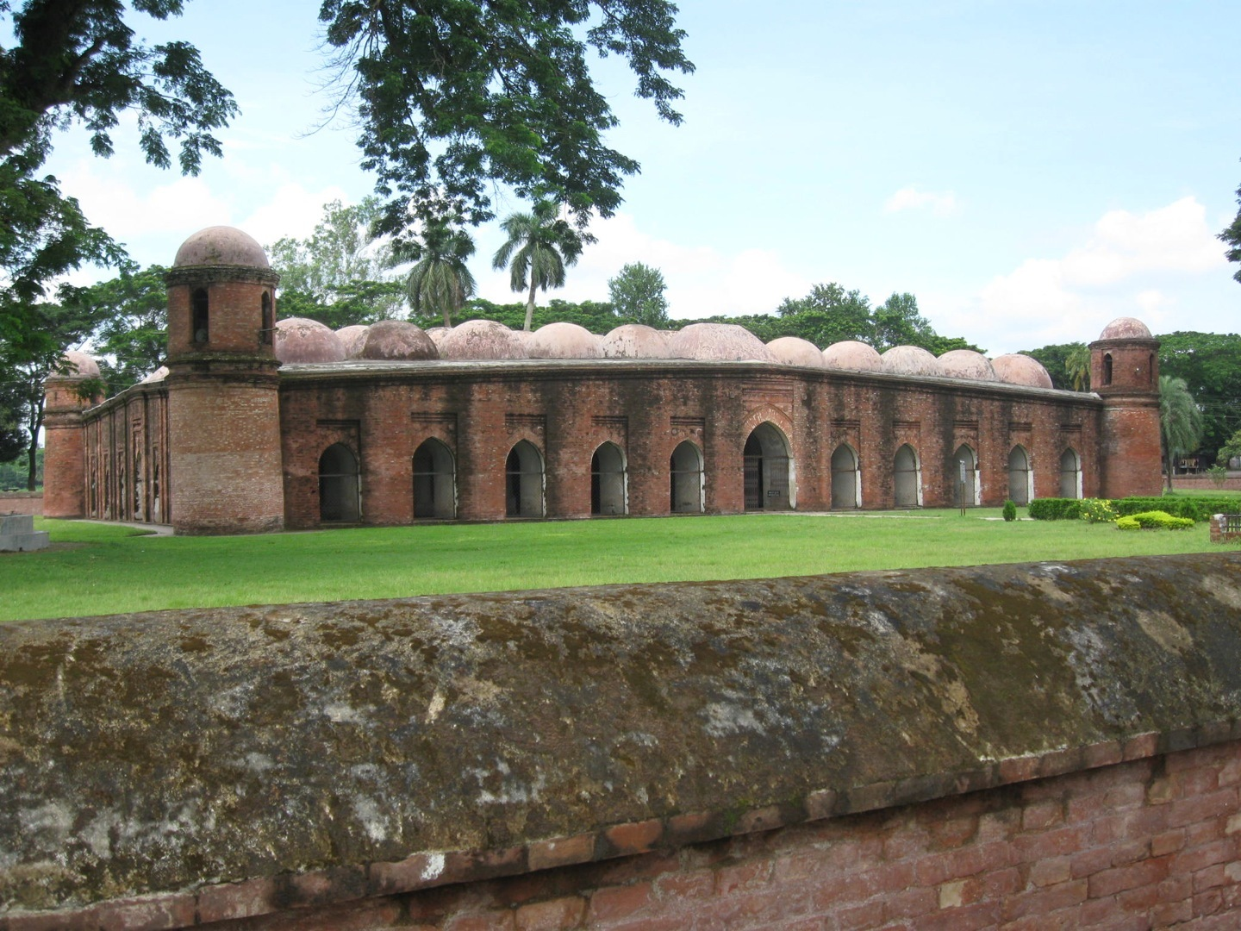
Look at the picture? Share about it with your teacher and mates.
This is the Shat Gombuj Mosque. It is one of the historical site of Bangladesh. It is also one of the world heritage of Bangladesh.

Slide 5
Today our lesson is
The Shat Gambuj Mosque
Unit- 08
Lesson- 01

Slide 6
Learning Outcomes
After this lesson the students will be able to---
1. talk about the picture.
2. listen for specific information.
3. read and understand the text through silent reading.
4. learn about the meaning from the key word.
5. write a paragraph on the basis of the text.

Slide 7
B. Read the text and complete the question given below:
‘Heritage’ is what we inherit from the past, live with them in the present and then pass on to our children or future generation. Our unique source of life and inspiration is our cultural and natural heritage. When we speak of ‘World Heritage’, it indicates places and sites that we got from the past and pass on to the future generation of the entire world.
The ‘Shat Gambuj Mosque’ in Bagerhat is such a heritage. It became a UNESCO World Heritage Site in 1985.Originally, the historic Mosque City was known as ‘ Khalifatabad’. It is situated at the outskirts of Bagerhat town--- not very far from the dense angrove forest of the Sundarbans. Khalifatabad was a Muslim colony. It was founded by the Turkish general, a saint warrior Ulugh Khan Jahan in the 15th century. The infrastructure of the city reveals significant technical skills in many mosques as well as early Islamic monuments. Baked bricks are used for the construction of the buildings. The planning of the city is distinctly dominated by Islamic architecture and the decorations are a combination of Mughal and Turkish architecture.

Slide 8
Khan Jahan built a network of roads, bridges, public buildings and reservoirs to make the city habitable. There are about 360 mosques in the city. Among them the most remarkable is the multi-domed Shat Gombuj Mosque. The mosque is unique in the sense that it has 60 pillars that support the roof, with 77 low height domes. The 4 towers at 4 corners have smaller domes on the roof as well. The vast prayer hall has 11 arched doorways on the east and 7 each on the north and south for light and ventilation. It has 7 aisles running along the length of the mosque and 11 deep curves between the slender stone columns. These columns support the curving arches created by the domes. The thickness of the arches is 6 feet and have slightly narrowing hollow and round wall. The west wall in the interior has 11 ‘mihrabs’ (niche in mosque pointing towards Makkah). These mihrabs are decorated with stonework and terracotta. The floor of the mosque is made of brick. Besides being used as a prayer hall, Khan Jahan used the mosque as his court also. Today, it is one of the greatest tourist attractions and one of the best architectural beauties of Bangladesh.

Slide 9
First read the questions then choose the best answer.
1. How many domes in the Shat Gambuj mosque.
a) 66 b) 60 c) 77 d) 70
$$$$
2. Where is the Shat Gombuj Mosque situated in?
a) centre of Bagerhat b) out of Bagerhat
c) suburb of Bagerhat d) centre of Khulna
$$$$
3. Which have worn away with the passage of time?
a) pillars b) domes c) doors d) roof
$$$$
4. When Khan Jahan Ali established this mosque?
a) 14-th century b) 13-th century
c) 15-th century d) 16-th century
$$$$

Slide 10
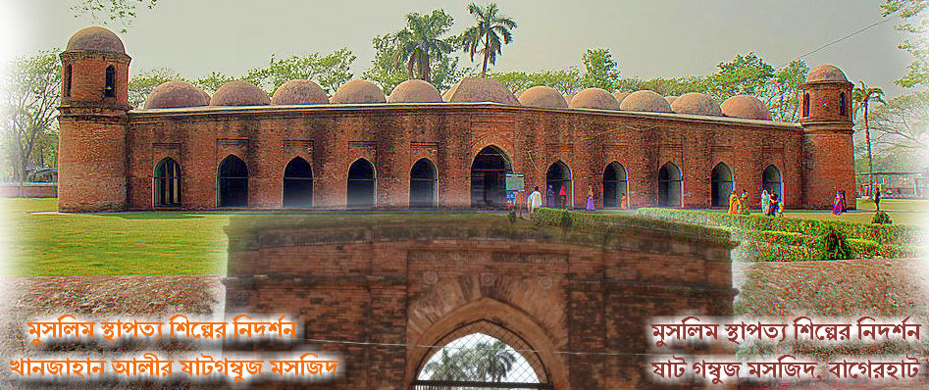
At a glance outside of the mosque.
77 low height dooms
Four corners have 4 smaller dooms
11 Arched doorways on east

Slide 11
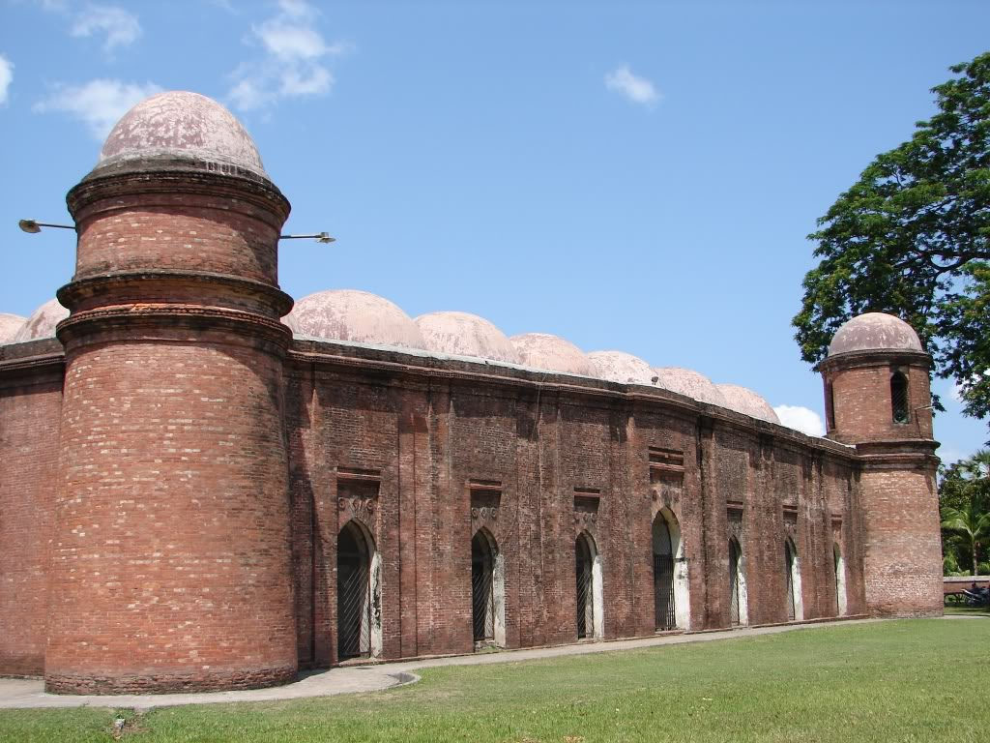
7 Arched doorways each on north and south each

Slide 12
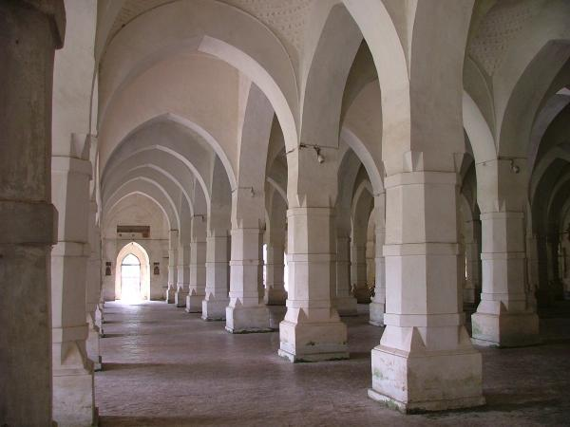
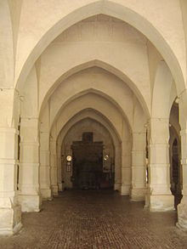
What do you see inside of the mosque?

Slide 13
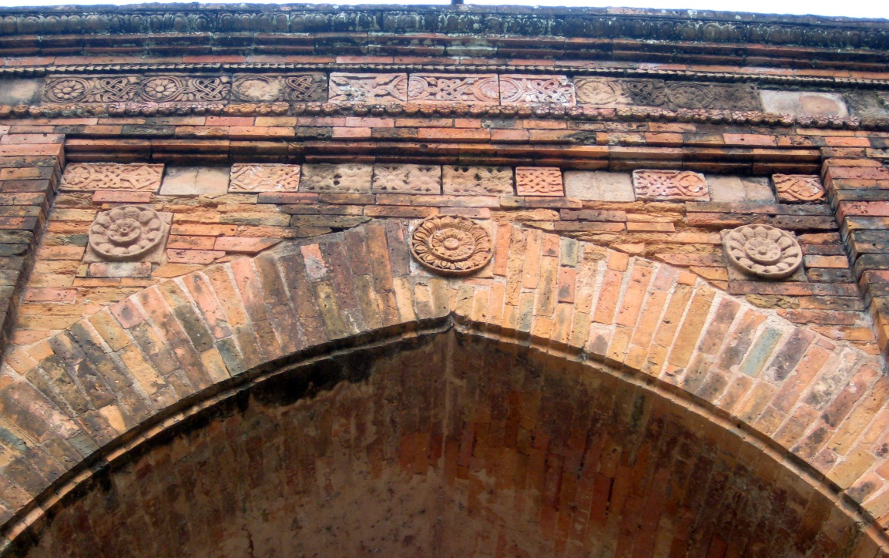
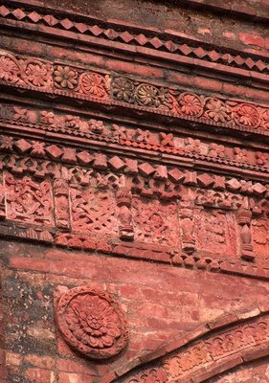
The interior western wall of the mosque is beautifully decorated with terracotta .

Slide 14
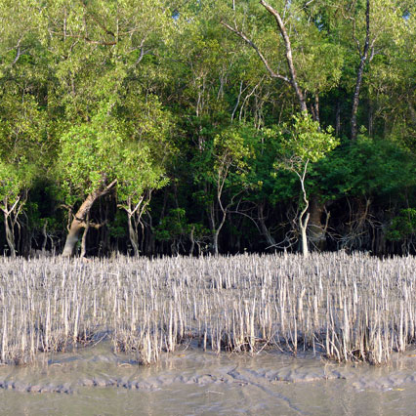
Mangrove
Key Words
Meaning
Coastal tree of sea coast.
Sunderban is one of the biggest mangrove forest.

Slide 15
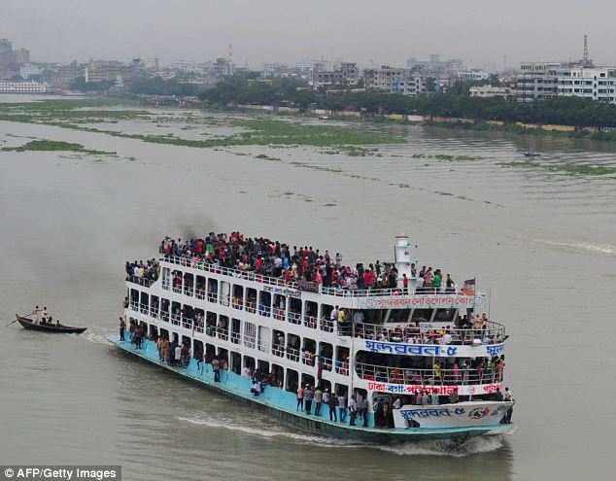
Outskirts
Meaning
Meaning : Borders/outer edge/environs
The Buriganga river is at the outskirts of Dhaka city.

Slide 16
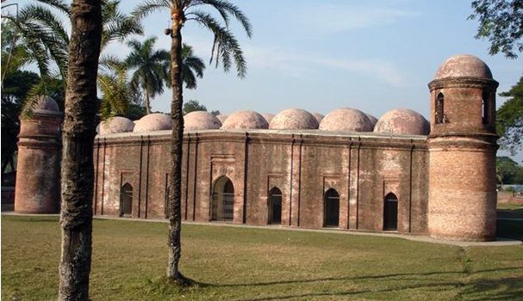
Unique
Meaning
Exclusive/exceptional/distinctive
Shat Gambuj Mosque is a unique world heritage.

Slide 17
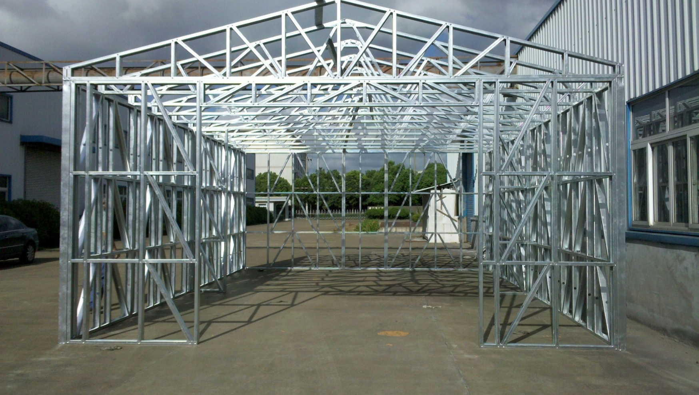
Infrastructure
Meaning
Frame/setup/structure/substructure
The infrastructure of this factory is very strong.

Slide 18
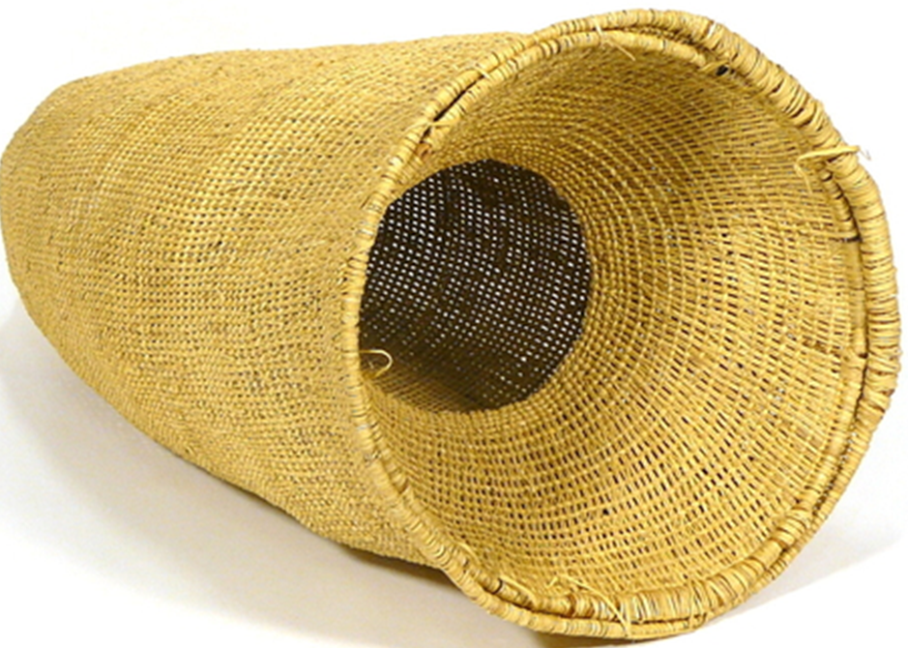
Hollow
Meaning
Empty space inside
Hollow
There is a hollow in the basket.

Slide 19
Read the text in the book and write the answers of the following questions.
Q 1. When the Shat Gombuj Mosque was a world heritage?
Q 2. For what purpose was the mosque used?
Q 3. What do you mean by “Heritage” ?

Slide 20
Read the text again and fill the gaps . [pair work]
Who/What | Event/Activities | When/Why
The Shat Gombuj Mosque | became a UNESCO World Heritage Site
It was |  | in the 15th century.
Khan Jahan Ali | built a networks of roads, bridges, public buildings and reservoirs
The mosque | is unique
Its |  | attracts the tourists for its
(i) in 1985
(ii) founded
(iii) to made the city habitable.
(iv) for its 60 pillars that supports the roof with 77 low height domes.
(v) architectural beauties

Slide 21
Group work
Soopose, your friend lives in London. He wants to know about Shat Gambuj mosque. Now write a description on the Shat Gambuj Mosque according to the lesson.

Slide 22
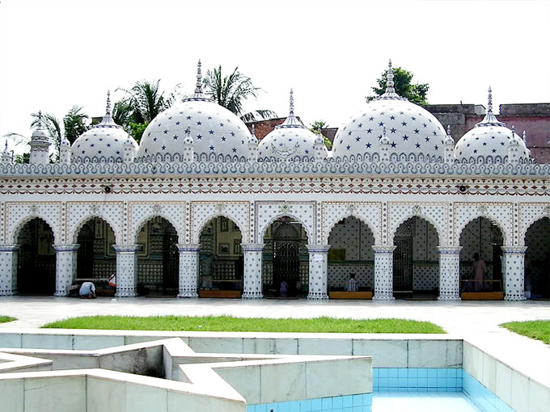
Home work
C. Look at the picture of the Star Mosque in Dhaka. Now write the charecterestic of the Star Mosque.

Slide 23
Thank you

Slide 24
Acknowledgement
GOOGLE
NATIONAL CURRICULUM & TEXTBOOK BOARD, BANGLADESH.
TEACHER`S OF AMRIA ISLAMIA ALIM MADRASA.

