Slide 1
Good morning

Slide 2
Introduction
Hemia Afrin
Assistant teacher
Digholia (south) Govt. primary school
Digholia,Khulna.
hemia1922@gmail.com
Class:One
Subject:English
Unit:8
Lesson:4-6
Time:45 mins

Slide 3
Learning outcome
Students will be able to-
Listening:
3.2.1- understand simple statement.
Speaking:
1.1.2-say simple words and phrases.

Slide 4
Video

Slide 5
What’s this?
It’s a book

Slide 6
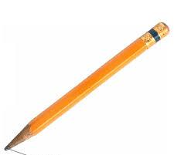
What’s this?
It’s a pencil

Slide 7
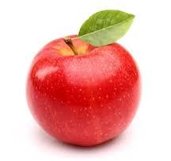
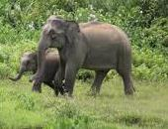
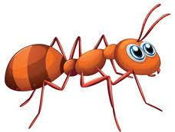
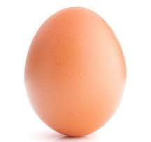
It’s an apple
It’s an elephant
It’s an ant
It’s an egg

Slide 8
Lesson Declaration
What’s this?
Page-16

Slide 9
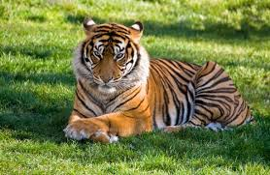
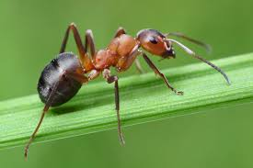
Look, listen and say carefuly.
What’s this?
It’s a tiger
It’s an ant

Slide 10
What’s this?
It’s a chair
It’s a pencil

Slide 11
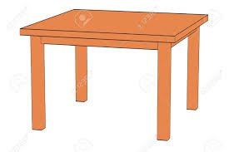
What’s this?
It’s a table
It’a a book

Slide 12
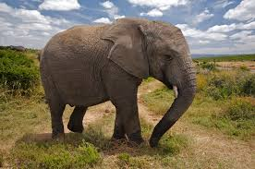
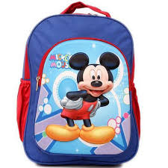
What’s this?
It’s an elephant
It’s a bag

Slide 13
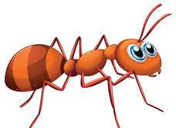
wcw
It’s an ant
It’s a book

Slide 14
Group work
It’s an egg
It’s a chair
It’s a book
It’s a pencil

Slide 15
Thank you

